Slide 1

SP18 KICKOFF MEETING

Slide 2
Goal
Have Fun
Become a better programmer
Compete with other colleges in ACM – ICPC (scoreboard)
Notes:
http://acmicpc-pacnw.org/ProblemSet/2017/index2.html

Slide 3
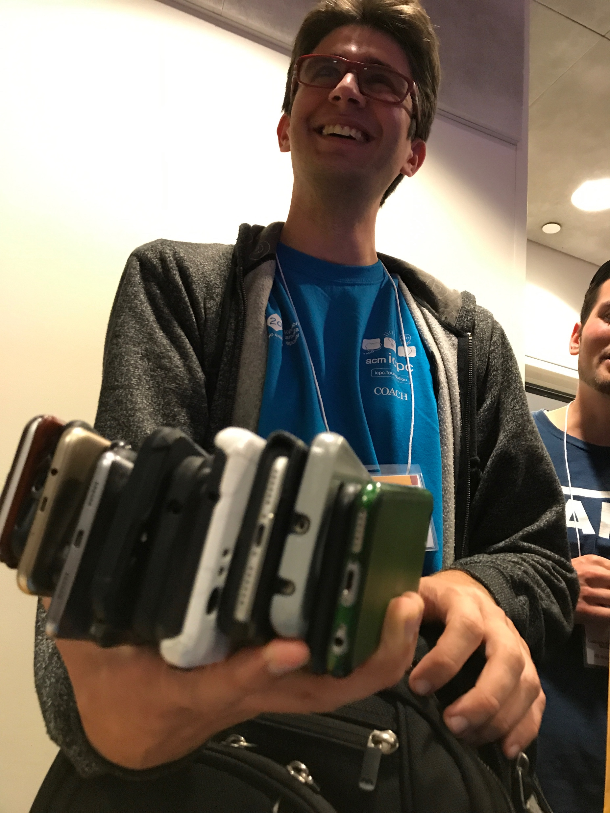
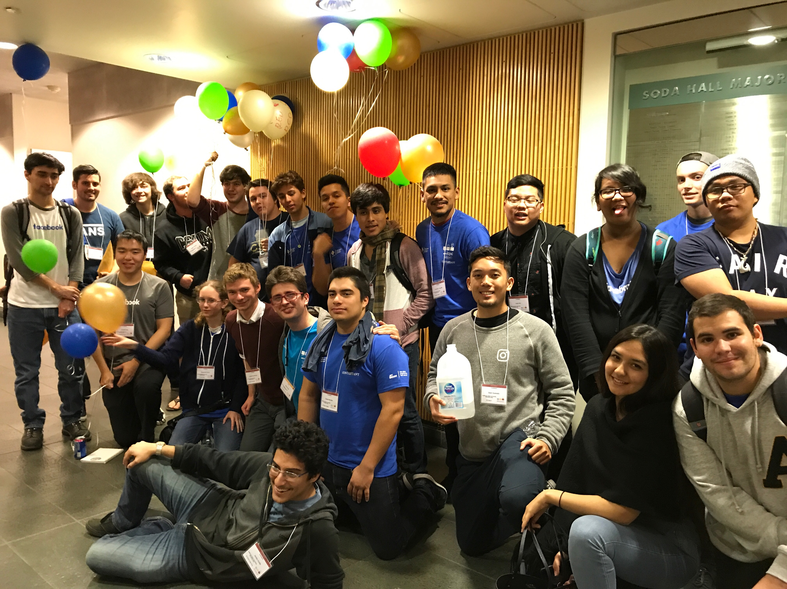
Story

Slide 4
Plan
Meetings
Topics in algorithms & data structures (help us!)
Practice problems (review)
Temporary teams & Practice Contests

Slide 5
Plan
 | Monday | Tuesday | Wednesday | Thursday | Friday
Where | Library 1180 | BIT 117 | BIT 104 | BIT 117 | BIT 117
When | 6pm – 8pm | 4pm - 6pm | 6pm – 8pm | 4pm – 6pm | 5pm – 7pm

Slide 6
TO DO
Move around and form your team!
If you are a veteran, please find a team with new people!

Slide 7
TO DO
Join our slack channel #progteam
&& fill the google form to subscribe the mailing list
Notes:
https://goo.gl/forms/Spnr8dKiuahznGMm2

Slide 8
TO DO
Create an account on Kattis
&& solve the problem Stuck In A Time Loop
Notes:
https://open.kattis.com/problems/timeloop

Slide 9
READY?

Slide 10
Good Luck!

