Slide 1
SOLID

Slide 2
Intro
Donatas Kukta
Kazimieras Slivka
TransUnion
These slides are based on https://github.com/Almantask/CSharp-From-Zero-To-Hero/wiki/Summary#chapter-5-solid

Slide 3
What does SOLID stand for?
Single-responsibility: One reason to change
Open–closed: Open for extension, closed for modification
Liskov substitution: Use derived classes without knowing it
Interface segregation: Fine grained client-specific interfaces
Dependency inversion: Depend on abstractions, not concretions

Slide 4
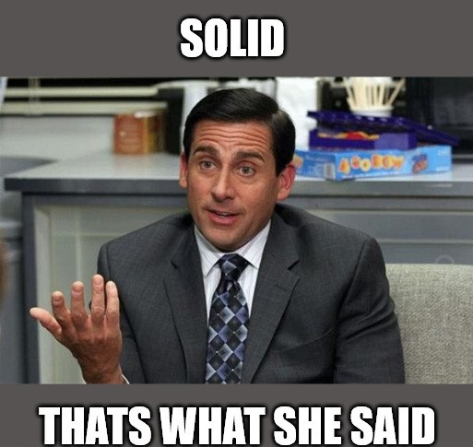
Why SOLID is important?
Best practices to follow
Avoid complexity headache
Better code quality:
Improved readability
Better flexibility
Lower maintainability overhead
Applicable for software in general, not just source code
It is industry-standard and common question in interviews

Slide 5
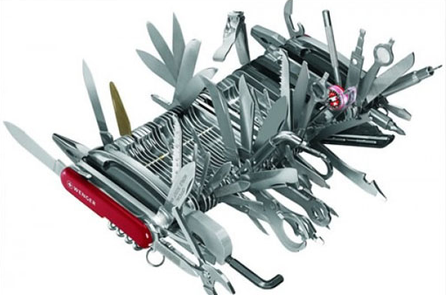
Single Responsibility principle
A function, class or a module should have a single reason to change.
Just Because You Can, Doesn’t Mean You Should!

Slide 6
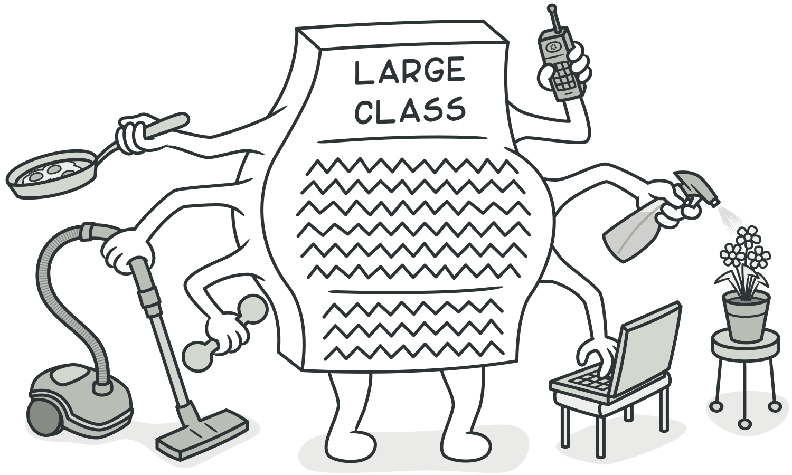
Single Responsibility principle
The God Class
Obvious flow of behavior
Structure is easy to understand
It’s easy to insert changes
Illusion vs reality
Nobody understands how it works
Everyone is afraid to change existing code
Everyone just stich new code to the class
Tech debt keeps growing

Slide 7
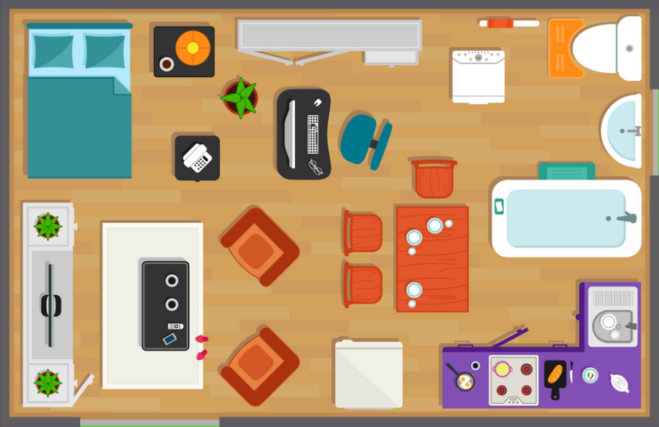

Single Responsibility principle. Examples
Bad
Good

Slide 8

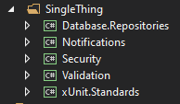
Single Responsibility principle. Examples
Bad
Good
Unknown, abstract contents
Semantical use (common things, third party things)
Question: what about common infrastructure?
Clear contents
Logical use (by project purpose)
No questions

Slide 9

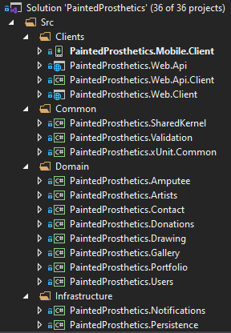
Single Responsibility principle. Examples
Bad
Good
For long term projects, it’s worth tackling complexity by splitting different system concerns into subsystems
Developers should strive to minimize the things we need to care about at once.

Slide 10
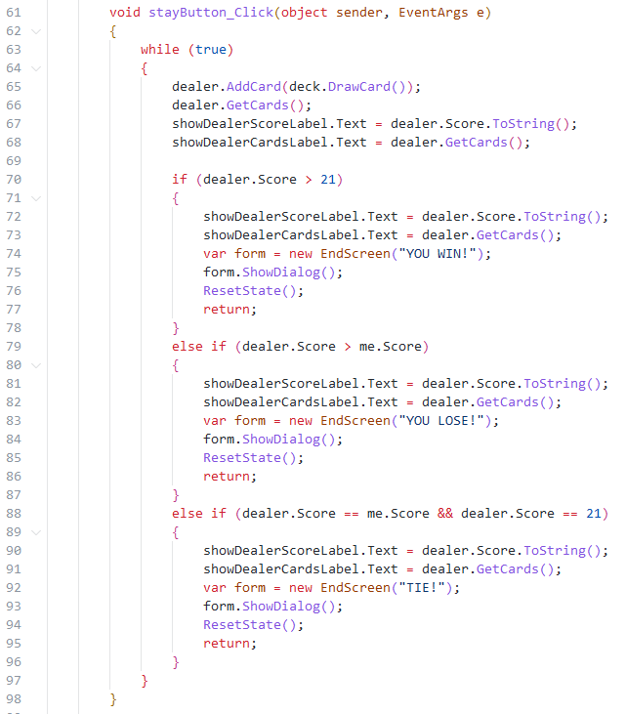
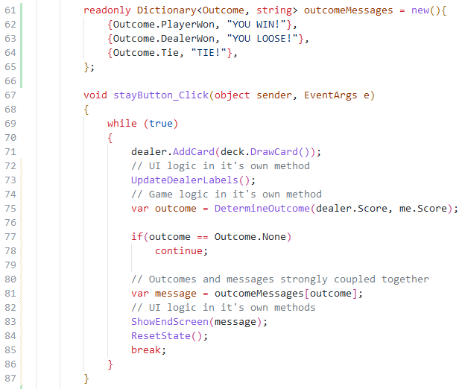
Bad
Better

Slide 11
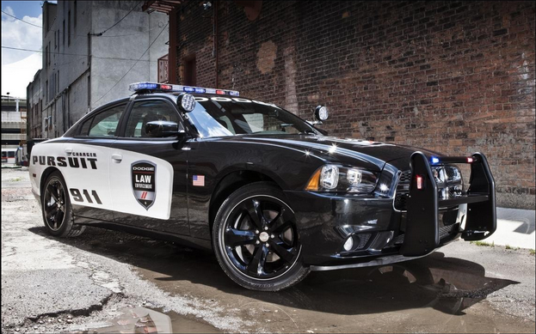
Open-Closed principle
Software entities (classes, modules, functions, etc.) should be open for extension, but closed for modification.
Lights can be attached without disassembling the engine

Slide 12
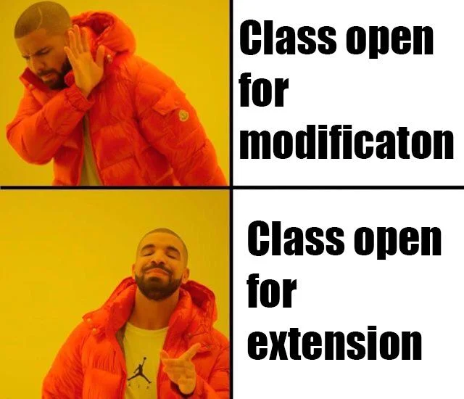
Open-Closed principle

Slide 13
Open-Closed principle

Slide 14
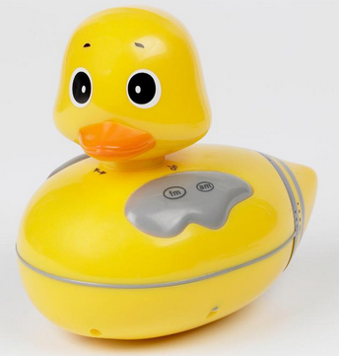
Liskov substitution principle
Objects of a superclass shall be replaceable with objects of its subclasses without breaking the application.
TLDR; Use derived classes without knowing it.
It looks like a duck, quacks like a duck, but it needs batteries!
You probably have the wrong abstraction.

Slide 15

Interface Segregation principle
Fine grained client-specific interfaces
There is no combined power & water connector

Slide 16

Dependency Inversion principle
Depend on abstractions, not concrete implementations.
Excavator design doesn’t depend on attachments

Slide 17
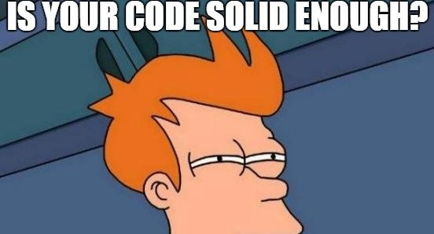
Workshop time!

Slide 18
Useful links
https://github.com/Almantask/CSharp-From-Zero-To-Hero/

