Slide 1
AUTOMATED ELECTROLYSIS SYSTEM
UNIVERSITY OF NAIROBI
DONATUS OMONDI

Slide 2
ACKNOWLEDGEMENTS
DR. DAVIES SEGERA
MITCH MACHARIA
DOMINICK KIPROTICH & ALPHONSE ODHIAMBO
MR. ROTICH, MADAM CELESTINE, MR. NGANGA

Slide 3
INTRODUCTION
ELECTROLYSIS
AUTOMATED ELECTROLYSIS SYSTEM
CONTROL UNIT

Slide 4
PROBLEM STATEMENT & JUSTIFICATION
Increasing global demand for hydrogen and oxygen
Traditional methods of producing these gases often rely on fossil fuels and are costly
An automated electrolysis has the potential to produce gases in a cost effective and environmentally friendly manner

Slide 5
OBJECTIVES
To develop an automated electrolysis system that enhances efficient, safe, and cost effective hydrogen and oxygen production
To detect gas flowrate, concentration and temperature realised by the electrolysis system
To detect gas pressure
PCB Design and Fabrication
Firmware development

Slide 6
OTHER HYDROGEN AND OXYGEN PRODUCTION PROCESSES
HYDROGEN
OXYGEN
Steam Methane Reforming
Partial Oxidation
Biomass Gasification
Cryogenic Air Separation
Pressure Swing Adsorption
Vacuum Pressure Swing Adsorption

Slide 7
HYDROGEN AND OXYGEN PRODUCTION USING ELECTROLYSIS
Involves the decomposition of water (H₂O) into its constituent gases
Occurs in an electrolyser
Anode and Cathode
Electrolyte
At the cathode (reduction): 2H₂O + 2e⁻→ H₂ + 2OH⁻
At the anode (oxidation): 4OH⁻ → O₂ + 2H₂O + 4e⁻

Slide 8
Advantages of hydrogen and oxygen production using electrolysis
Environmentally friendly when powered by renewable sources
High purity gas production
Scalable
Energy storage for renewable system
Decentralised production

Slide 9
Types of Electrolysers
ALKALINE ELECTROLYSERS
PROTON EXCHANGE MEMBRANE ELECTROLYSERS
SOLID OXIDE ELECTROLYSERS

Slide 10
Automation of Electrolysis
Important input parameters
Voltage and Current
Temperature of electrolyte
Electrolyte Concentration
Electrode Material
Important gas parameters
Flowrate
Concentration
Temperature
Pressure

Slide 11
Measurement of Gas Parameters
Gas flowrate sensors
Gas concentration sensors
Gas temperature sensors
Gas pressure sensors

Slide 12
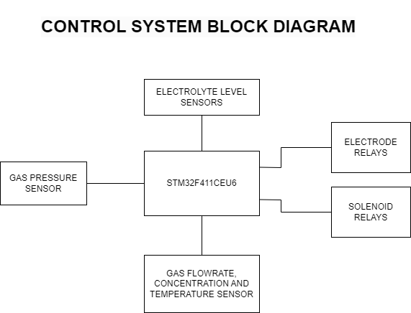
Hardware Design

Slide 13
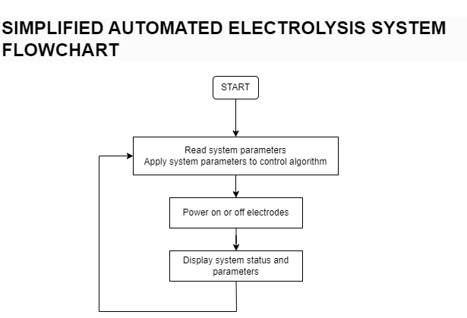
Software Design

Slide 14
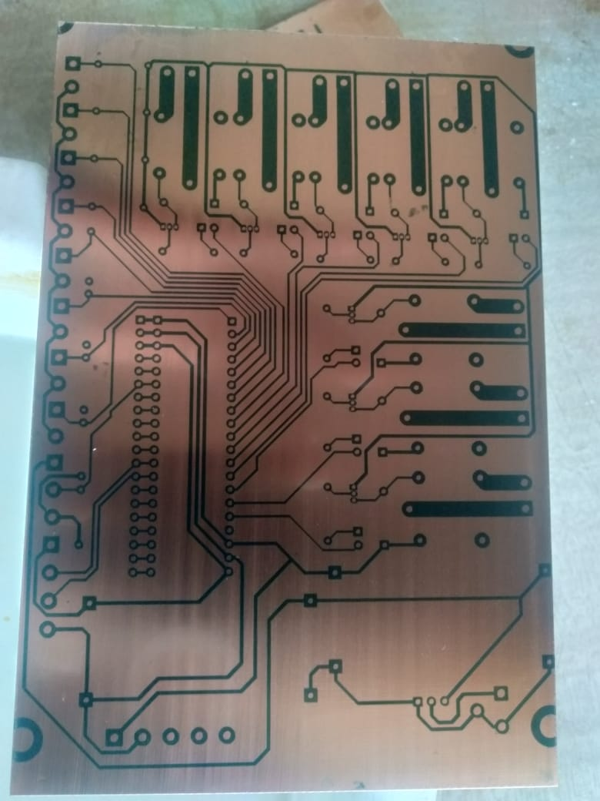
Implementation

Slide 15
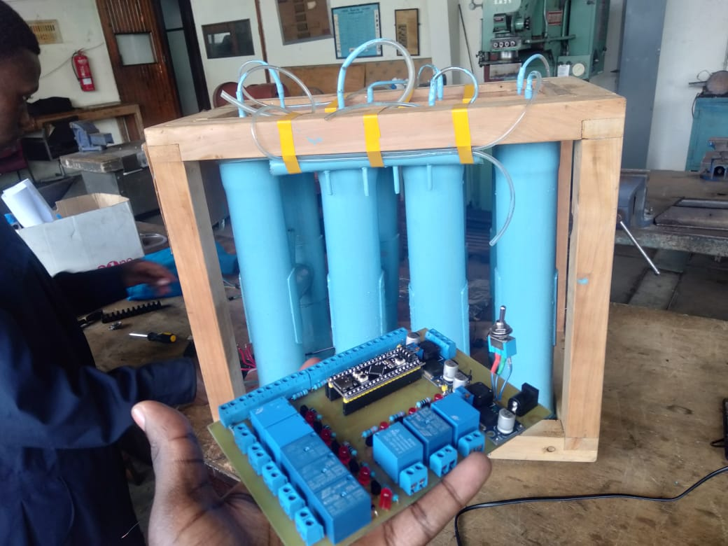

Slide 16
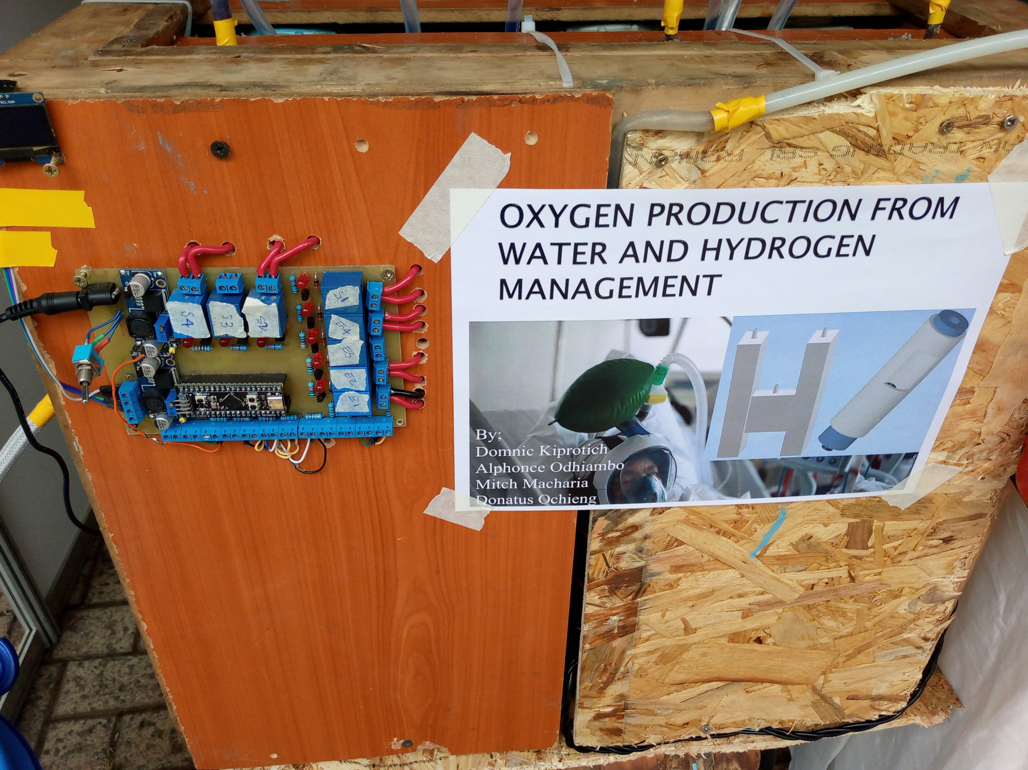

Slide 17
Results
Measurement of gas parameters
Displaying of system status
Powering off and on of the electrode relays based on control thresholds

Slide 18
Table of input power & electrolyte concentration against flowrate
Amount of electrolyte (g/litre) | Voltage(V) | Current(A) | Flowrate(Bubbles per minute)
10 | 20 | 6 | 4
20 | 20 | 6.2 | 6
30 | 20 | 6.2 | 7
40 | 20 | 6.4 | 9
50 | 20 | 6.5 | 11
60 | 20 | 6.7 | 12
70 | 20 | 7.1 | 16

Slide 19
Table showing increase in oxygen concentration over time from starting of the electrolysis process. Electrolyte concentration at 100g/litre
Time(minutes) | Voltage(V) | Current(A) | Oxygen Concentration(%)
1 | 24 | 8 | 25
3 | 24 | 8.4 | 34
6 | 24 | 9.0 | 48
9 | 24 | 9.7 | 62
12 | 24 | 10.2 | 83
15 | 24 | 11.1 | 95
18 | 24 | 11.6 | 95

Slide 20
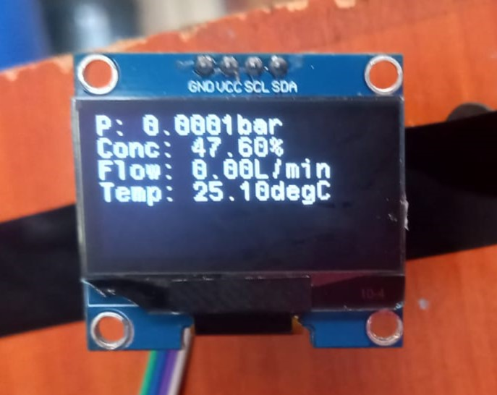
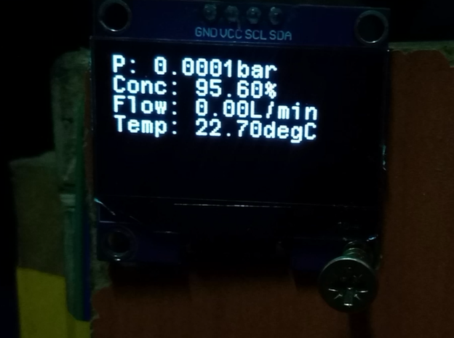

Slide 21
Conclusion
Design and implementation of control system
Design and implementation of electrolysis chamber
Areas of improvement of current control system
Board Design
Over the air updates

Slide 22
THANK YOU

