Slide 1
Gas Pressure, Flowrate & Concentration monitoring for automated Electrolysis control

Slide 2
Introduction
Automation of the electrolysis process is dependent on the gas pressure in the gas reservoir, gas flowrate through the pipes entering and leaving the reservoir and concentration of the target gas flowing through the pipe.
Thus monitoring these variables is of essence

Slide 3
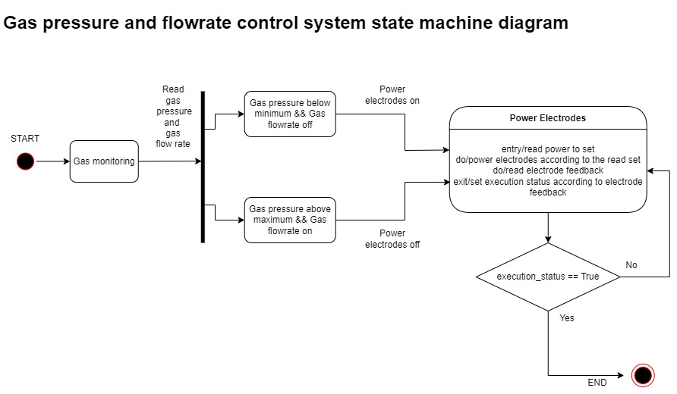
A state machine diagram of the process is as below

Slide 4
Gas Pressure Measurement
Gas pressure measurement will be achieved using a pressure transducer at the gas reservoir.
The pressure transducer will convert pressure to a voltage reading which can be read by the microcontroller.
Using this we can determine whether to power on or power off the electrodes when the gas pressure reaches the maximum allowed value in the reservoir or goes below the allowed pressure in the reservoir.
Using this we can also determine if there are leaks in the reservoir if pressure reduces without use of gas

Slide 5
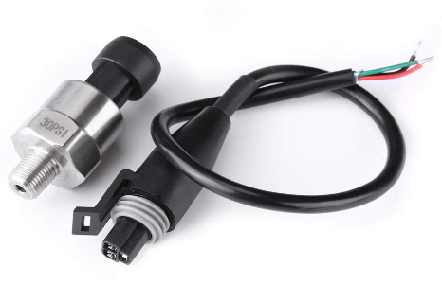
Gas pressure transducer

Slide 6
Gas flowrate measurement
This is important in determining how efficient the electrolyser is and is a good indicator of its state of health over time.
This is also important in situations whereby a variable amount of power is to be applied to power the electrodes depending on the net flowrate in the gas reservoir.
This can be achieved by measuring the change in gas pressure in the reservoir. However this method involves difficulty as a lot of factors are involved in calculating the flowrate.
A professional method is using a venturi tube and calculating gas flowrate from known dimensions of pressure, fluid density and area measurements

Slide 7
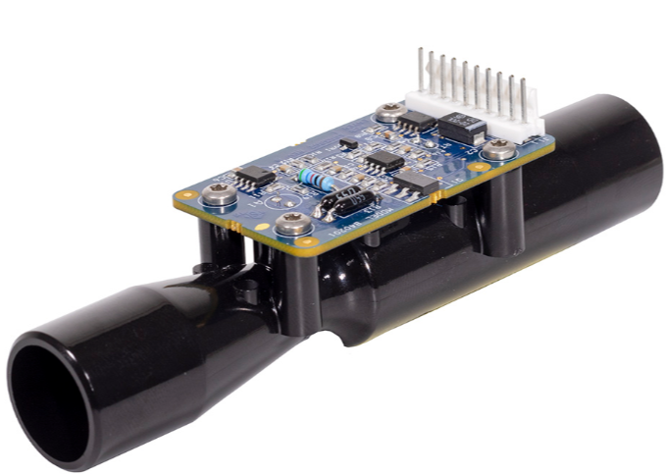
Professional flow rate sensor

Slide 8
Gas Concentration measurement
Since the reservoir is not a vacuum at the initial process of gas collection, the electrolysis process will need to operate for some time and drive out air in the reservoir since oxygen is denser than air.
Gas concentration will be measured at the outlet of the reservoir and collection will be commenced when concentration is at required levels
This will be achieved using an oxygen concentration and flow sensor as below

Slide 9
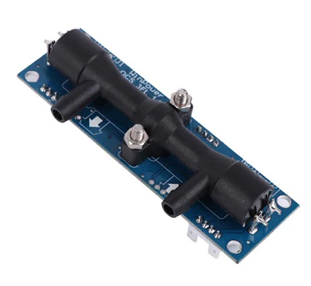
Oxygen concentration & flow rate sensor

Slide 10
Gas Concentration measurement
Using this both the flow and concentration of oxygen can be measured. However this device is limited to a flow rate of up to 10L/min beyond which only concentration will be of importance
Using this the quality of oxygen being delivered can also be monitored

Slide 11
Monitoring
Constant monitoring of whole process will be done. This will enable setting of the system appropriately and promptly in abrupt events such as power failure, gas leakage among others

Slide 12
Pricing
The budget for this project can be broken into two, first the POC (proof of concept), second the alpha prototype which is a more refined prototype based on findings from the proof of concept

Slide 13
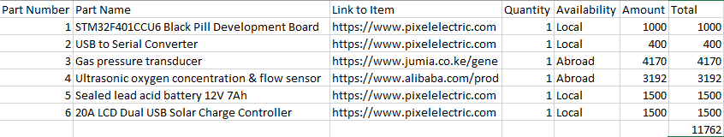
Budget for the POC

