Slide 1
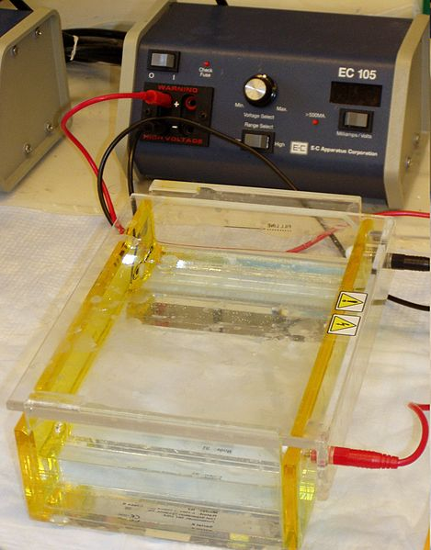

Slide 2
FEDERAL UNIVERSITY OF TECHNOLOGY, AKURE.
A BIOTECHNOLOGY SEMINAR ON
ELECTROPHORESIS
PRESENTED BY
ABODUNRIN STEPHEN O.
APRIL, 2017.

Slide 3
INTRODUCTION

Slide 4
Electrophoresis, electro (electric) phoresis (being carried)
Main components= EMF+{matrix + buffer}

Slide 5
TYPES OF ELECTROPHORESIS

Slide 6
Paper Electrophoresis
Dry
wet
Gel Electrophoresis
Agarose (a polygalactose polymer) gels
Polyacrylamide gels
others
ISOELECTRIC FOCUSING (IEF)
IMMUNE-ELECTROPHORESIS
COUNTER CURRENT IMMUNOELECTROPHORESIS
Capillary Electrophoresis
Using capillary tubes

Slide 7
Polyacrylamide gels
Sodium Dodecyl Sulfate–Polyacrylamide Gel Electrophoresis (SDS-PAGE):
Native-PAGE

Slide 8
FACTORS EFFECTING THE MOBILITY FRAGMENTS IN AGAROSE GELS

Slide 9
Agarose concentration
The speed of DNA strand is subject to the frictional force of the gel which is proportional to its concentration
Different molecular weight protein have optimal induction voltages
Electrophoresis buffer
Higher concentration of buffers might produce more heat which would melt the gel and give false results
Voltage
Effect of ethidium bromide
As a staining agent, if used at inappropriate concentration can unduly increase the concentration of the agar

Slide 10
MATERIALS AND METHOD

Slide 11
MATERIALS
Nucleic Acids and Oligonucleotides;
Buffers and Solutions
Agarose solutions, Electrophoresis buffer, DNA staining solution and 6x Gel-loading buffer.
DNA samples, DNA size standards and PCR product

Slide 12
METHODS
Pour a small amount of electrophoresis buffer on the top of the gel, remove the comb. Pour off the electrophoresis buffer
Place the gel into the electrophoresis device and enough electrophoresis buffers to cover the gel to a depth of approx. 1 mm.
Mix the sample by loading dye with a ration 1:5 or 1:10
Slowly load the sample mixture into the slots of the submerged gel using a disposable micropipette, Load size standards into slots on both the right and left sides of the gel.
Close the lid of the gel tank and attach the electrical leads /so that the DNA will migrate toward the positive anode (red lead). Apply a voltage of 1-5 V/cm. If the leads have been attached correctly, bubbles should be generated at the anode and cathode, the bromophenol blue should migrate from the wells into the body of the gel. Run the gel until the bromophenol blue and xylene cyanol FF have migrated for distance through the often to the last third of the gel.
When the DNA samples or dyes have migrated for a sufficient distance through the gel, turn off the electric current and remove the leads and lid from the gel tank. Otherwise, stain the gel by immersing it in electrophoresis buffer for 20-45 minutes at 25^{O}C.

Slide 13
Schematic representation of gel electrophoresis

Slide 14
ADVANTAGES
Capillary electrophoresis possess extremely high resolution, speed, and high sensitivity for the analysis of extremely small samples, minimal sample preparation and viability assessment, make it an attractive technique for the analysis of microbial analytes , in some cases, without the need for culture methods.
Agarose gels can accommodate larger samples than most paper electrophoresis systems, and so can be used for preparative scale electrophoresis of macromolecules.
Polyacrylamide gels offer greater flexibility and more sharply defined banding than agarose gel.

Slide 15
LIMITATIONS
Electrophoresis has limited sample analysis
Paper electrophoresis is not used to resolve macromolecules because of its adsorption and surface tension which alters or denatures the macromolecules, causing poor resolution.
Electrophoresis’ measurements are qualitative rather than quantitative which would not give us precise protein value.
Comparison of molecules is based on the band density (darkness) of different spots on the gel. This method has some degree of error, and samples are usually run multiple times to get clean results.

Slide 16
Substantial starting sample is required
Only certain molecules can be visualized
As in protein electrophoresis, relatively low level of polymorphism is found at different levels resulting in lower taxonomic limits for the population.
Capillary electrophoresis obviously not useful as a preparative method.

Slide 17
USES OF ELECTROPHORESIS

Slide 18
Agarose gel electrophoresis.
Agarose gel is used to estimate the size of DNA fragments after digesting with restriction enzymes.
It has also been routine tool in molecular genetics diagnosis or genetic fingering via analyses of PCR products.
Capillary electrophoresis finds place in assessment of the spermatocytes’ viability.
It is commonly used to resolve circular DNA with different supercoiling topology
It allows purification of DNA fragments.

Slide 19
SDS-PAGE
Determine molecular weight of a peptide/protein
Identify protein
Determine sample purity
Identify existence of disulfide bonds
Quantify amounts of protein
Second dimension in 2-D electrophoresis
Detection/Estimation of Genetic Diversity

Slide 20
THANKS
FOR
YOUR ATTENTION

