Slide 1
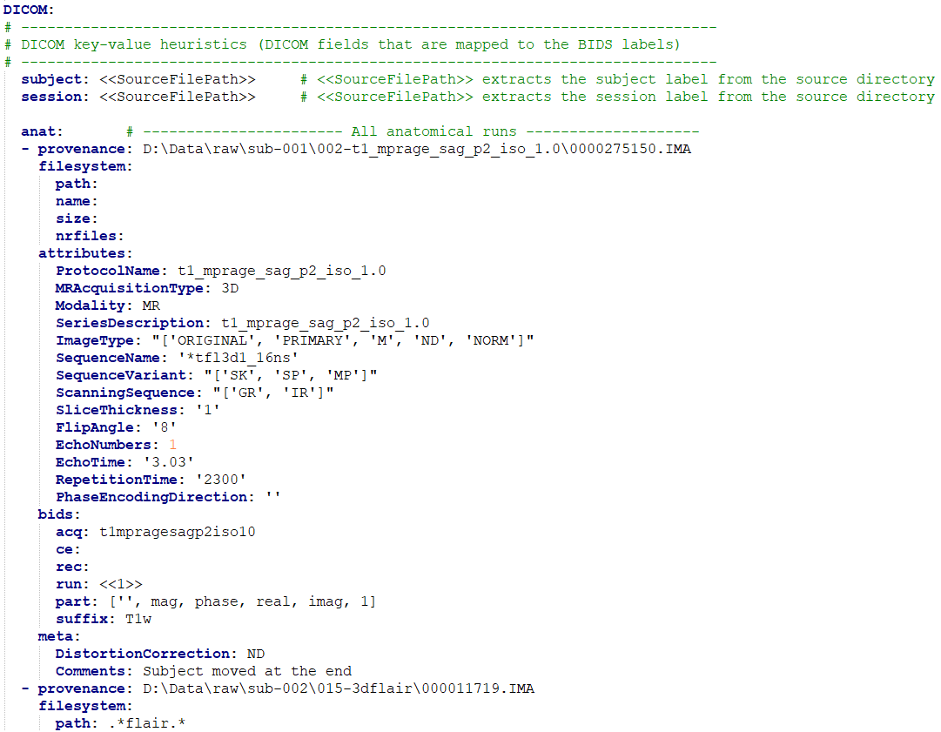
source input dictionaries
BIDS-mapping
run item
BIDS output dictionaries

