Slide 1
Linux Basics
-------------------Working with text files
Welcome!

Slide 2
Linux/HPC tutorial
Schedule:
Linux Basics 11:00-11:30
Introduction to Terminal
Linux Directory Structure
File Explorer
Essential Commands
Command Options
File Types and Permissions
Using Wildcards
Working with Text(Data) Files 11:30-12:00
Difference Between Nano and Gedit
Input and Output
Essential commands for manipulating (text)files
Exercise 12:00-12:15
Experiment with new command on provided file.
Additional info like literature, references, etcetera

Slide 3
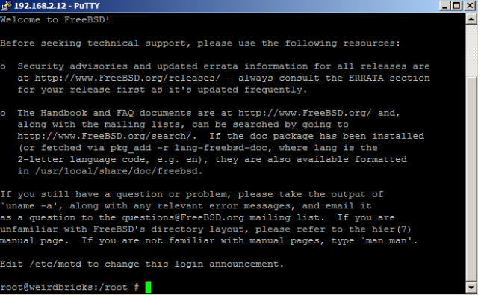
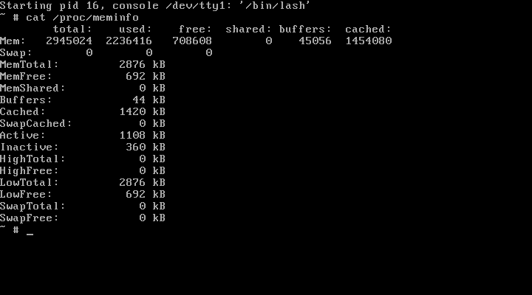
Linux/HPC tutorial
Linux Basics: Introduction to the Terminal
The Linux terminal acts as the medium for input and output of the Linux System
The “output” could be the text on your screen
The “input” could be the characters you type on your keyboard
The Terminal interacts directly with the Linux system, so EVERY action can be done through the terminal itself, no graphical environment is necessary.
Most people know the terminal like this But the terminal is also in Linux itself!

Slide 4
Linux/HPC tutorial
Linux Basics: Linux Directory Structure
When you log in to the Terminal, you will be directed to you Home directory
The home directory is also indicated as the “~” sign
The most “top” level of the Linux Directory structure is the “root” “/”
The Directory you are in at the moment is called the “Present Working Directory” “PWD”
If our current “PWD” is “/home/tg/mikveng” the structure is as follows:
/ ← the root directory
|-- home ← first-level child
| |-- tg ← second-level child
| | |-- mikveng ← the Present working directory
The Present Working Directory is always an absolute path. (from the Root)

Slide 5
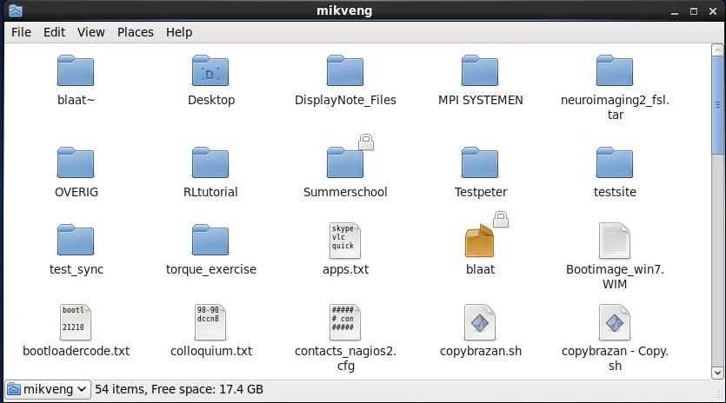
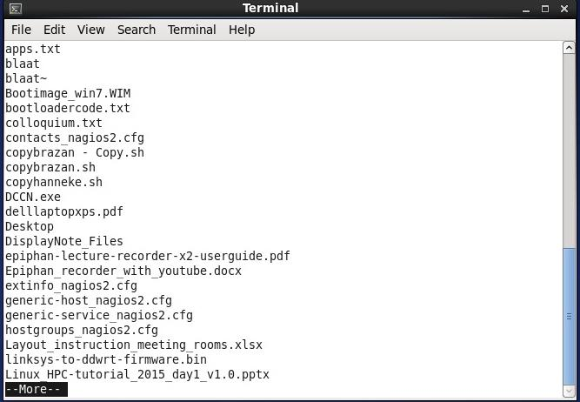
Linux/HPC tutorial
Linux Basics: File Explorer
The File explorer gives you the option to browse the Linux Filesystem.
You can use the graphical as well as the CLI to browse.
Graphical: CLI:
The graphical File Explorer is pretty self explanatory, so no more details will be given.

Slide 6
Linux/HPC tutorial
Linux Basics: Essential Commands
To get help for a command, use the ‘man’ command (example: man ls)
For some commands this doesn’t work… use “help xx” where xx is command of choice
To view contents of current working directory , use the ‘ls’ command
To change the current working directory , use the ‘cd’ command
Example: cd /home/tg/mikveng/test
To copy files, use the ‘cp’ command
Example: cp /home/tg/test /home/tg/test.copy (test is the copied file)
To remove files/folders, use the ‘rm’ command (-r flag to remove folders)
Example: rm /home/tg/test
Example: rm –r /home/tg/testdir
To create a folder, use the ‘mkdir’ command
Example: mkdir /home/tg/test or mkdir test (folder will be made in PWD)

Slide 7
Linux/HPC tutorial
Linux Basics: Command Options
Almost all command in Linux commands have Options.
Like seen before, the ‘rm’ command has the “R” option to remove recursively.
The options can be used by adding them to the command: i.e. rm –R
The ‘-’ symbol indicates an option, so rm r does NOT work.
Other options are:
ls –a (show all files, including hidden folders)
rm –r (recursively removes a directory) (be careful with this!)

Slide 8
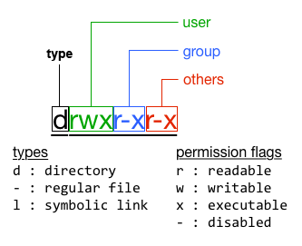
Linux/HPC tutorial
Linux Basics: File type and permissions
Example file: -rwxr-xr-x 1 mikveng tg 737 Aug 19 12:56 test.sh (using LS command)

Slide 9
Linux/HPC tutorial
Linux basics: Using Wildcards
A wildcard is a special syntax to specify more than 1 file/folder at a time.
Mostly used wildcard is the ‘*’ (asterisk) representing any number or character
Remove all files that begin with subject_ and end with .out:
‘rm subject_*.out’
Other wildcard characters:
‘?’ Represents 1 SINGLE random character or digit
‘[ ]’ specifies a range, for instance t[a,o,i]ll will be ‘tall, toll and till’

Slide 10
Linux/HPC tutorial
Any questions so far?
Coming up: Working with text files

Slide 11
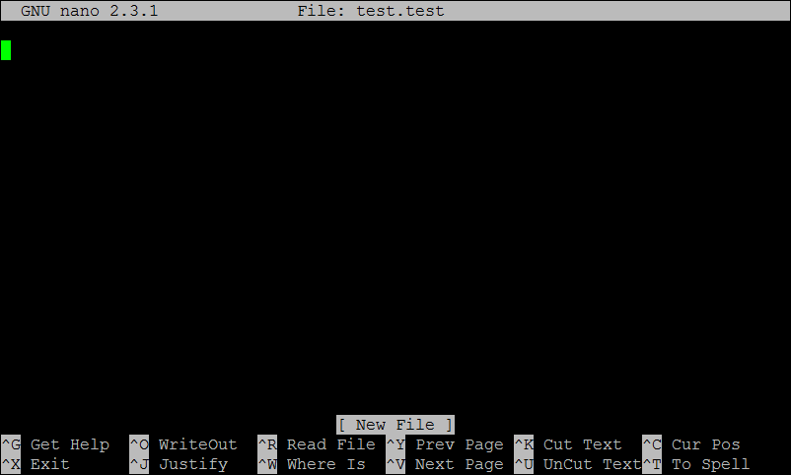
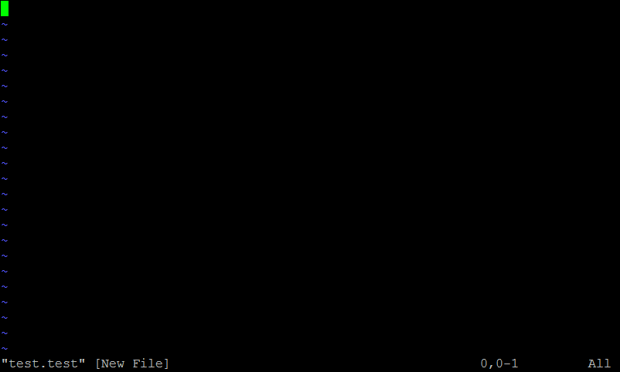
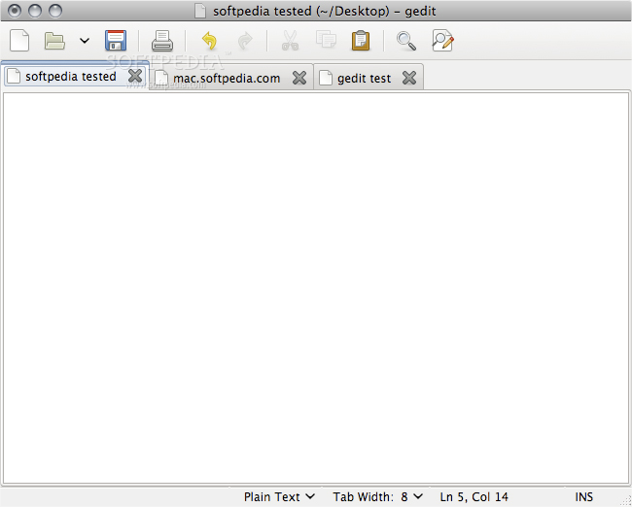
Linux/HPC tutorial
Working with text files: Creating and editing text files
To create a text file, we need a text editor
There are 2 common ways to create/edit text files:
Command line Text editor: VI and NANO (VI/NANO “filename”)
Graphical editor: Gedit (use the same way as notepad/word)
Nano: VI: Gedit:

Slide 12
Linux/HPC tutorial
Working with text files: Essential Commands Pt.1
echo
Echo prints your input to the terminal, I.E. ‘echo hello world’ will output ‘hello world’.
cat
Cat will output the contents of a (text)file, I.E. ‘cat file.txt’ will output the file.txt contents
head
Head will output the first 10 lines of a file (10 lines is changeable through options)
tail
Same as HEAD, only it will show last 10 lines of a file
sort
Will sort the lines of a file based on given parameters

Slide 13
Linux/HPC tutorial
Working with text files: Essential Commands Pt.2
uniq
Reports or omits repeated/duplicate lines of specified file
grep
Will display lines that comply to given syntax (sort of a search engine)

Slide 14
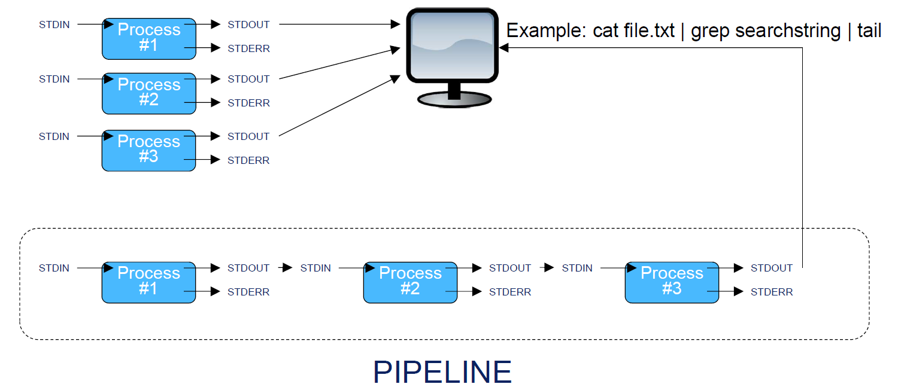
Linux/HPC tutorial
Working with text files: Input and Output pipeline
Linux knows 3 input/output streams: STDIN, STDOUT, STDERR.
We use a ‘pipeline’ to “link” processes to each other

Slide 15
Linux/HPC tutorial
Working with text files: Manipulating the Pipeline
Commonly used redirect characters are > >> and |
cat file.txt | head will redirect the output of cat file.txt to the input of the command head
cat file.txt > NewFile.txt will redirect the output of cat file.txt to the file NewFile.txt and overwrite existing contents
cat file.txt >> NewFile.txt will redirect the output of cat file.txt to the file NewFile.txt and append to existing contents
A common use of the pipe is to send the output of one grep command to refine the search
cat file.txt | grep search-pattern | grep second-search-pattern

Slide 16

Linux/HPC tutorial
Any Questions?

