Slide 1
Welcome Online HPC workshop
Edward Gerrits
http://hpc.dccn.nl
http://hpc.dccn.nl/tutorial.html

Slide 2
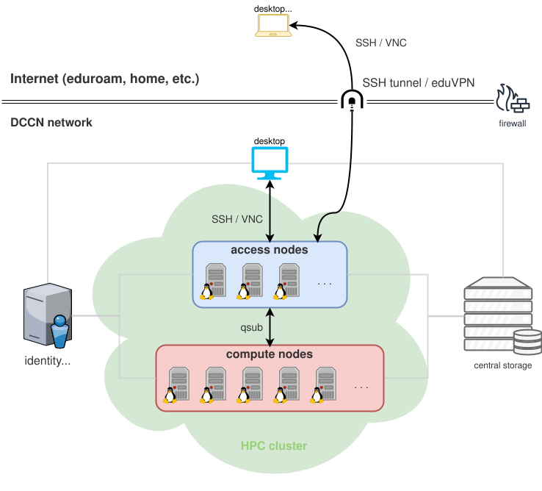
Online HPC workshop
Using the Torque/Moab HPC cluster
HPC Cluster
The HPC cluster at DCCN consists of two groups of computers, they are:
access nodes: mentat001 ~ mentat005 as login nodes.
compute nodes: a pool of powerful computers with more than 1000 CPU cores.
Computer nodes are managed by the Torque job manager and the Moab job scheduler. While the access nodes can be accessed via either a SSH terminal or a VNC session, compute nodes are only accessible by submitting computational jobs.

Slide 3
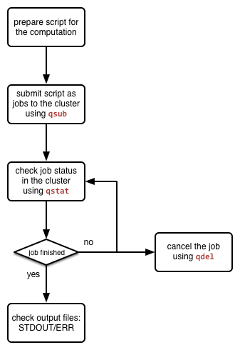
Online HPC workshop
Using the Torque/Moab HPC cluster
Job management workflow
Prepare linux script
Submit a job:
$ qsub
Monitor job status:
$ qstat
Delete job:
$ qdel
Check output files for results

Slide 4
Online HPC workshop
Using the Torque/Moab HPC cluster
Job submission and job management
qsub (submit jobs to the cluster)
arguments (most used)
-I uppercase i (eye), Interactive
-q specify a queuename
-l lowercase l (el), specify required resources (walltime and mem)
-N uppercase n, specify a job Name
Script (myscript.sh)
example: $ qsub –I –l walltime=00:30:00,mem=4gb
qstat (monitor you queued/running/completed cluster jobs)
arguments
-a list all your jobs
-r list only running jobs
-f <jobID> detailed overview of one job
qdel <jobID> (delete a submitted job)

Slide 5
Online HPC workshop
Using the Torque/Moab HPC cluster
Examples
Interactive computation (text mode)
$ qsub -I -l nodes=1:ppn=2,mem=250mb,walltime=00:10:00
qsub: waiting for job 17629375.dccn-l029.dccn.nl to start
qsub: job 17629375.dccn-l029.dccn.nl ready
----------------------------------------
Begin PBS Prologue Tue Oct 16 14:00:09 CEST 2018 1539691209
Job ID: 17629375.dccn-l029.dccn.nl
Username: edwger
Group: tg
Asked resources: nodes=1:ppn=2,mem=250mb,walltime=00:10:00,neednodes=1:ppn=2
Queue: interactive
Nodes: dccn-c012.dccn.nl
----------------------------------------
Limiting memory+swap to 262144000 bytes ...
End PBS Prologue Tue Oct 16 14:00:09 CEST 2018 1539691209
----------------------------------------
Job info started...
edwger@dccn-c012:~

Slide 6
Online HPC workshop
Using the Torque/Moab HPC cluster
Examples
Batch job submission
$ echo '/bin/hostname –f' | qsub –l \ nodes=1:ppn=1,mem=128mb,walltime=00:10:00
$ qsub –l nodes=1:ppn=1,mem=128mb,walltime=00:10:00 \ ${PWD}/my_analysis.sh
$ echo "${PWD}/my_analysis.sh 001" | qsub -N 's001' \ –l nodes=1:ppn=1,mem=128mb,walltime=00:10:00

Slide 7
Online HPC workshop
Using the Torque/Moab HPC cluster
Examples
Special Resource Requirements (node features/properties)
$ qsub –l 'nodes=1:ppn=4,mem=4gb,walltime=00:10:00' \ ${PWD}/my_analysis.sh
$ qsub –l 'file=500gb,walltime=12:00:00,mem=4gb' \ ${PWD}/my_analysis.sh
$ qsub –l 'nodes=1:intel:network10GigE,mem=4gb, \ walltime=00:10:00' ${PWD}/my_analysis.sh
$ qsub –I –l 'nodes=1:gpus=1,feature=cuda, \ walltime=1:00:00,mem=4gb,reqattr=cudacap>=5.0'
List node info (state/utilization/features/properties)
$ checknode [nodename] [ALL]
$ hpcutil cluster nodes status [nodename] [ALL]

Slide 8
Online HPC workshop
Using the Torque/Moab HPC cluster
Troubleshooting
Exceeding Memory limitations
Job completed successfully but not expected results
Check epilogue messages in your output file:
----------------------------------------
Begin PBS Epilogue Wed Oct 17 11:13:20 CEST 2018 1539767600
Job ID: 17635418.dccn-l029.dccn.nl
Job Exit Code: 137
Username: edwger
Group: tg
Job Name: MATLAB
Session: 13957
Asked resources: walltime=00:05:00,mem=1gb,nodes=1,neednodes=1
Used resources: cput=00:00:42,walltime=00:01:47,mem=1074147328b
Queue: interactive
Nodes: dccn-c011.dccn.nl
End PBS Epilogue Wed Oct 17 11:13:20 CEST 2018 1539767600
----------------------------------------

Slide 9
Online HPC workshop
Using the Torque/Moab HPC cluster
Troubleshooting
Exceeding Memory limitations (exit code 137)
False positive
Job completed successfully but not expected results
MyScript.sh:
$ qsub -l walltime=00:10:00,mem=100mb -q batch MyScript.sh
12130389.dccn-l029.dccn.nl
#!/bin/bash
echo "Hello!!"
cd ~
pwd
cd noexistingdir
/bin/cat noexistingfile
echo "Goodbye!!"
exit 0;
$ qstat
job id Name User Time Use S Queue
--------------------- ------------- --------------- -------- - -----
12130389.dccn-l029 MyScript.sh edwger 00:03:00 C batch

Slide 10
Online HPC workshop
Using the Torque/Moab HPC cluster
Troubleshooting
$ ls
-rw------- 1 edwger tg 168 Oct 4 12:08 MyScript.sh.e12130389
-rw------- 1 edwger tg 933 Oct 4 12:08 MyScript.sh.o12130389

Slide 11
Online HPC workshop
Using the Torque/Moab HPC cluster
Troubleshooting
$ cat MyScript.sh.o12130389
----------------------------------------
Begin PBS Prologue Tue Oct 4 12:08:12 CEST 2016 1475575692
Job ID: 12130389.dccn-l029.dccn.nl
Username: edwger
Group: tg
Asked resources: mem=100mb,ncpus=1,neednodes=1,nodes=1,walltime=00:10:00
Queue: batch
Nodes: dccn-c360.dccn.nl
End PBS Prologue Tue Oct 4 12:08:12 CEST 2016 1475575692
----------------------------------------
Hello!!
/home/tg/edwger
Goodbye!!
----------------------------------------
Begin PBS Epilogue Tue Oct 4 12:08:17 CEST 2016 1475575697
Job ID: 12130389.dccn-l029.dccn.nl
Username: edwger
Group: tg
Job Name: MyScript.sh
Session: 14939
Asked resources: mem=100mb,ncpus=1,neednodes=1,nodes=1,walltime=00:10:00
Used resources: cput=00:00:00,mem=0kb,walltime=00:00:00
Queue: batch
Nodes: dccn-c360.dccn.nl
End PBS Epilogue Tue Oct 4 12:08:17 CEST 2016 1475575697
----------------------------------------
#!/bin/bash
echo "Hello!!"
cd ~
pwd
cd noexistingdir
/bin/cat noexistingfile
echo "Goodbye!!"
exit 0;

Slide 12
Online HPC workshop
Using the Torque/Moab HPC cluster
Troubleshooting
$ cat MyScript.sh.e12130389
/var/spool/torque/mom_priv/jobs/12130389.dccn-l029.dccn.nl.SC: line 8: cd: noexistingdir: No such file or directory
/bin/cat: noexistingfile: No such file or directory
#!/bin/bash
echo "Hello!!"
cd ~
pwd
cd noexistingdir
/bin/cat noexistingfile
echo "Goodbye!!"
exit 0;

Slide 13
Online HPC workshop
Using the Torque/Moab HPC cluster
Troubleshooting
Exceeding Memory limitations (exit code 137)
False positive
Check your email
MyScript.sh:
$ qsub -l walltime=00:10:00,mem=100mb -q batch MyScript.sh
12130443.dccn-l029.dccn.nl
#!/bin/bash
echo "Hello!!"
cd ~
pwd
cd existingdir
/bin/cat existingfile
echo "Goodbye!!"
sleep 1800
exit 0;
PBS Job Id: 12130443.dccn-l029.dccn.nl
Job Name: MyScript.sh
Exec host: dccn-c360.dccn.nl/2
Aborted by PBS Server
Job exceeded its walltime limit. Job was aborted
See Administrator for help
Exit_status=-11 resources_used.cput=00:00:00 resources_used.mem=4764kb resources_used.vmem=453724kb resources_used.walltime=00:10:16

Slide 14
Online HPC workshop
Using the Torque/Moab HPC cluster
Troubleshooting
Exceeding Memory limitations (exit code 137)
False positive
Check your email
Check job with command: checkjob
$ qsub -I -l walltime=00:10:00,mem=200mb
qsub: waiting for job 12130819.dccn-l029.dccn.nl to start
$ checkjob 12130819

Slide 15
Online HPC workshop
Using the Torque/Moab HPC cluster
Troubleshooting
$ checkjob 12130819
job 12130819
AName: STDIN
State: Idle
Creds: user:edwger group:tg class:interactive
WallTime: 00:00:00 of 00:10:00
SubmitTime: Tue Oct 4 14:18:04
(Time Queued Total: 00:01:02 Eligible: 00:00:03)
.....some other stuff
SystemID: Moab
SystemJID: 12130819
Notification Events: JobFail
Partition List: production,test,torque
Flags: INTERACTIVE
Attr: INTERACTIVE,checkpoint
StartPriority: 200000
NOTE: job violates constraints for partition production (job 12130819 violates active HARD MAXJOB limit of 2 for class interactive user partition ALL (Req: 1 InUse: 2))
NOTE: job violates constraints for partition test (job 12130819 violates active HARD MAXJOB limit of 2 for class interactive user partition ALL (Req: 1 InUse: 2))
limit of 2 for class
BLOCK MSG: job 12130819 violates active HARD MAXJOB interactive user partition ALL (Req: 1 InUse: 2) (recorded at last scheduling iteration)

Slide 16
Online HPC workshop
Using the Torque/Moab HPC cluster
Troubleshooting
Exceeding Memory limitations
exit code 137
False positive
Script errors
Check your email
Exceeding walltime limit (walltime)
Check job with command: checkjob
Why doesn’t my job run? (queue limitations, running jobs already run into total memory usage limitation)

Slide 17
Online HPC workshop
Thank you for attending
Using the Torque/Moab
HPC cluster
Edward Gerrits

