Slide 1
EZQUOTE / SDC 2026
From a WhatsApp inquiry to an accountable quote
For Malaysian micro and small building-materials and hardware retailers.
Understand the
request
Connect the records
Keep the owner in
control
Chinese, English and Malay
inquiries can mix products,
quantities, specifications and
delivery details.
Catalog prices, stock, delivery
rules and past orders are often
checked across separate
records.
A useful recommendation still
needs a person to verify the
source and approve the final
price.
EZQuote brings the quote chain together — without automatic customer
sending or autonomous price approval.
EZQuote | Local, owner-approved quotation prototype
01 / 08

Slide 2
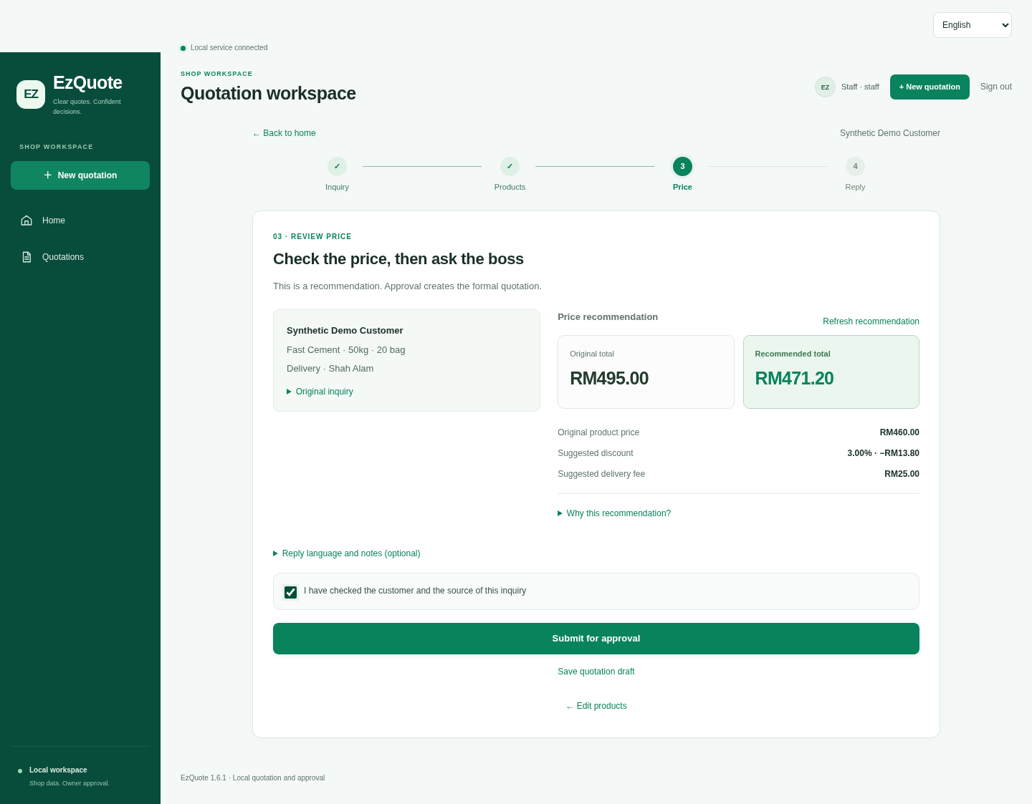
EZQUOTE / SDC 2026
From inquiry to an approved quotation
Review the inquiry
Check the source, matched
items, quantities and delivery.
Use connected data
Import the store workbook; keep
prices and stock checks
deterministic.
Approve and export
Owner approves. Staff prepare
files and replies, then record the
outcome.
Actual local interface with synthetic demonstration data.
EZQuote | Local, owner-approved quotation prototype
02 / 08

Slide 3
EZQUOTE / SDC 2026
Human-in-the-loop by design
01 TRIGGER
02 CONNECTED DATA
03 DECISION LOGIC
Selected WhatsApp inquiry or
pasted text.
Store products, stock, history,
delivery and rules.
Local parsing, matching, pricing
and review checks.
06 ACTIVITY LOG
05 VISIBLE OUTPUT
04 HUMAN APPROVAL
Record revisions, decisions and
the customer outcome.
Approved PDF, Excel and a reply
checked before sending.
Staff verify; the owner accepts or
edits the final price.
Recorded outcomes inform later suggestions. Owner approval is not a completed sale.
EZQuote | Local, owner-approved quotation prototype
03 / 08

Slide 4
EZQUOTE / SDC 2026
A local, auditable architecture
Deterministic prices, stock checks and final approval stay outside the language model.
Inquiry
SQLite records
Selected WhatsApp
text or manual input.
Quote versions, decisions,
activities and outcomes.
Workspace
FastAPI backend
Chrome extension and
browser interface.
Parse, review, price,
authenticate, approve.
Store workbook
Approved output
Products, stock, history,
delivery, rules.
PDF, Excel and checked
customer reply.
Optional OpenAI structured extraction is implemented only for legacy catalog mode and is disabled by
default. Qwen is not implemented.
EZQuote | Local, owner-approved quotation prototype
04 / 08

Slide 5
EZQUOTE / SDC 2026
One inquiry. Clear numbers. Owner approval.
20 bags of fast-setting cement, delivered to Shah Alam.
Original total
Recommendation
Owner-edited approval
RM495.00
RM471.20
RM471.60
RM460.00 goods + RM35.00 delivery
RM460.00 − RM13.80 + RM25.00
RM460.00 − RM18.40 + RM30.00
The owner changes the discount from 3% to 4% and sets delivery to RM30.
The approved PDF, Excel and customer replies use the final approved amount. Pricing suggestions remain
traceable.
Fresh synthetic workbook: 20 × RM23.00; no payment or real customer transaction.
EZQuote | Local, owner-approved quotation prototype
05 / 08

Slide 6
EZQUOTE / SDC 2026
Engineering evidence and validation limits
Real local services and browser requests; synthetic data and provider responses.
352
10
8
7
Backend tests
Extension checks
Browser smoke groups
Business groups
1 warning
Simulated Chrome APIs
End-to-end local workflow
Local mobile gateway
What these checks exercise
Quantity integrity, multilingual rules, stock and pricing limits, permissions, review binding, approvals,
exports, outcomes, mobile links, and opt-in hosting origins and account initialization.
Not yet verified: native WhatsApp integration, real API delivery, paid models, public hosting or clean Windows installation.
EZQuote | Local, owner-approved quotation prototype
06 / 08

Slide 7
EZQUOTE / SDC 2026
SDG alignment, grounded in the workflow
8.2
8.3
9.3
Productivity through
technology
Support micro and
small firms
Connect small firms to
markets
Organize inquiry review,
business records and quotation
preparation in one repeatable
digital workflow.
Keep human ownership of
pricing while making records,
decisions and customer
outcomes easier to trace.
Consistent, documented
quotations may support buyer
and supplier relationships. No
credit-access result is claimed.
This is qualitative alignment, not measured impact. No adoption, revenue, time-saving or
environmental outcome is claimed.
Targets: sdgs.un.org/goals/goal8 • sdgs.un.org/goals/goal9
EZQuote | Local, owner-approved quotation prototype
07 / 08

Slide 8
EZQUOTE / SDC 2026
Local access today. Verified public links next.
SOURCE AND LOCAL DEMO
Submission access status
github.com/Dong-Wenhao/EZQuote
Local prototype
Validated with synthetic demonstration data.
1. Install Python 3.10+
2. Run: python run.py
3. Load extension/ in Chrome
4. Import samples/business_demo.xlsx
5. Review, approve and export a quote
Hosted prototype and video
Public URL and YouTube link awaiting verification.
Replit / RunPod
Usage is not verified; no proof is asserted.
Formal submission materials
Official form, eligibility and signatures require team input.
Code: Apache 2.0
Bundled font: SIL OFL 1.1
EZQuote | Local, owner-approved quotation prototype
08 / 08

