Slide 1
Descriptive statistics
Lecture 11

Slide 2

Statistics
Many studies generate large numbers of data points, and to make sense of all that data, researchers use statistics that summarize the data, providing a better understanding of overall tendencies within the distributions of scores.

Slide 3
Types of statistics
Types of statistics:
descriptive (which summarize some characteristic of a sample)
Measures of central tendency
Measures of dispersion
Measures of skewness
inferential (which test for significant differences between groups and/or significant relationships among variables within the sample
t-ratio, chi-square, beta-value

Slide 4

Reasons for using statistics
aids in summarizing the results
helps us recognize underlying trends and tendencies in the data
aids in communicating the results to others

Slide 5
Descriptive statistics
If we wanted to characterize the students in this class we would find that they are:
Young
From Edmonton
Fit
Male
How young?
How Edmontonian is this class?
How fit is this class?
What is the distribution of males and females?

Slide 6
Frequency distribution
The frequency with which observations are assigned to each category or point on a measurement scale.
Most basic form of descriptive statistics
May be expressed as a percentage of the total sample found in each category

Slide 7
Frequency distribution
The distribution is “read” differently depending upon the measurement level
Nominal scales are read as discrete measurements at each level
Ordinal measures show tendencies, but categories should not be compared
Interval and ratio scales allow for comparison among categories

Slide 8
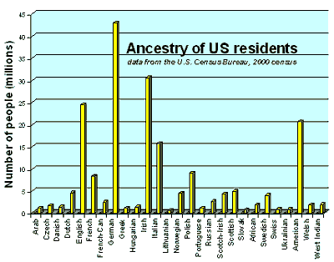
Ancestry of US residents

Slide 9
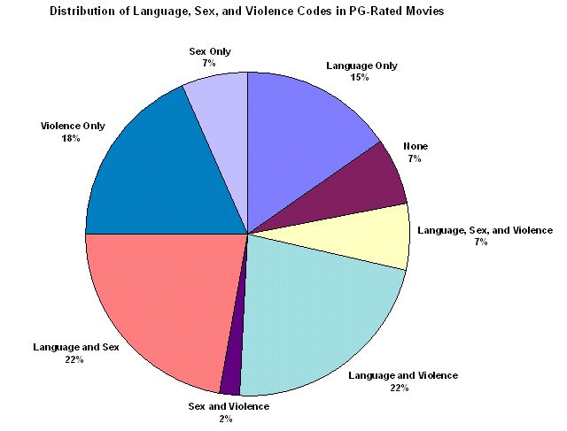
Source: Protecting Children from Harmful Television: TV Ratings and the V-chip
Amy I. Nathanson, PhD Lecturer, University of California at Santa Barbara
Joanne Cantor, PhD Professor, Communication Arts, University of Wisconsin-Madison

Slide 10
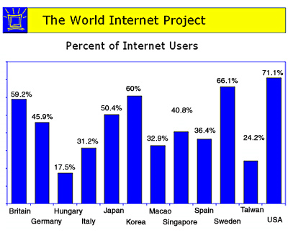
Source: UCLA International Institute

Slide 11
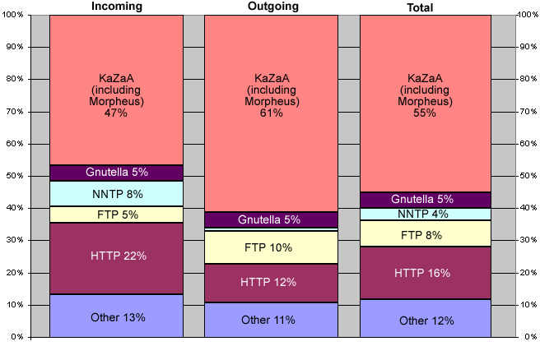
Source: www.cit.cornell.edu/computer/students/bandwidth/charts.html

Slide 12
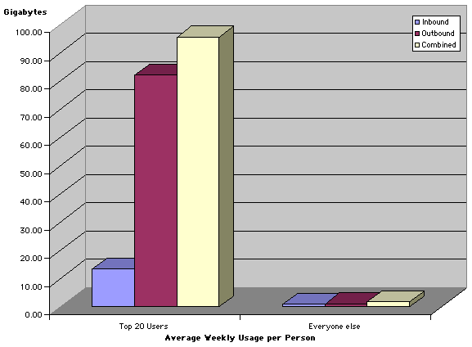
Source: www.cit.cornell.edu/computer/students/bandwidth/charts.html

Slide 13
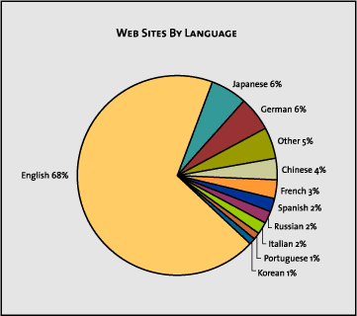
Source: Verisign

Slide 14
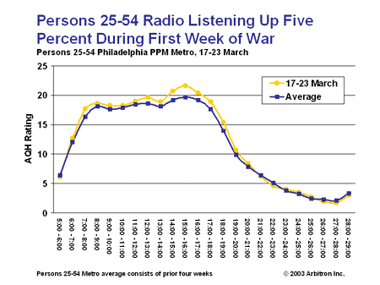

Slide 15
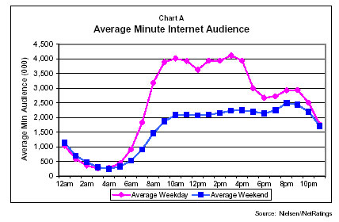

Slide 16
Normal distribution
Many characteristics are distributed through the population in a ‘normal’ manner
Normal curves have well-defined statistical properties
Parametric statistics are based on the assumption that the variables are distributed normally
Most commonly used statistics
This is the famous “Bell curve” where many cases fall near the middle of the distribution and few fall very high or very low
I.Q.

Slide 17
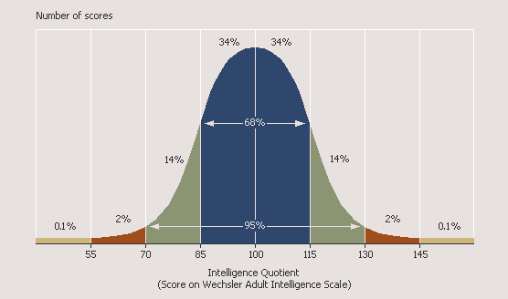
I.Q. distribution

Slide 18
Measures of central tendency
These measures give us an idea what the ‘typical’ case in a distribution is like
Mode (Mo): the most frequent score in a distribution
good for nominal data
Median (Mdn): the midpoint or midscore in a distribution.
(50% cases above/50% cases below)
– insensitive to extreme cases
--Interval or ratio
Source : Reasoning with Statistics, by Frederick Williams & Peter Monge, fifth edition, Harcourt College Publishers.

Slide 19
Measures of central tendency
Mean
The ‘average’ score—sum of all individual scores divided by the number of scores
has a number of useful statistical properties
however, can be sensitive to extreme scores (“outliers”)
many statistics are based on the mean

Slide 20
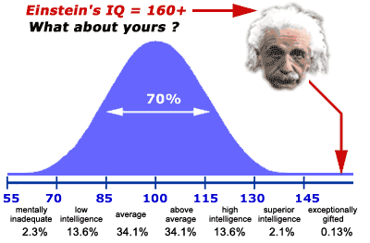
Source: www.wilderdom.com/.../L2-1UnderstandingIQ.html

Slide 21
Statistics estimating dispersion
Some statistics look at how widely scattered over the scale the individual scores are
Groups with identical means can be more or less widely dispersed
To find out how the group is distributed, we need to know how far from or close to the mean individual scores are
Like the mean, these statistics are only meaningful for interval or ratio-level measures

Slide 22
Estimates of dispersion
Range
Distance between the highest and lowest scores in a distribution;
sensitive to extreme scores;
Can compensate by calculating the interquartile range (distance between the 25th and 75th percentile points) which represents the range of scores for the middle half of a distribution
Usually used in combination with other measures of dispersion.

Slide 23
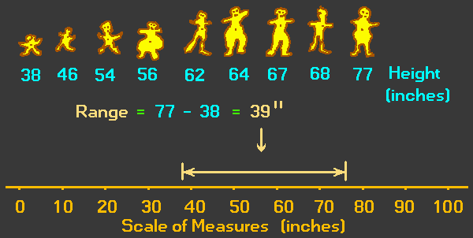
Range
Source: www.animatedsoftware.com/ statglos/sgrange.htm

Slide 24
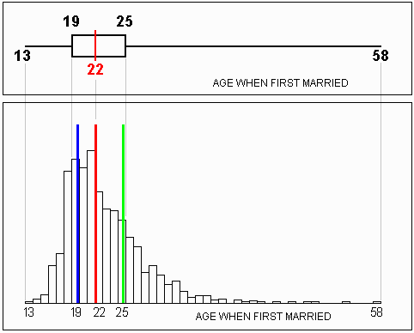
Source: http://pse.cs.vt.edu/SoSci/converted/Dispersion_I/box_n_hist.gif

Slide 25
Estimates of dispersion
Variance (S²)
Average of squared distances of individual points from the mean
sample variance
High variance means that most scores are far away from the mean. Low variance indicates that most scores cluster tightly about the mean.
The amount that one score differs from the mean is called its deviation score (deviate)
The sum of all deviation scores in a sample is called the sum of squares

Slide 26
Standard Deviation (SD)
A summary statistic of how much scores vary from the mean
The square root of the Variance
expressed in the original units of measurement
Represents the average amount of dispersion in a sample
Used in a number of inferential statistics

Slide 27
Skewness of distributions
Measures look at how lopsided distributions are—how far from the ideal of the normal curve they are
When the median and the mean are different, the distribution is skewed. The greater the difference, the greater the skew.
Distributions that trail away to the left are negatively skewed and those that trail away to the right are positively skewed
If the skewness is extreme, the researcher should either transform the data to make them better resemble a normal curve or else use a different set of statistics—nonparametric statistics—to carry out the analysis

Slide 28
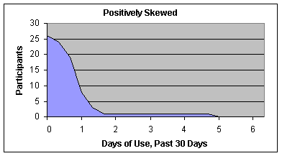

Slide 29
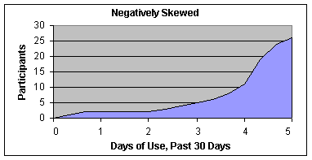

Slide 30
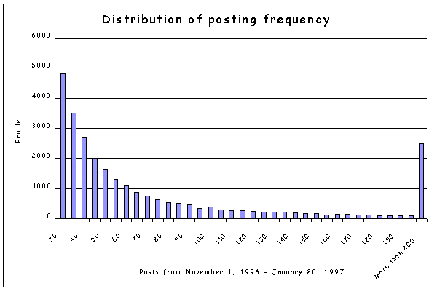
Distribution of posting frequency on Usenet

Slide 31
So
Descriptive statistics are used to summarize data from individual respondents, etc.
They help to make sense of large numbers of individual responses, to communicate the essence of those responses to others
They focus on typical or average scores, the dispersion of scores over the available responses, and the shape of the response curve

