Slide 1
Predictive Analytics Foundations
Lecture 9 - 10

Slide 2
Housekeeping
Questions:
From others asking:
Break problems into individual smaller tasks.
Print “what happened” (e.g. variable values) after each line if needed. (Read something, print it; change a variable, print it; calculate something, print it…)
Today:
Datasheets and data shapes.
Pandas and manipulating data.
Simple concepts, moderately tricky code, important for the future.
Slicing and dicing data.

Slide 3
Datasheets

Slide 4
Manipulating Data
To this point, we can read data from a file and do a lot to manipulate it.
Each time we use some data, we need to “organize” it to some degree:
What data do we have?
Which parts come where?
It might be easier to use lots of data if it was in a standardized format.
We can have assumptions that we rely on to make things easier.
When we get to machine learning, we use this old, organized, data as our main source.

Slide 5
Large Amounts of Data
This system of using old examples to make accurate predictions fits well with how data is stored in databases.
We’ll look at this in more detail over the next two times, for now we just want a basic understanding of what’s in a database.
Databases are made of tables that each look like a spreadsheet.
Each table represents an entity – one ”thing” that we track.
Each column represents an attribute - one value that we store for this entity.
Each row represents an instance – one example of that entity.
So, each table is effectively a list of items, and what we know about them.

Slide 6
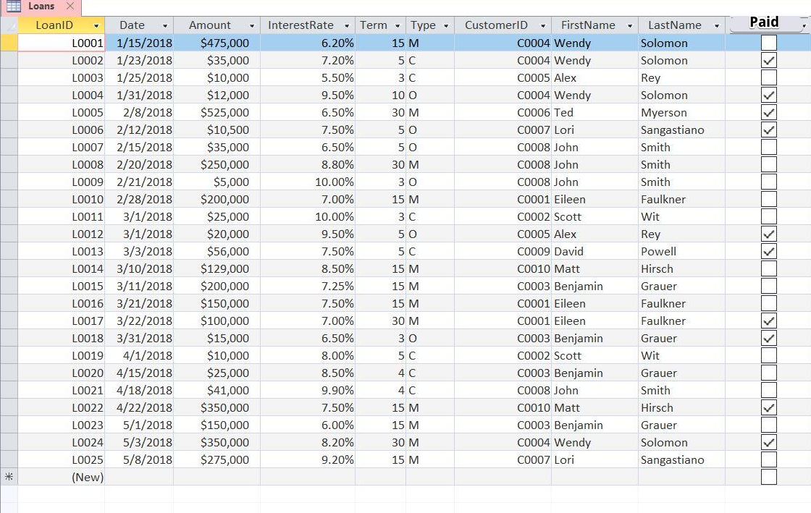
Table – loans.
Row – instance, one loan.
Column – thing we track about the loan.
Including if it was paid.
We could know the inputs (other stuff) before giving a loan, then use these old ones to predict if it was paid.

Slide 7
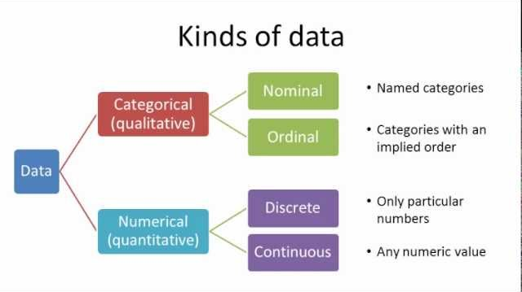

Slide 8
datasheets
This format (table, row, column) is called a datasheet.
Most databases that exist in the world look just like this.
We keep one table for each “item” – sale, product, customer, registration.
Each column is one value that we track for that thing.
Each row is one instance, or one specific example of that thing.
We generally load and manipulate data that looks like this.
Safe assumptions for the “shape” of the data.
Standardized tools and commands to manipulate the data.

Slide 9
Data Separation
Continuing with the idea of using a database as a source for our data…
Databases are normally large and centralized, used by many people.
We can’t have all our data in a spreadsheet because we don’t own it.
Other people need to be looking at and updating that data as well.
Solution – connect to the data that is held remotely.
Data stays in a database where it is, or it stays in a file like it will for us.
We can grab it and use it remotely in Excel, on the web, in Tableau, in another system…
We assume that the data is structured in a datasheet format, allowing us to use those assumptions to handle any data interchangeably.

Slide 10
Your file with your super cool and useful sheets, charts, and tables
Connection to data.
We connect our file to the data that is held elsewhere.
That data could be in a CSV, a database, etc…
Our stuff is built “on” the data, we don’t have it we just reach out and “grab” it from elsewhere.
We can use it just like we have been.
It isn’t actually located in our workbook.
That data can change on its own, we update from it.
This is how most “data tools” work in real usage.
Data Source.
The CSV you download.
Could be a DB.

Slide 11

Pandas
Pandas is a library that provides a Dataframe – roughly a Python spreadsheet.
We can manipulate our data largely as we would think about it in Excel, but through code.
Maps easily to databases, if we are getting data from them.

Slide 12
Slice and Dice the Data
One useful thing about dataframes is that they make it easy to “slice” data.
In ML, we commonly need to slice “vertically”, or separate a column.
E.g. separate the column that we want to predict from the inputs.
We can also slice ”horizontally”, or create groupings or samples.
Horizontal slices can allow us to segment the data into subsets.
We can compare groups against each other.
If we have a large amount of data, or want to do some stats calculations, we can generate samples from our “population” (population = everything, in stats).

Slide 13
Data and Analysis
Much of common data analysis that we want to do is based on Aggregation.
Aggregation is the “totaling” of some value, here it’s calculating sums, avg, count, etc…
We can combine these aggregations with grouping and slicing of the data.
We can calculate any aggregate we want – min, max, average, sum, etc….
We can group or split our data to get the result for any subgroup.
We can compare and contrast these groups for a powerful analysis tool.
This works directly with the datasheet formatted data that we get from a DB.

Slide 14
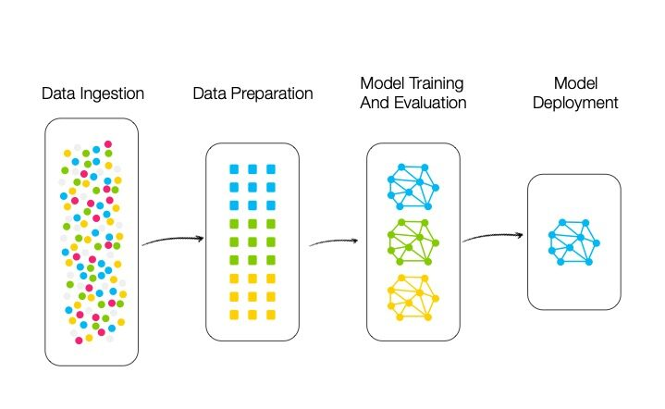

Slide 15
