Slide 1
feature map张量的可视化
董成栋 June 14th 2021

Slide 2
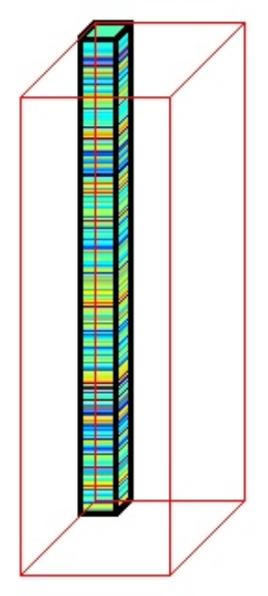

Slide 3
Why not matplotlib?
the ratio of axes

Slide 4
