Slide 1
Driving N on the Dalton Highway… (though it feels like it!)
Welcome to Programming Practicum
Pittsburgh
Victorville, for DARPA's Urban Granc Challenge
Waiting for the snow enveloping you on Route 5 N to melt
“Putting the C into CS”
University of St. Petersburg
Engineering dept.
exploring martian soil
On the 405, in traffic, being chased by police (and TV) helicopters.
You aren’t here
Worldcom Headquarters
Krispy Kreme’s drive through
writing clinic reports
rebooting knuth (or turing or…)
coding chunky strings
Being dragged off-course 18 miles into a marathon race by a crazed spectator
clinic liaison phone call
installing Debian 3.1
Teaching Honors English for Janice Barbee at Pomona High School
Leading a Gray Davis / Gary Coleman / Arnold “T-800” Schwarzenegger gubernatorial fundraiser
Massey University Palmerston North, NZ
Mailing something at the Claremont Post Office
the dumpster
Notes:
I don’t know if this really works...

Slide 2
What is this course about?

Slide 3
What is this course about?
A chance to “improve” your programming skills
Algorithm analysis and insight
What
Program design and implementation

Slide 4
What is this course about?
A chance to “improve” your programming skills
Algorithm analysis and insight
optimizing coding time
What
Program design and implementation

Slide 5
What is this course about?
A chance to “improve” your programming skills
Algorithm analysis and insight
optimizing coding time
What
Program design and implementation
ACM programming contest
Hands-on practice with algorithms and techniques
Why
Familiarity with C++’s STL or Java’s API (more options in the spring…)
Research/prototype programming

Slide 6
What is this course about?
A chance to “improve” your programming skills
Algorithm analysis and insight
optimizing coding time
What
Program design and implementation
ACM programming contest
Hands-on practice with algorithms and techniques
Why
Familiarity with C++’s STL or Java’s API (more options in the spring…)
Research/prototype programming
Unofficial course name: CS -70

Slide 7
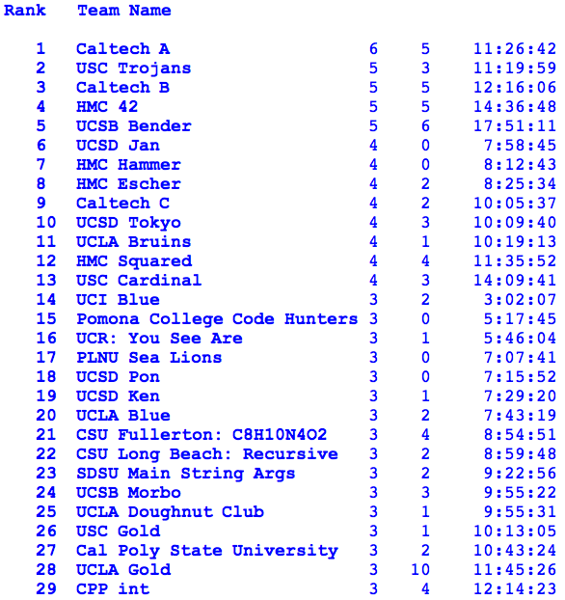
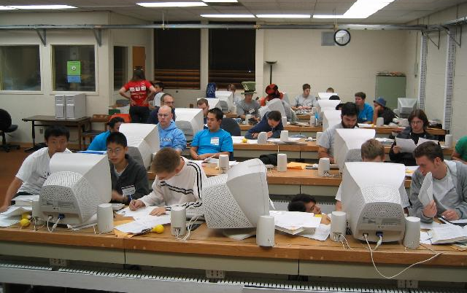
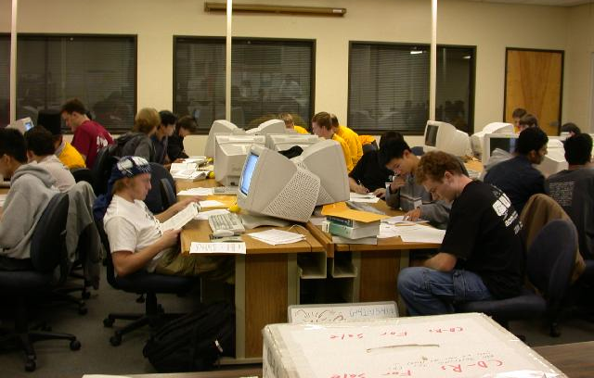
2006 ACM Results
http://socalcontest.acm.org/
Site for the regionals
http://icpc.baylor.edu/icpc/
Site for the world finals

Slide 8
Class Organization
Feedback from prior semesters…
lab sessions not considered best use of time
more contest-like practice sessions
there should be opportunities to start coding “cold”
better to have the course graded individually
continue to play jotto
have better snacks <-- need more feedback here
Notes:
PERL stories
- use in ACM
- creating scripts
- LTS, BOT

Slide 9
Course Organization
Sep 4 Welcome! (topic: dynamic programming)
Sep 11 Practice session to work on problems (here - laptops?)
Sep 18 Discussion session (topic: graph algorithms)
Sep 25 Practice session (here…)
Oct 2 Discussion session (topic: search problems)
Oct 9 Practice session (here…)
Oct 16 Discussion session (topic: geometry/parsing)
Oct 23 No class - Fall break
Oct 30 Mock ACM contest, 9pm – 1am, teams of 3, in CS labs
Nov 6 Brief meeting for the ACM contest participants
Nov 10 Regional ACM contest in Riverside
Nov 13 Wrap-up session for everyone

Slide 10
Problems and grades
alternating format
discussion sessions
lab sessions
problem and program analysis
strategy, coding tips
3 problems, count individually
3 problems can be done by team or individually -- you decide
meet here in this room (?) - bring a laptop - I'll have some too.
contest conditions:
  new problems
  one computer per team
  credit for the entire team
Problems can be done any time during the term.
Problems solved during the lab sessions count as
2 problems before 6pm
Notes:
PERL stories
- use in ACM
- creating scripts
- LTS, BOT

Slide 11
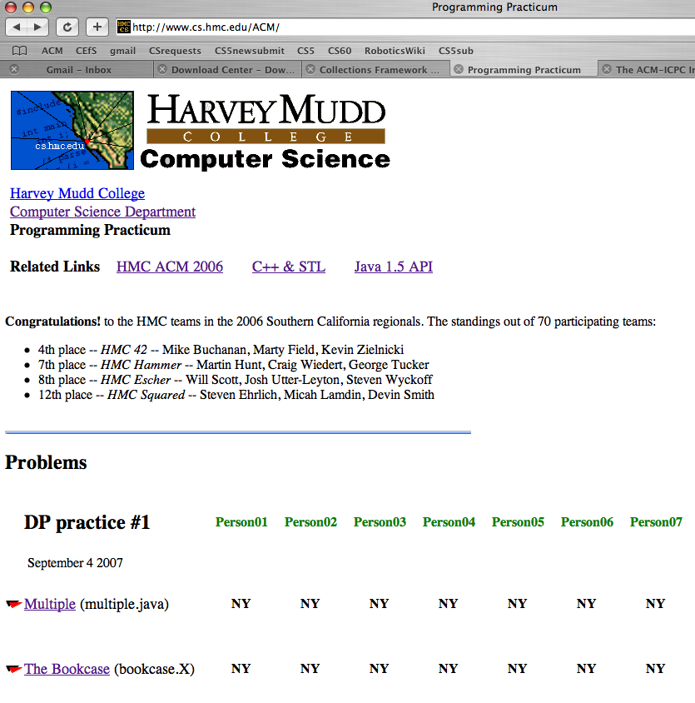
Course webpage
reference links
problem statements and example I/O
people
results!!
administrative info

Slide 12
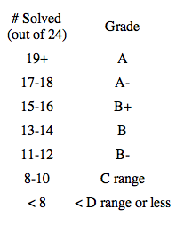
Grading
CS 189 is graded individually... (it’s possible to take it P/F, too)
Coding Guidelines
problems can be done any time during the semester
discussion of algorithms always OK
coding should be within teams
during lab "contests", you may only use C++ or Java API references
anyother time, you may use any reference at all except an existing solution or partial solution…
use /cs/ACM/acmSubmit <file> to submit
try things out !
the reason for ACM!

Slide 13
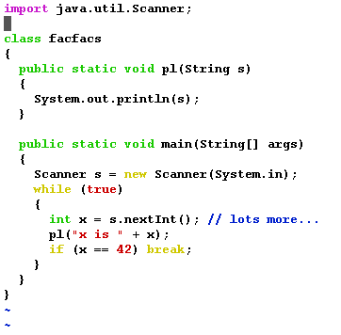
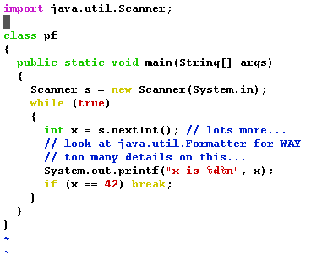
Java !
Not required (C++ is the alternative), but consider...
extensive library of data structures and algorithms available
I/O made simpler with 1.5’s Scanner and printf
formatted output
parsed input
the C in CS!

Slide 14
Problem Set #1: Dynamic Programming

Slide 15

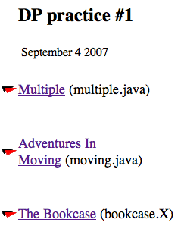
Problem Set #1: Dynamic Programming
Rob Gonsalves
www.sapergalleries.com/Gonsalves.html

Slide 16
Problem Set #1: multiple.java
2
6
3
19
0
Input
0 marks the end of the input
integers (N) with 2 < N < 10000
change!

Slide 17
Problem Set #1: multiple.java
2
6
3
19
0
Input
0 marks the end of the input
integers (N) with 2 < N < 10000
change!
Output
10
1110
111
11001
change!
the smallest (decimal) multiple of N with only the digits 0 and 1 !

Slide 18
Problem Set #1: multiple.java
2
6
3
19
0
Input
0 marks the end of the input
Ideas?
Most naïve solution…
integers (N) with 2 < N < 10000
…how can we save time?
change!
Output
10
1110
111
11001
change!
the smallest (decimal) multiple of N with only the digits 0 and 1 !

Slide 19
Dynamic programming
Storing intermediate results in a table for fast look-up:
multiple.java
input N = 6
possible remainders upon dividing by N (6)
0
1
2
3
4
5
1
2
# of digits in answer
3
4

Slide 20
Dynamic programming
Storing intermediate results in a table for fast look-up:
input N = 6
possible remainders upon dividing by N (6)
0
1
2
3
4
5
1
1
2
# of digits in answer
3
4

Slide 21
Dynamic programming
Storing intermediate results in a table for fast look-up:
input N = 6
possible remainders upon dividing by N (6)
0
1
2
3
4
5
1
1
2
1
10
11
# of digits in answer
3
4

Slide 22
Dynamic programming
Storing intermediate results in a table for fast look-up:
input N = 6
possible remainders upon dividing by N (6)
0
1
2
3
4
5
1
1
2
1
10
11
# of digits in answer
3
1
110
111
10
11
4

Slide 23
Dynamic programming
Storing intermediate results in a table for fast look-up:
input N = 6
possible remainders upon dividing by N (6)
0
1
2
3
4
5
1
1
2
1
10
11
# of digits in answer
3
1
110
111
10
11
4
1110
1
110
111
10
11

Slide 24
Problem Set #1: multiple.java
2
6
3
19
0
Input
Java Classes
0 marks the end of the input
BigInteger
LinkedList<String>
integers (N) with 2 < N < 10000
int[]
change!
Output
10
1110
111
11001
change!
the smallest (decimal) multiple of N with only the digits 0 and 1 !

Slide 25
Coding tips: multiple.java
import java.util.Scanner;
import java.util.LinkedList;
import java.math.BigInteger;
class multiple
{
public static void pl(String s) { System.out.println(s); }
public static void pld(String s) { /* pl(s); */ ; }

Slide 26
Coding tips: multiple.java
import java.util.Scanner;
import java.util.LinkedList;
import java.math.BigInteger;
class multiple
{
public static void pl(String s) { System.out.println(s); }
public static void pld(String s) { /* pl(s); */ ; }
public static void main(String[] argv)
{
Scanner s = new Scanner(System.in); // for input
int[] remainders; // the DP table
LinkedList<String> LL; // a queue

Slide 27
Coding tips: multiple.java
while (true) // while there is input
{
LL = new LinkedList<String>(); // new, empty queue
LL.addLast("1"); // starting value
while (LL.size() > 0) // more data left?
{
String next = LL.removeFirst(); // dequeue from front
the LinkedList class is a ready-made Deque

Slide 28
Coding tips: multiple.java
the BigInteger constructor takes a String
BigInteger r0_big = (new BigInteger(next0)).remainder(input);
int r0 = r0_big.intValue(); // convert to an int
if (r0 == 0) { // we're done!
pl(next0); // print the answer
break; // go to next input
}

Slide 29
Coding tips: multiple.java
the BigInteger constructor takes a String
BigInteger r0_big = (new BigInteger(next0)).remainder(input);
int r0 = r0_big.intValue(); // convert to an int
if (r0 == 0) { // we're done!
pl(next0); // print the answer
break; // go to next input
}
our table
if (remainders[r0] == 0) { // have we seen this one?
remainders[r0] = 42; // 42 marks it as seen
pld(" " + next0 + "," + r0); // for debugging
LL.addLast( next0 ); // put next0 on the queue
}

Slide 30
Jotto!
A word-guessing game similar to mastermind…
Sophomores
Juniors
Seniors
Me
fjord 3
fjord 0
fjord 1
fjord 2
Notes:
PERL stories
- use in ACM
- creating scripts
- LTS, BOT

Slide 31
Problem Set #1: bookcase.java
Input
1
4
220 29
195 20
9
180 30
number of data sets
number of books in this data set
height and width of each book

Slide 32
Problem Set #1: bookcase.java
Input
1
4
220 29
195 20
9
180 30
number of data sets
number of books in this data set
height and width of each book
Fit the books tightly onto a rectangular, 3-shelf bookcase:
220
29
200
20 + 9
180
30
30

Slide 33
Problem Set #1: bookcase.java
Input
1
4
220 29
195 20
9
180 30
number of data sets
number of books in this data set
height and width of each book
Fit the books tightly onto a rectangular, 3-shelf bookcase:
220
29
200
20 + 9
Output
180
30
What is the smallest total area for such a bookshelf?
30

Slide 34
Problem Set #1: bookcase.java
Thoughts?
Input
1
4
220 29
195 20
9
180 30
number of data sets
number of books in this data set
height and width of each book
Fit the books tightly onto a rectangular, 3-shelf bookcase:
220
29
200
20 + 9
Output
180
30
What is the smallest total area for such a bookshelf?
30

Slide 35
Tracking width, height, and books…
Consider the books in order of height (decreasing)
Key decisions will be
given some number of books on the first two shelves,
the width of the shelves and the height of the shelves
0
width of Shelf #1
0
how many of the tallest books in top two shelves
1
Contains: smallest possible height of shelf #2
2
3

Slide 36
See you next time!

Slide 37
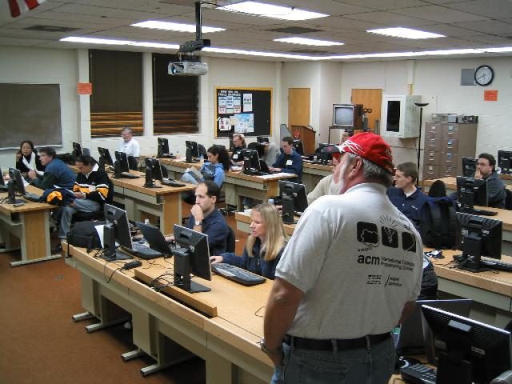
Coaches’ Room

