Slide 1
ACM Programming Contests
Coordinator: Dr. Hubert Chan
Coach: Luyi Mo
Training Holder: Jonathan So
Website: i.cs.hku.hk/~provinci

Slide 2
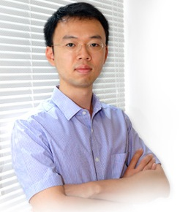
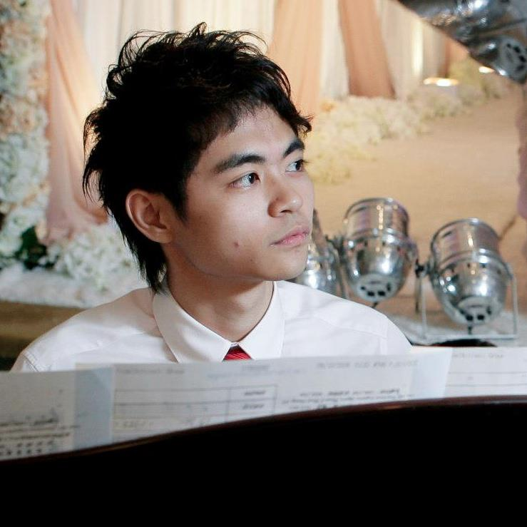
Contact Information
Coordinator (grant raiser)
Dr. Hubert Chan
hubert@cs.hku.hk
Office at CB429
Coach (consultant)
Luyi Mo
lymo@cs.hku.hk
Office at CB417
Training Holder (great volunteer!)
Jonathan So (Soso)
http://facebook.com/soso.so

Slide 3

What is ACM-ICPC
ACM International Collegiate Programming Contest (a.k.a. ACM ICPC, ACM competition, ICPC) is the largest university-level programming contest in the world.
http://icpc.baylor.edu
Statistics in 2012
  # of students: 29,479
  # of universities: 2,322
  # of countries: 91
  # of continents: 6

Slide 4
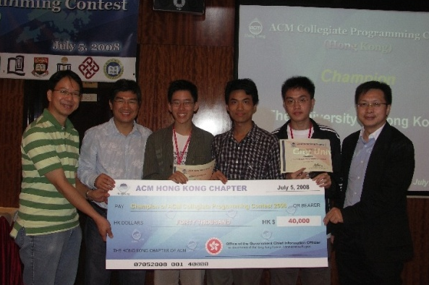
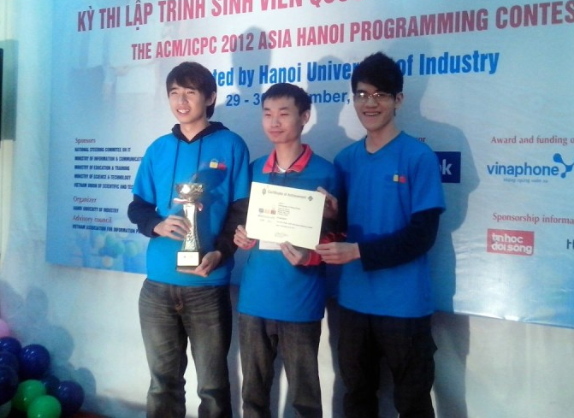
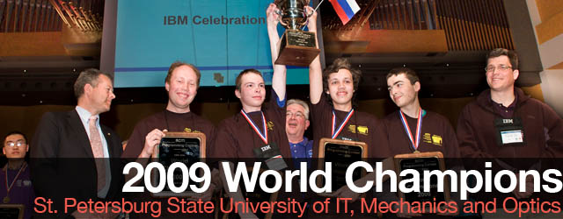
What is ACM-ICPC
ACM-ICPC is comprised of several levels:
  Hong Kong Local Contest
  Asia Regional Contest
  Earn ticket to World Finals
  World Finals
    100+ teams

Slide 5
Why ACM-ICPC
You can learn…
  Many useful algorithms, mathematical insights
  How to code/debug quickly and accurately
  How to work in a team
Then you can rock in classes, job interviews, etc.
It’s also fun!

Slide 6
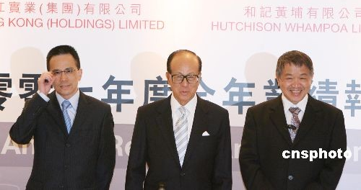
Contest Rule
Each team: 3 students
One computer per team
4 - 5 hours
8 - 13 problems to solve
  Presented in a real-life scenario
  Need to discern the underlying essential problem and develop algorithms
  Input and output requirement
  Time limit
Judge by some test cases (unknown to us)
  Pass all test cases = solve the question
  If you fail, you can resubmit
Winner is the team that solves the most problems in the least time!

Slide 7
The Contest
while ( ! isTimeout() ) {
read();
think();
program();
//debug();
submit();
}

Slide 8
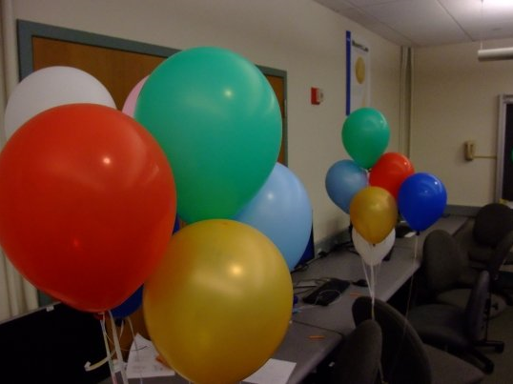

One Balloon as a gift for solving a problem.
Each problem is associated with a color.

Slide 9
Tips to win in acm-icpc

Slide 10

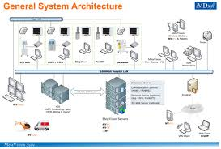
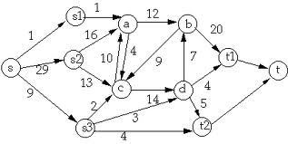
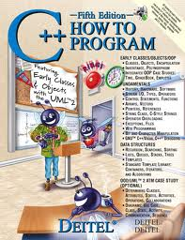
Four levels of programmer
World
  How can I change the world?
Software engineering
  manage different components and people
Algorithms
  Design good solutions
Implementation
  know the language well, translate idea to programs

Slide 11
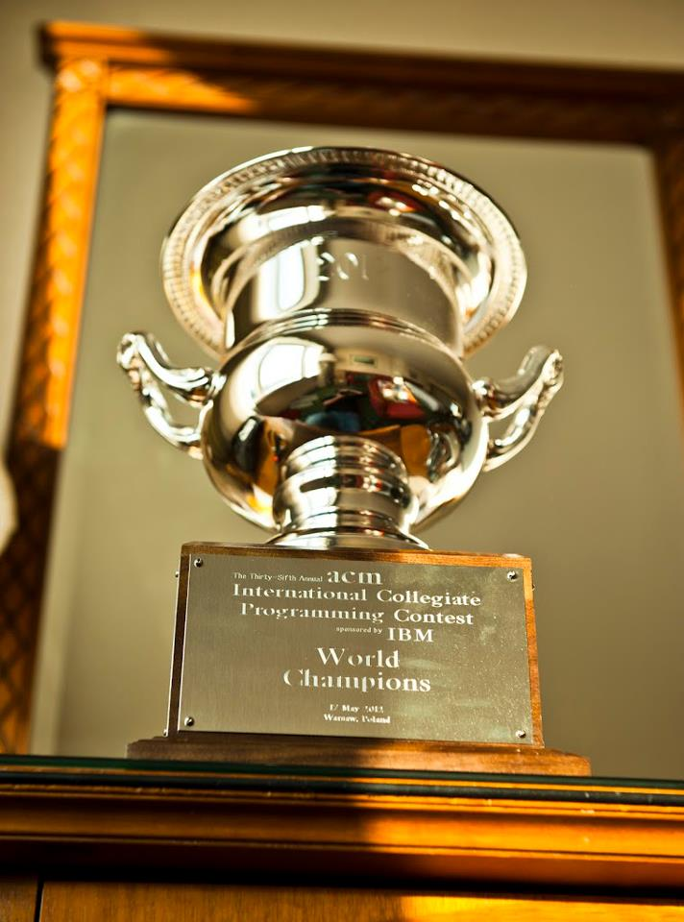
How to win in ACM-ICPC
Winning ACM-ICPC only requires you to be excellent in implementation and algorithms!

Slide 12
How to win in ACM-ICPC
Be excellent in implementation and algorithms.
Important Warning!
  ACM cannot test your ability beyond algorithms
  To change the world requires many more things.
  See the bigger picture and keep learning.
  Implementation and algorithms are necessary, but they are not the end. :)

Slide 13
What kind of implementation skills are needed?
Variables, loops, functions
Exhaustion
  Try all permutations
  Try all subsets
  Try all paths, etc
Classes, operator overloading, STL
Persistence (don't be afraid of long problems and programs)

Slide 14
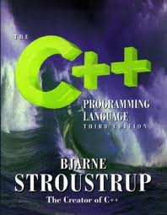
How to improve implementation?
Write more programs
Read more books
Don't afraid of new tools
  STL
Exercises.
Codeforces: 48A, 242A, 75B, 81B, 82B, 9C
POJ: 1000, 1001, 1002, 1004, 1005, 1006, 1007, 1008, 1010, 1012, 1016, 1019

Slide 15
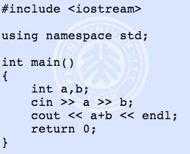
POJ 1000 – A + B = ?

Slide 16
Algorithmic skills (1/4)?
Standard algorithm design principles
  Divide-and-conquer
  Dynamic programming
    Save up the partial results
    The optimal solution can be found by backtracking
  Greedy
    Sometimes the seemingly best choice is the only best choice
These are principles that we don't need to memorize

Slide 17
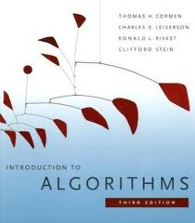
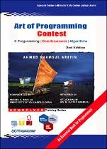
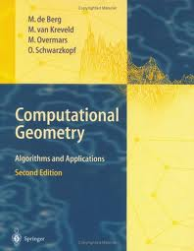
Algorithmic skills (2/4)?
Common algorithms
  Algorithms that have been studied before.
  Memorize the algorithms (or at least their usage)
  Sorting, graphs, network flow, coordinate geometry, math
Be hardworking, read more books

Slide 18
Algorithmic skills (3/4)?
Running time analysis

Slide 19
Algorithmic skills (4/4)?
Observation and creativity
  Find some properties about the problem

Slide 20
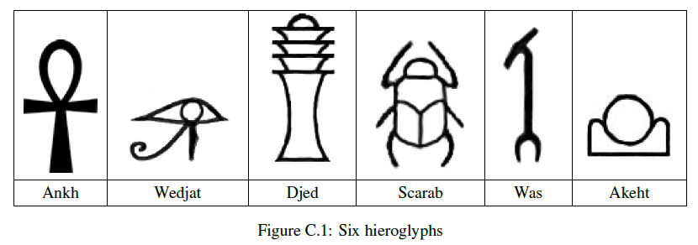

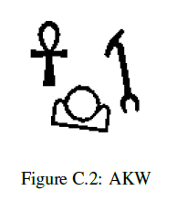
Example – Ancient Messages (WF11’)

Slide 21
Example – Ancient Messages
# of holes per shape:
1
3
5
4
0
2
# of adjacent white regions per shape:
2
4
6
5
1
3

Slide 22
Example – Ancient Messages
Solution Framework:
  Step 1 - Figure our all black regions
  Step 2 - For each black region, count number of adjacent white regions
Flood Fill Algorithm to find regions
Recursions to implement

Slide 23
Tips for Self-learning
Be self-motivated, passionate, and persistent.
Try to do an many exercises as possible.
Form a team or a study group ASAP so that you can learn with others.
Make full use of online materials (http://i.cs.hku.hk/~provinci/utilities.html)
  E-books
  Online Tutorials (recommend Stanford course homepage)
  Recommended Online Judges:
    Codeforces (www.codeforces.com)
    Peking University Online Judges(poj.org)

Slide 24
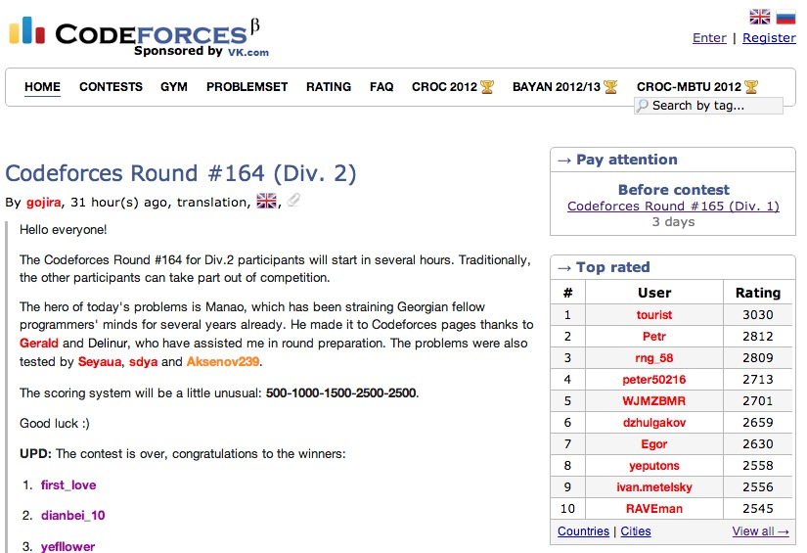

Slide 25
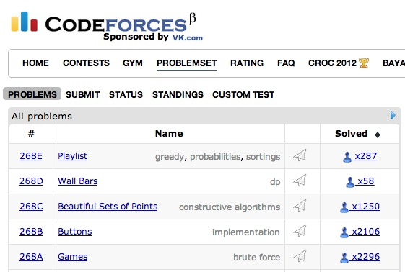

Slide 26
Tips for Self-learning
Attend online contests
  CodeForces Regular Round Contests: http://www.codeforces.com/contests
  Topcoder Single Round Matches: http://community.topcoder.com/tc
  Monthly Contests in Online Judges
    e.g. ZOJ Monthly Contests: http://acm.zju.edu.cn
  Google Code Jam
  Facebook Hacker Cup
  ……

Slide 27
Tips for Self-learning
Practices make perfect!
Test your ability in an individual contest around reading week!
Discuss in our Facebook Fans Page
  To join, contact Luyi Mo or Jonathan So

Slide 28
Tentative Schedule
 | Topics
Feb - April | Basic topics: recursion, breadth first search, depth first search, greedy, dynamic programming, graphs
May | Team formation test for local contest
June / July | ACM Hong Kong Local Contest
July - August | Online Contests (e.g. Codeforces regular round Div.1 and Div.2)
Sep - Oct | Advanced topics: Contest like problems Team formation test for regional contest
Oct / Nov | ACM Asia Regional Contest
March | ACM World Final Contest (by invitation)

Slide 29
Self-introduction
Name
Come from …
Major in …
Year … student
Beginner? Need teammates? Any previous programming experience?
Senior member? Anything want to share? Any help you can provide?
…

Slide 30
Summary
Implementation
  Persistence
Algorithms
  Running time analysis
  Design techniques
  Observation and creativity
  Common algorithms
Prepare for internal and local contest

