Slide 1
ACGAN
Zheng Lu

Slide 2
Some discovery in previous work
Class conditional synthesis can significantly improve the quality of generated samples. Richer side information such as image captions and bounding box may improve sample quality further.
One can also forcing the D network to do classification task (C1, C2, …, Cn, fake) that can improve performance on the original task, which is discriminate (real, fake)
This paper (ACGAN) mainly explore the above mentioned idea. The change is very simple. However, the performance gain is huge. Also the performance measurement proposed in this paper is interesting.

Slide 3
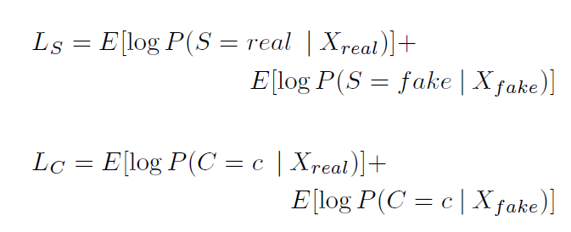
ACGAN loss function
Only change the loss function of original GAN. The new loss function contains two parts:
Fake or real?
Which class?

Slide 4
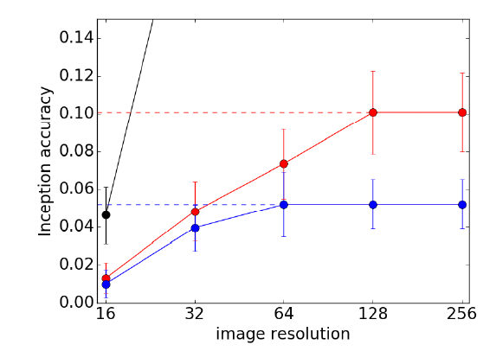
Measure of Discriminability
Previous work use inception score [see appendix for measurements in previous works]
ACGAN use a pre-trained inception network and report the fraction of samples for which the inception network assigned the correct label.
Summary of accuracies across varying spatial resolutions for training data and image samples from 64 x 64 and 128 x 128 models. Error bar measures standard deviation across 10 subsets of images. Dashed lines highlight the accuracy at the output spatial resolution of the model. The training data (clipped) achieves accuracies of 24%, 54%, 81% and 81% at resolutions of 32, 64, 128, and 256 respectively.
Figures are from [1]

Slide 5
Measuring the diversity of generated sample
Why diversity? A model that simply memorize one sample for each class will have a very high inception accuracy (a measurement of how good GAN generated sample is).
Previous work use entropy to measure diversity. However, entropy is sensitive to trivial changes that human consider ‘perceptually meaningless’.
ACGAN use MS-SSIM as the perceptual similarity metric that attempts to discount aspects of an image that are not important for human perception.

Slide 6
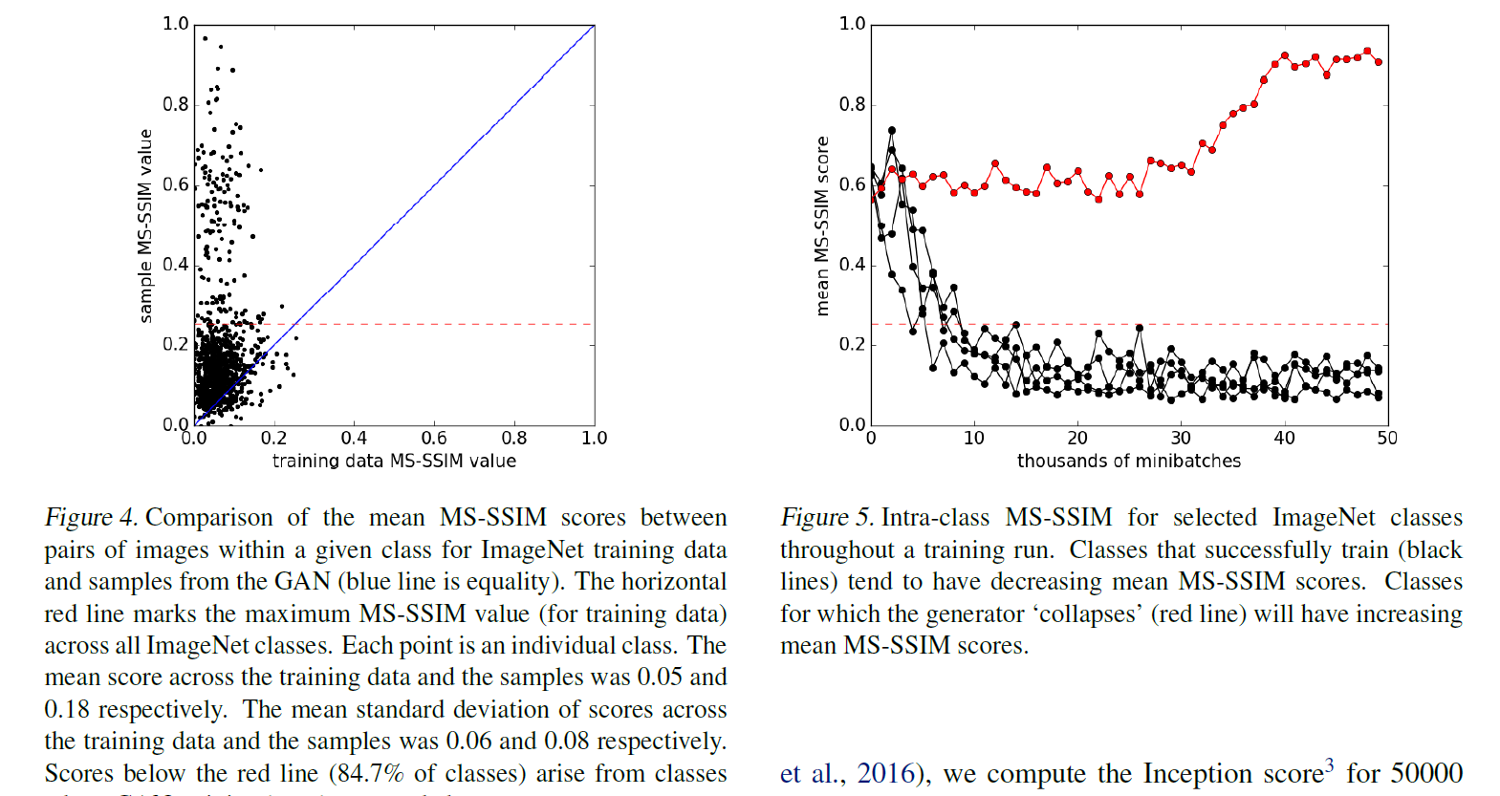
Diversity of generated sample
Figures are from [1]

Slide 7
Reference
[1] Salimans, Tim, et al. "Improved techniques for training gans." Advances in Neural Information Processing Systems. 2016.
[2] Odena, Augustus, Christopher Olah, and Jonathon Shlens. "Conditional image synthesis with auxiliary classifier gans." arXiv preprint arXiv:1610.09585 (2016).

Slide 8
Appendix - Inception score
We apply the Inception model to every generated image to get the conditional label distribution p(y|x).
Images that contain meaningful objects should have a conditional label distribution p(y|x) with low entropy.
Moreover, we expect the model to generate varied images, so the marginal R p(y|x = G(z))dz should have high entropy.
Combining these two requirements, the metric that we propose is: exp(ExKL(p(y|x)||p(y))), where we exponentiate results so the values are easier to compare.

Slide 9
Appendix - VGG loss as content loss
We define the VGG loss based on the ReLU activation layers of the pre-trained 19 layer VGG network described in Simonyan and Zisserman [49]. With i;j we indicate the feature map obtained by the j-th convolution (after activation) before the i-th maxpooling layer within the VGG19 network, which we consider given. We then define the VGG loss as the euclidean distance between the feature representations of a reconstructed image GG(ILR) and the reference image IHR:

Slide 10
Appendix - Mean opinion score (MOS) testing
we asked 26 raters to assign an integral score from 1 (bad quality) to 5 (excellent quality) to the super-resolved images

