Slide 1
Nvidia DGX for AI research
Dali Wang

Slide 2
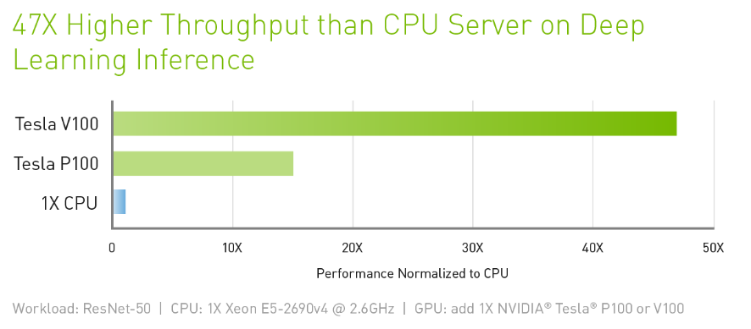
Nvidia DGX
Our Nvidia DGX server has 4 cutting edge Nvidia GPU Tesla V100

Slide 3
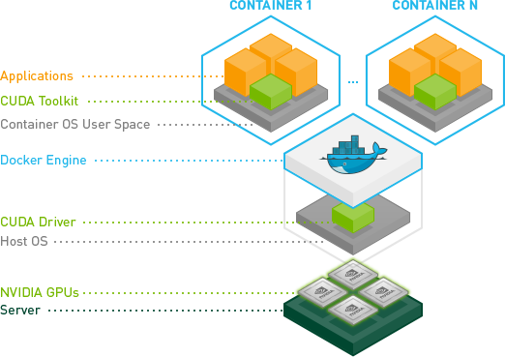
Nvidia docker
Need sudo privilege to run the docker
Currently a single-user system
There are pre-defined images for different AI library:
Tensorflow
Pytorch

Slide 4
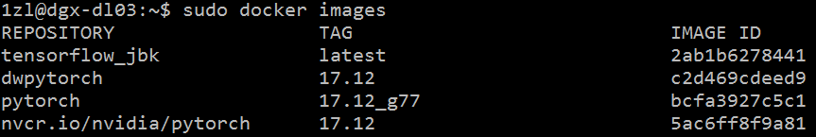
How to create a container
Login to the DGX system via ssh using UCAMS id: ssh -X userid@dgx-dl03.ornl.gov
If you want your data to be saved after running, you need to create a data space: mkdir [data_folder]
Find the right docker image for you. You can check the available images: sudo nvidia-docker images

Slide 5
How to create a container- continued
Run the image in interactive mode: sudo nvidia-docker run -v [data_folder]:[path_for_mapping] -it -e DISPLAY=$DISPLAY -v /tmp/.X11-unix:/tmp/.X11-unix -v $HOME/.Xauthority:/root/.Xauthority:rw --name=[container_name] --net=host --rm [image_name]:[tag]
Or, if you are not using xwindow: sudo nvidia-docker run -v [data_folder]:[path_for_mapping] -it --name=[container_name] --net=host --rm [image_name]:[tag]
You should see the system logo and you are login as root, now you can use your software library
Be sure to assign a name to your container

Slide 6
Test your environment
You can simply import the software library to see if it has already set up: python -c “import tensorflow” You shouldn’t see any error report.

Slide 7
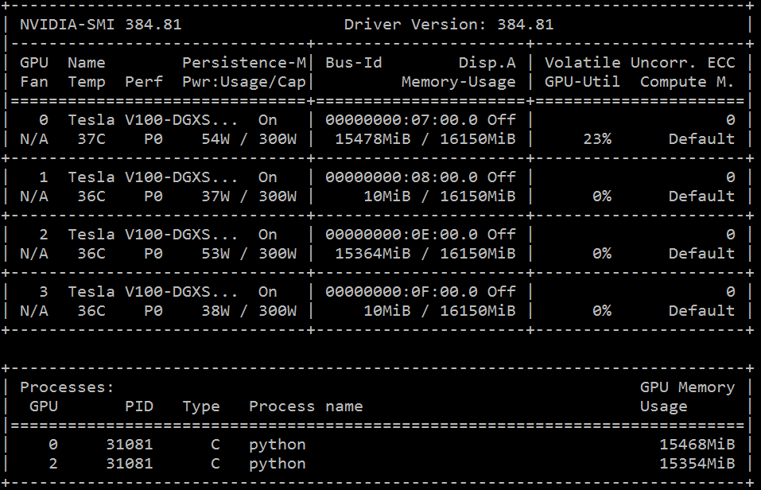
Check GPU usage
nvidia-smi
Current usage for each GPU
Current GPU memory usage for each GPU

Slide 8

Docker commands
List container sudo docker ps
Kill a container (USE WITH CAUTION) sudo docker kill [container name]
Attach local standard input, output, and error streams to a running container sudo docker attach [container name]
Open a new bash window for the container (this is useful when you want to open multiple windows of the same container) sudo docker exec –it [container name] /bin/bash
container name

Slide 9
Exit or detach a container
If you open your container in interactive mode. Type exit or Ctrl-c will kill the container and any running process in it.
To detach a container, type the sequence Ctrl-p + Ctrl-q. This will turn the container from interactive mode to daemon mode.

Slide 10
GPU options in tensorflow.
As we have 4 GPU on DGX server. GPU id range from 0 to 3. You can specify in your code which GPU you want to use: import os os.environ[“CUDA_VISIBLE_DEVICES”] = “0, 2” # use GPU0 and GPU2
For each gpu, you can set the amount of memory you want to use: # Assume that you want to allocate ~8GB out of 16GB: gops = tf.GPUOptions(per_process_gpu_memory_fraction=0.5) sess = tf.Session(config=tf.ConfigProto(gpu_options=gops))

Slide 11
Usage rules
Since it is a single user environment, please make sure your code has finished before your logout. (i.e. nvidia-smi on the host node).
Please backup your code and data in time. Only data in the data folder you created will be saved.
All your data is visible to all the other users. Others may kill your container and unfinished job.
You may find out that “screen” and “tmux” are available and helpful on the host node.

