Slide 1
Transfer Learning
Zheng Lu

Slide 2
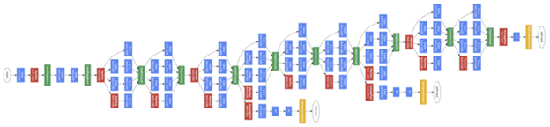
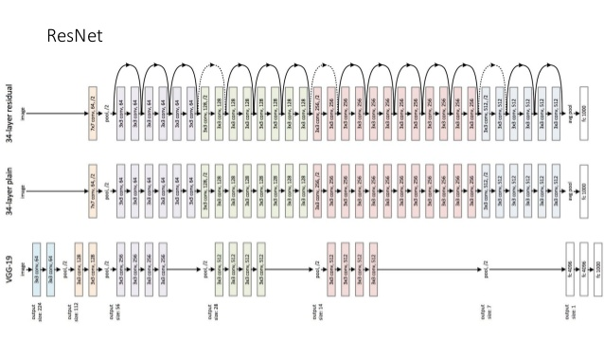
There are many existing pretrained models
Inception
[CVPR 2015]
[CVPR 2016]

Slide 3
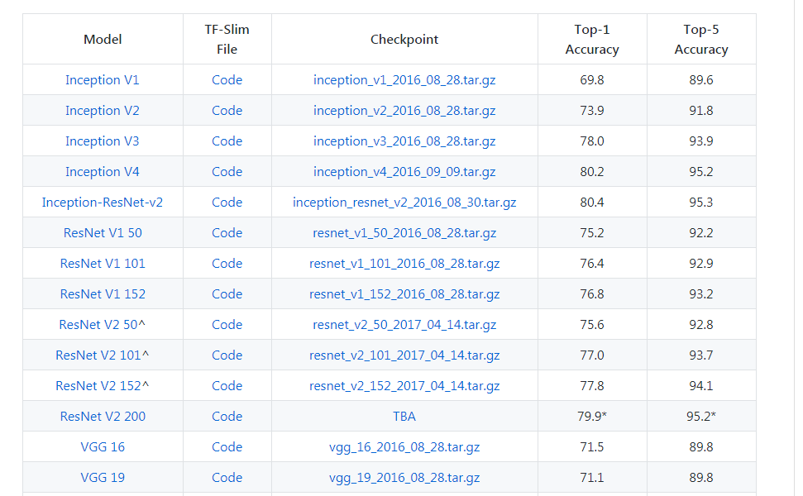
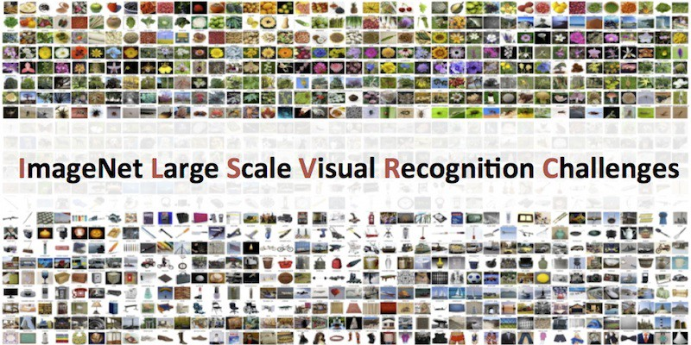
And a benchmark dataset - ImageNet
10,000,000 hand-labeled images depicting 10,000+ object categories
Large Scale Visual Recognition Challenge: 1000 class
Top k accuracy: if the real label is in the predicted label with top-k possibility.

Slide 4
Fine-tune networks on new dataset
When using a network for a new dataset, we have two options:
Training the network with the new dataset from scratch, all parameters in the network are randomly initialized.
Training the new dataset on the pre-trained network (transfer learning):
For example, we have a inception network pre-trained on the ImageNet.
Both the network architecture and the value of parameters are stored to files.
Then we want to train the same network on a new dataset, say cifar10
We load the network and initialize parameters with values loaded from files.
We modify the network as the new dataset may not have same input and output size as the old dataset.
Train the network on the new dataset
Transfer learning usually achieves better performance.

Slide 5
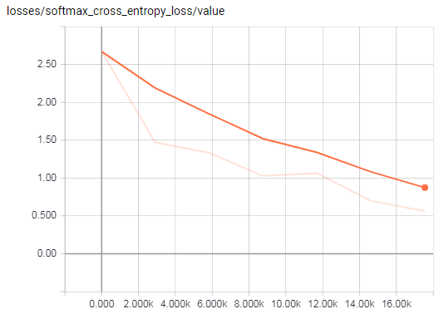
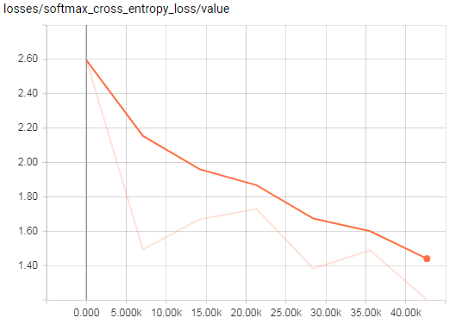
Training inception network on cifar 10 dataset for 1 hour
Method 1: Training from scratch
Method 2: Training on pretrained network
Evaluation result [accuracy]: 0.7545
Evaluation result [accuracy]: 0.6978
Ok, we have worse performance with transfer learning, why? I’ll look for reasons.

