Slide 1
Literature review and possible ideas
Zheng Lu

Slide 2
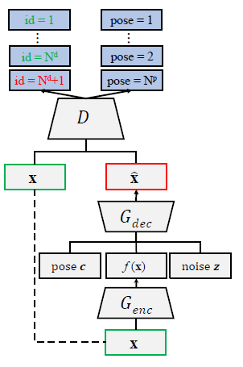
Encoder-decoder
First acquire an encoding of the input, most features of the input are preserved in the encoding.
Append specific label information for desired feature, e.g., we want have the output of a face with specific pose
Append noise to ensure randomness.
Used in [1, 2, 7, 8] and more.

Slide 3
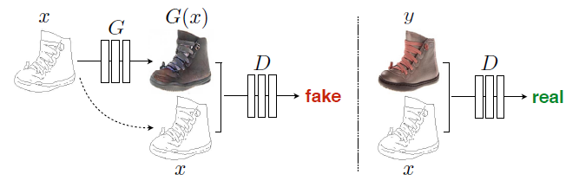
Pair learning
Conditional GAN conditioned on images.
Training a conditional GAN to map edges to photo. The discriminator, D, learns to classify between fake (synthesized by the generator) and real (edge, photo) tuples
Used in [3, 9]

Slide 4
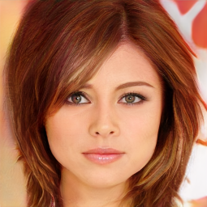
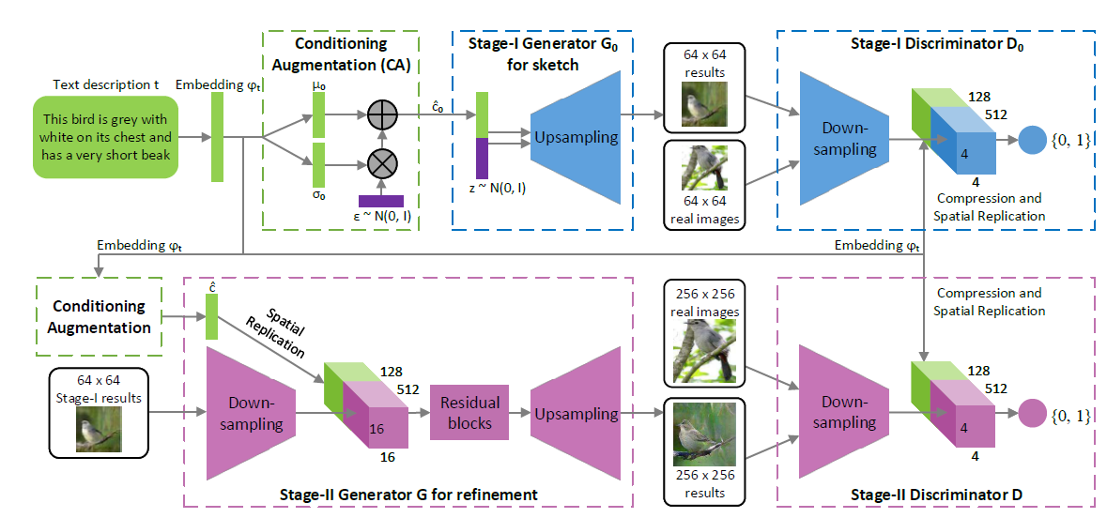
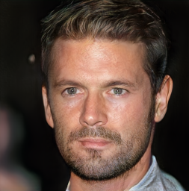
Stacked structure
Use first layer to get a rough estimation of the input and use second layer to refine the output.
The output of first one could be blurred or has lower resolution.
Could have multiple stack to generate high resolution images.
Used in [5,6, 10]

Slide 5
Ideas
Noise / image -> G -> a series / pair of images
G can be a star-GAN structure when input is pure noise
G can be an encoder-decoder when input is a image
Possible problem
Input is noise, output is a series of images
Not too much space to manipulate and can only generate a whole series at once
Network is too large and slow to train
Or each image can only have low resolution
Input is image, output is a pair of images
May not have good diversity [see appendix]
Loss accumulation when generate a whole series recurrsively.

Slide 6
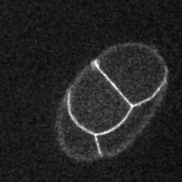
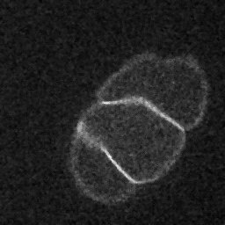
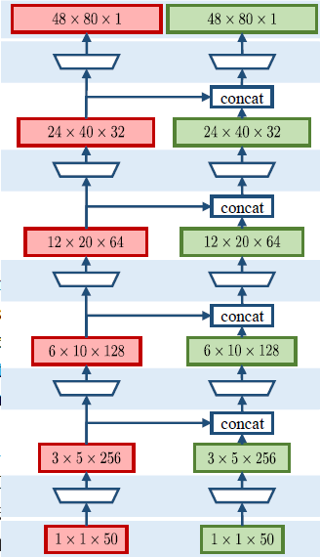
Star-GAN
Implement star-GAN on tfGAN.
Only 2 towers now:
One for reference
One for future time slice

Slide 7
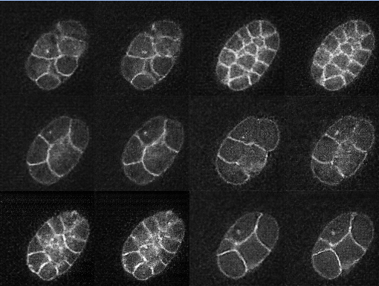
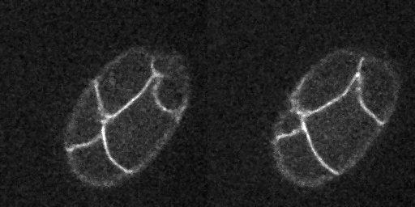
Star-GAN – 1 time slice interval
Training data is a pair of images with a time interval of 1

Slide 8
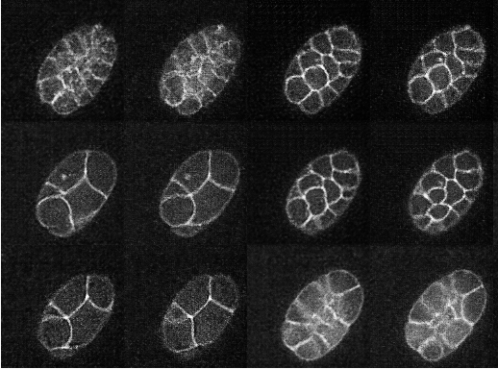
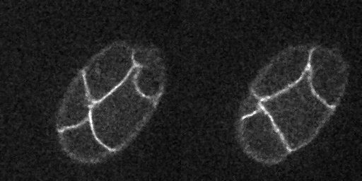
Star-GAN – 2 time slice interval
Training data is a pair of images with a time interval of 2

Slide 9
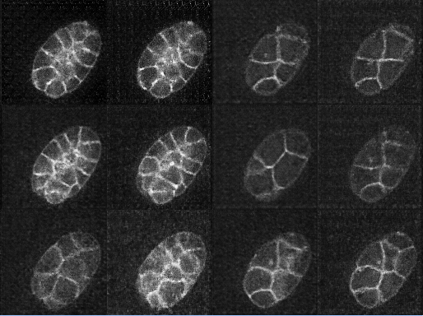
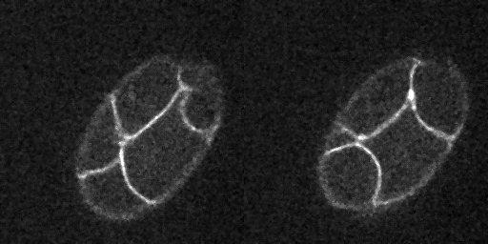
Star-GAN – 4 time slice interval
Training data is a pair of images with a time interval of 4

Slide 10
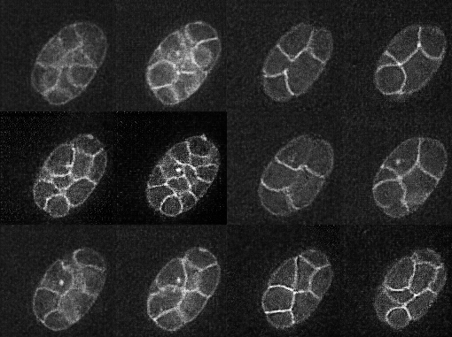
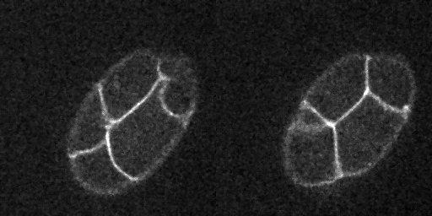
Star-GAN – 8 time slice interval
Training data is a pair of images with a time interval of 8

Slide 11
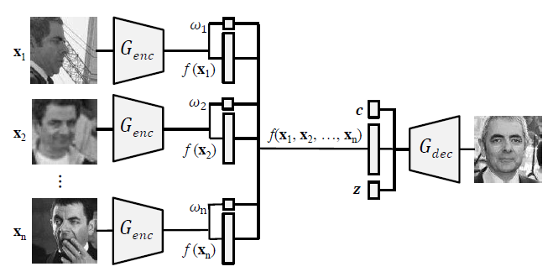
Appendix – multiple input GAN
To leverage multiple input per subject in training
Used in [1, 11]

Slide 12
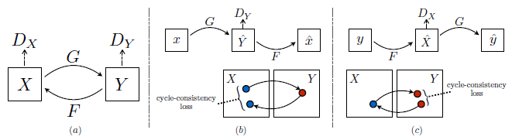
Appendix - Cycle-consistent loss
Used in [4]

Slide 13
Reference - important
[1] Disentangled GAN
Tran, Luan, Xi Yin, and Xiaoming Liu. "Disentangled representation learning gan for pose-invariant face recognition." CVPR. Vol. 3. No. 6. 2017.
[2] BEGAN
Berthelot, David, Tom Schumm, and Luke Metz. "Began: Boundary equilibrium generative adversarial networks." arXiv preprint arXiv:1703.10717 (2017).
[3] pix2pix GAN
Isola, Phillip, et al. "Image-to-image translation with conditional adversarial networks." arXiv preprint (2017).
[4] CycleGAN
Zhu, Jun-Yan, et al. "Unpaired image-to-image translation using cycle-consistent adversarial networks." arXiv preprint arXiv:1703.10593 (2017).
[5] StackGAN
Zhang, Han, et al. "Stackgan: Text to photo-realistic image synthesis with stacked generative adversarial networks." IEEE Int. Conf. Comput. Vision (ICCV). 2017.
[6] Progressive growing of GANs
Karras, Tero, et al. "Progressive growing of gans for improved quality, stability, and variation." arXiv preprint arXiv:1710.10196 (2017).

Slide 14
Reference - relevant
[7] Yang, Jimei, et al. "Weakly-supervised disentangling with recurrent transformations for 3d view synthesis." Advances in Neural Information Processing Systems. 2015.
[8] Huang, Rui, et al. "Beyond face rotation: Global and local perception gan for photorealistic and identity preserving frontal view synthesis." arXiv preprint arXiv:1704.04086 (2017).
[9] Wang, Ting-Chun, et al. "High-Resolution Image Synthesis and Semantic Manipulation with Conditional GANs." arXiv preprint arXiv:1711.11585 (2017).
[10] Ghodrati, Amir, et al. "Towards automatic image editing: Learning to see another you." arXiv preprint arXiv:1511.08446(2015).
[11] Generalization and Equilibrium in Generative Adversarial Nets (GANs)

