Slide 1
New dataset
Zheng Lu

Slide 2
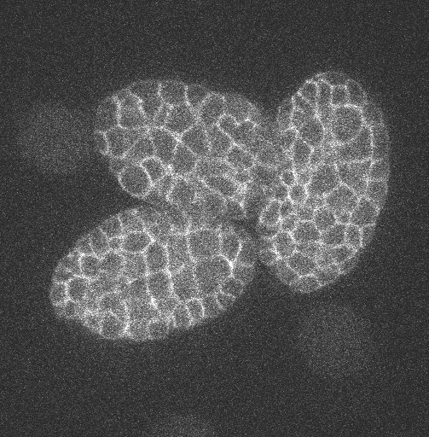
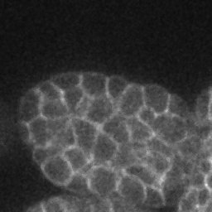
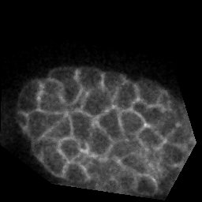
New dataset
Rectangle crop
Polygon crop

Slide 3
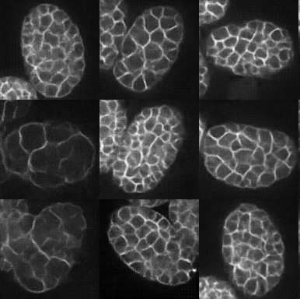
Generated Images
Generated

Slide 4
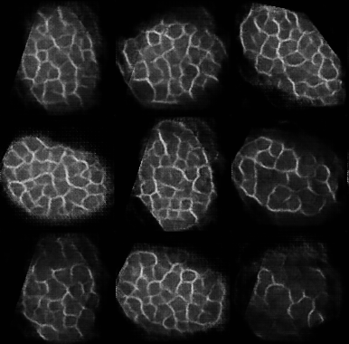
Generated Images
Generated

