Slide 1
Back ground class bug
Zheng Lu

Slide 2
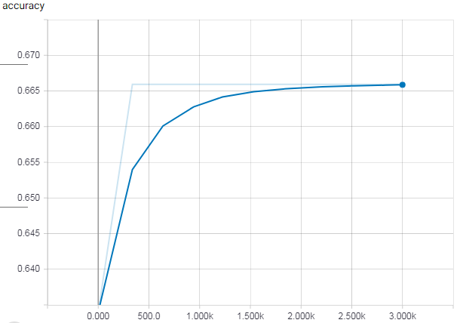
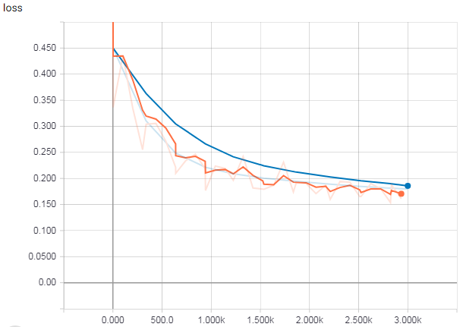

Training & Testing
The network does not seem to learn, as the accuracy merely changes. However, the loss keeps decreasing. This means that the network “thinks” it keeps learning and it learns very well.

Slide 3
Problems I found
When I change the ratio of non-rosettes to rosettes, the final accuracy of the network also changes. If I use 1:1, the final accuracy is 50%. If I use 2:1, the final accuracy is 66.7%
Then by output the prediction results, I found that the network always output one hot label of [0, 1], that indicate the class of non-rosette.

Slide 4
The bug – back ground
Some back ground of the program:
Tensorflow use a special data format (tfrecord) as input to improve the performance of reading the data when training on large dataset.
Labels (non-rosette, rosette) are first map to integers (0, 1) and then map to one hot labels ([1, 0], [0, 1])

Slide 5
The bug
REASON: Inconsistent interface of different part of program.
There is a popular script from Google that convert image files (jpg) to tensorflow data format (tfrecord).
It will silently add a back ground class that is represented by integer 0. So our in case, non-rosette is represented by 1, and rosette is represented by 2.
However, when performing one-hot encoding, I set the number of class to 2. So non-rosette class will have wrong label [0, 1] (should be [1, 0]), and rosette class will have wrong label of [0, 0] (shuold be [0, 1]).
The network input is also two value that forms a probability density, meaning that they are two float number adds up to 1. Based on the higher value, the network predict the class of the input image. For example, if network output is [0.57, 0.43], then the predicted label is [1, 0]
The problem is, the network will never output the label of [0, 0]. So, this cause the network always output the label [1, 0], which representing non-rosette class, as that is the only valid label it has ever seen.

Slide 6
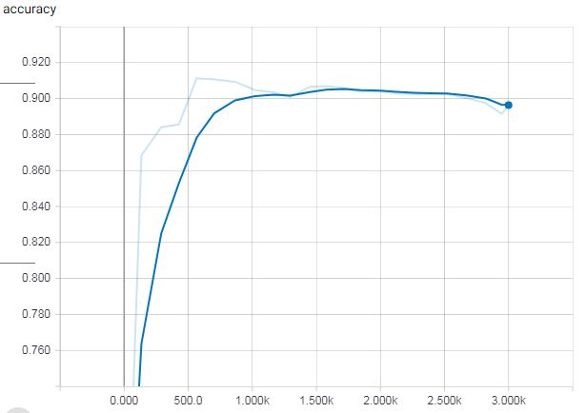
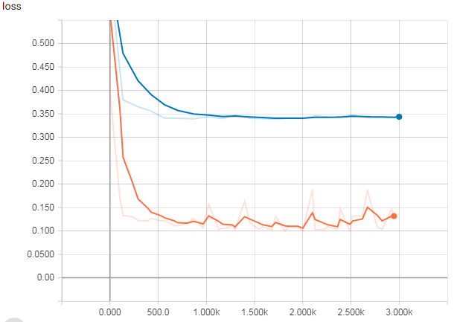

After correcting the bug
After fix the bug in the label, the network can really learn from the dataset and have pretty high accuracy

Slide 7
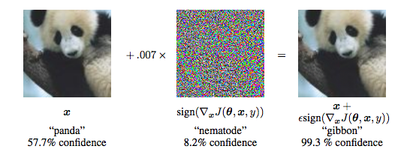
Back ground class
So what is the purpose of this “back ground class” that the script has silently added.
Neural networks are robust to natural noises such as blurry or rotation, but are very vulnerable to artificial noises.
Back ground class is introduce to add fooling images with well designed artificial noises to make the network more robust to this kind of noises !

