Slide 1
Rosette classifier
Zheng Lu

Slide 2
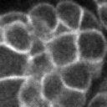
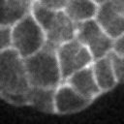
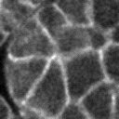
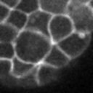
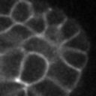
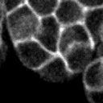
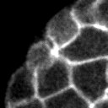
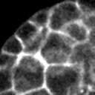
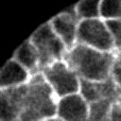
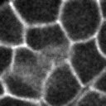
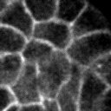
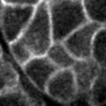
Manually prepare the data
Only cut a small portion (128 x 128) of each image data (2014 x 512)
Manually processed 12 embryos
In total we have 67 images with rosettes and 134 images without rosettes
I split the dataset into 150 images as training set, 51 images as testing set. Both sets have 1:2 rosettes to non-rosettes images ratio.
rosettes
non-rosettes

Slide 3
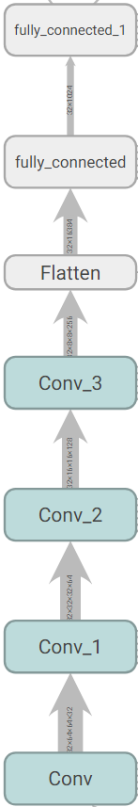
Create a simple convolutional network
Since we have such a small dataset, large networks can easily over-fit.
The number of parameters in our networks are: 1M / 76K
Compared to other famous networks structures:
VGG (classification): 140M parameters trained on 1.2M images
GNMT (translation): 380M parameters trained on 6M sentence pairs

Slide 4
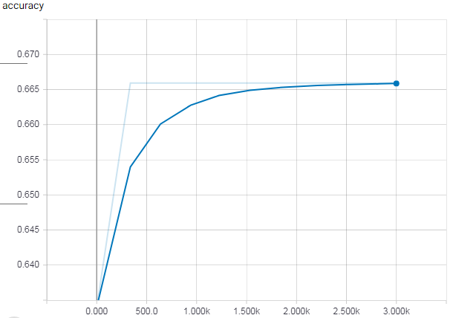
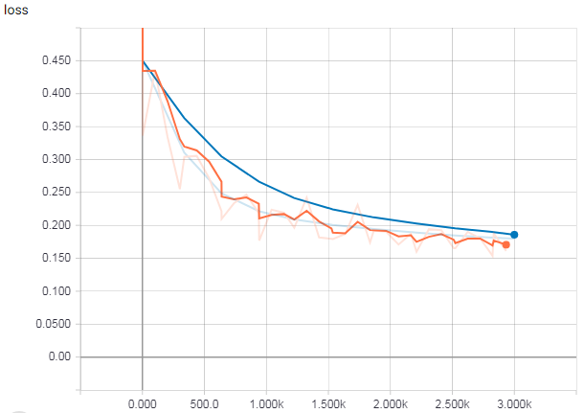

Training & Testing
The network does not seem to learn, as the accuracy merely changes. However, loss keeps decreasing.

Slide 5
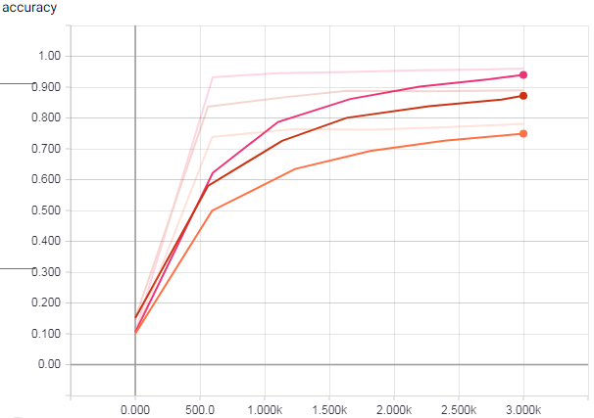
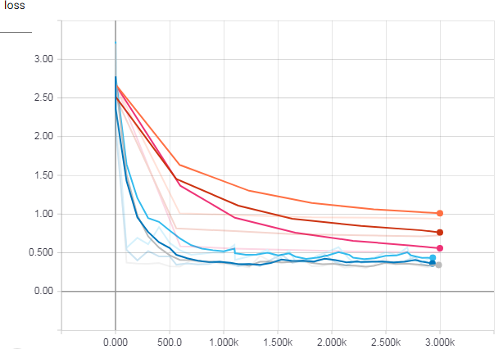
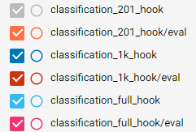
Same network structure (smaller) training & testing on MNIST hand-writting dataset

