Slide 1
Object detection
Zheng Lu

Slide 2
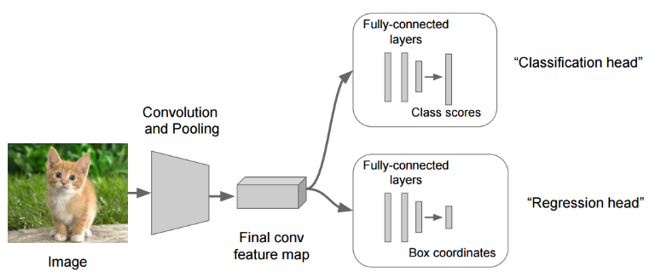
Object localization is regression problem
Regression is about returning a number instead of a class, in our case we're going to return 4 numbers (x0,y0,width,height) that are related to a bounding box.
You train this system with an image an a ground truth bounding box, and use L2 distance to calculate the loss between the predicted bounding box and the ground truth.

Slide 3
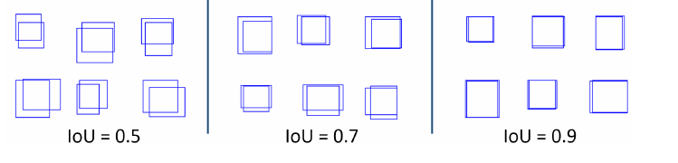
Compare bounding box prediction accuracy
Basically we need to compare if the Intersect Over Union (ioU) between the prediction and the ground truth is bigger than some threshold (ex > 0.5)

Slide 4
Sliding window object detection
One could perform detection by carrying out a classification on different sub-windows or patches or regions extracted from the image.
Most of the approaches vary on the type of methodology used for choosing the windows. Very slow and not efficient.

Slide 5
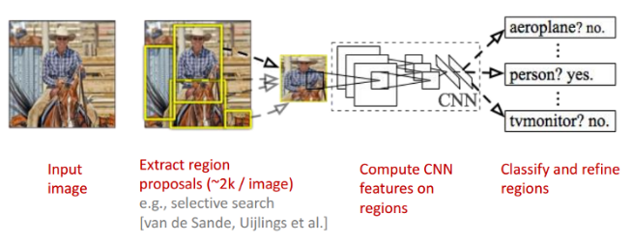
R-CNN
R-CNN therefore uses a object proposal algorithm like selective search in its pipeline which gives out a number(~2000) of TENTATIVE object locations and extents on the basis of local cues like color rgb, hsv etc.
The tricky part is feeding the appropriate regions labeled as background during the training of convolutional network.
Notes:
If random regions that do not have anything to do with the object classes are fed as background the network wont be able to distinguish between the object regions and regions which are partially containing the objects. Therefore regions which have an IOU greater than 0.5 with the objects are marked with class of that object and those with overlap < 0.3 are marked as background.

Slide 6
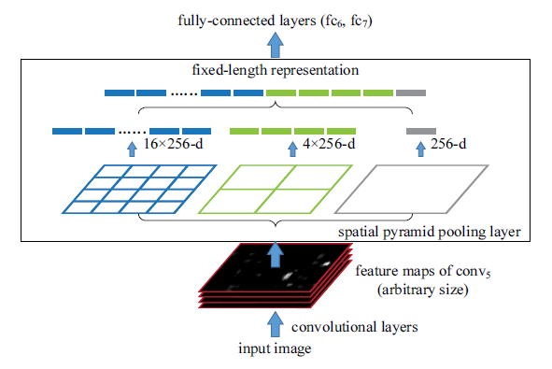
SPP(spatial pyramid pooling)
RCNN had to pass all the ~2000 regions from Selective Search independently through CNN and is therefore a very slow algorithm.
SPP allows the whole image(not individual regions but the whole image) to be passed through the convolutional layer only once.
PP solves this problem by replacing max pooling layer with spatial pooling layer. SPP layer divides a region of any arbitrary size into constant number of bins and max pool is performed on each of the bins.
Notes:
This saves a lot of time because same patch may belong to multiple regions and convolutions on them are not calculated multiple time as done in RCNN thereby enabling a shared computation of conv layers among the regions.
After passing the image through conv layers, independent feature need to be calculated for each of the regions generated by SS. This can be done by performing a pooling type of operation on JUST that section of the feature maps of last conv layer that corresponds to the region.
The training windows for positive and negative samples are chosen in the same manner as RCNN. The only difference in SPP net is that since windows of arbitrary size are used for pooling operation, back-propagation through SPP layer and finetuning the network end-to-end is not trivial and therefore SPP net finetunes just FC part of the network and gradients are not propagated across the SPP layer. The second part follows on the same lines as RCNN wherein it fits a linear regression layer for localization on top of conv5 layers.

Slide 7
Fast RCNN
Still SPP has certain downsides that it does not use the full potential of CNN because training is not end-to-end.
Fast RCNN tackles the downsides by installing the net with the capacity to back-propagate the gradients from FC layer to conv. layers.
Second major change is a single network with two loss branches pertaining to soft-max classification and bounding box regression. This multitask objective is a salient feature of Fast-rcnn as it no longer requires training of the network independently for classification and localization.
In the pipeline of fast-rcnn, the slowest part is generating regions from SS(~2s) or edgeboxes(~0.2s). Faster-RCNN replaces SS with CNN itself for generating the region proposals(called RPN-region proposal network) which gives out tentative regions at almost negligible amount of time.
Notes:
All these methods concentrate on increasing the run-time efficiency of object detection without compromising on the accuracy. Faster-Rcnn has become a state-of-the-art technique which is being used in pipelines of many other computer vision tasks like captioning, video object detection, fine grained categorization etc.

Slide 8
YOLO (you only look once)
Prior detection systems repurpose classifiers or localizers to perform detection. They apply the model to an image at multiple locations and scales. High scoring regions of the image are considered detections.
We use a totally different approach. We apply a single neural network to the full image. This network divides the image into regions and predicts bounding boxes and probabilities for each region. These bounding boxes are weighted by the predicted probabilities.
Our model has several advantages over classifier-based systems. It looks at the whole image at test time so its predictions are informed by global context in the image. It also makes predictions with a single network evaluation unlike systems like R-CNN which require thousands for a single image. This makes it extremely fast, more than 1000x faster than R-CNN and 100x faster than Fast R-CNN.

