Slide 1
Rosette classifier
Zheng Lu

Slide 2
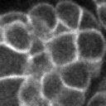
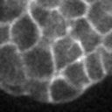
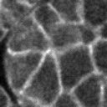
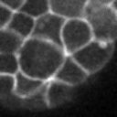
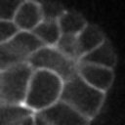
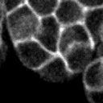
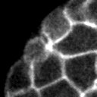
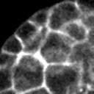
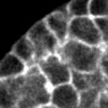
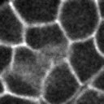
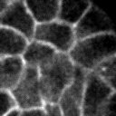
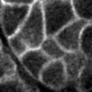
Manually prepare the data
Only cut a small portion (128 x 128) of each image data (2014 x 512)
Manually processed 12 embryos
In total we have 67 images with rosettes and 134 images without rosettes
I split the dataset into 150 images as training set, 51 images as testing set. Both sets have 1:2 rosettes to non-rosettes images ratio.
rosettes
non-rosettes

Slide 3
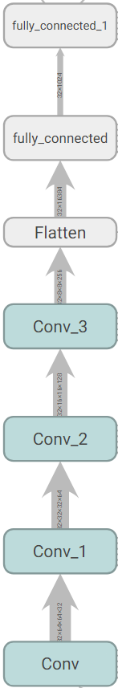
Create a simple convolutional network
Since we have such a small dataset, large networks can easily over-fit.
The number of parameters in our networks are: 1M
Compared to other famous networks structures:
VGG (classification): 140M parameters trained on 1.2M images
GNMT (translation): 380M parameters trained on 6M sentence pairs

Slide 4
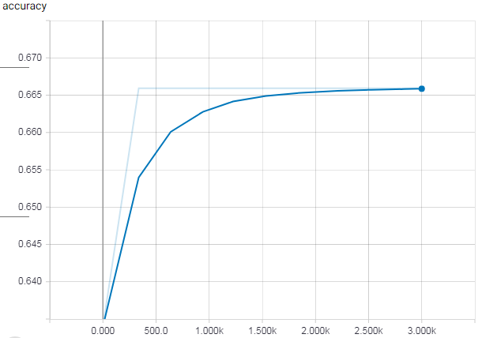
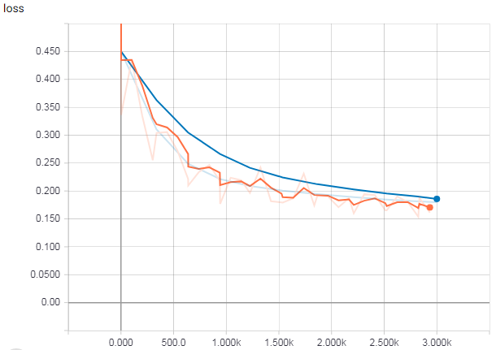

Training & Testing
The network does not seem to learn, as the accuracy merely changes. However, loss keeps decreasing.

Slide 5
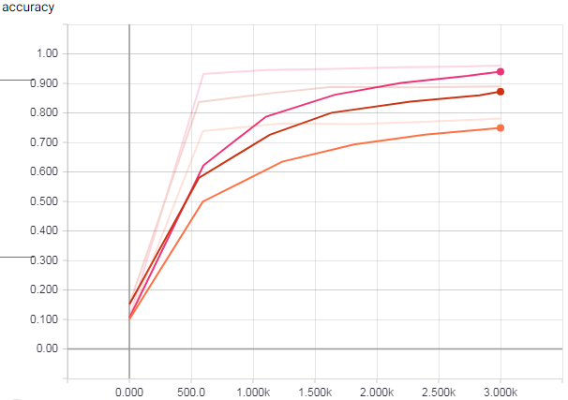
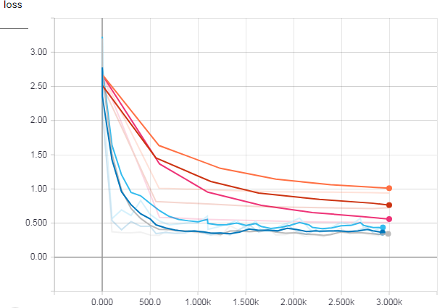
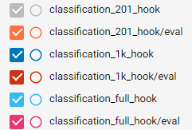
Same network structure (smaller) training & testing on MNIST hand-writting dataset

Slide 6
Interface bug
When I change the ratio of non-rosettes to rosettes, the final accuracy of the network also changes. If I use 1:1, the final accuracy is 50%. If I use 2:1, the final accuracy is 66.7%
Then by output the prediction results, I found that the network always output one hot label of [0, 1], that indicate the class of non-rosette.
The bug is caused by interface mismatch in 3rd party scripts.

Slide 7
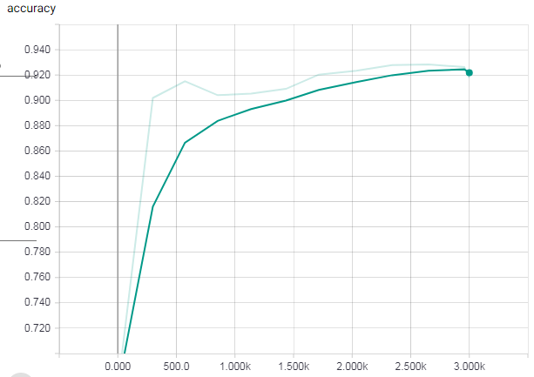
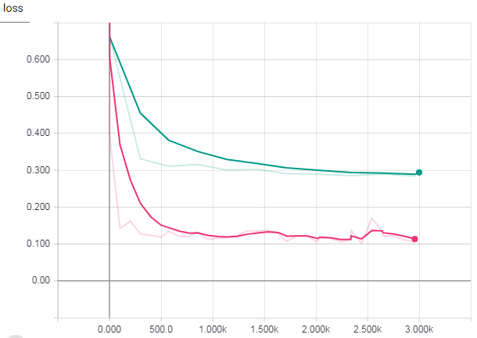

Training & Testing after fix the bug
The network seems to train correctly. However, the 90% accuracy suggest great similarity in both train and testing

Slide 8
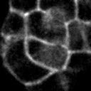
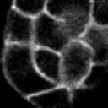
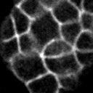
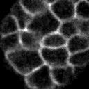
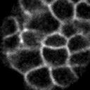
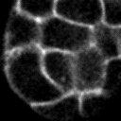
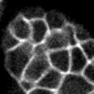
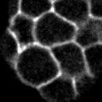
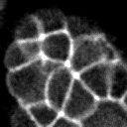
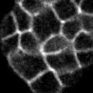
Discover rosettes in new inputs
Input randomly selected 124 images from 4 celegans at time slides from 70 to 100.
36 images are classified as having rosettes, in which I found 10 of them having rosettes (10 images of 3 rosettes).
Normally in this time period, I can find 2 – 12 rosette images in a single celegans. However, I don’t exam a particular area, I exam the whole celegans.
Samples I can find rosettes
Samples I cannot find rosettes

Slide 9
Next step
Generate a dataset and increase the performance.
However, the network only works with images of parts of celegans.
Classification and detection.
Find the location of the cells.
Use the classifier to help the training of GAN. For example, let GAN generate images with rosettes.

