Slide 1
Rosette classifier prediction result analysis
Zheng Lu

Slide 2
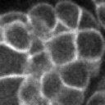
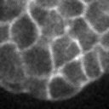
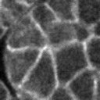
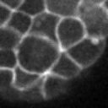
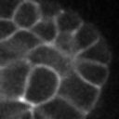
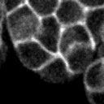
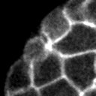
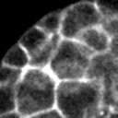
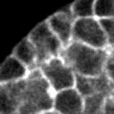
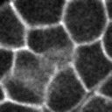
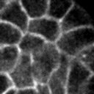
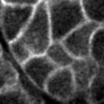
Manually prepare the data
Only cut a small portion (128 x 128) of each image data (2014 x 512)
In total we have 67 images with rosettes and 134 images without rosettes from 12 embryos.
I split the dataset into 150 images as training set, 51 images as testing set. Both sets have 1:2 rosettes to non-rosettes images ratio.
For prediction, I randomly selected 124 images from 4 new embryos at time slides from 70 to 100.
rosettes
non-rosettes

Slide 3
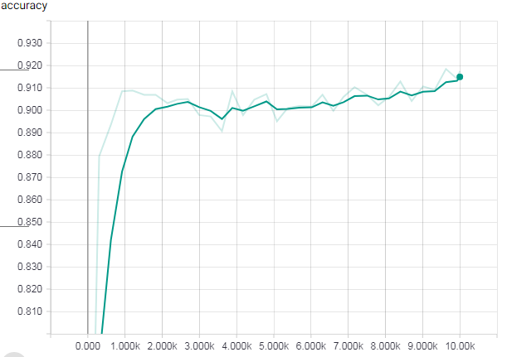
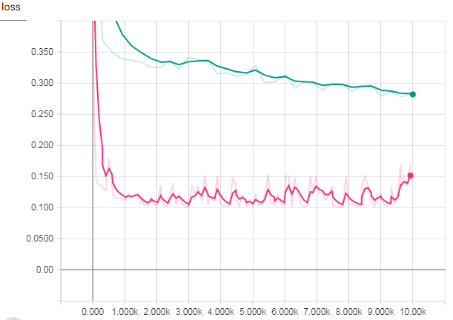

Training & Testing Performance
The network seems to train correctly. However, the 90% accuracy suggest great similarity in both train and testing

Slide 4
Prediction result analysis
Input randomly selected 124 images from 4 celegans at time slides from 70 to 100.
36 images are classified as having rosettes. 88 images are classified as not having rosettes.
After manually verified, I found the following stats:
Stats for images classified as having rosettes:
Definitely having ros: 4
Probably having ros: 15
Not likely having ros: 17
Stats for images classified as not having rosettes:
Definitely having ros: 3
Probably having ros: 17
Not likely having ros: 68
If we count “probably having ros” as having rosette, then we have accuracy of 70%
If we count “probably having ros” as not having rosette, then we have accuracy of 72%

Slide 5
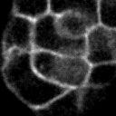
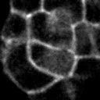
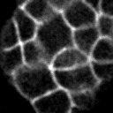
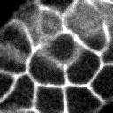
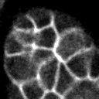
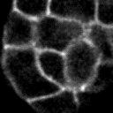
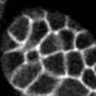
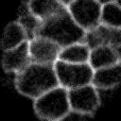
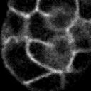
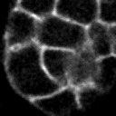
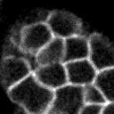
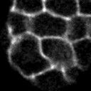
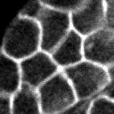
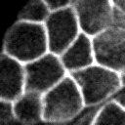
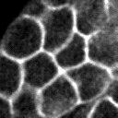
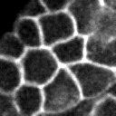
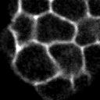
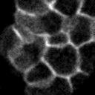
Manually verification details - Images classified as having rosettes
Definitely having ros
Stats for images classified as having rosettes:
Definitely having ros: 4
Probably having ros: 15
Not likely having ros: 17
Probably having ros
Not likely having ros

Slide 6
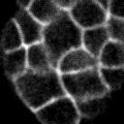
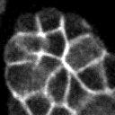
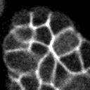
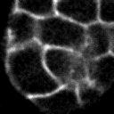
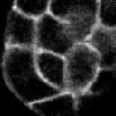
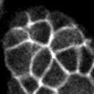
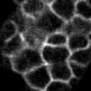
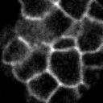
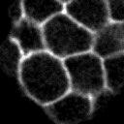
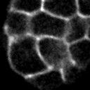
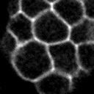
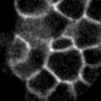
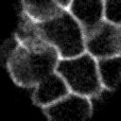
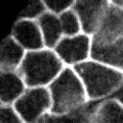
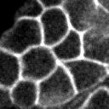
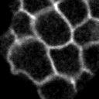
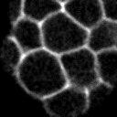
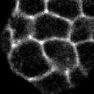
Manually verification details - Images classified as having rosettes (continued…)
Definitely having ros
Probably having ros
Not likely having ros

Slide 7



























Manually verification details - Images classified as not having rosettes
Stats for images classified as not having rosettes:
Definitely having ros: 3
Probably having ros: 17
Not likely having ros: 68
Definitely / Probably having ros
Not likely having ros

Slide 8































Manually verification details - Images classified as not having rosettes (continued…)
Definitely / Probably having ros
Not likely having ros

Slide 9





























Manually verification details - Images classified as not having rosettes (continued…)
Definitely / Probably having ros
Not likely having ros

Slide 10

Adding data augmentation
Orange is with data augmentation
4 kinds of data augmentation are added.
Randomly flip upside down
Randomly flip left to right
Randomly adjust brightness in a small range (12.5%)
Randomly adjust contrast in the range of [50%, 150%]

Slide 11


New dataset and Different network size
Green network size is smaller than blue network size.

