Slide 1
Rosette classifier prediction result analysis and future work
Zheng Lu

Slide 2
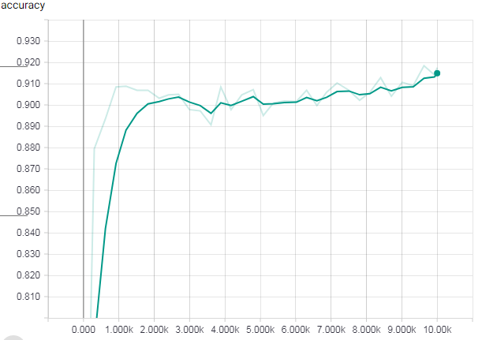
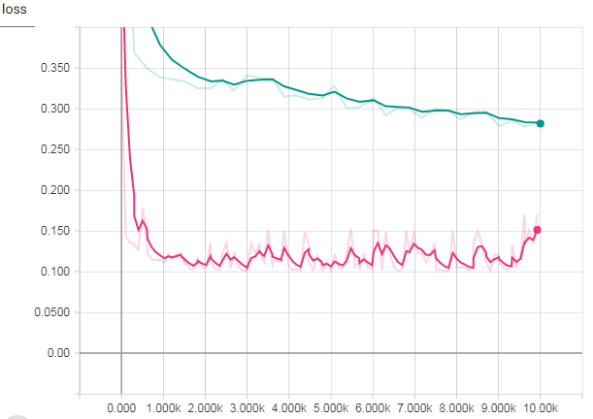

Previous Training & Testing Performance
The network seems to train correctly. However, the 90% accuracy suggest great similarity in both train and testing

Slide 3
Prediction result analysis
Input randomly selected 124 images from 4 celegans at time slides from 70 to 100.
36 images are classified as having rosettes. 88 images are classified as not having rosettes.
After manually verified, I found the following stats:
Stats for images classified as having rosettes:
Definitely having ros: 4
Probably having ros: 15
Not likely having ros: 17
Stats for images classified as not having rosettes:
Definitely having ros: 3
Probably having ros: 17
Not likely having ros: 68
If we count “probably having ros” as having rosette, then we have accuracy of 70%. Both precision and recall of rosettes are around 50%.
If we count “probably having ros” as not having rosette, then we have accuracy of 72%. Precision in this case is very low at around 10%. Recall is around 60%.

Slide 4
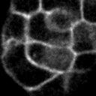
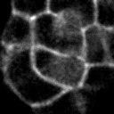
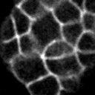
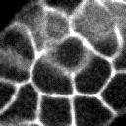
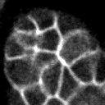
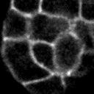
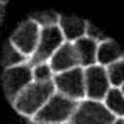
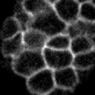
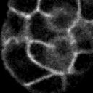
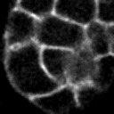
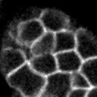
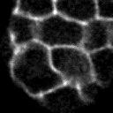
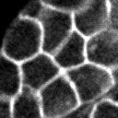
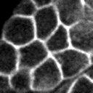
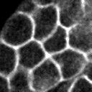
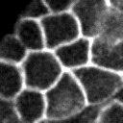
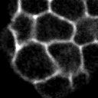
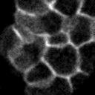
Manually verification details - Images classified as having rosettes
Definitely having ros
Stats for images classified as having rosettes:
Definitely having ros: 4
Probably having ros: 15
Not likely having ros: 17
Probably having ros
Not likely having ros

Slide 5
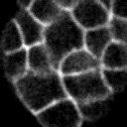
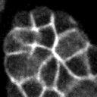
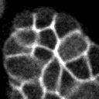
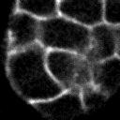
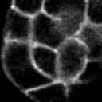
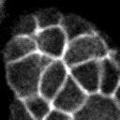
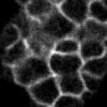
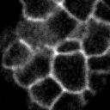
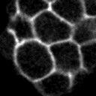
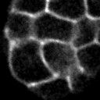
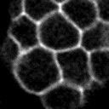
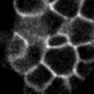
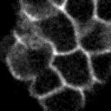
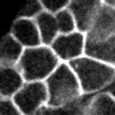
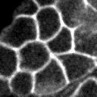
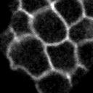
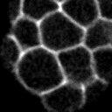
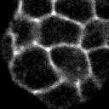
Manually verification details - Images classified as having rosettes (continued…)
Definitely having ros
Probably having ros
Not likely having ros

Slide 6
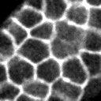
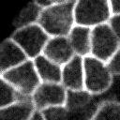
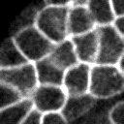
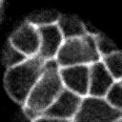
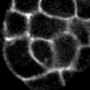
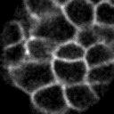
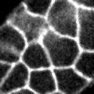
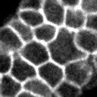
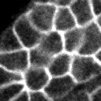
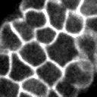
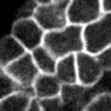
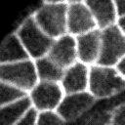















Manually verification details - Images classified as not having rosettes
Stats for images classified as not having rosettes:
Definitely having ros: 3
Probably having ros: 17
Not likely having ros: 68
Definitely / Probably having ros
Not likely having ros

Slide 7































Manually verification details - Images classified as not having rosettes (continued…)
Definitely / Probably having ros
Not likely having ros

Slide 8





























Manually verification details - Images classified as not having rosettes (continued…)
Definitely / Probably having ros
Not likely having ros

Slide 9

Adding data augmentation
Orange is with data augmentation
4 kinds of data augmentation are added.
Randomly flip upside down
Randomly flip left to right
Randomly adjust brightness in a small range (12.5%)
Randomly adjust contrast in the range of [50%, 150%]
Possible reason:
Dataset is too small

Slide 10




New dataset and Different network size
I use all 200 labeled data as training set, and then I manually labeled the 124-image prediction dataset as testing data. They are from different images sets so the similarity should be small.
Green network size is smaller than blue network size.

