Slide 1
Rosette classifier prediction result analysis and future work
Zheng Lu

Slide 2
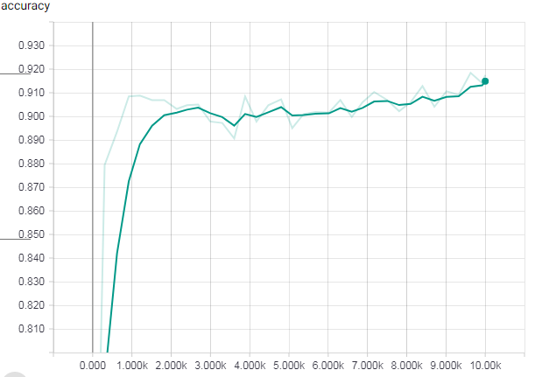
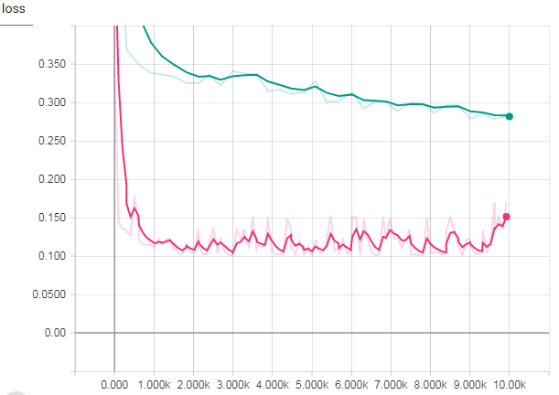

Previous Training & Testing Performance
The network seems to train correctly. However, the 90% accuracy suggest great similarity in both train and testing

Slide 3
Prediction result analysis
Input randomly selected 124 images from 4 celegans at time slides from 70 to 100.
36 images are classified as having rosettes. 88 images are classified as not having rosettes.
After manually verified, I found the following stats:
Stats for images classified as having rosettes:
Definitely having ros: 4
Probably having ros: 15
Not likely having ros: 17
Stats for images classified as not having rosettes:
Definitely having ros: 3
Probably having ros: 17
Not likely having ros: 68
If we count “probably having ros” as having rosette, then we have accuracy of 70%. Both precision and recall of rosettes are around 50%.
If we count “probably having ros” as not having rosette, then we have accuracy of 72%. Precision in this case is very low at around 10%. Recall is around 60%.

Slide 4
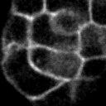
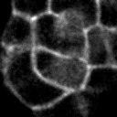
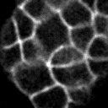
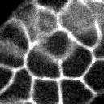
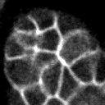
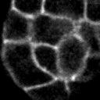
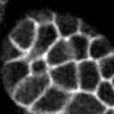
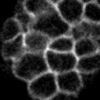
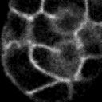
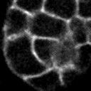
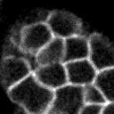
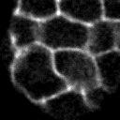
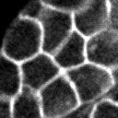
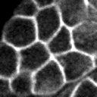
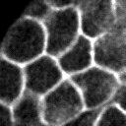
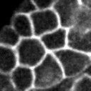
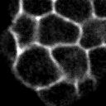
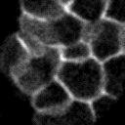
Manually verification details - Images classified as having rosettes
Definitely having ros
Stats for images classified as having rosettes:
Definitely having ros: 4
Probably having ros: 15
Not likely having ros: 17
Probably having ros
Not likely having ros

Slide 5
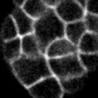
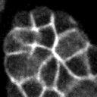
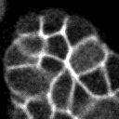
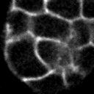
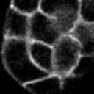
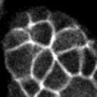
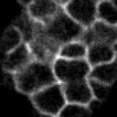
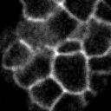
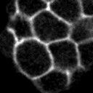
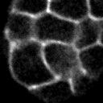
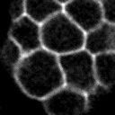
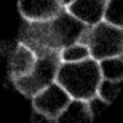
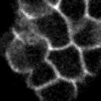
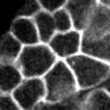
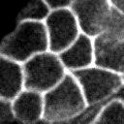
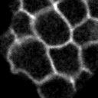
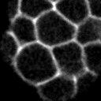
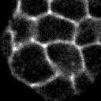
Manually verification details - Images classified as having rosettes (continued…)
Definitely having ros
Probably having ros
Not likely having ros

Slide 6
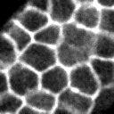
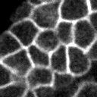
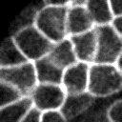
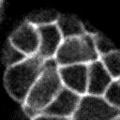
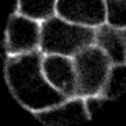
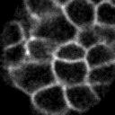
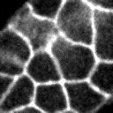
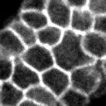
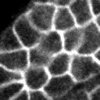
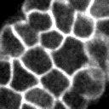
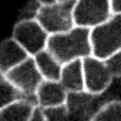
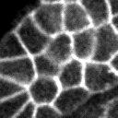















Manually verification details - Images classified as not having rosettes
Stats for images classified as not having rosettes:
Definitely having ros: 3
Probably having ros: 17
Not likely having ros: 68
Definitely / Probably having ros
Not likely having ros

Slide 7































Manually verification details - Images classified as not having rosettes (continued…)
Definitely / Probably having ros
Not likely having ros

Slide 8





























Manually verification details - Images classified as not having rosettes (continued…)
Definitely / Probably having ros
Not likely having ros

Slide 9

Adding data augmentation
Orange is with data augmentation
4 kinds of data augmentation are added.
Randomly flip upside down
Randomly flip left to right
Randomly adjust brightness in a small range (12.5%)
Randomly adjust contrast in the range of [50%, 150%]
Possible reason:
Dataset is too small

Slide 10




New dataset and Different network size
I use all 200 labeled data as training set, and then I manually labeled the 124-image prediction dataset as testing data. They are from different images sets so the similarity should be small.
Green network size is smaller than blue network size.

Slide 11


Transfer learning
GAN - Unsupervised learning
Classifier - Supervised learning

Slide 12

Object detection
Much harder problem
Use different window size at different location of the image to do classification. Network is harder to train.
Data require more effort to label

