Slide 1
Transfer learning
Zheng Lu

Slide 2
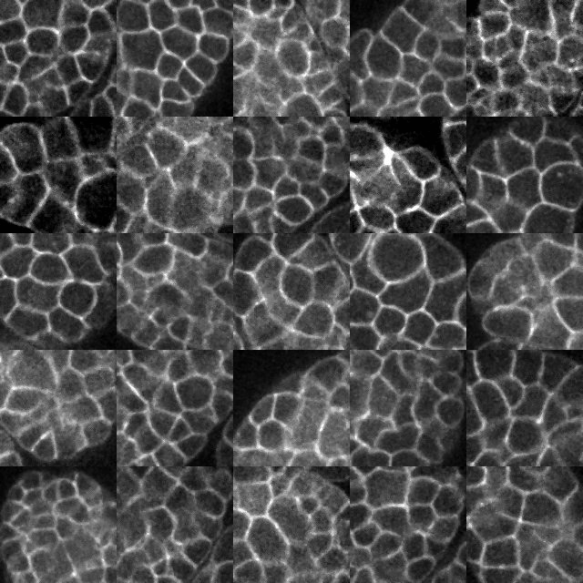
Unlabeled dataset for GAN training
In total of 45 embryos.
Cover time period from 61 to 110.
Cover slice from 9 to 13.
At each time period and each slice of a embryo, randomly select 1 image patch of size 128 x 128.
So each embryo has 5 * 50 = 250 random image patches.
In total we have 45 * 250 = 11250 image patches.

Slide 3
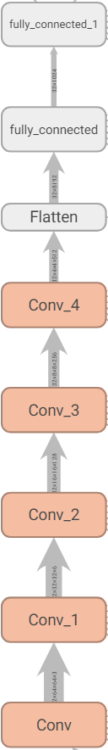
Training GAN on new dataset
Input noise dimension: 64
Activation for G and D: Relu for G, leaky relu for D
Batch norm: both G and D
Learning rate: 1e-4 for G and 1e-5 for D
Network size: symmetric G, D

Slide 4

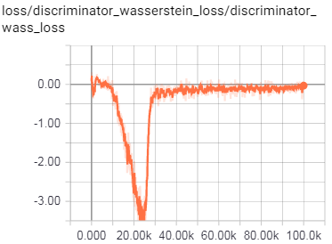
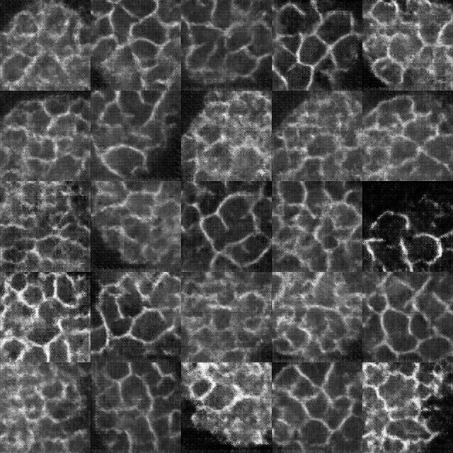
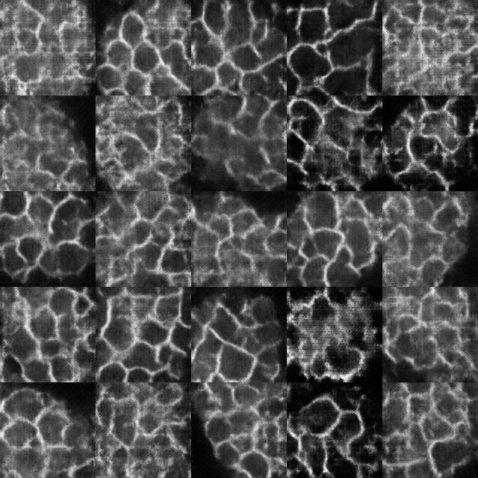
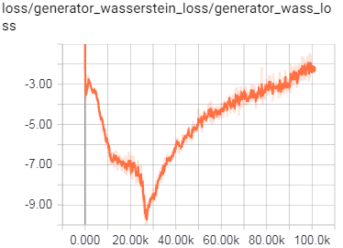
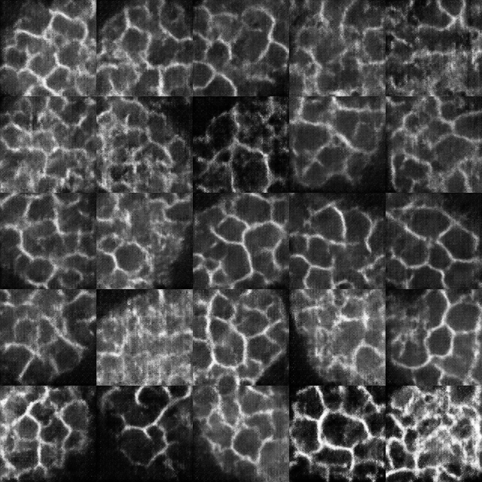
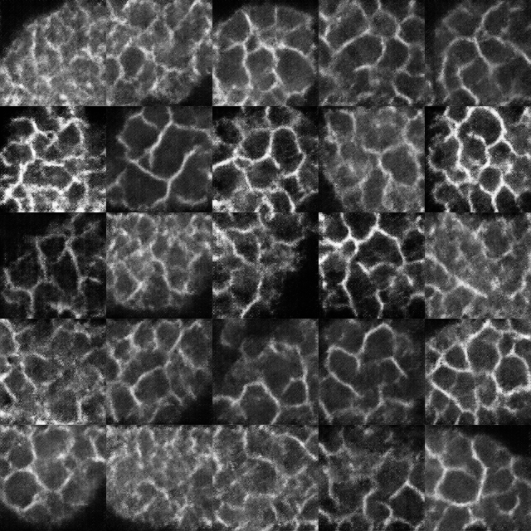
GAN training stats
58K
65K
D loss
G loss
72K
99K

Slide 5
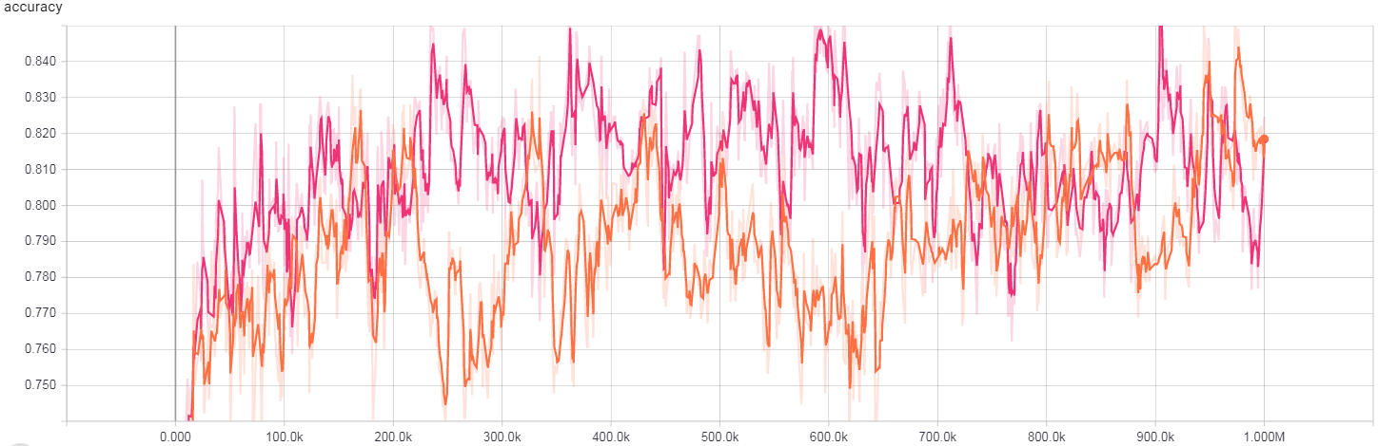

Transfer learning with learning rate 1e-4

Slide 6
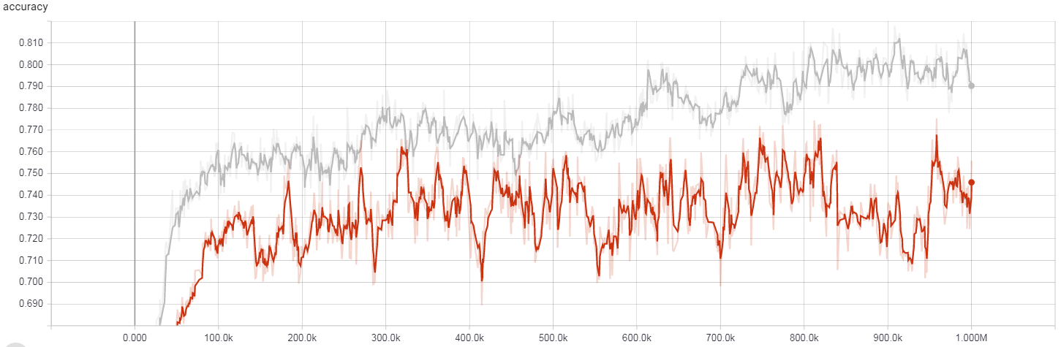

Transfer learning with learning rate 1e-5

