Slide 1
Generative Adversarial Networks
Zheng Lu
Notes:
My name is Zheng, PhD student in computer engineering.
Most figures in these slides is from online sources which I listed at the end of the slides.

Slide 2
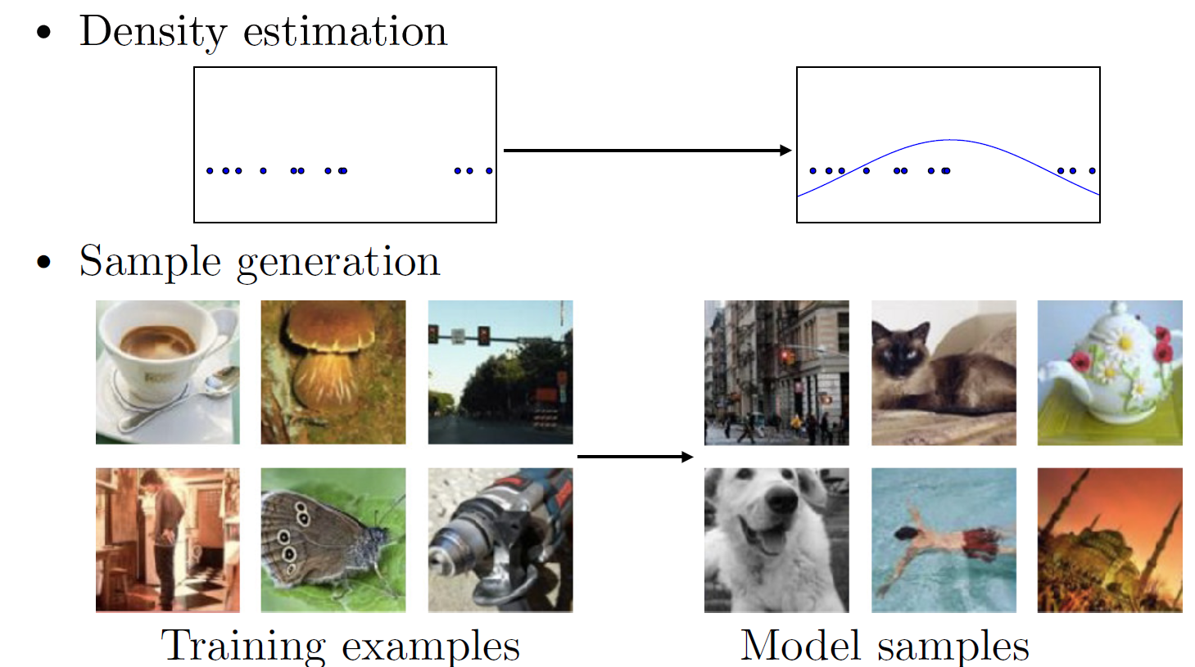
Generative model
Notes:
Generative model is given a training dataset, it will estimate the probability distribution of data, and then generate new samples from same distribution.
Why we use generative model
It’s because probability distribution of data PdataPdata might be a very complicated distribution and very hard or intractable to infer. So, having a generative machine that could generate samples from PdataPdata within same probability distribution is very nice. We could use it for another process that require sample from PdataPdata as we could get samples relatively cheaply using the trained Generative Net.

Slide 3
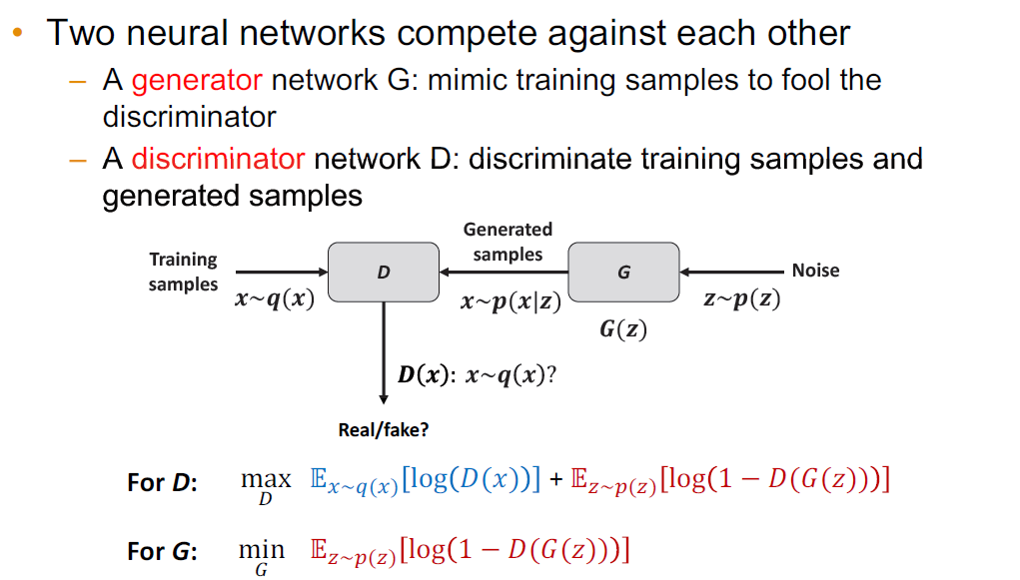
GAN – two competing networks
1
0
Notes:
2 parts, blue is output when input is training sample, red is inversed output when input is generated.
Real and fake represented by 1 and 0.
Let’s consider the rosy relationship between a money conterfeiting criminal and a cop.
the objective of the criminal is to fool the cop, so that the cop can’t tell the difference between counterfeited money and real money
The objective of the cop wants to detect counterfeited money as good as possible
This kind of situation could be modeled as a minimax game in Game Theory. And this process is called Adversarial Process.

Slide 4
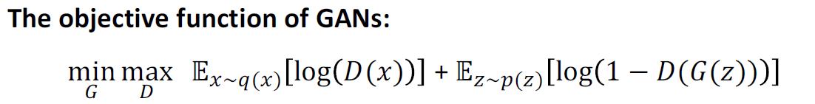
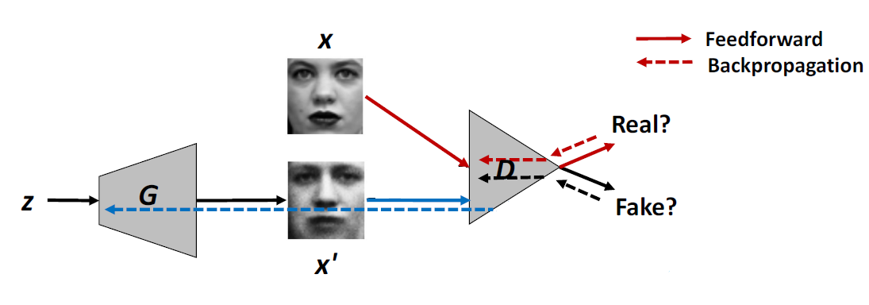
GAN – feedforward & backprop.
Notes:
We combine the object of both network and show the object of the minimax game here.
Here we have an example of a GAN that generate face images.
You can see a More clear structure of GAN
Z is Noise as the input of G here to ensure G can output different samples.
Use output of D to calculate the cost.
With the cost, the system can use back to update the parameters in both G and D.
GAN only define the structure of the network must have a generative network and a discriminative network.
The inside structure of each network is users to decide.

Slide 5
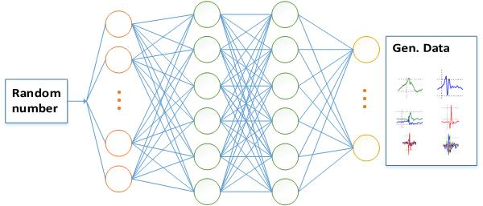
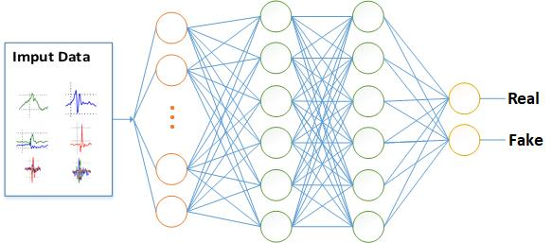
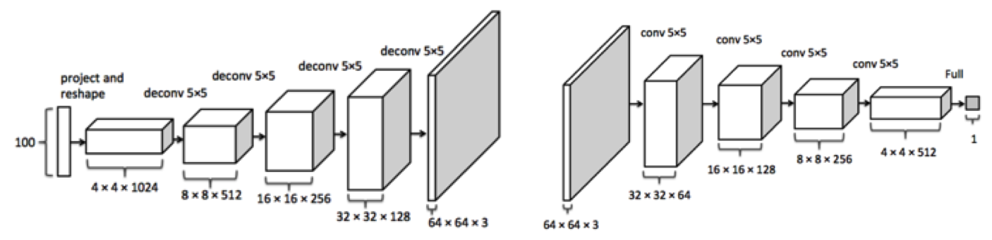
GAN – network structure
G
D
G
D
Notes:
It could be just a simplest multiple layer perceptron.
Different network structure are good for different kind of data.
Depends on the input data you want to generate samples for.
Or It could be convolutional/deconvolutional networks

Slide 6
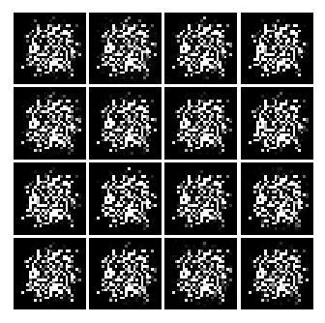
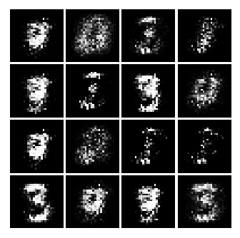
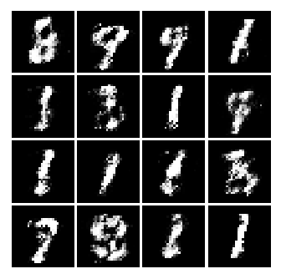
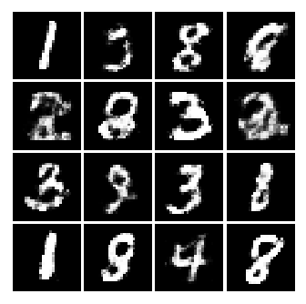
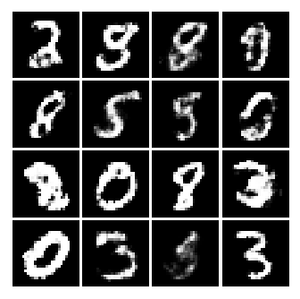
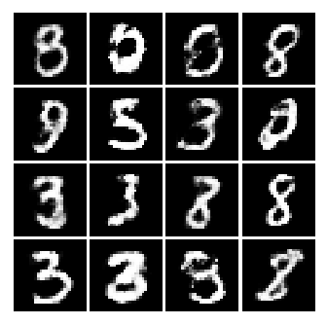
GAN – MNIST examples
1k batch
3k batch
10k batch
50k batch
100k batch
150k batch
Notes:
To show the how GAN gradually learns to generate samples. I did some experiments on the MNIST hand writing data with both G and D network are very simple multiple layer perception. It only has one hidden layer. For fast trains.
Each batch has 128 training images.
Due to the limitation of the structure of the network is very simple. Given a more complex network structure and more training time, you can expect to get more realistic images.

Slide 7
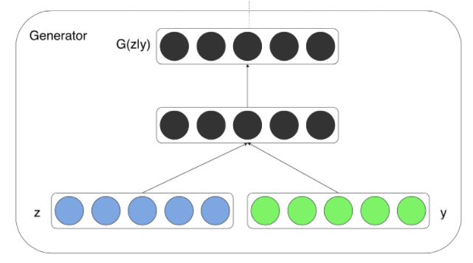
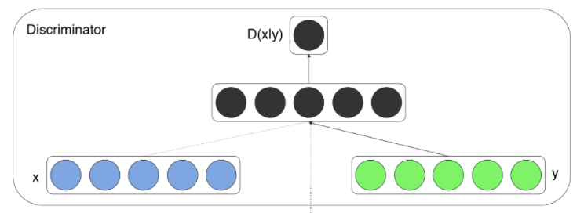
Conditional GAN
The input to G(z) is a random noise.
Now we want to condition generated samples with some vector y, e.g., generate hand writing image of a specific number.
Feed y to both networks: G(z) and D(X) -> G(z, y) and D(X, y), z is random noise, X is training data.
Notes:
A vector of random numbers.
Now, as we want to condition those networks with some vector yy, the easiest way to do it is to feed yy into both networks. Hence, our generator and discriminator are now G(z,y)G(z,y) and D(X,y)D(X,y) respectively.
It might be quite abstract, let me use a concrete example.

Slide 8


Conditional GAN – MNIST example (1)
One hot label
Random noise
1
8
z: 100 x 1
y: 10 x 1
Input of G:
x: 784 x 1
A vector of size 10
Real / Generated Image
y: 10 x 1
Input of D:
Notes:
Come back to MNIST example.
We have handwritten numbers of 10 classes in total.
Use a vector of size 10.
32x32 images.
For y, we just use the one hot label for each class and concatenated it to the random noise and the input image.

Slide 9
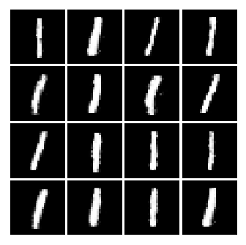
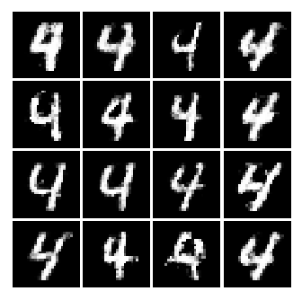
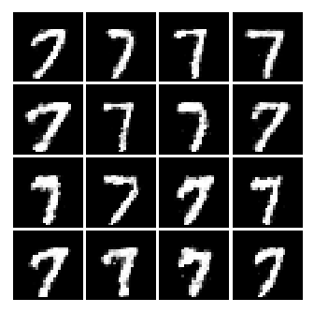
Conditional GAN – MNIST example (2)
y = one_hot(1)
y = one_hot(4)
y = one_hot(7)
Notes:
For y, we just use the one hot label for each class and concatenated it to the random noise and the input image.

Slide 10
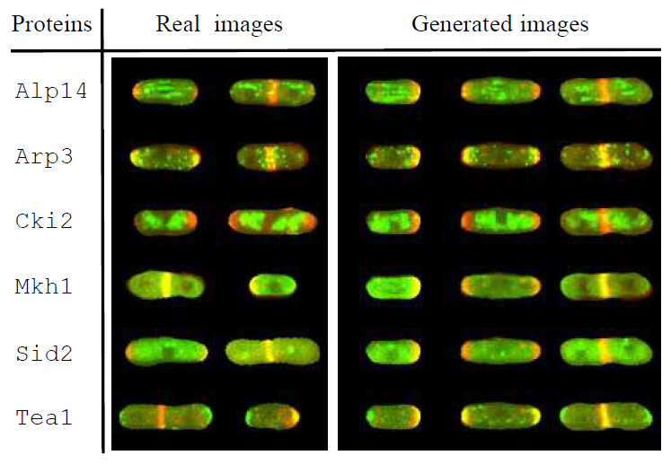
GAN example – Biological image
The application of GAN to the Synthesis of cells imaged by fluorescence microscopy
Notes:
Each image only contains 2 colors, or we call them channels: red and green.
Red represent to a specific protein, green represent one of 41 different kinds of proteins.
There are some correlation between red channel and green channel.

Slide 11
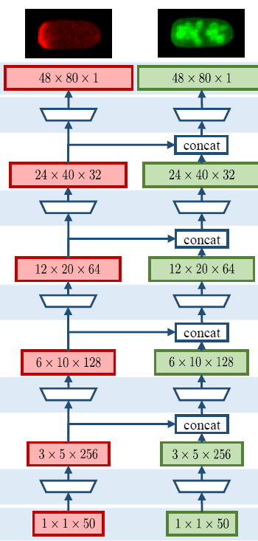
GAN example – network structure
Challenge: Each image can only use green color to label one (out of 41) protein by current biology technology.
Goal: use the common information contained in the red channel to learn how to generate a cell image with several of the green-labeled proteins together.
Structure of Generative network
Notes:
Generate each channel of image using a separate network.
They use output from each layer of the red channel output to feed into the network of green channel.\
By doing this, they can mimic the correlations between red channel and green channel.
To have multiple green channel with a single red channel, they use a star-shaped network: each green channel has it’s own network. And output from layers of red channel feeds into each of the green chennels’ networks.

Slide 12
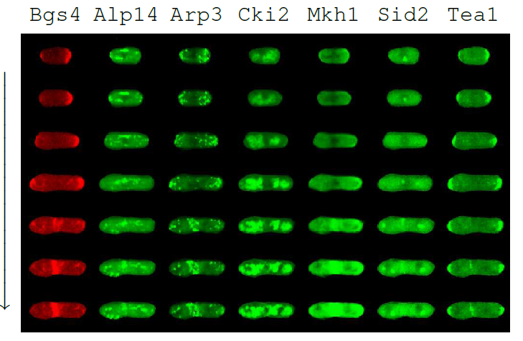
GAN example – generated images
Notes:
With the same red channel, you can have multiple green channel, each represents a different protein.

Slide 13
Existing problems of GAN
Mode missing problem
Generate unrealistic images
Hard to learn to generate discrete data, e.g. text data
Notes:
In the end, I want to talk about some existing problems of GAN.
These are the draw backs you need to care about.
An intuitive example is that …
Usually text data are embedded as discrete points in high dimensional spaces.

Slide 14
Reference
[1] http://web.eecs.utk.edu/~qi/deeplearning/lecture12-gan.pdf
[2] https://wiseodd.github.io/techblog/2016/09/17/gan-tensorflow/
[3] https://wiseodd.github.io/techblog/2016/12/24/conditional-gan-tensorflow/
[4] Mirza, Mehdi, and Simon Osindero. "Conditional generative adversarial nets." arXiv preprint arXiv:1411.1784 (2014).
[5] Osokin, Anton, et al. "Gans for biological image synthesis." 2017 IEEE International Conference on Computer Vision (ICCV). IEEE, 2017.
[6] Goodfellow, Ian. "NIPS 2016 tutorial: Generative adversarial networks." arXiv preprint arXiv:1701.00160 (2016).

Slide 15
Questions?

Slide 16
Thank you!

