Slide 1
Wasserstein GAN
Zheng Lu

Slide 2
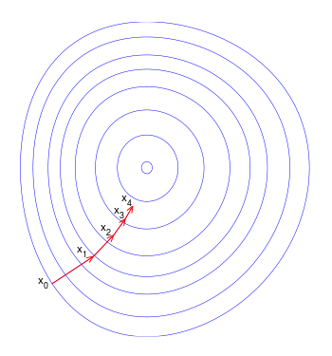
Gradient descent

Slide 3
The problem with vanilla GAN
Hard to train: Gradient vanishing for G when D is well trained. Why:
Low dimension (100) to high dimension (64x64)
Hardly have overlapping between two density function
Should not train D too well
Mode missing:
High cost when generate unreal sample
Low cost when failed to generate real sample
So, generate “safe” sample

Slide 4
Wasserstein Distance
Vanilla GAN use KL-divergence:
Optimal D will make gradient vanishing for G
G tries to find “safe” sample, lead to model missing
Wasserstein Distance:
Measure the effort of change one distribution to another distribution
Can provide meaningful gradient for G even with optimal D

Slide 5
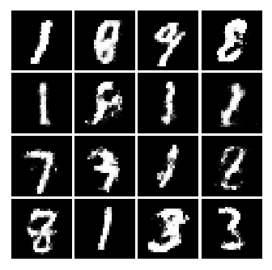
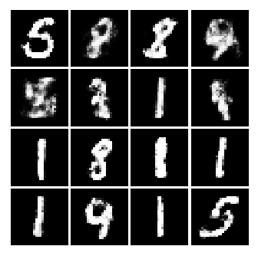
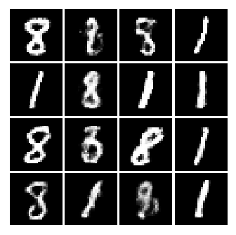
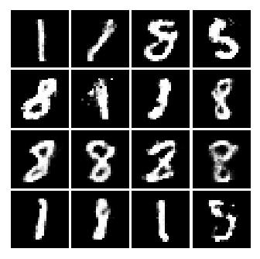
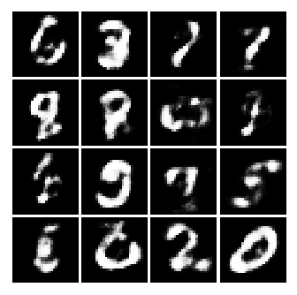
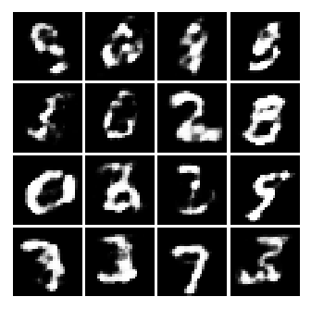
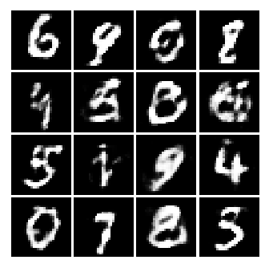
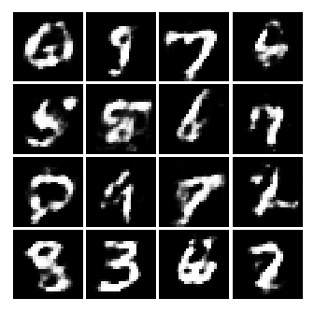
Vanilla GAN vs Wasserstein GAN
Vanilla GAN
Mode missing
Wasserstein GAN
Slow converge (cannot use momentum optimizer)
Training stage

Slide 6
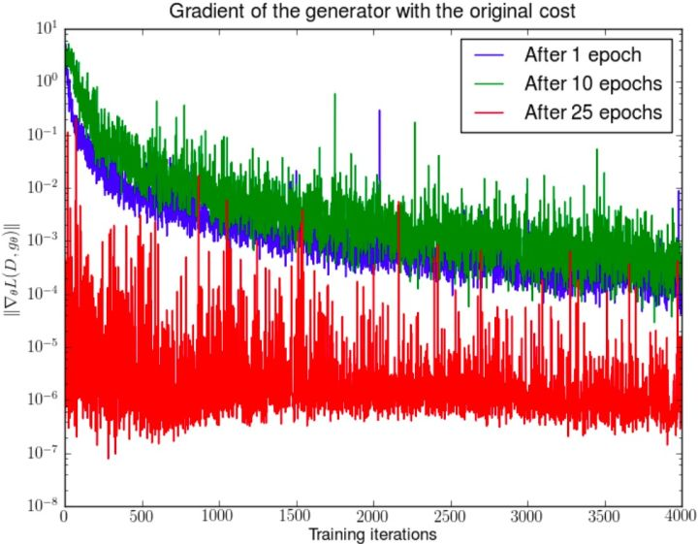
Gradient of G
Train GAN for certain epochs
Then we fix G and reinitialize D and train D from beginning

Slide 7
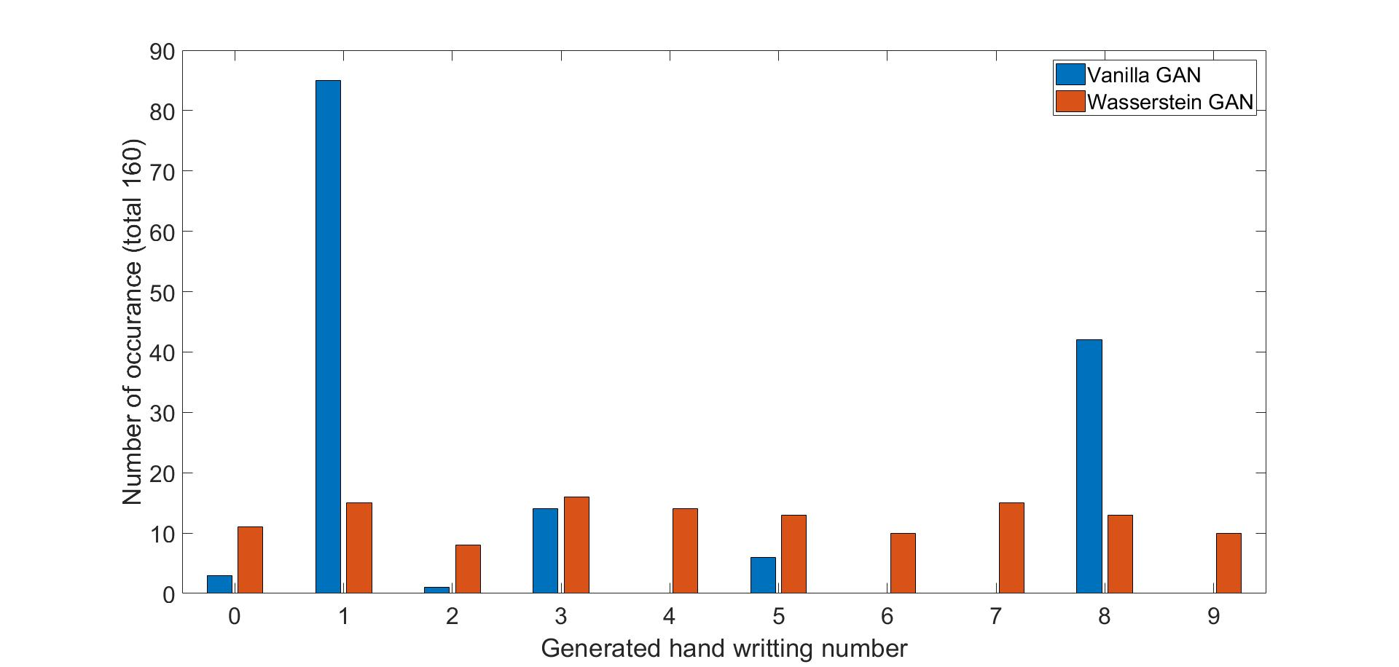
Mode Missing

Slide 8
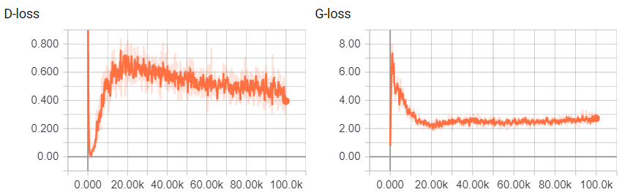
Vanilla GAN - 128

Slide 9
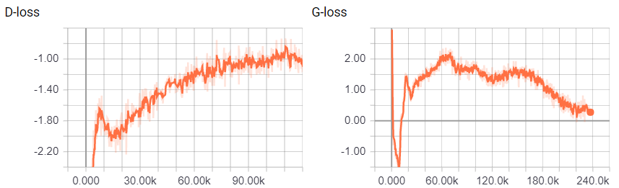
Wasserstein GAN - 128
Robust sign of training progress

Slide 10
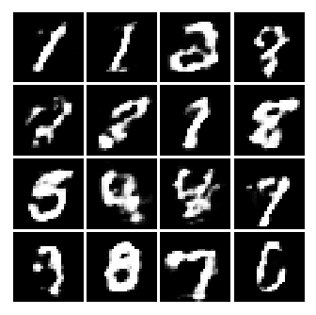
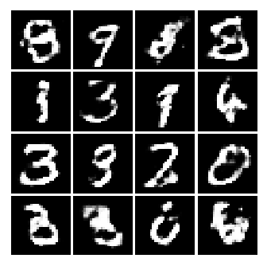
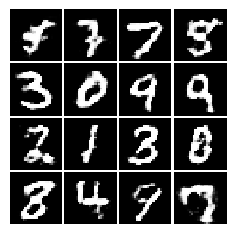
Wasserstein GAN after long training

Slide 11
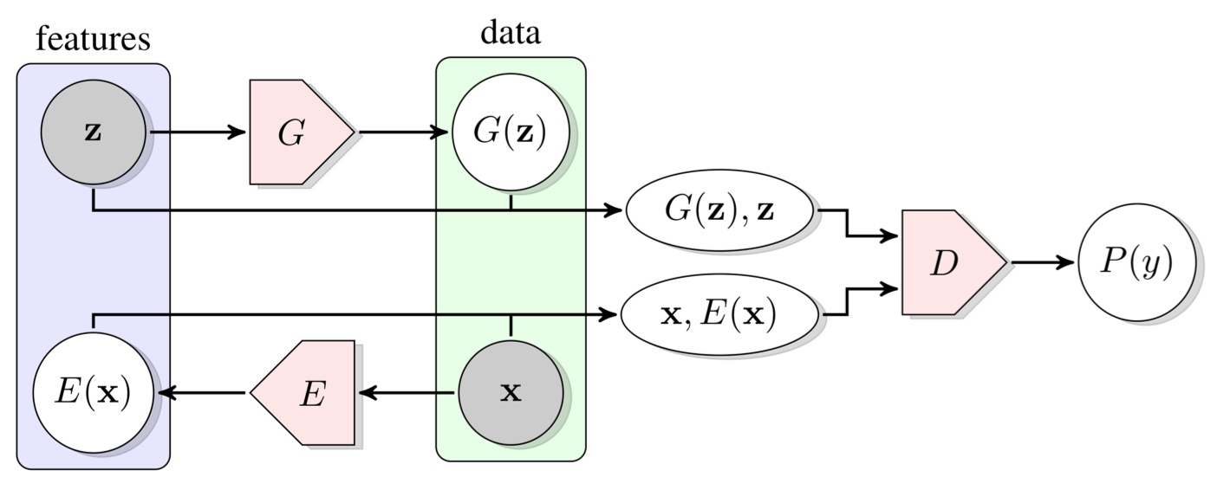
Recent improvements on GAN - BiGAN

Slide 12
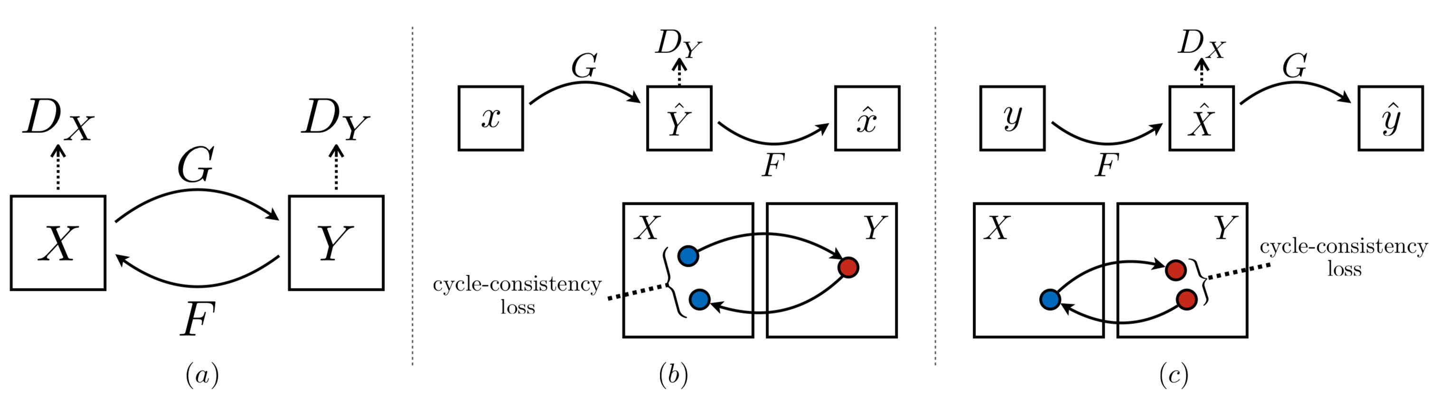
Recent improvements on GAN - CycleGAN
4 networks

Slide 13
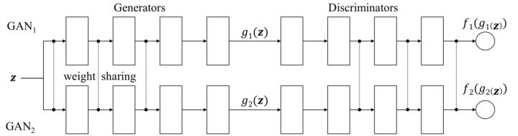
Recent improvements on GAN – Couple GAN

Slide 14
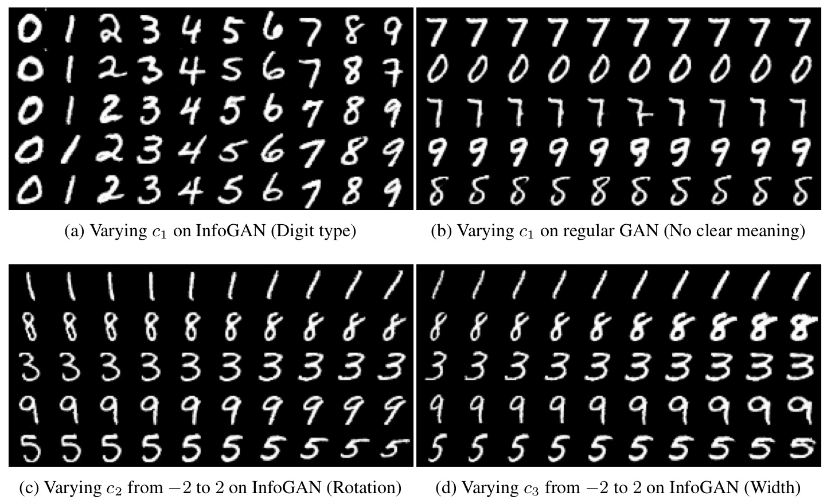
Recent improvements on GAN – Info GAN
Try to explain mapping input to generated sample

