Slide 1
APP chain and Road map

Slide 2
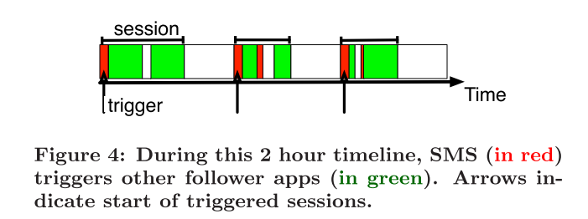
App chain
Triggers and followers:
[paper] Fast App Launching for Mobile Devices Using Predictive User Context

Slide 3
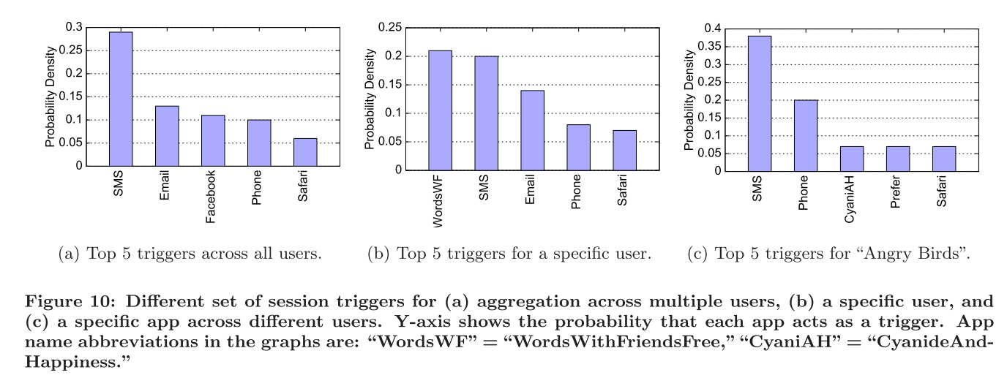
Top triggers

Slide 4
Triggers in our dataset
 | 0-20 km/h | 20-40 km/h | 40-60 km/h | 60-80km/h | 80-100km/h | All (including no speed sessions)
1st | 微信 | 微信 | 微信 | 微信 | 微信 | 微信
2nd | qq空间 | 腾讯数据分析 | qq空间 | qq空间 | 腾讯视频 | qq空间
3rd | 腾讯数据分析 | qq空间 | 腾讯视频 | 百度地图 | 网页浏览 | 腾讯数据分析
4th | 腾讯视频 | 腾讯视频 | 腾讯数据分析 | 腾讯数据分析 | qq空间 | 腾讯视频
5th | 网页浏览 | 网页浏览 | qq | qq | qq | 网页浏览
Settings: If there are no network access for 2 min before network access from one APP, count it as a trigger
Problem:
There are very few triggers
They may not be triggers due to real triggers may not use data, such as phone, SMS.

Slide 5
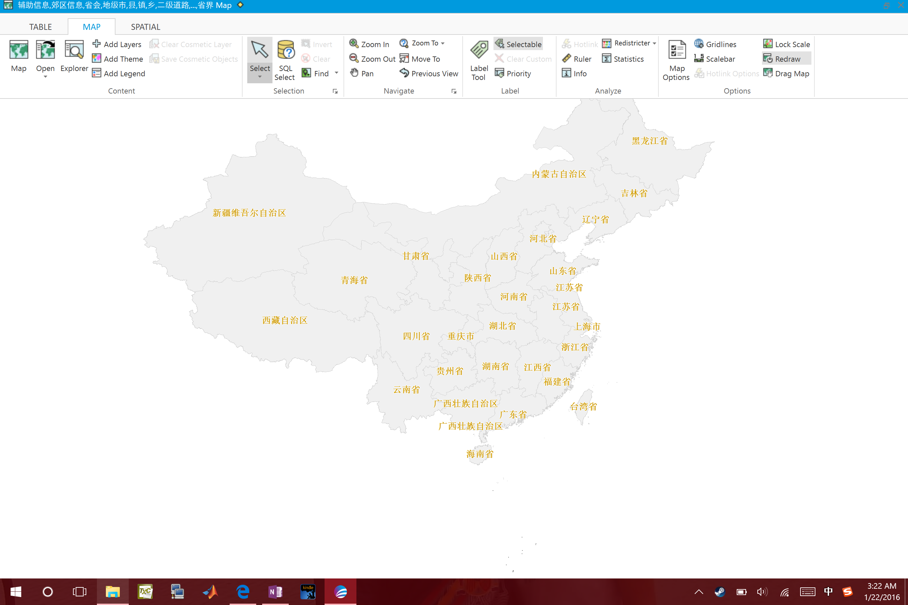
Road map

Slide 6
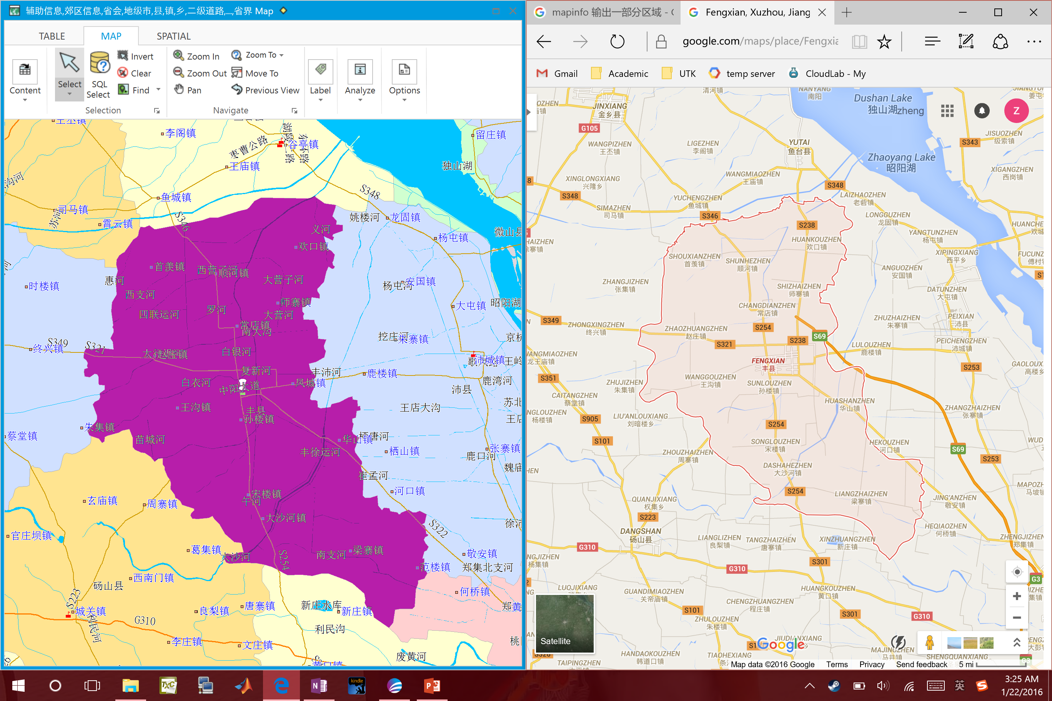
Contains city boundaries and roads

Slide 7
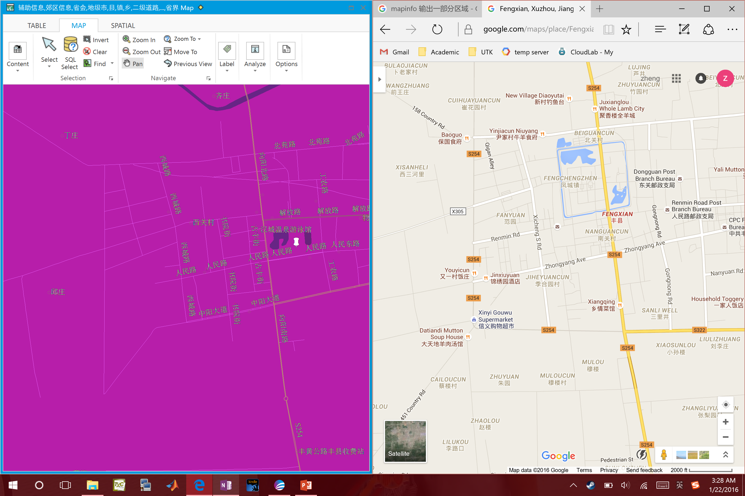
Missing some roads

Slide 8
Output formats
Road name: Gxxx
Seg 1 | Lat1 | Lng1
Seg 2 | Lat2 | Lng2
Seg 3 | Lat3 | Lng3
Seg 4 | Lat4 | Lng4
Seg 5 | Lat5 | Lng5

Slide 9
How can road help
Estimate distance: (Distance(towerA, towerB) + Distance(towerB, towerC)) /2 Shown in blue
Distance lower bound Distance(bound1, bound2) Shown in green
Actual road distance: Shown in purple

Slide 10
Why we need distance lower bound
User’s actual moving path is shown in red

