Slide 1
App chain and utilization of data

Slide 2
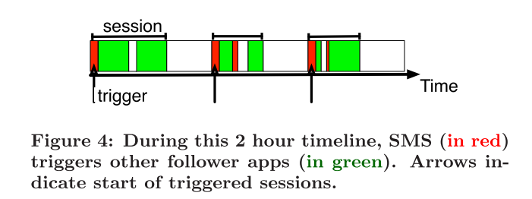
Trigger definition
Triggers and followers:
In our case, an app will be counted as a trigger when there are no network access before it for a period of time (i.e. 2min)

Slide 3
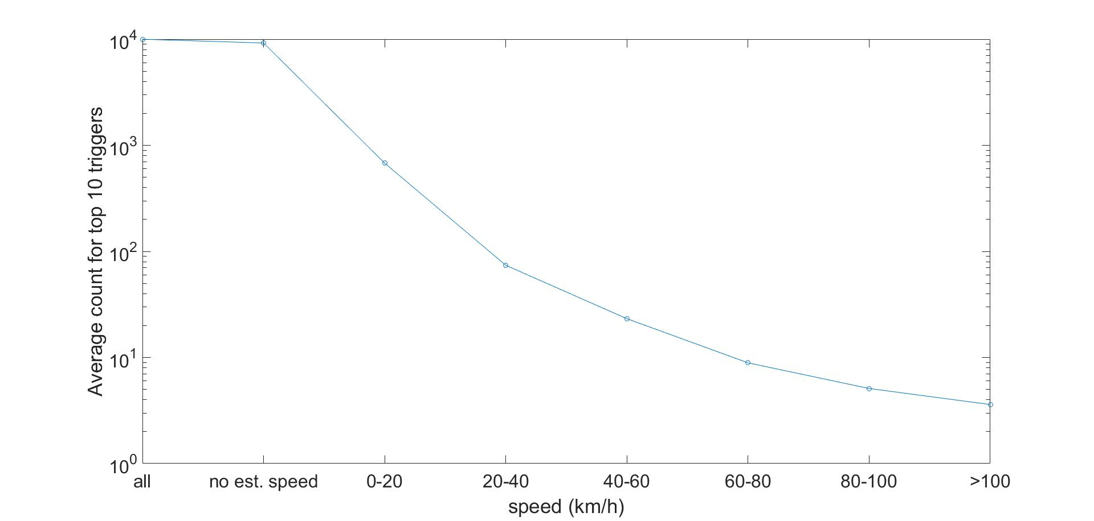
Too few triggers in high speed sessions

Slide 4
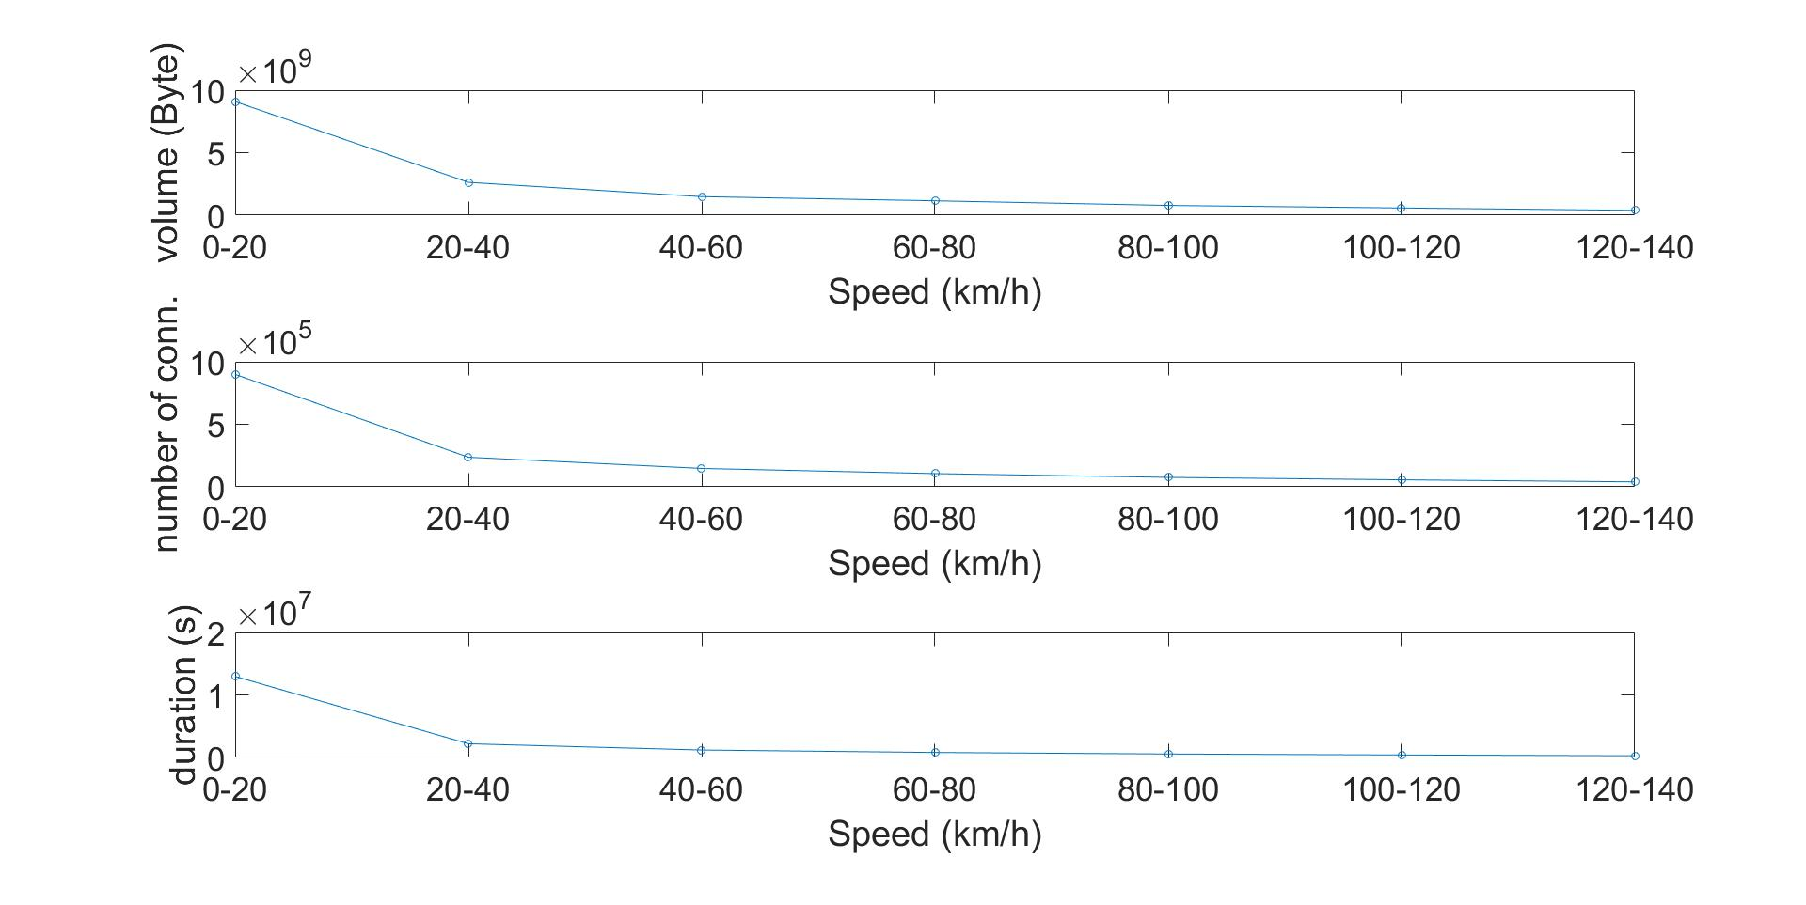
The amount of data

Slide 5
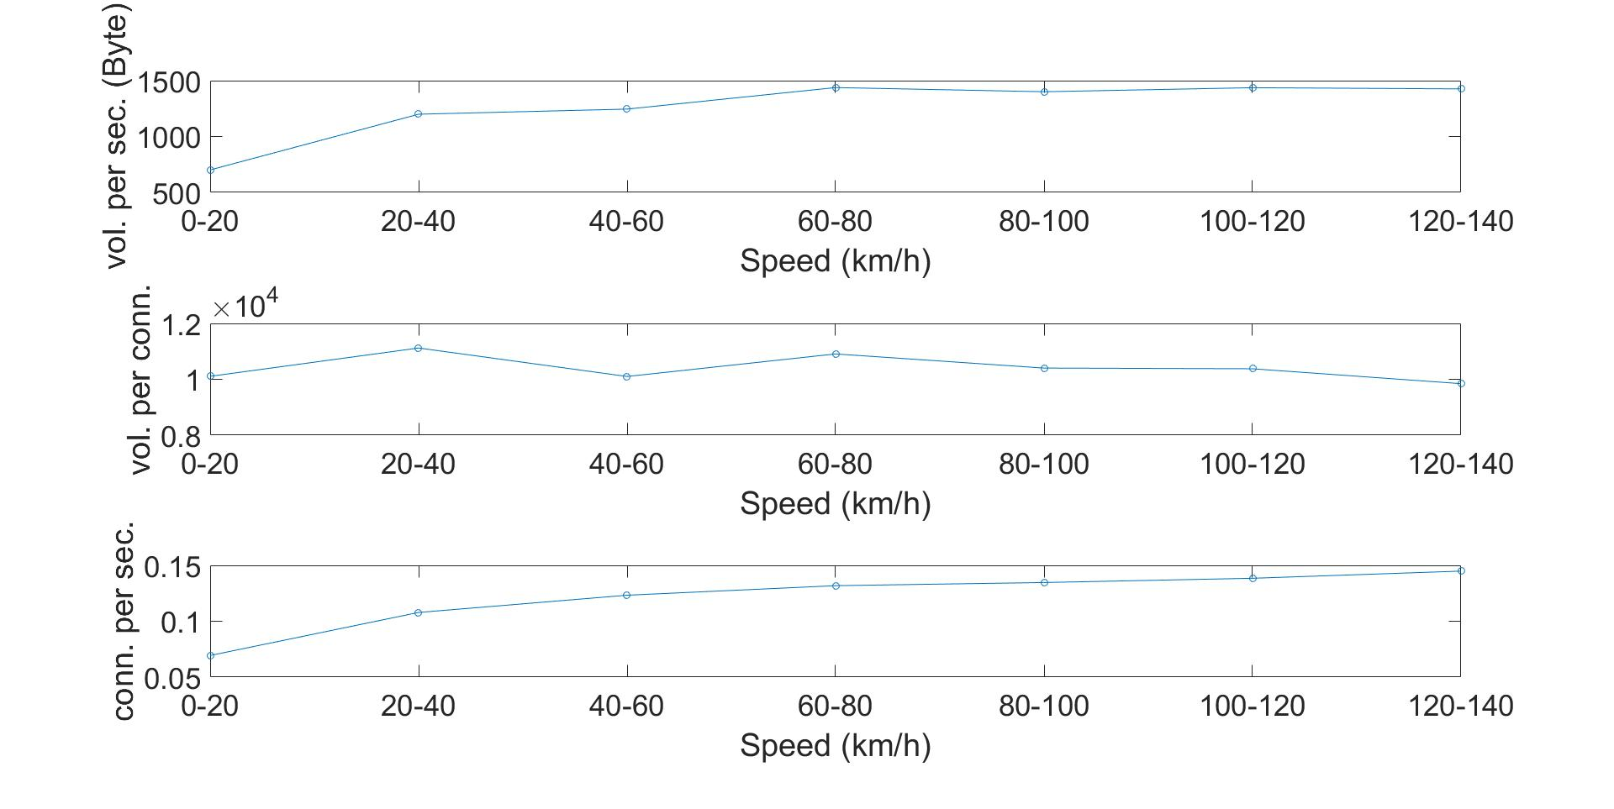
Some statics of data
Notes:
Too few data in high speed sessions
Much high connection frequency for high speed users. This might be the cause of high speed sessions have fewer triggers as connections are much closer to each other

Slide 6
To better utilize the data
Only use the sessions with rules:
Passing boundary time is below a strict threshold (30 sec)
Tow towers near the boundary should be adjacent
Estimated distance and distance lower bound agree on a certain level
With these two rules, only approximately 1/20 data have been given a estimated speed
Use sessions with strict passing boundary rules as “landmarks” to help estimate speed for sessions between a pair of “landmarks”

Slide 7
Recap - How can road help
Estimate distance: (Distance(towerA, towerB) + Distance(towerB, towerC)) /2 Shown in blue
Distance lower bound Distance(bound1, bound2) Shown in green
Actual road distance: Shown in purple

Slide 8
Road Networks
Much complicated than I thought:
Map road networks to the underlying Voronoi map.
Find all intersections of roads and Voronoi ridges -> A set of vertices for each ridge.
Calculate shortest distance between a pair of lines:
For each vertex pair in two sets of vertices of the lines, find a point-to-point shortest path in the Road networks.
I need to design an algorithm basically replicate the function of Google Map.
Use the Google Map API, which only allowed 2500 queries a day.
Benefit: A little higher accuracy, not too much to mention the effort in the paper.

Slide 9
Other efforts
Modifying the draft of the paper
Modified the design part
Adding current results to the paper
Code review:
Fixed several minor bugs Find several bugs that may cause the program to report false high speed sessions.

