Slide 1
매니코어 환경에서 PARSEC 벤치마크 ROI 확장성 분석
An Analysis of ROI Scalability on PARSEC
Benchmark for Many-core System
서동주 , 경주현 , 임성수 / 국민대
commisori28@gmail.com

Slide 2
Introduction
Increase cpu core number of commercial chip
Ex) Xeon Phi
Need Operating system scalability

Slide 3
Introduction
We decided to research about scalability,
especially when running multithreaded programs.
So,
analyze the scalability of the actual kernel first.

Slide 4
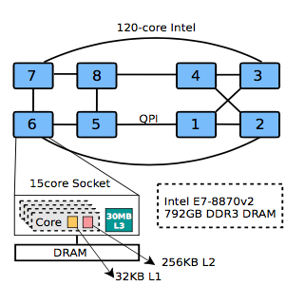
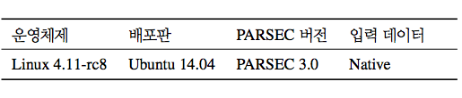
Environment
We used 120-core xeon-phi machine,
4.11-rc8 kernel version, ubuntu and
PARSEC 3.0 benchmark.

Slide 5
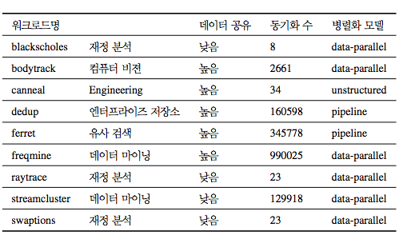
Workload

Slide 6
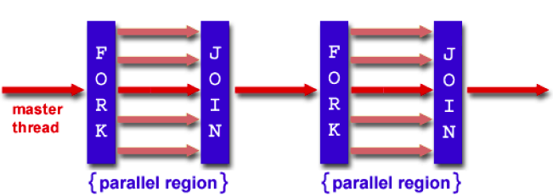
ROI ( Region of Interest )
The interval in which the actual parallelization is performed

Slide 7
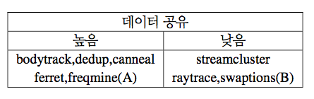
Result
We were able to divide the results
into two groups based on the degree of data sharing.

Slide 8
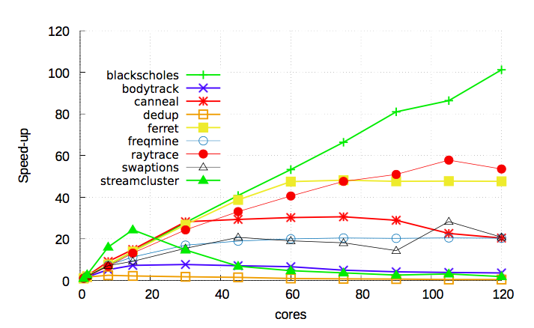
Result
Although there was a difference
in the experimental results,
we confirmed that all workloads
except for blackscholes had
problems with scalability.

Slide 9
Thank you

