Slide 1
GANs (Generative Adversarial Nets)
Ian J. Goodfellow
KESL
서동주

Slide 2
Contents
Abstract
Introduction
Adversarial Nets
Theoretical Results
Experiments
Conclusions

Slide 3

Abstract
Introduction
Adversarial Nets
Theoretical Results
Experiments
Conclusions
Alchemist
Jeweler
(Generator)
(Discriminator)
The coolest idea in ML in the last twenty years - Yann Lecun

Slide 4
Abstract
Introduction
Adversarial Nets
Theoretical Results
Experiments
Conclusions
She have to make gold bars
that others can not distinguish.
Alchemist
(Generator)

Slide 5
Abstract
Introduction
Adversarial Nets
Theoretical Results
Experiments
Conclusions
He must distinguish the Fake.
Jeweler
(Discriminator)

Slide 6
Abstract
Introduction
Adversarial Nets
Theoretical Results
Experiments
Conclusions
both ability going up
Vs
Alchemist
Jeweler
(Generator)
(Discriminator)
Goal : It can not really tell whether this is real gold or not

Slide 7
Abstract
Introduction
Adversarial Nets
Theoretical Results
Experiments
Conclusions
Generator
(G)
Discriminator
(D)
Alchemist
Jeweler

Slide 8
Abstract
Introduction
Adversarial Nets
Theoretical Results
Experiments
Conclusions
출처 : NIPS 2016 Tutorial: Generative Adversarial Networks

Slide 9
It could use another method,
but this paper used multilayer perceptron model for D and G.

Slide 10
Define multilayer perceptron G (Generator)
Generator distribution : Pg
generator input : noise variables Pz(z)
Data space : G (z; θg)

Slide 11
Define multilayer perceptron D(Discriminator)
Data space : D (x; θd)
Output : Probability ( Fake or not )

Slide 12
=
minimax problem for Value function V(D,G)

Slide 13
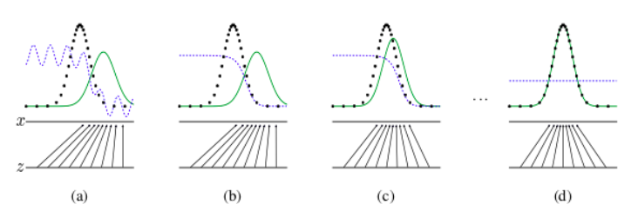
: data generating distribution
x , z : domain
: generative distribution
: x = G(z) mapping
: discriminator distribution

Slide 14
Two result
Introduced method will get global optimum when Pg = Pdata
They prove that the algorithm presented in the paper finds the global optimum

Slide 15

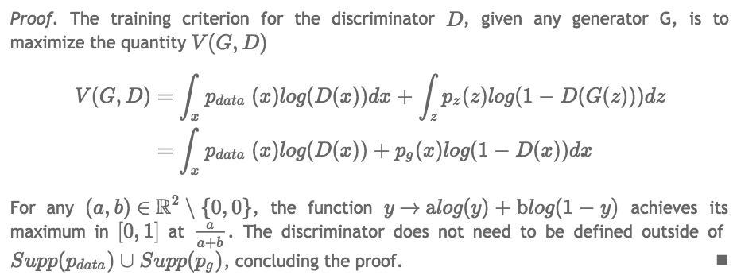
Proposition

Slide 16
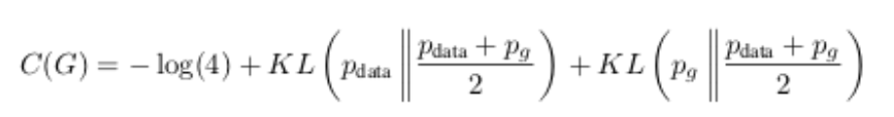

Main Theorem
The global minimum of the virtual training criterion C(G) is
Achieved if and only if Pg = Pdata. At that point, C(G) achieves the value -log4

Slide 17
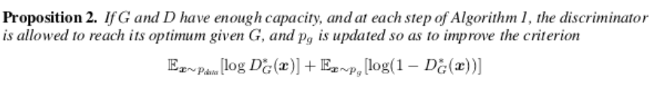
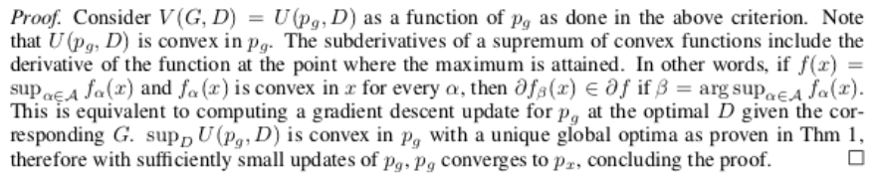
Convergence of Algorithm

Slide 18
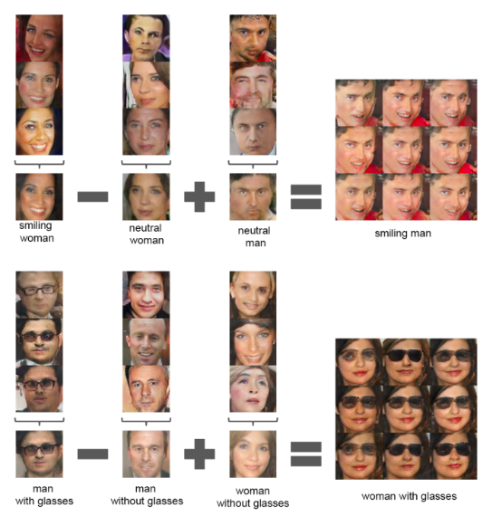
DCGAN , Alec Radford et al.2016

Slide 19
BEGAN , David Berthelot et al.2017

Slide 20
QnA

