Slide 1




On the Equivalence of Decoupled GCN and Label Propagation
Hande Dong, Jiawei Chen, Fuli Feng, Xiangnan He, Shuxian Bi, Zhaolin Ding, Peng Cui
Notes:
Hello, everyone, I’m Hande Dong, a second-grade graduate student at USTC, advised by Xiangnan He. It’s my pleasure to pre’sent our paper in the web conference 2021. It’s a joint work with NUS, NCSU, and Chinghua University. The key idea of this paper is to prove that decoupled GCN is equivalent to label propagation.

Slide 2
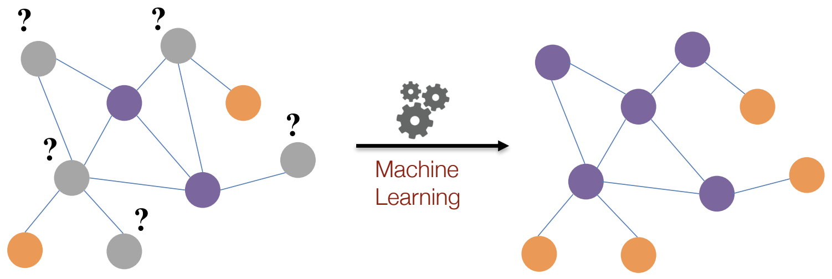

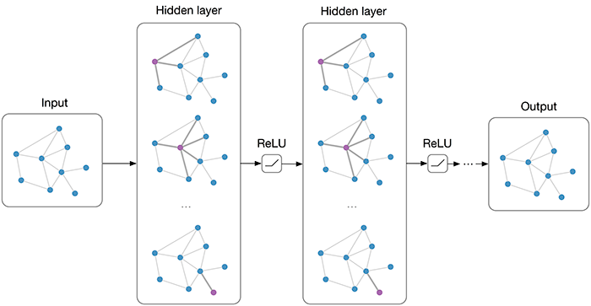

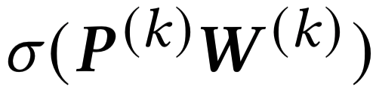
Background
Semi-supervised node classification task:
Graph convolution network (GCN):
Aggregation:
coupling
Transformation:
Notes:
In the beginning, I want to talk graph-based semi-supervised node classification task.
In this task, given graph structure, features of all nodes in graph, and labels of a part of nodes, the goal is to predict labels for the unlabeled nodes.
Inspired by representation learning, graph convolution network was proposed to solve this task.
The key idea of GCN is to represent node embedding better by convolutional operation.
In fact, GCN contains two important operation, aggregation to aggregate neighbor embedding according to graph structure, and transformation to transform node embedding by one-layer neural network.
One-layer aggregation mush be accompanied with one-layer transformation in GCN. We name this design of GCN coupling.

Slide 3
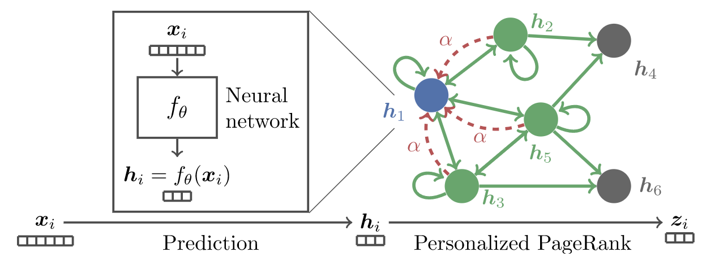
From GCN to decoupled GCN
Predict then propagate (APPNP):
APPNP decouples neighborhood aggregation and feature transformation: DECOUPLED GCN!
SOTA performance
High efficiency
APPNP (ICLR 2019), DAGNN (KDD 2020) SGCN (ICML 2019), lightGCN (SIGIR 2020)
Notes:
The coupling design makes GCN hard to leverage graph structure deeply.
To overcome the drawback, APPNP is proposed.
APPNP firstly transforms features into embedding by a neural network. This neural network is a conventional network and not relevant to graph structure.
Then APPNP propagates embedding several times according to graph structure.
APPNP decouples neighborhood aggregation and feature transformation.
The decoupling is also adopted by some other works, such as SGCN, DAGNN and lightGCN.
And we name GCN with this design as decoupled GCN.
Decoupled GCN is better than GCN, and achieves SOTA performance in many tasks.

Slide 4
Graph Information diffusion
Label propagation vs. representation aggregation:
Indirect diffusion vs. direct diffusion:
SOURCE NODE
TARGET NODE
Label Propagation
Representation Aggregation
Step 1
Step 2
Indirect diffusion ~ Multiple steps.
Direct diffusion ~ One step.
The effect of multiple indirect diffusion is the same as once direct diffusion.
Notes:
The embedding aggregation in decoupled GCN can be regarded as information diffusion according to graph structure.
Another classical graph information diffusion algorithm is label propagation.
Label propagation diffuses label from source node to its neighbors.
In contrast, decoupled GCN diffuses representation to target node from its neighbors.
Both label propagation and decoupled GCN only diffuse information to first-order neighbor.
Therefore, information needs multiple diffusion to achieve high-order neighbor, such as from 1 to 2 to 3.
In fact, the multiple diffusion is equvlent to once direct diffusion to high-order neighbor, such as from 1 to 2 and 3.

Slide 5


LP vs. decoupled GCN
Label propagation
Decoupled GCN
2002
Label diffusion
Structure driven
Graph algorithm
Not learnable
Explainable
2019
Representation diffusion
Structure and feature driven
Representation learning
Learnable
Not explainable
Question:
Any intrinsic relationship between LP and decoupled GCN?
Notes:
Here show a comparison between label propagation and decoupled GCN,
Decoupled GCN emerged much later than label propagation in 2019.
Label propagation diffuses label information, while decoupled GCN diffuses representation information;
Label propagation focuses on structure only, while decoupled GCN focuses on structure and feature.
Although they are proposed in different eras, and differ in many details, they are also similar.
Is there anay intrinsic relationship bwteeen them?
5.0
Label propagtion is inspired by graph algorithm, while decoupled GCN is inspired by representation learning.
Label propagtion is not learnable, while decoupled GCN is learnable.
The formula of label propagation is A^bar Y, while the formular of decoupled GCN is A^bar f_theta(X).

Slide 6
Outline
Motivation and background
Theoretical analysis
Propagation then Training Statically vs. decoupled GCN
The weight of decoupled GCN
Pros and cons of decoupled GCN
Method
Experiments
Conclusion
Notes:
Next, I will show that decoupled GCN is equivalent to label propagation.

Slide 7
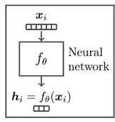
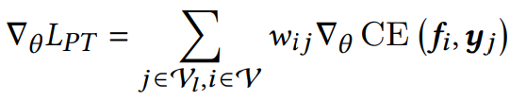


Propagation then Training vs. decoupled GCN
Two-step label propagation:
Reweight pseudo-label! Propagation then Training
Gradient analysis:
SOURCE NODE
Step 1: label propagation ~ pseudo-label
Step 2: Training
Notes:
Traditional label propagation can not utilize feature information.
To overcome it, we propose a two-step label propagation. propagating labels of training set to other nodes in graph firstly and generating pseudo-labels for other nodes, and then using both labels and pseudo labels to train a neural network predictor.
Besides, the labels and pseudo labels can be reweighted. We name two-step label propagation with reweighting strategy as propagation then training, abbreviated as PT.
Because gradient descent is used in optimizing neural model, we calculate the gradient of PT and decoupled GCN.
By comparison, we find only set the reweighting-values in PT with this specific form, PT is equvalent with decoupled GCN.
The equvalence has been proved.

Slide 8
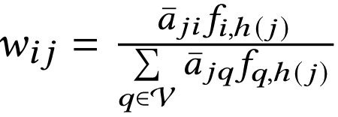
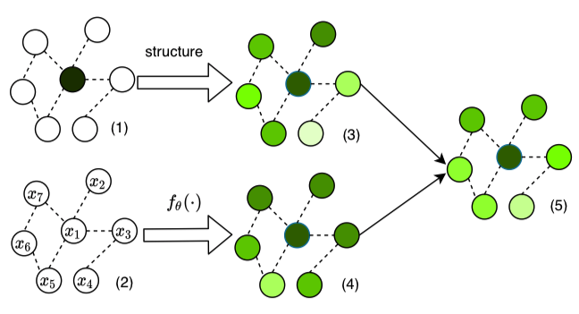
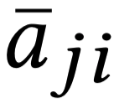
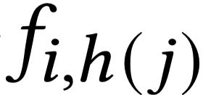
The weight of decoupled GCN
Weight of decoupled GCN:
Product
Normalize
Notes:
The weight of decoupled GCN contains three parts.
The first is static weight a^bat_ij accoding to graph structure;
The second is dynamic weight f_i,h(j) according to neural predictor and feature;
The third is to multiply static and dynamic weight and normalize weight.

Slide 9
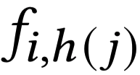
Strengths and weaknesses
The effects of our analysis:
Help us understand strengths and weaknesses of model
Provide intuition to improve decoupled GCN
Strengths:
Pseudo-label ~ data augmentation
Reasonable weight ~ reweight the pseudo labels
Ensemble ~ combine neighbors when inference
Weaknesses:
Unstable to initialization ~ is reliable?
Sensitive to label noise ~ equal weight?
Notes:
What can we benefit from our analysis? First, it can help us understander strengths and weaknesses of decoupled GCN, sencond, it can provide tntuition to improve decpupled GCN.
From our analysis, the strgth of d-GCN is revled:
pseudo-label augments data;
Reasonable weight makes the model more robust;
Ensemble in inference stage boosts the performance.
Drawbacks of decoupled GCN are also revealed:
First, Whether dynamic weight can denoise depends on the neural predictor. When the initialization is suitable, it can guide the training. It mill mislead the training otherwise. It indicates that decoupled GCN is unstable to initialization.
Second, the normalization indicates that labels in the training set are equal, which makes decoupled GCN sensitive to label noise.
8.45

Slide 10
Outline
Motivation and background
Theoretical analysis
Method
How to improve decoupled GCN?
PTA: Propagation then Training Adaptively
Experiments
Conclusion
Notes:
Next I will introduce our proposed method.

Slide 11



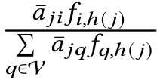


How to improve d-GCN?
Weight of decoupled GCN:
Design 1 - remove normalization:
Different label weight
Robust to label noise
Design 2 - add adaptive factor:
Factor:
The model becomes more and more reliable,
stable to initialization
Advantages: stable, robust to label noise.
remove
normalization
adaptive
factor
Notes:
To overcome the weaknesses of decoupled GCN, we propose two design about weight:
remove normalization for allowing different weight in the training set. This design improves the robustness to label noise.
add adaptive factor gamma to dynamic weight. Gamma is determined by current epoch e and hyper-parameter epsilon. At the beginning of training, model is not reliable, gamma equals zero, and.the model-aware dymaic weight f_i,h(j) has no effect. With the training going, the model becomes more and more reliable, gamma increases, and the role of model aware weight is more and more important.
The two design can make model stable and robust to label noise.
///
The factor gamma adaptively combines static weight a^hat and dynamic weight f_i,h(j). (controls thee effect of neural predicor f, at the begin 去文中抄)
Removing normalization makes the model more robust to label noise.
Adding adaptive factor makes the model more stable.
///
We further improved our paradigm to PT adaptively, or PTA, by removing normalization as in decoupled GCN and introducing an adaptive factor.
removing normalization makes it robust to label noise.
adaptive factor makes it stable.
The adaptive factor consists of epoch number and another parameter. With training more and more deeply, the model becomes more and more reliable, as gamma increases.
The matrix form of loss function of PTA is concise, and easy to compute by matrix element-wise product.

Slide 12

PTA: PT adaptively
Element form of loss function:
Matrix form of loss function:
No neighborhood aggregation. Much faster!
Decoupled GCN aggregates neighborhood
Neighborhood aggregation is hard to parallelly compute
Notes:
Due to adaptive factor, we name the improved model Propagation then training adaptively, abbreviated as PTA.
In fact, PTA has a concise matrix form, It only needs to do twice element-wise matrix product in the training stage,
But decoupled GCN needs to aggregate neighborhood several times.
So besides the above two advantages, PTA is more efficient than decoupled GCN.
10.30

Slide 13
Outline
Motivation and background
Theoretical analysis
Method
Experiments
About decoupled GCN
About PTA
Conclusion
Notes:
Next I will introduce our experiments.

Slide 14
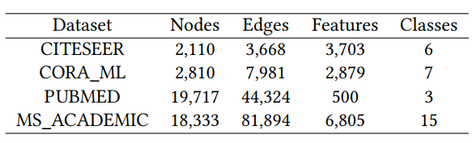
Setting
Datasets:
CITESEER, CORA_ML, PUBMED, MS_ACADEMIC
Evaluation metrics: accuracy
Data split:
Training set: 20*C
Early stopping set: 500
Test set: 1500/5000 - 20C - 500
Notes:
We conducted experiments on four datasets in term of accuracy.
The table shows the information of the datasets.

Slide 15
Five questions to answer
Is our analysis for decoupled GCN are rational?
How does the proposed PTA perform as compared with state-of-the-art GCN methods?
Is PTA more stable to the initialization?
Is PTA more robust to label noise?
Is PTA more efficient?
Notes:
By experiments, we explore five questions.
Our paper analyze why decoupled GCN works well. So we verify whether our analysis is rational in the first question.
We then verify the effectiveness of our proposed PTA in the second question.
Based on our design and analysis, PTA has three advantages. Therefore, we validate the three advantage respectively in the last three question.

Slide 16
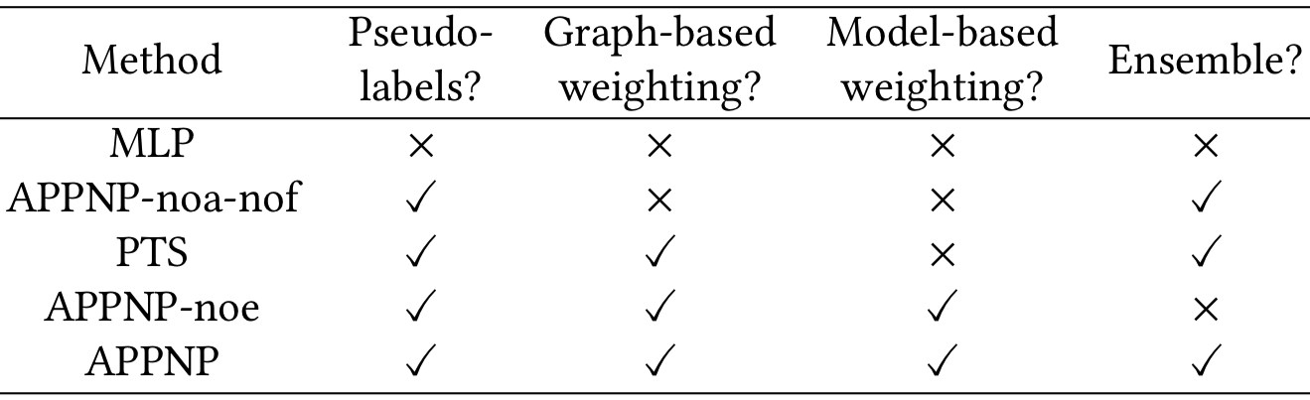
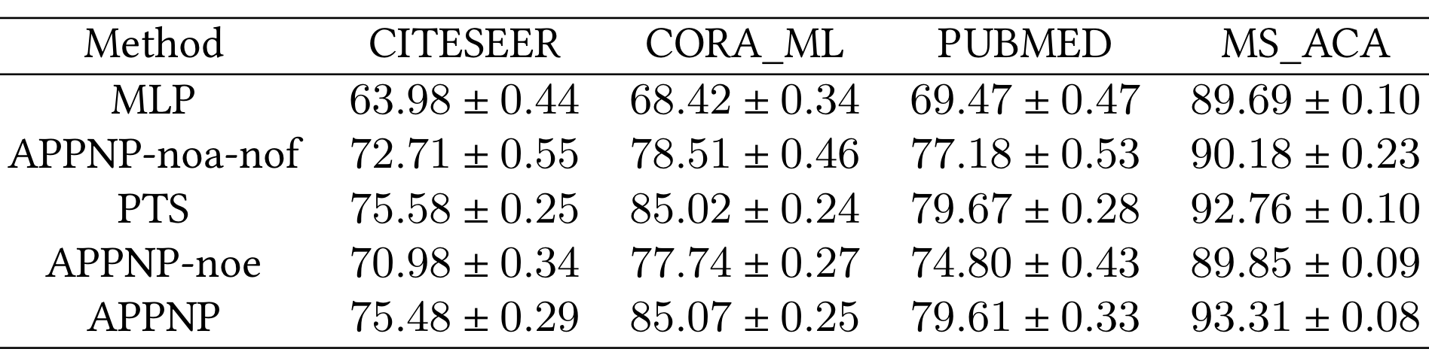
Effects of different components in decoupled GCN
Ablation study of APPNP:
The effect: Label propagation(+++), graph-based weighting(+++), model-based weighting(+), ensemble(++).
Notes:
Compared with MLP, APPNP contains four components: ….
By ablation study, we can testify whether the four componets are all useful.
This comparison is about ensemble, this ….
From the four comparison, four components in APPNP are all useful,
And label propagation and graph-based weighting contribute the most.
每个模块做一个ppt

Slide 17
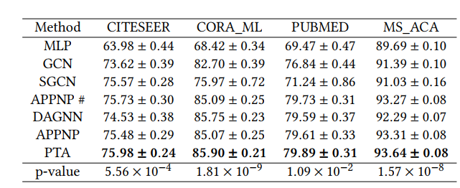
Performance comparison: PTA performs best
Accuracy comparison with SOTA methods:
PTA is better than APPNP with t-test. Statistically significant!
Notes:
now let’s see how our proposed PTA further improves APPNP.
This table shows overall performance comparison of different models. According to this table, the performance of PTA is best in them.

Slide 18
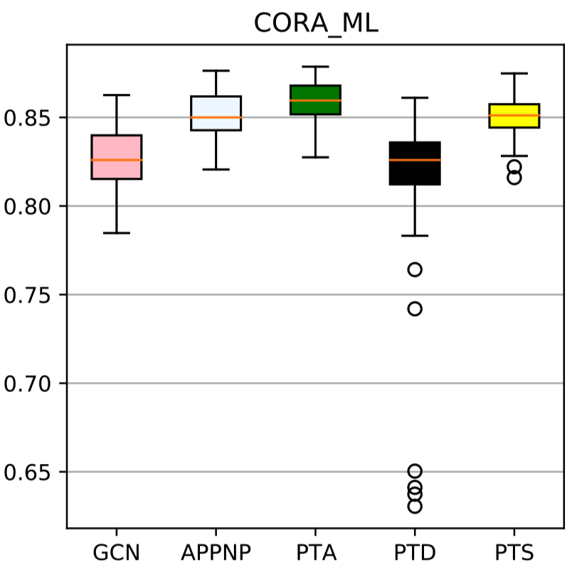
PTA is stable to initialization
Box plot of accuracy of different models:
PTS>APPNP: the effect of dynamic weight in APPNP is unstable, relying on the initialization
PTA>APPNP, PTD: adaptive strategy in PTA is useful
PTD is much unstable: merely removing normalization of APPNP will cause unstable. Removing normalization need co-occur with adaptive strategy.
Notes:
By random experiments, we draw box plot for different. Among them, PTA has the smallest box. this validatrs that PTA is stable to initialization.

Slide 19
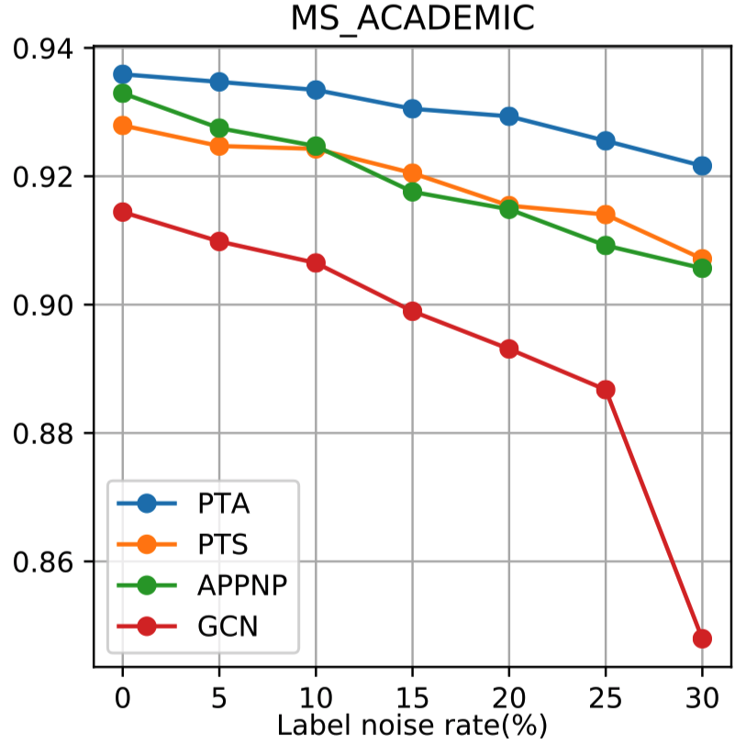
PTA is robust to label noise
Simulate label noise
Add noise to label in the training set
The margins of PTA and APPNP become larger with noise increasing: PTA is more robust to label noise.
PTA>others for all different label noise rate.
APPNP≈PTS: PTS is implicitly normalization.
Notes:
This is a simulation experiments with regard to label noise,
With the increasing of label noise, the performance of PTA decreases less.
This experiment can validate that PTA is robust to label noise.
½图

Slide 20
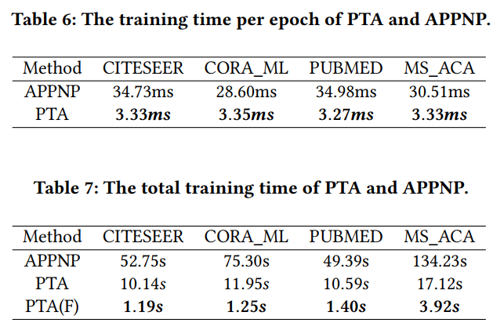
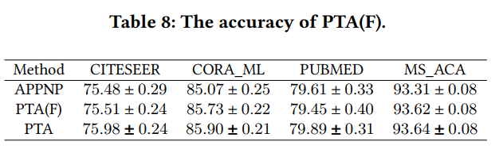
PTA is much faster
Compare the efficient of PTA and APPNP
10-times faster
PTA: 5 times faster
PTA(F): 50 times faster
PTA(F) still performs well.
Notes:
In the last, we compare the efficiency of PTA and APPNP.
We find that PTA is much faster than decoupled GCN in both per epoch time and total training time.
13.20
///
The imperial results showed that PTA is much faster than APPNP while remaining good performances.
We introduced PTA(F), which is a Fast mode, that it doesn’t aggregate neighborhood before the judgement of fast stop.

Slide 21
Conclusion and future work
Conclusion:
Why decoupled GCN works well:
data augmentation, structure and model-aware weighting, ensemble
Proposed method -- PTA:
stable; robust to label noise; efficient
Future work:
Link prediction and graph classification tasks
Theoretical analysis for general GCN
Sophisticated weighting strategy
Notes:
In this work, we prove decoupled GCN is a special case of Propagation then Training. This insight can explain why decoupled GCN works well, including data augmentation, reasonable weighting strategy, emsemble.
With our analysis, two weaknesses of decoupled GCN are also revealed.
To overcome them. We proposed a new graph learning algorithm PTA.
Experiments support our analysis about decoupled GCN and prove the superiority of PTA.
I will share three promising directions as future work:
Extend PTA to link prediction and graph classification tasks.
Provide theoretical analysis for general GCN
Design better weighting strategy for propagation then training.

Slide 22
Reference
Zhu Xiaojin and Ghahramani Zoubin. 2002. Learning from labeled and unlabeled data with label propagation. Technical Report, Carnegie Mellon University (2002).
Thomas N. Kipf and Max Welling. Semi-Supervised Classification with Graph Convolutional Networks. In International Conference on Learning Representations, ICLR, 2017.
Felix Wu, Amauri H. Souza Jr., Tianyi Zhang, Christopher Fifty, Tao Yu, and Kilian Q. Weinberger. Simplifying Graph Convolutional Networks. In International Conference on Machine Learning, ICML, 2019.
Johannes Klicpera, Aleksandar Bojchevski, and Stephan Günnemann. Predict then Propagate: Graph Neural Networks meet Personalized PageRank. In International Conference on Learning Representations, ICLR, 2019.
Xiangnan He, Kuan Deng, Xiang Wang, Yan Li, Yong-Dong Zhang, and Meng Wang. LightGCN: Simplifying and Powering Graph Convolution Network for Recommendation. In International ACM SIGIR conference on research and development in Information Retrieval, SIGIR 2020.
Meng Liu, Hongyang Gao, and Shuiwang Ji. Towards Deeper Graph Neural Networks. In The ACM SIGKDD Conference on Knowledge Discovery and Data Mining, KDD, 2020.
Notes:
Here it reference of this presentation.

Slide 23
Thanks & QA?
The code is available at https://github.com/DongHande/PT_propagation_then_training
Notes:
We also release our code in github.
Thanks for your listening!

