Slide 1



VE414
Project Presentation
Ji Jiazhen
Dong Jing
Guo Wenhao

Slide 2


01
Visualization
02
Data Processing
CONTENT
03
Model
04
Future Works

Slide 3
01
Visualization

Slide 4
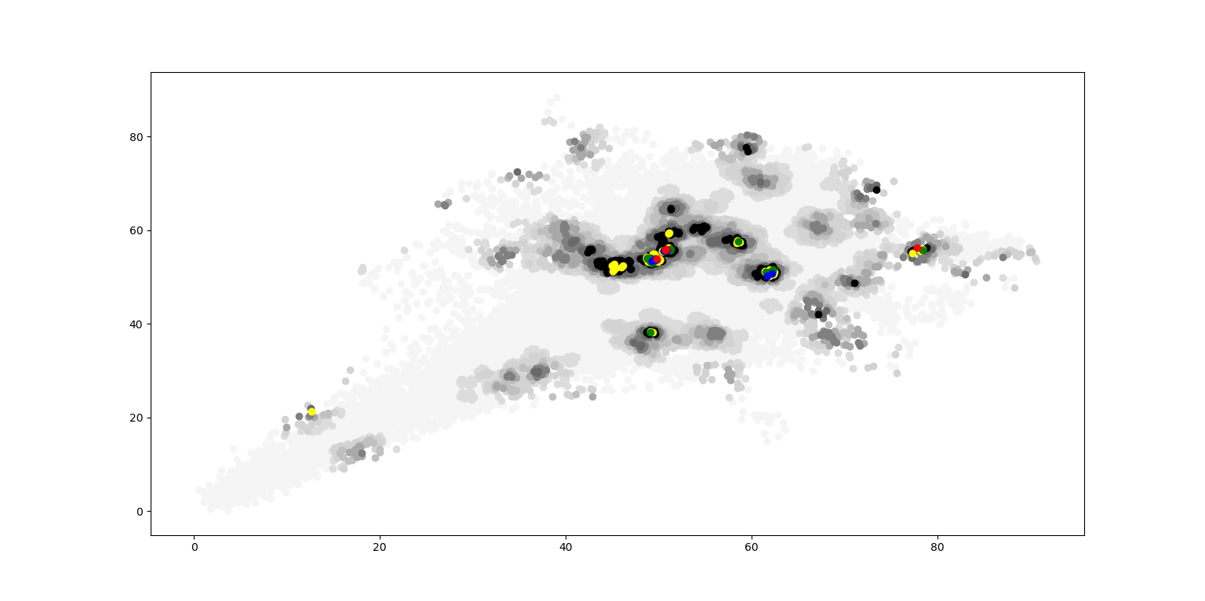
Data Visualization - Different Colors
Problem: Circle will be covered

Slide 5
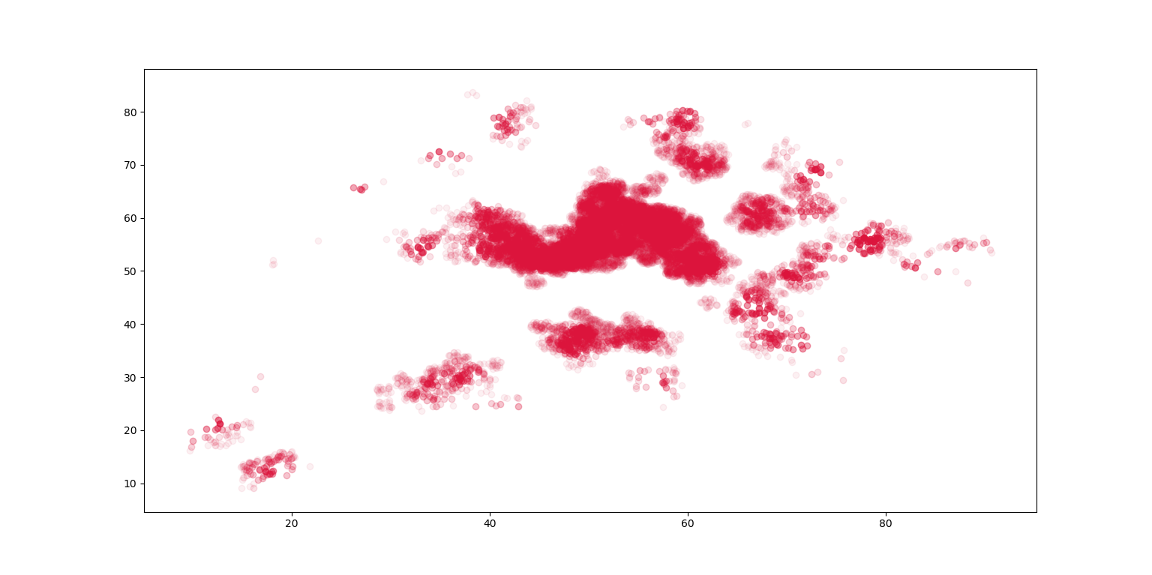
Data Visualization - Transparency
Problem: Too many Tayes are found in the center part

Slide 6
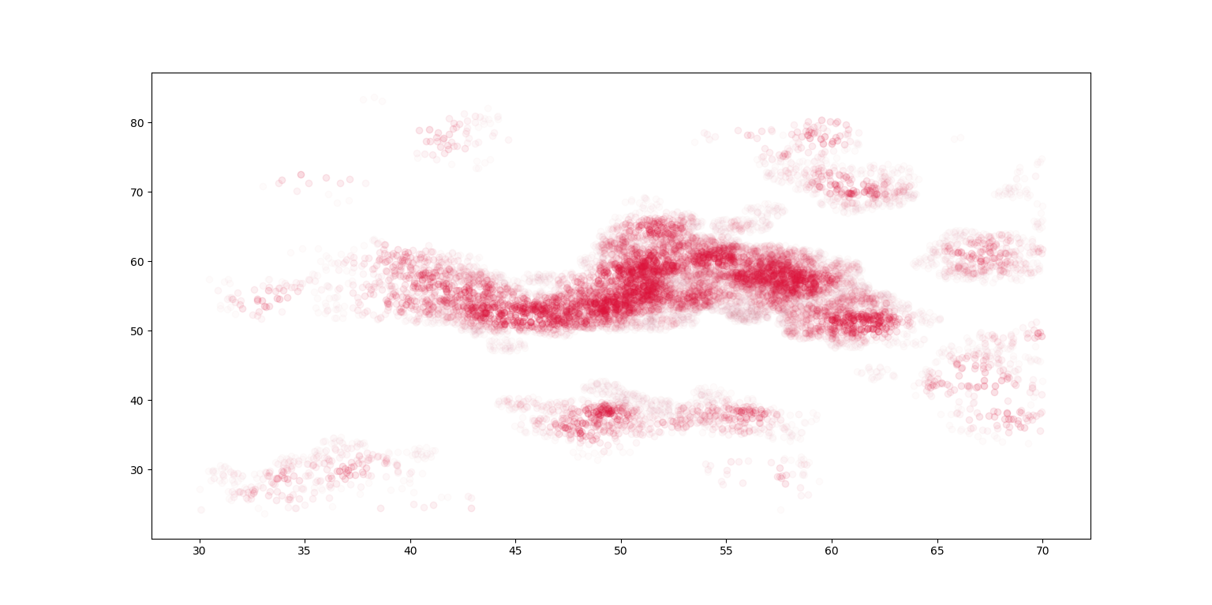
Data Visualization – Transparency & Center Part

Slide 7
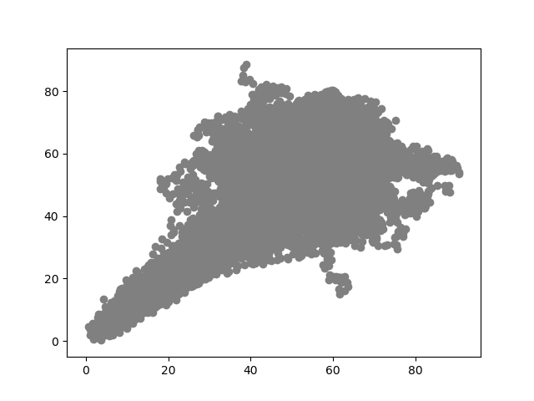
Data Visualization - Trip
Result: the ratio of area recorded to the whole area is 28.30%

Slide 8
02
Data Processing

Slide 9
0 | 0 | 0
0 | 1 | 0
0 | 0 | 0
(a,b)
→
→
0 | 0 | 0 | 0 | 1 | 0 | 0 | 0 | 0
0 | 0 | 0 | 0 | 1 | 0 | 0 | 0 | 0
0 | 0 | 0 | 0 | 0 | 1 | 0 | 0 | 0
0 | 0 | 1 | 0 | 0 | 0 | 0 | 0 | 0
0 | 0 | 0 | 0 | 0 | 0 | 0 | 1 | 0
0 | 0 | 0 | 1 | 0 | 0 | 0 | 0 | 0
(A,B)
→

Slide 10
w_1
w_2
w_3
w_4
w_5
w_6
w_7
w_8
w_9
1
2
3
4
1
W =
Y =
XW ≈ Y

Slide 11

Non-negative least squares

Slide 12
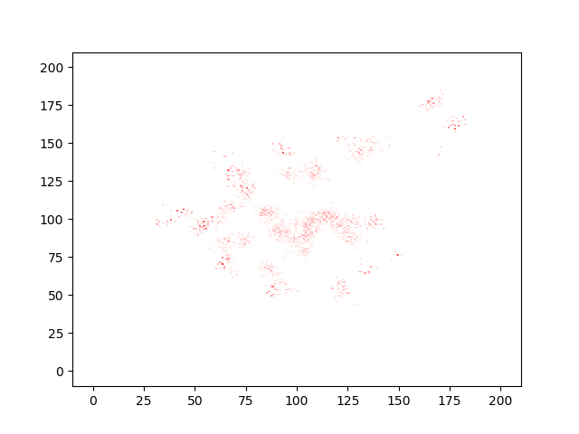

Slide 13
03
Model

Slide 14
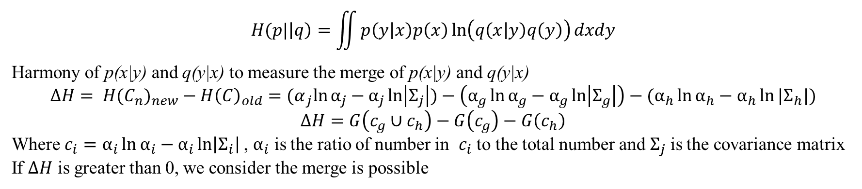
Hierarchical Clustering Based on a Bayesian Harmony Measure
$$H(p|\left|q\right)=\iint{p\left(y | x\right)p\left(x\right)\ln\left(q\left(x | y\right)q\left(y\right)\right)dxdy}$$
Harmony of p(x|y) and q(y|x) to measure the merge of p(x|y) and q(y|x)
$$ΔH= {H(C_{n})}_{new}−{H\left(C\right)}_{old}={(α}_{j}\ln{α_{j}}−α_{j}\ln\left|Σ_{j}\right|)−\left(α_{g}\ln{α_{g}}−α_{g}\ln\left|Σ_{g}\right|\right)−(α_{h}\ln{α_{h}}−α_{h}\ln{|Σ_{h}|})$$
$$ΔH=G\left(c_{g}∪c_{h}\right)−G\left(c_{g}\right)−G\left(c_{h}\right)$$
Where $c_{i}=$ $α_{i}\ln{α_{i}}−α_{i}\ln\left|Σ_{i}\right|$ , $α_{i}$ is the ratio of number in $c_{i}$ to the total number and $Σ_{j}$ is the covariance matrix
If $ΔH$ is greater than 0, we consider the merge is possible

Slide 15
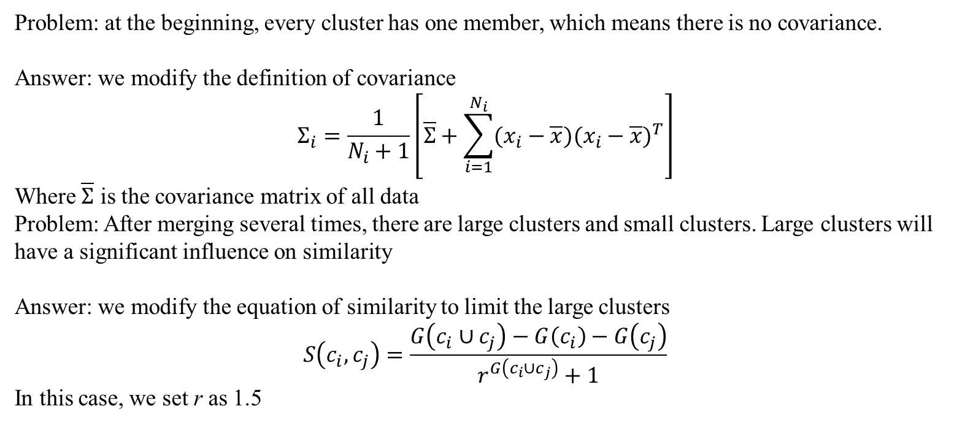
Hierarchical Clustering Based on a Bayesian Harmony Measure
Problem: at the beginning, every cluster has one member, which means there is no covariance.
Answer: we modify the definition of covariance
$$Σ_{i}=\frac{1}{N_{i}+1}\left[\overline{Σ}+\sum_{i=1}^{N_{i}}{(x_{i}−\overline{x}){(x_{i}−\overline{x})}^{T}}\right]$$
Where $\overline{Σ}$ is the covariance matrix of all data
Problem: After merging several times, there are large clusters and small clusters. Large clusters will have a significant influence on similarity
Answer: we modify the equation of similarity to limit the large clusters
$$S\left(c_{i},c_{j}\right)=\frac{G\left(c_{i}∪c_{j}\right)−G\left(c_{i}\right)−G\left(c_{j}\right)}{r^{G\left(c_{i}∪c_{j}\right)}+1}$$
In this case, we set r as 1.5

Slide 16
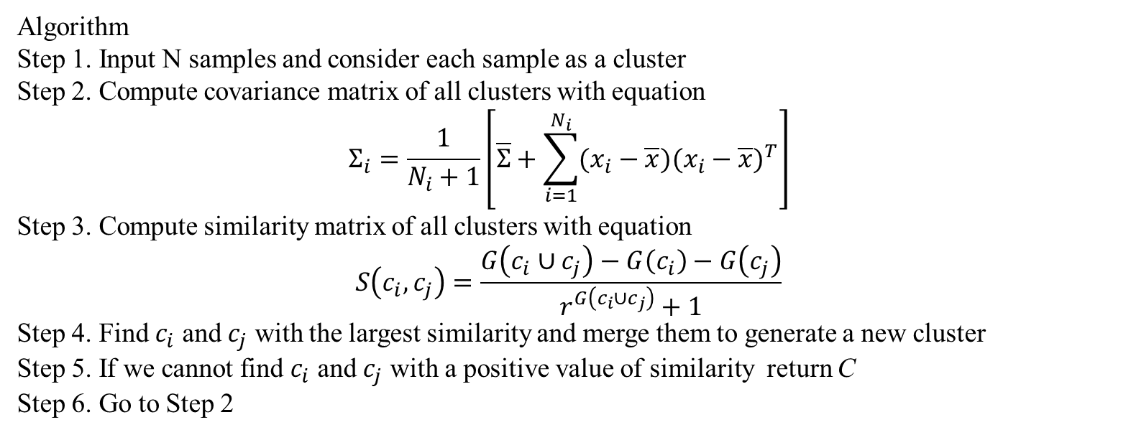
Hierarchical Clustering Based on a Bayesian Harmony Measure
Algorithm
Step 1. Input N samples and consider each sample as a cluster
Step 2. Compute covariance matrix of all clusters with equation
$$Σ_{i}=\frac{1}{N_{i}+1}\left[\overline{Σ}+\sum_{i=1}^{N_{i}}{(x_{i}−\overline{x}){(x_{i}−\overline{x})}^{T}}\right]$$
Step 3. Compute similarity matrix of all clusters with equation
$$S\left(c_{i},c_{j}\right)=\frac{G\left(c_{i}∪c_{j}\right)−G\left(c_{i}\right)−G\left(c_{j}\right)}{r^{G\left(c_{i}∪c_{j}\right)}+1}$$
Step 4. Find $c_{i}$ and $c_{j}$ with the largest similarity and merge them to generate a new cluster
Step 5. If we cannot find $c_{i}$ and $c_{j}$ with a positive value of similarity return C
Step 6. Go to Step 2

Slide 17
Hierarchical Clustering Based on a Bayesian Harmony Measure
Result:
If Jiulings are identical,
the number of Jiulings in area recorded is 416.725 / 12.653 = 33
the number of Jiulings in the whole area is 33 / 0.2830 = 116
Else
the number of Jiulings in area recorded is 8
the number of Jiulings in the whole area is 8 / 0.2830 = 28

Slide 18
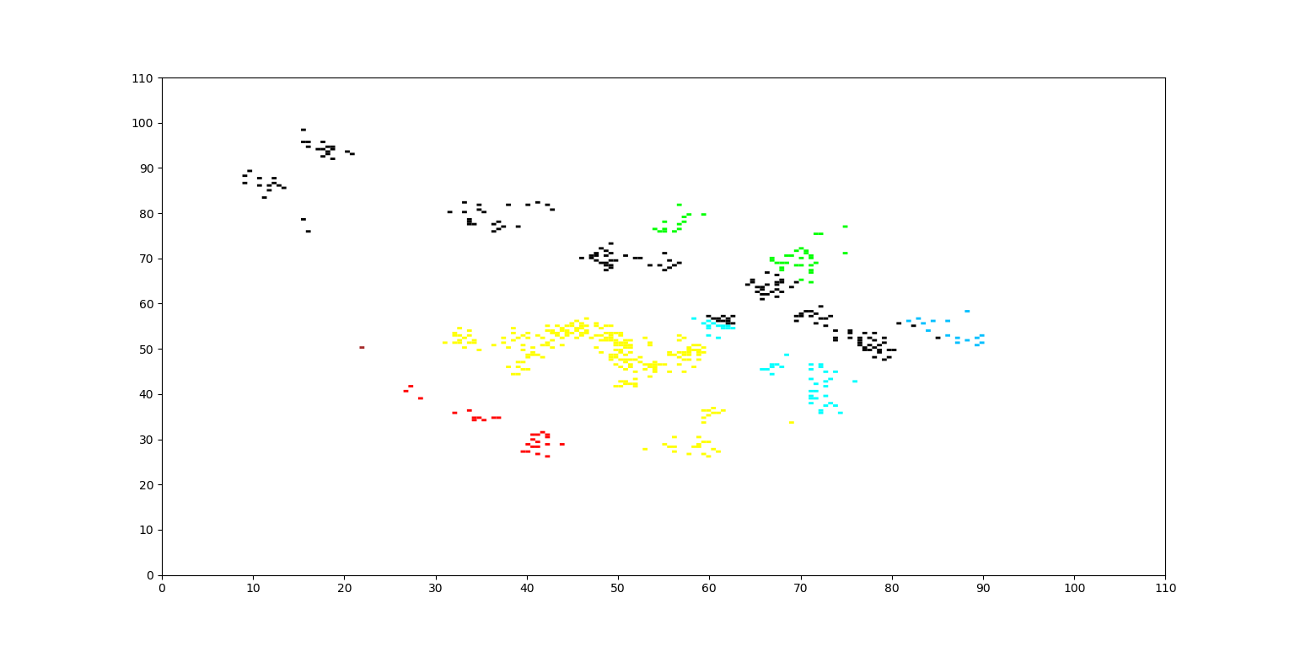
Hierarchical Clustering Based on a Bayesian Harmony Measure

Slide 19
04
Future Works

Slide 20
If Jiuling Can Move
Using the value in Column Trip!

Slide 21
If Jiuling Can Move
Hyperparameters: k

Slide 22
28%
70%
23%
47%
COLOR IS EVERYTHING
Our destiny offers not the cup of despair ,but the
chalice of opportunity.

Slide 23
THANK YOU
B E A U T Y O F L I F E

