Slide 1
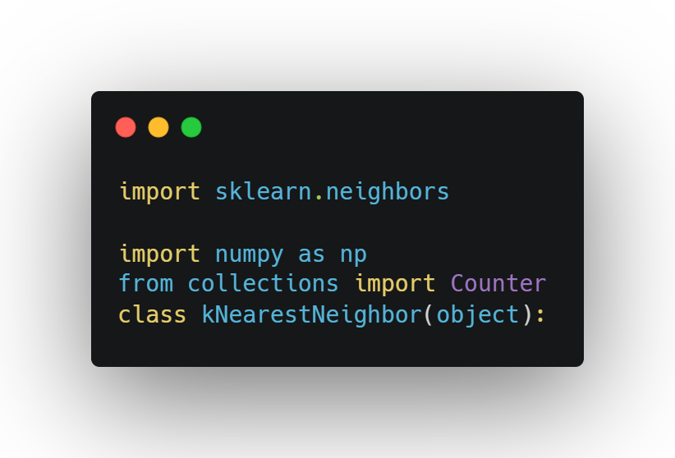
1. code analysis
import
Counter is used to count the number of datas

Slide 2
1. code analysis
class
initialization
fit
predict
Knn class consist of 3 functions
Initialization : initialize variables
fit : initialize this class with labeled training data
Predict : using trained model, we predict category to be belongs from new data

Slide 3
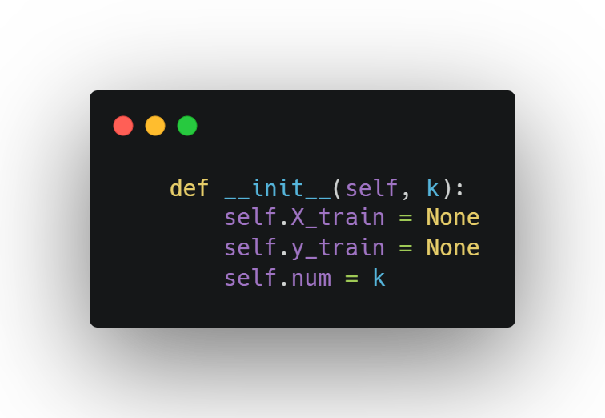
1. code analysis
initialization
Take the number of neighbors as parameter and initialize variables

Slide 4
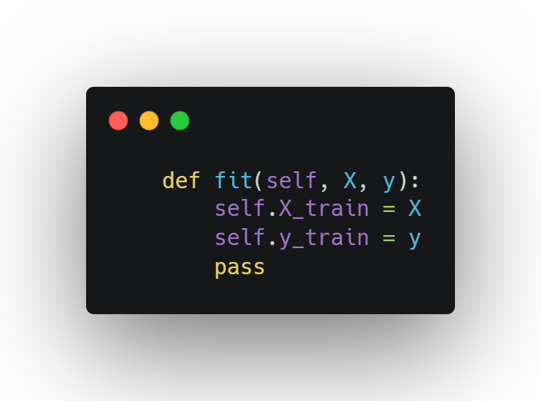
1. code analysis
fit
X,Y are the feature of samples and labels,respectively.

Slide 5
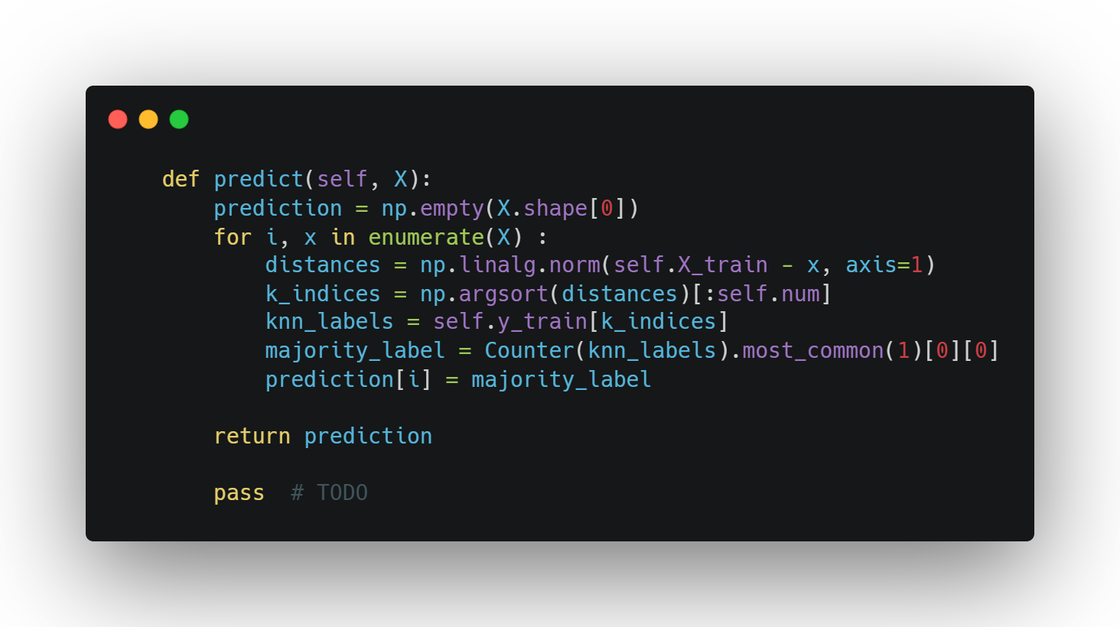
1. code analysis
predict
Calculate the distance between test data and each training sample and sort them in ascending order in
order to find closer neighbors. And then, extracts the labels of nearest neighbors from training set and find
most frequent one. Finally assign it to current test sample

Slide 6
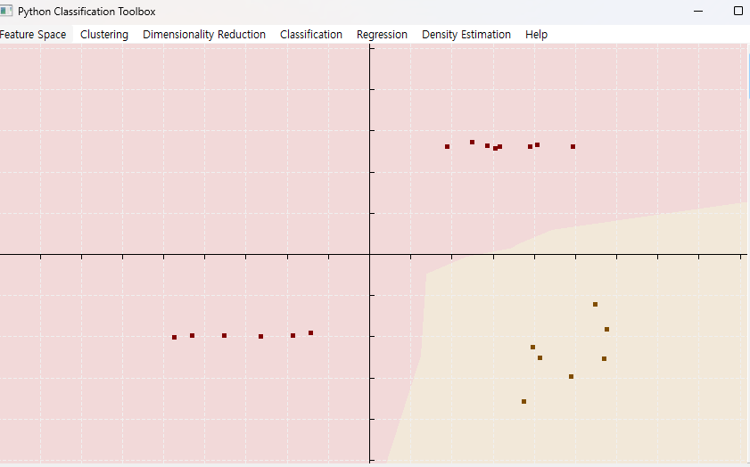
2.Result(PyClassificationToolbox)
KNN(2 classes)
It seperate classes quite well

Slide 7
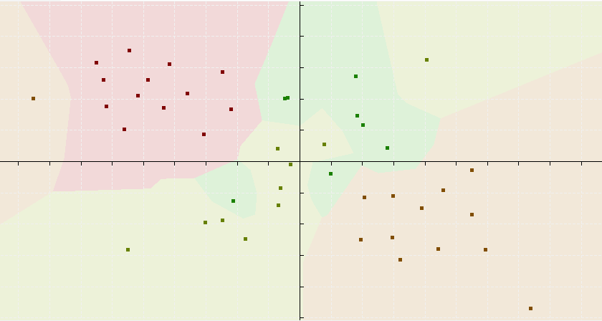
2. Result
KNN(4 classes)
Even though I add some classes and data, it almost perfectly reflect on it

Slide 8
3. limitation
KNN(4 classes)
But we have to keep all of data in memory and also calculate all of data each other, which require complex and slow computation in high dimension
Dependiong of k size, it can be too sensitive for small k, and low generalization for too large k
That is not learning algorithm

