Slide 1

프로그래밍언어론 보고서#4 재귀 하강 파서
이름 | 신동욱
학번 | 20204101

Slide 2

목차
BNF
코드 소개
실행 결과

Slide 3
BNF
<expr> -> <term> + <term> | <term> - <term> | <term>
<term> -> <factor> * <factor> | <factor> / <factor> | <factor>
<factor> -> <number> | ( <expr> )
<number> -> 1, 2, … 9
예시 : 2 * ( 3 + 4 )
<expr> -> <term>
-> <factor> * <factor>
-> <number> * <factor>
-> 2 * <factor>
-> 2 * ( <expr> )
-> 2 * ( <term> + <term> )
-> 2 * ( <factor> + <term> )
-> 2 * ( <number> + <term> )
-> 2 * ( 3 + <term> )
-> 2 * ( 3 + <factor> )
-> 2 * ( 3 + <number> )
-> 2 * ( 3 + 4 )

Slide 4
Parser Class
class Parser { final int NONE = 0; final int OPERATOR = 1; final int NUMBER = 2; final String EOE = "\0"; private String exp; private int expIdx; private String token; private int tokType;
public double evaluate(String exp) private double expr() private double term() private double factor() private double number() private void handleError() private void lex()

Slide 5
evaluate()
public double evaluate(String expstr) throws ParserException { double result; exp = expstr; expIdx = 0; lex(); if (token.equals(EOE)) handleError(); result = expr(); if (!token.equals(EOE)) handleError(); return result; }

Slide 6
private void lex() { tokType = NONE; token = ""; if (expIdx == exp.length()) { token = EOE; return; } if (isOperator(exp.charAt(expIdx))) { token += exp.charAt(expIdx); expIdx++; tokType = OPERATOR; } else if (Character.isDigit(exp.charAt(expIdx))) { while (!isOperator(exp.charAt(expIdx))) { token += exp.charAt(expIdx); expIdx++; if (expIdx >= exp.length()) break; } tokType = NUMBER; } else { token = EOE; } }
lex()

Slide 7
expr()
private double expr() throws ParserException { char op; double result; double nextResult; result = term(); while ((op = token.charAt(0)) == '+' || op == '-') { lex(); nextResult = term(); switch (op) { case '+' -> result += nextResult; case '-' -> result -= nextResult; } } return result; }

Slide 8
term()
private double term() throws ParserException { char op; double result; double nextResult; result = factor(); while ((op = token.charAt(0)) == '*' || op == '÷') { lex(); nextResult = factor(); switch (op) { case '*' -> result *= nextResult; case '÷' -> { if (nextResult == 0.0) handleError(); result /= nextResult; } } } return result; }

Slide 9
factor()
private double factor() throws ParserException { double result; if (token.equals("(")) { lex(); result = expr(); if (!token.equals(")")) handleError(); lex(); } else result = number(); return result; }

Slide 10
number()
private double number() throws { double result = 0.0; if (tokType == NUMBER) { result = Double.parseDouble(token); lex(); } else { handleError(); } return result; }

Slide 11
handleError()
private void handleError() throws ParserException { throw new ParserException("Error"); }

Slide 12
CalGUI Class
public class CalGUI extends JFrame implements ActionListener { Parser p = new Parser(); private final JTextField ExpTextField; //수식이 입력될 텍스트 필드 private final JTextField ResultTextField; //결과를 보여줄 텍스트 필드

Slide 13
CalGUI Class
switch (command) { case "=" -> {
String expression = ExpTextField.getText(); try { double result = p.evaluate(expression); ResultTextField.setText(Double.toString(result)); } catch (ParserException ex) { ResultTextField.setText("" + ex); } }

Slide 14
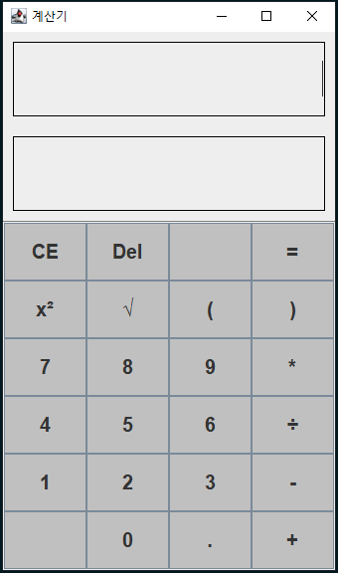
실행 결과

Slide 15
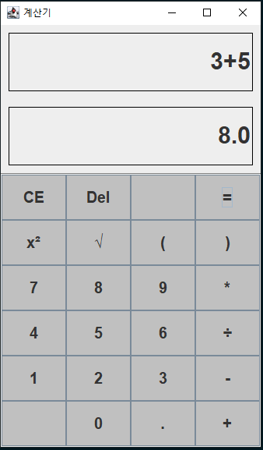
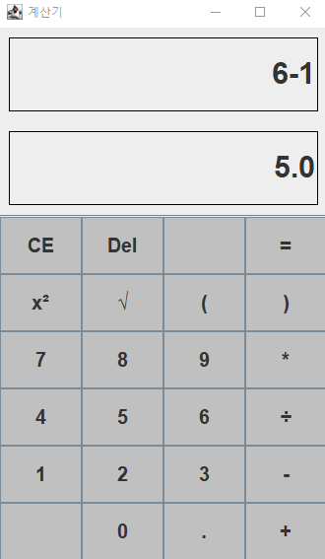
실행 결과

Slide 16
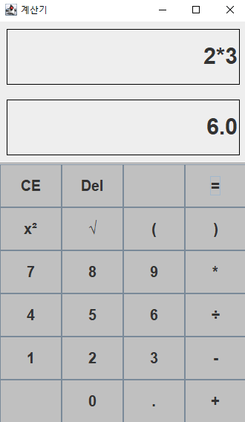
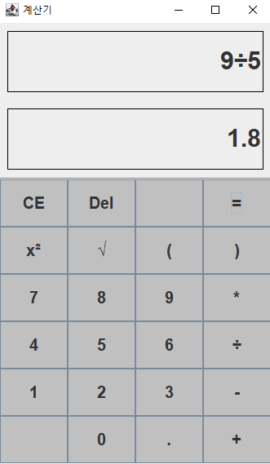
실행 결과

Slide 17
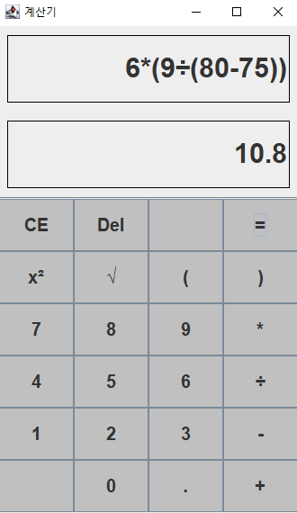
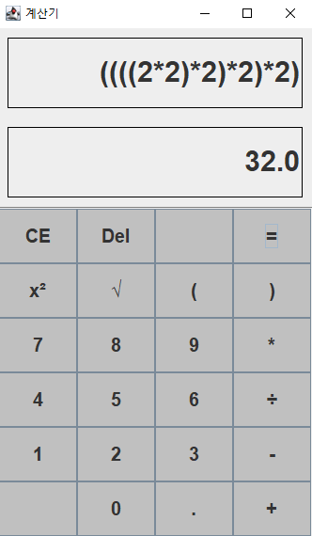
실행 결과

Slide 18
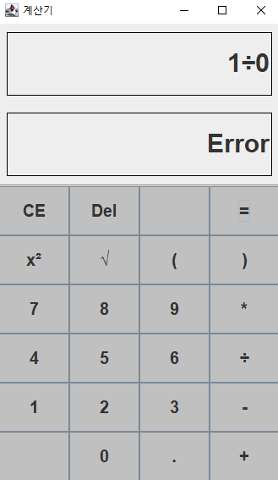
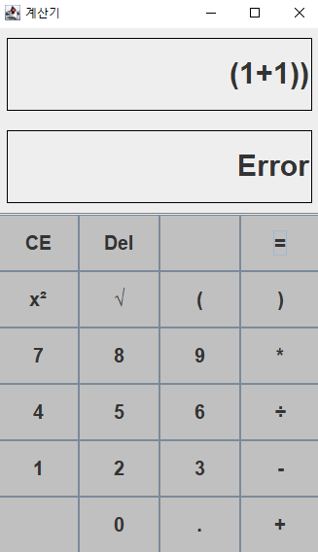
실행 결과

Slide 19
감사합니다
이름 | 신동욱
학번 | 20204101

