Slide 1
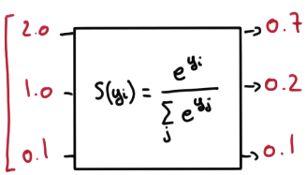
Softmax
Score
Probabilities

Slide 2
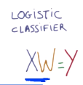


Slide 4

Cross entropy

Slide 5
Minimize cost

Slide 6
One hot encoding

Slide 7


Slide 8
Using arg_max

Slide 9
Using arg_max

Slide 10



Slide 11


Slide 12
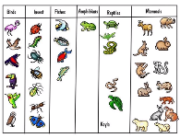
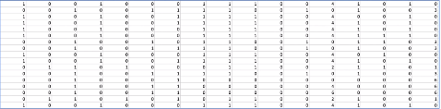

Slide 13


