Slide 1
TERM PROJECT
PRESENTATION
201533632 김동욱
201533671 조경호

Slide 2
INDEX
Classification(Bank Marketing)
-object setting
-data curation
-data inspection
-preprocessing
-analysis&evaluation
2. Clustering(World Development Indicators)
-object setting
-data curation
-data inspection
-preprocessing
-analysis&evaluation

Slide 3
Classification

Slide 4
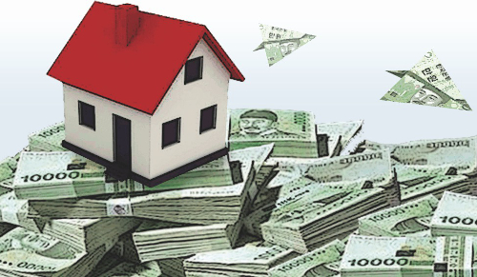
Objective – In proposal
Find people that have no housing loan
&
Explain and advertise about it

Slide 5
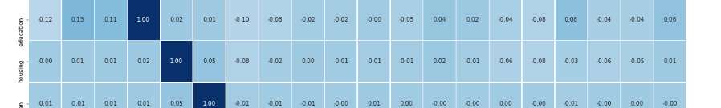
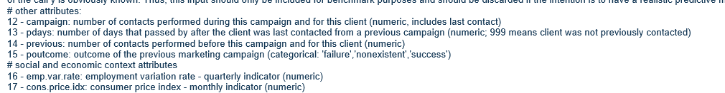
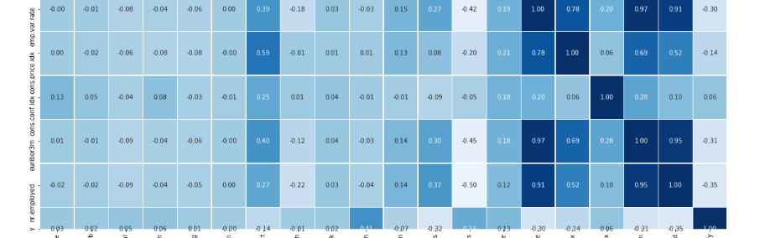
Objective – In proposal
housing
y

Slide 6

Objective
Find people that have no subscribe a term deposit
&
Explain and advertise again
If people that subscribe deposit receive advertise again, it can make side effect

Slide 7
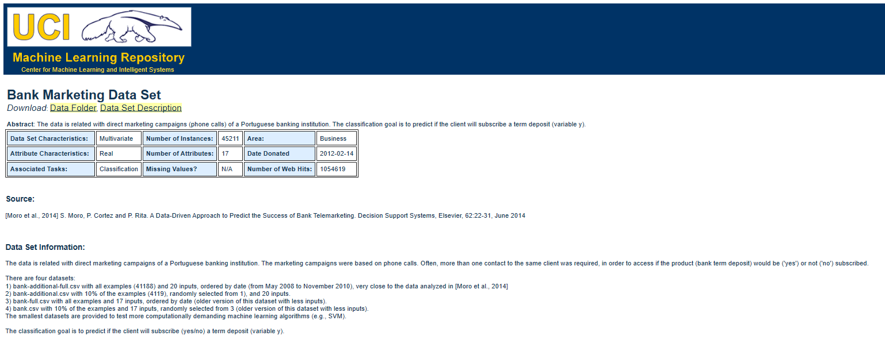
Data Curation
Bank Marketing Dataset

Slide 8
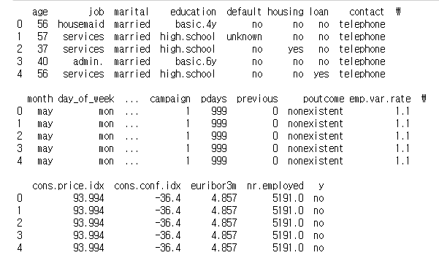
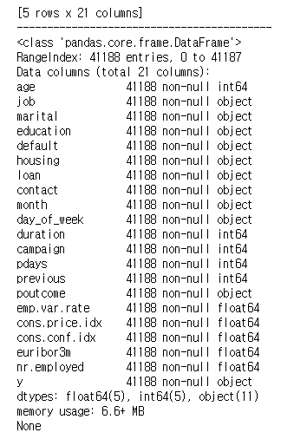
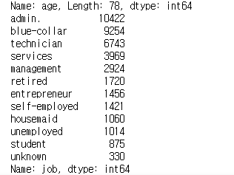
Data Inspection
Head()
Info()
Value_counts()

Slide 9
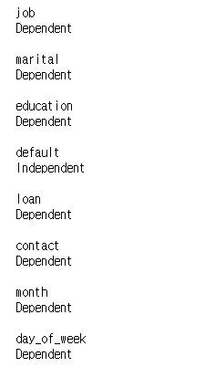
Data preprocessing
correlation()
Chi_square()
Low correlation
Drop
Independent column

Slide 10
Data Inspection
All column’s unknown rare
Drop unknown data

Slide 11
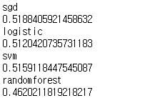
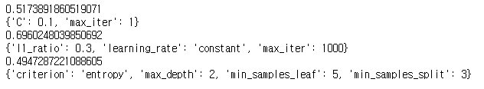
Algorithm & evaluation
It’s not a good ML Model
Dataset is not fit to
this objective
First algorithm test
Grid search

Slide 12
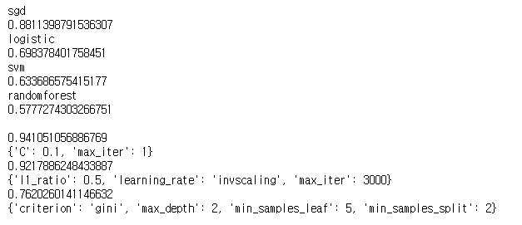
Algorithm & evaluation
Select
Algorithm test
Similar accuracy,
but for next analysis
Grid search

Slide 13
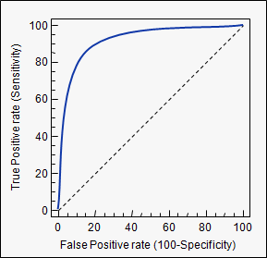
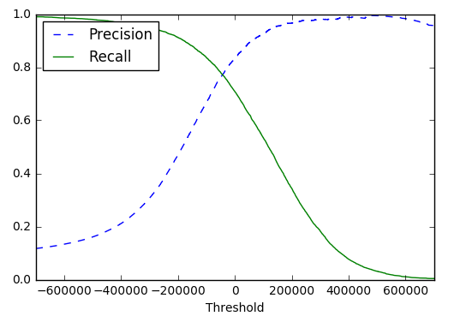
Algorithm & evaluation
ROC curve vs PR curve
We prefer the PR curve whenever
the positive class is rare
or when you care more about the
false positives than the false negatives

Slide 14
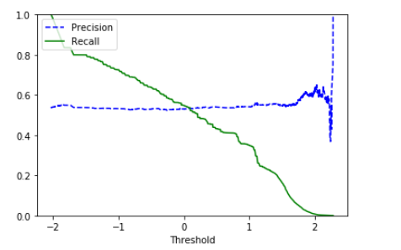
Algorithm & evaluation
Housing target PR curve
Change is not valuable
Very low recall , high precision is bad model

Slide 15
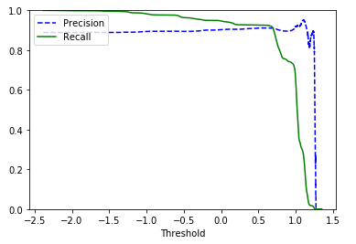
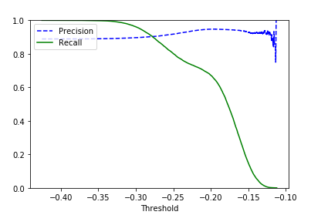
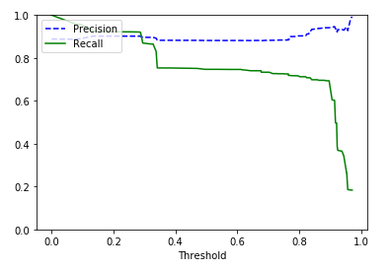
Algorithm & evaluation
SGD
Logistic
Random forest
Control threshold to make high precision

Slide 16

Algorithm & evaluation
How we control this?
Scikit-learn don’t support direct access to this

Slide 17

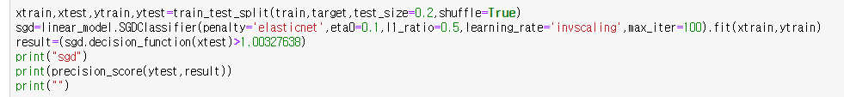
Algorithm & evaluation
How we control this?
SGD
Logistic
Random forest

Slide 18
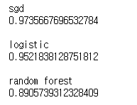

Algorithm & evaluation
Result
Is it really high?

Slide 19
Clustering

Slide 20
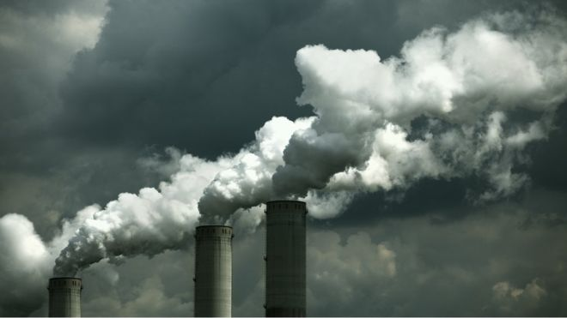
Objective
Cluster country by it’s Co2 emission,
And analyze it (by each year)

Slide 21
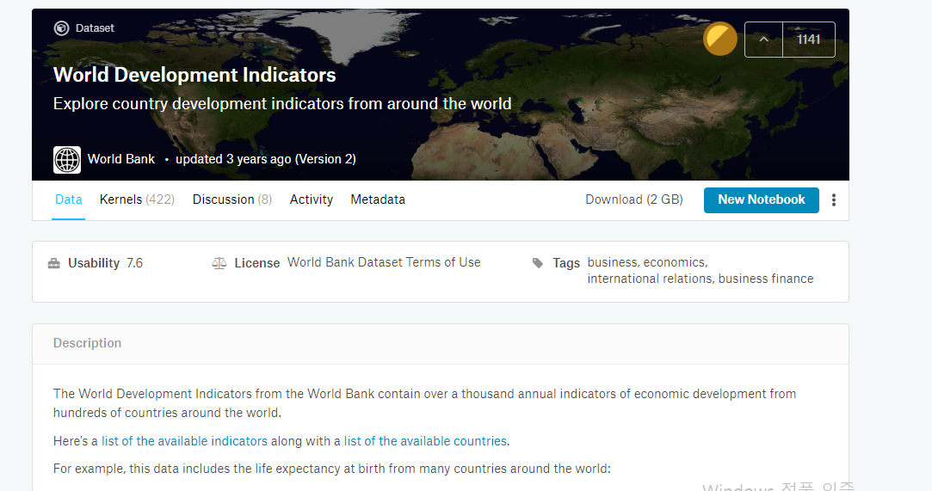
Data Curation
World Development Indicators

Slide 22
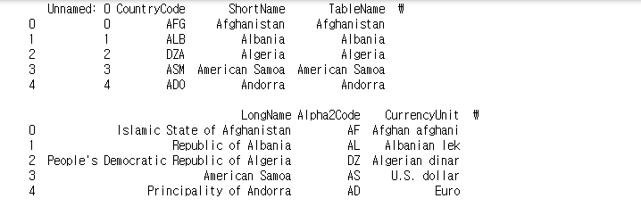
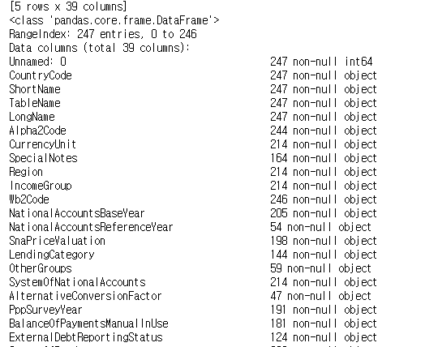
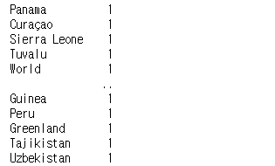
Data Inspection
Head()
Info()
Value_counts()

Slide 23

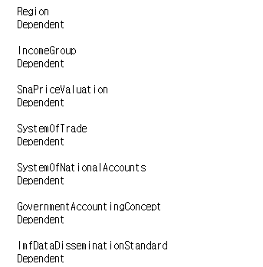
Data preprocessing
correlation()
Low correlation
Chi_square()
Drop
No Independent column

Slide 24
Data preprocessing
All data is unique
Drop column

Slide 25
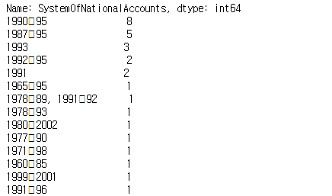
Data preprocessing
Each categorical data is rare
Drop column

Slide 26
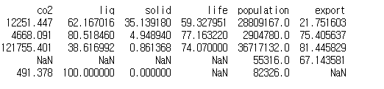
Data preprocessing
In categorical data,
fill it unknown value
- It look like some relation
In numeric data,
fill it mean value

Slide 27
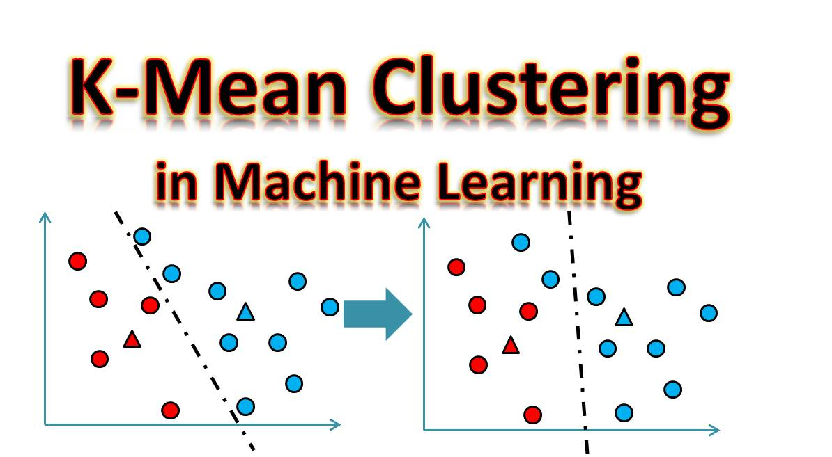
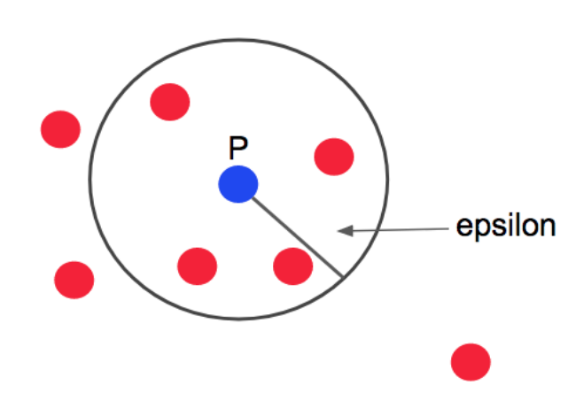
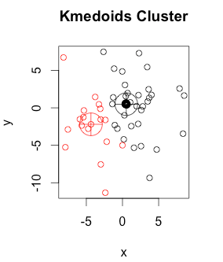
Algorithm & evaluation
K-means
DBSCAN
K-medoid

Slide 28
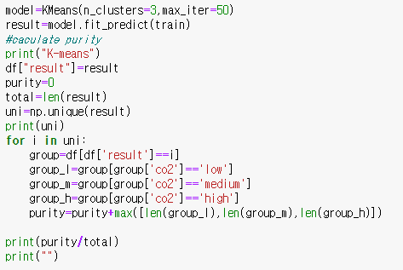
Algorithm & evaluation
Evaluate by Purity
Progress parameter tuning by purity

Slide 29
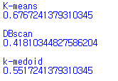
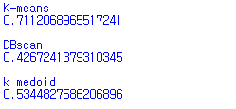
Algorithm – World development indicator
2010 result
2011 result

Slide 30
THANK YOU

