Slide 1
Analyzing the Secure Overlay
Services Architecture under
Intelligent DDoS Attacks
Dong Xuan*, Sriram Chellappan*,
Xun Wang* and Shengquan Wang⁺
*Dept. of Computer and Information Science,
The Ohio-State University
⁺Dept. of Computer Science,
Texas A&M University

Slide 2
Outline
Motivation
The SOS Architectures
Intelligent DDoS Attacks
Analysis
Related Work
Final Remarks

Slide 3
Motivation
Analyze the impacts of design features of the Secure Overlay Services (SOS) architecture on system performance under intelligent DDoS attacks

Slide 4
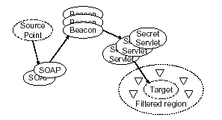
The Secure Overlay Service Architecture
It is an intermediate forwarding overlay system.
Layering: Each node only knows the next layer nodes.
Access to target controlled by a set of filters.
Target is known only to filters.

Slide 5
Design Features
The number of layers: 3 layers of hierarchy between sources and a target.
Mapping degree: Number of next layer neighbors
Node density: Number of nodes per layer
Under random congestion attacks, path availabilities are high.

Slide 6
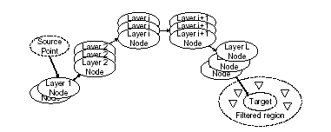
The Generalized SOS Architecture
Design features are flexible.

Slide 7
Intelligent DDoS Attacks
Combination of Congestion-based attacks and break-in based attacks
  Congestion attacks result in node being non-functional for the duration of the attack.
  Successful break-in attacks result in disclosure of next layer neighbors.

Slide 8
Combination of Congestion-based and Break-in based Attacks
One-burst attack model
  The attacker attempts to break into nodes all at once, depending on attack resources.
  The attacker congests the disclosed nodes and maybe more, or less depending on resources.
Successive attack model
  The attacker attempts to break into nodes depending on resources, in multiple rounds (R).
  The attacker congests the disclosed nodes and maybe more, or less depending on resources.
Other attack models are possible too.

Slide 9
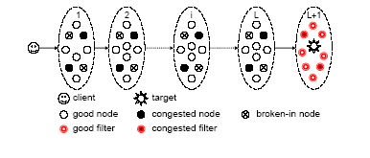
The SOS Working Scenario under Intelligent DDoS Attacks
Some nodes will be compromised (broken-in or congested)
Forwarding: Nodes will select an alive node in the next layer to do forwarding
Repair: no repair and repair

Slide 10
System Performance
  Probability that a client can find a path to communicate with the target, denoted by Ps.
  System performance is affected by the set of compromised nodes.

Slide 11
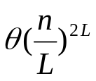
Analysis Methodology
A baseline approach
  Exhaustion-
  Listing all possible combinations of compromised nodes across layers and calculating Ps for each combination and summarizing them to get overall Ps.
  For a system with n nodes across L layers, we have
  combinations. It is un-scalable.

Slide 12
Analysis Methodology
We employ an average case approach to derive Ps.
  We calculate the average number of compromised nodes in each layer to obtain Ps.
  The key task is to estimate the set of compromised nodes in each layer.

Slide 13
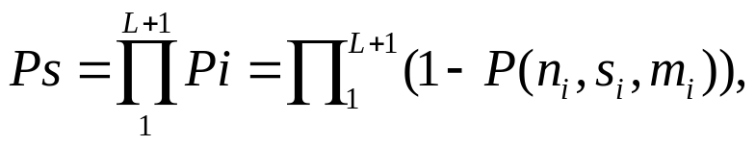
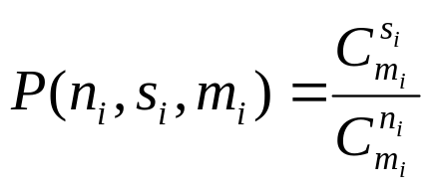
PS Computation Formula
We need to estimate individual probabilities (Pi) of finding a path between each layer
We need to determine the set of compromised nodes across each layer.
It is not easy. The main challenge is to discount overlaps among the set of compromised nodes, e.g., overlaps among disclosed nodes, overlaps among broken-in and disclosed nodes etc.
s_{i} = c_{i} + b_{i} , where c_{i} and b_{i} are the set of congested and broken-in nodes respectively.

Slide 14
System Parameters
System Model
  N overlay nodes, of which n are in the SOS system.
  System consists of L layers.
  Number of nodes in each layer is n_{i} .
  Mapping degree is m_{i} .
  Probability that a first layer node is known to attacker prior to attacks is Pe.
  Probability of a node being broken into is Pb.
  Probability of a node in layer i has a neighbor in layer i+1 is Pi.
Attacker resources
  Nt break-in resources.
  Nc congestion resources.

Slide 15
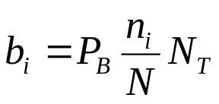
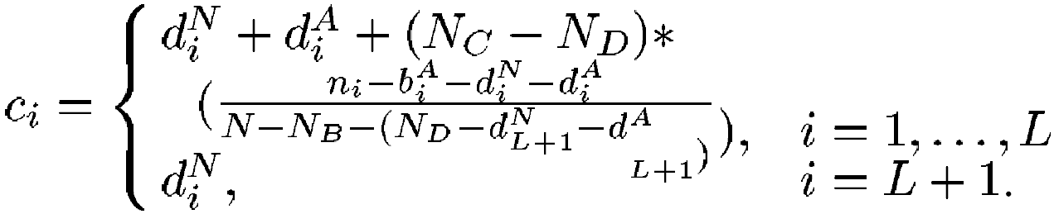
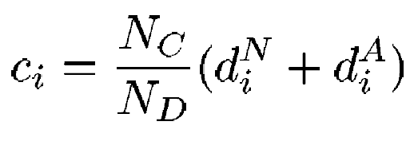
PS Computation under the One-burst Attack Model
Total number of broken into nodes in layer i are given by
Total number of congested nodes in layer i are given by
  When Nc ≥ Nd
  When Nc < Nd

Slide 16
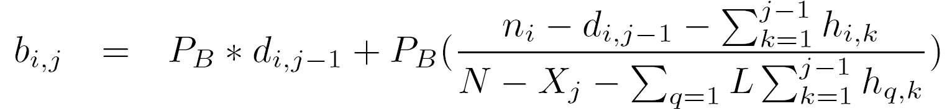

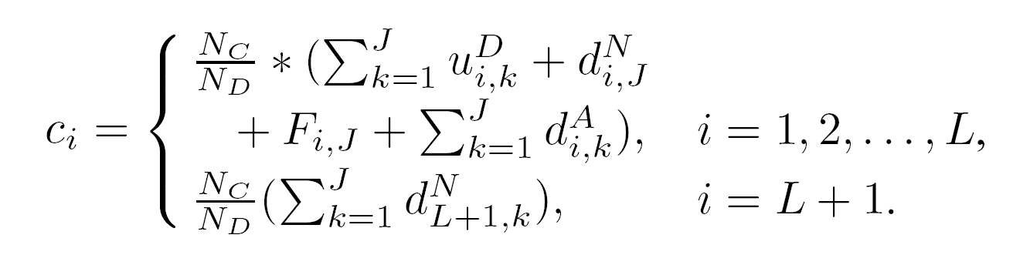
PS Computation under the Successive Attack Model
Total number of broken into nodes in layer i are given by
Total number of congested nodes in layer i are given by
  When Nc < Nd

Slide 17
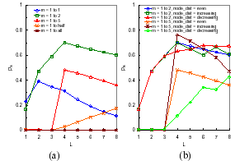
Sensitivity of Ps to Layer, Mapping Degree and Node Distribution
  N = 10,000, n = 100, Nc = 2000, Nt = 200, R=3, Pb = 0.5, Pe = 0.2.
L = 4 is best.
m_{i} = 1 to 2 seems best.
Increasing node distribution performs best.

Slide 18
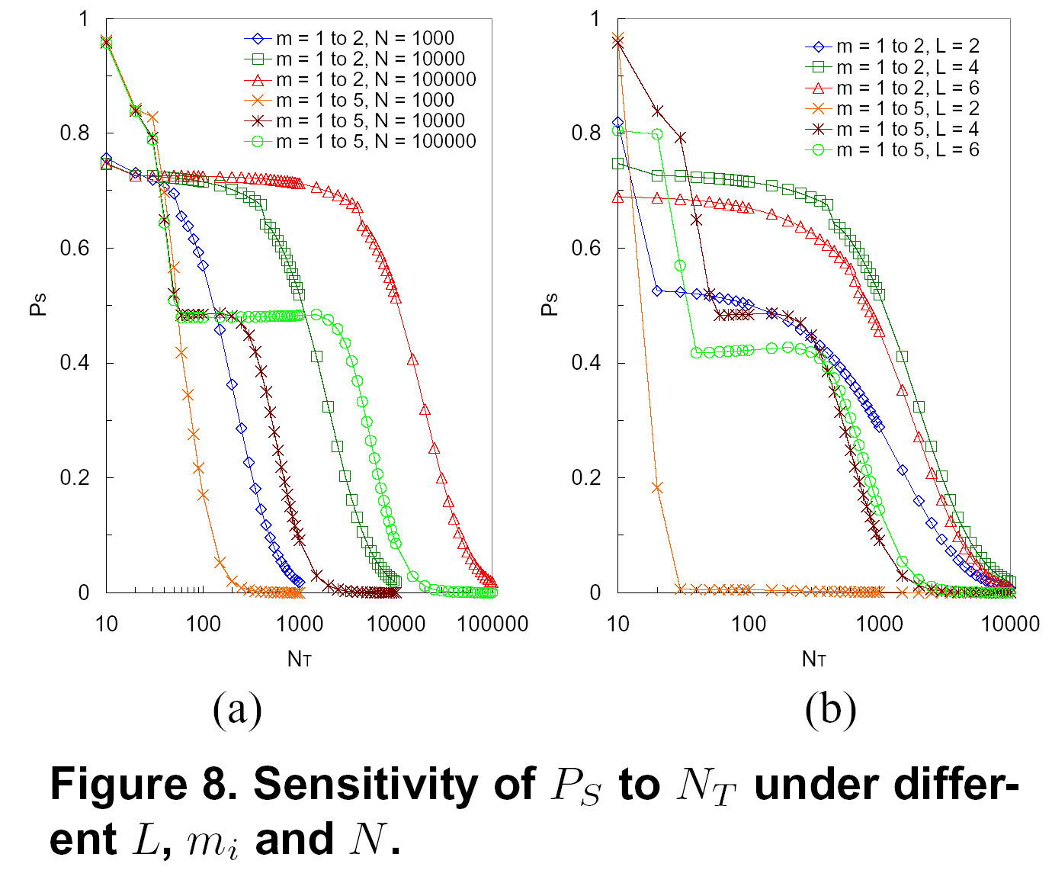
Sensitivity of Ps to Break-in Attack Intensity
  N = 10,000, n = 100, Nc = 2000, R=3, Pb = 0.5, Pe = 0.2, L = 4.
Ps is more sensitive to m_{i} with increasing Nt.
Stable portion due to advantages offered by layering.

Slide 19
Summary of Observations
L = 3 is not the best choice.
Mapping degree and number of layers have opposite effects on resilience to break-in and congestion attacks.
  Less layers offer more protection against congestion based attacks, but are not good under break-in attacks.
  A larger mapping degree offers more protection against congestion based attacks, but is not good under break-in attacks.
Increasing node distribution performs best in general.

Slide 20
Our On-Going Work
We are investigating the system performance under dynamic repair.
Dynamic Repair can be classified as-
  Reactive repair
  Proactive repair

Slide 21
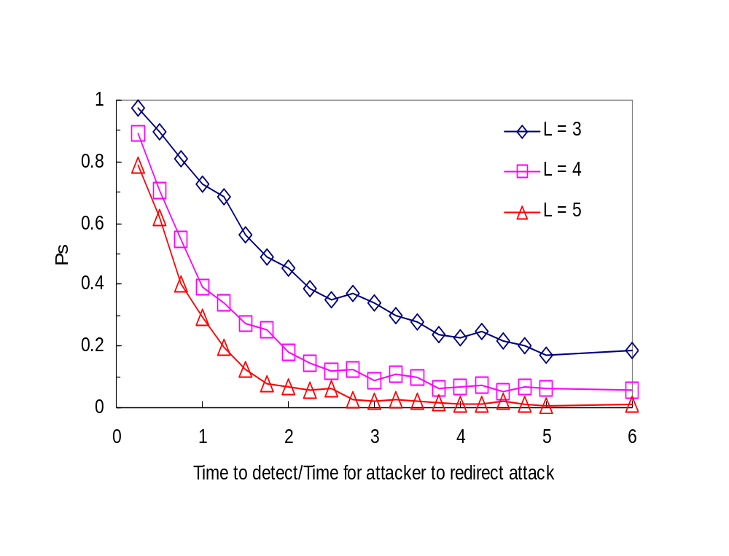
Reactive Repair
Reactive approaches can work if the system responds very quickly.

Slide 22
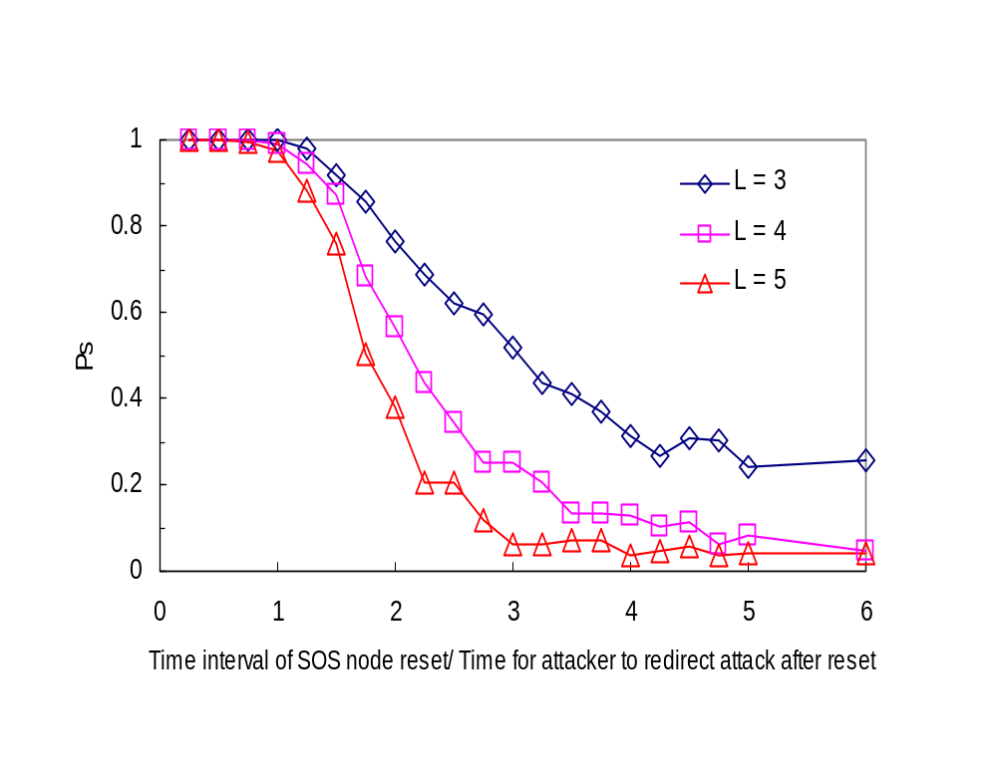
Proactive Repair
  N = 5000, n = 40, mi = 1 to 5, Nt = 1000, Nc = 2000.
Proactive approaches work more effectively that reactive approaches. We plan to study combination of proactive and reactive approaches.

Slide 23
Related Work
SOS focuses on system structure and dynamics under random congestion attacks.
  The layer number in SOS is fixed as 3.
  SOS does not consider break-in attacks.
MAYDAY generalizes work in terms of providing solutions to security threats in the overlay. It does not discuss design features.
UCSD work attempts to analyze intermediate forwarding systems under a simple break-in attack like model. They do not consider the congestion based attack and their combinations.

Slide 24
Final Remarks
Contributions
  We generalize the SOS architecture making design flexible.
  We define two novel and ‘intelligent’ DDoS attack models and an analysis approach that can be applied to analyze other similar systems.
  Our work provides strong guidelines to designers of such systems to enhance their resilience.
Open Issues
  More sophisticated attack models.
  Timely delivery.
  Dynamic repair (in progress).
  Underlying network attack model (in progress).
  Self healing systems under attacks.

