Slide 1

Sensor Networks Deployment using Flip-based Sensors
Sriram Chellappan, Xiaole Bai, Bin Ma‡ and Dong Xuan
Presented by Sriram Chellappan
chellapp@cse.ohio-state.edu
Department of Computer Science and Engineering
The Ohio State University, U.S.A.
‡ Department of Computer Science
University of Western Ontario, Canada
Nov 10th 2005

Slide 2
Overview
Flip-based sensors are simplest instances of limited mobility sensors
  A flip-based sensor can relocate by means of a discrete flip (or jump)
  Flips can be propelled by spring activation or by fuel ignition
Motivation to study
  Mobility in sensors is an energy consuming operation
  One concl. at RPMSN 2005 panel: Sensors should expend energy towards sensing/ communication rather than mobility
  Flip-based sensors can be powered by relatively simple mechanisms
  DARPA has already built such types of sensors
We study sensor networks deployment using flip-based sensors in this paper
Original location
New location

Slide 3
Outline
Flip-based sensor model
Our deployment problem
An example and challenges
Our optimal solution
Performance evaluations
Related work
Conclusions and future work
Notes:
note

Slide 4
Flip-based Sensor Model
Sensors can flip once to a new location
The basic unit of flip distance (d)
The maximum distance of flip (F)
  F=i x d, where i is an integer ≥1
Orientation mechanisms align sensors during flip

Slide 5
Our Deployment Problem
Sensor network model
  A rectangular field clustered into 2-D regions of size R
  A set of N flip-based sensors are deployed initially
  Initial deployment may have holes that do not contain any sensor
Problem definition
  Given the above sensor network model, determine a flip (movement) plan for the sensors to maximize number of regions with at least one sensor and simultaneously minimize the required number of sensor flips

Slide 6
An Example
Sensor Network with 16 regions
A simple, purely localized solution
Region 16 is still un-covered
1
2
3
4
1
2
3
4
5
6
7
8
5
6
7
8
9
10
11
12
9
10
11
12
13
14
15
16
13
14
15
16
(a)
(b)

Slide 7
Challenges in Limited Mobility
Limited mobility sensors is different from limiting the mobility of sensors
With limited mobility sensors:
  Movement distance itself is constrained
  Sensors have to be inter-dependent during movement
  An alternate movement plan for previous example is shown below
A chain of flips needs to be determined
1
2
3
4
1
2
3
4
5
6
7
8
5
6
7
8
9
10
11
12
9
10
11
12
13
14
15
16
13
14
15
16
(a)
(b)
d
1
2
3
4
5
source
(c)
destination

Slide 8
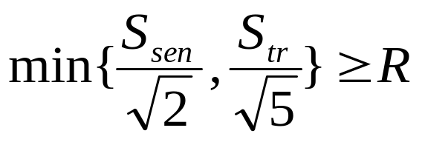
Assumptions
We assume that region R is contingent on application and has been decided
We assume that
We assume that sensors know their positions in the network
A routing protocol exists for sensors to forward information to base-station and vice-versa

Slide 9
Roadmap of Our Solution
Step 1: Sensors forward region information to the base-station
Step 2: With region information base-station constructs a virtual graph (VG)
  VG models initial network deployment and flip model
  The deployment problem is translated into min-cost max-flow problem
Step 3: The min-cost max-flow plan in VG is translated back as a flip plan for sensors

Slide 10
Why Our Problem can Translate to Min-cost Max-flow Problem
Definition: Two regions i and j are reachable if a sensor in region i can flip to region j and vice versa
Translation
  Model regions and reachability as vertices and edges
  Edge capacities denote how many sensors can move, and costs denote how many flips are required
  Every feasible flip sequence between regions has a feasible flow sequence between corresponding vertices in VG
Maximizing coverage ⬄ maximizing flow to sink regions in VG
Minimizing number of flips ⬄ minimizing cost of max-flow in VG

Slide 11
The Virtual Graph Construction
For each region ‘i’ in the sensor network, we create the following vertices in VG
  v_{i}^{b} to capture number of sensors in region i
  v_{i}^{in} to capture number of sensors that can flip into region i
  v_{i}^{out} to capture number of sensors that can flip from region i
Edges are added depending on reachability
For regions i with at least one sensor, v_{i}^{b} is a source vertex
For regions i with no sensor, v_{i}^{b} is a sink vertex

Slide 12
A Simple Example of VG Construction
R=d
1
2
v₁^{b}
v₂^{b}
1
0
0
inf
1
3
4
v₁^{in}
v₁^{out}
1
v₂^{in}
v₂^{out}
inf
1
(a)
(b)
Initial deployment
VG for regions 1 and 2
v₁^{b} is a sink and v₂^{b} is a source
Edge capacities are constrained
Non -zero edge costs are shown in Red

Slide 13
The Complete VG
R=d
v₁^{b}
v₂^{b}
Hole
1
0
Source
1
2
0
inf
1
v₁^{in}
v₁^{out}
v₂^{in}
v₂^{out}
inf
3
4
inf
inf
inf
inf
v₃^{b}
v₄^{b}
(a)
Source
0
1
Source
0
inf
2
Initial deployment
v₃^{in}
v₃^{out}
v₄^{in}
v₄^{out}
inf
(b)
Virtual Graph

Slide 14
Determining the Flip Plan
Determine the minimum-cost maximum flow in VG between source vertices and sink vertices
Each flow has capacity one (by definition)
The flow value between vertices v_{i}^{in} and v_{j}^{out} corresponds to a flip between regions i and j
The set of all such flips between regions (flip plan) is forwarded to corresponding sensors.
The resulting flip plan is optimal

Slide 15

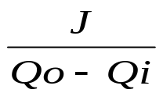
Performance Evaluations
We study sensitivity of coverage and number of flips to flip distance F
Metrics
  Coverage Improvement (CI) =
  Flip Demand (FD) =
  Qo and Qi denote final and initial number of regions covered and J denotes number of flips
Our Implementations
  Maximum Flow – Edmonds Karp algorithm
  Minimum cost flow – Goldberg’s successive approximation algorithm

Slide 16
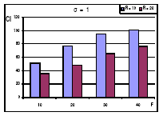
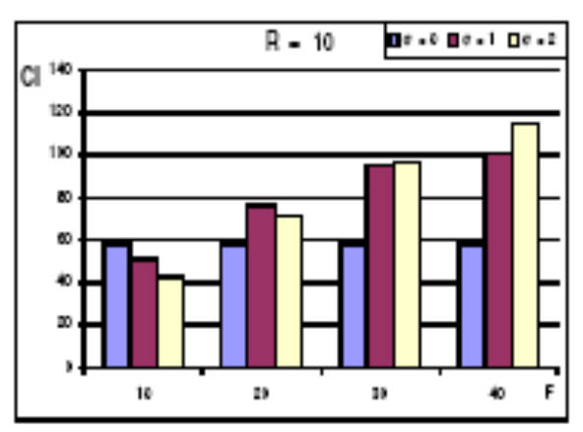
Performance Evaluations (CI)
Sensor Network model
  150mx150m and 300mx300m network, R=10m and 20m ,σ= 0, 1 and 2
(a)
(b)

Slide 17
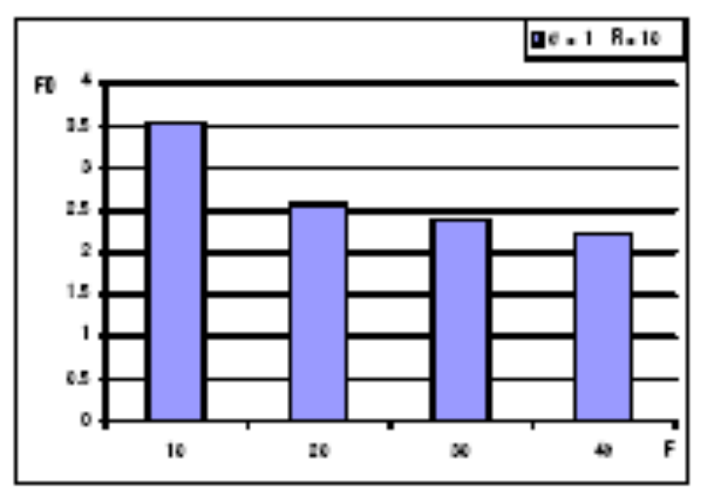
Performance Evaluations (FD)
Sensor Network model
  150mx150m network, R=10m,σ= 1

Slide 18
Discussions on Our Solution
Centralized
  Our solution requires global information
  It is executed by a centralized base-station
Can be executed distributedly
  With global information exchange, individual sensors can execute our solution
  Resulting solution is optimal
Other approaches without global information

Slide 19
An Alternate Distributed Approach
Divide the network into multiple areas
Determine flip plan in each area independently
A₁
A₂
A₃
A₄
(a)
(b)

Slide 20
Highly Applicable in Group Deployment
Air-dropping in landmarks
An instance
Distributed solution can be executed in each group
Performance is very close to optimum
G₁
G₂
G₃
G₄

Slide 21
Discussions on Our Models
Extensions for multiple sensor flips
  More regions are reachable
  The virtual graph needs to be modified
Repairing network partitions

Slide 22
Related Work
Mobility assisted deployment
  G. Cao et. al. in INFOCOM 2004
  K. Chakrabarty et. al. in INFOCOM 2003
  J. Wu and S. Yang in INFOCOM 2005
Mobility assisted localization
  N. Priyantha et. al. in INFOCOM 2005
  M. Sichitiu et. al. in MASS 2004
Mobility assisted tracking
  D. Towsley et. al. in MOBIHOC 2005

Slide 23
Conclusions and Future Work
Flip-based sensors are simplest cases of limited mobility sensors
We study an important deployment problem and derive optimum solutions for it
We observe that deployment can be enhanced significantly with sensors capable of only flip-based mobility
Our future work is in two directions
  Theoretically derive performance bounds
  Study a continuous mobility model (with limited distance)

Slide 24
Thank You !

