Slide 1

Defending against Search-based Physical Attacks in Sensor Networks
Wenjun Gu, Xun Wang, Sriram Chellappan,
Dong Xuan and Ten H. Lai
Presented by Dong Xuan
xuan@cse.ohio-state.edu
Department of Computer Science and Engineering
The Ohio State University

Slide 2
Physical Attacks: What and Why?
Physical attacks: destroy sensors physically
Physical attacks are inevitable in sensor networks
  Sensor network applications that operate in hostile environments
    Volcanic monitoring
    Battlefield applications
  Small form factor of sensors
  Unattended and distributed nature of deployment
Different from other types of electronic attacks
  Can be fatal to sensor networks
  Simple to launch
Defending physical attacks
  Tampering-resistant packaging helps, but not enough
  We propose a sacrificial node based defense approach to search-based physical attacks
Notes:
Physical attacks can permanently destroy the sensors, which are different from electronic attacks such as jamming attacks, which tries to interfere the radio channels and interrupt the sensor networks’ operation.
Emphasize that physical attacks are simple to lunch.

Slide 3
Outline
Physical attacks in sensor networks
Modeling search-based physical attacks
Defending against search-based physical attacks
Performance evaluations
Related work
Final remarks

Slide 4
Physical Attacks – A General Description
Two phases
  Targeting phase
  Destruction phase
Two broad types of physical attacks
  Blind physical attacks
  Search-based physical attacks

Slide 5



Blind Physical Attacks
Notes:
Due to the brute-force destruction methods and blindly selecting attack areas

Slide 6

Search-Based Physical Attacks
Notes:
It is hard for the attacker to get the exact location of the sensors, but it can isolate a relatively small area for each detection sensor.

Slide 7
Modeling Search-based Physical Attacks
Sensor network signals
  Passive signal and active signal
Attacker capacities
  Signal detection
  Attacker movement
  Attacker memory
Attack Model
  Attacker objective
  Attack procedure and scheduling
Notes:
Passive signals include heat, vibration, magnetic signals which are parts of the constant physical characteristics of the sensors. Active signals on the other hand include communication
messages, beacons, query messages etc., that are part of normal communications between sensors in the network.
Signal strength, active, passive signal detection range, active signal frequency
cluster-head: large active signal detection range, cluster-head rotation frequency
The cluster-head rotation is used to balance the power consumption and reduce the damage due to the destruction of the cluster-head
Isolation/detection accuracy
Attacker moving and destruction speed

Slide 8
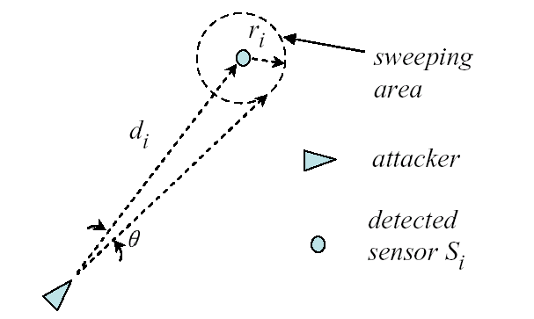
Signal Detection
d_{i}: Estimated distance
θ: Isolation accuracy
  Direction/Angle of arrival
πr_{i}²: Isolation/sweeping area
  r_{i} =d_{i *}θ
Attacker’s detection capacity is stronger than that of sensors

Slide 9
Network Parameters and Attacker Capacities
f: Active signal frequency
R_{noti}: message transmission range
R_{a}: The maximum distance the attacker is detected by active sensors
R_{s}: Sensing range
R_{ps}: Max. distance for passive signal detection
R_{as}: Max. distance for active signal detection
v: Attacker moving speed
M: Attacker memory size

Slide 10
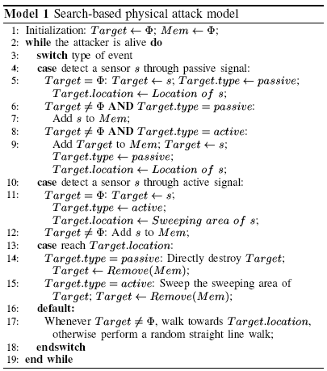
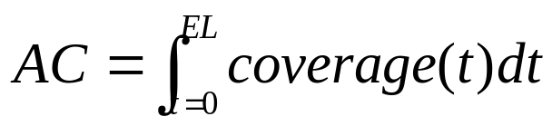
Attacker Objective and Attack Procedure
AC: Accumulative Coverage
  EL: Effectively Lifetime, the time period before the coverage falls below a threshold α
Objective: Decrease AC
Notes:
AC measures both coverage and lifetime of sensor networks.
During the scheduling of attack activities, the attacker needs to choose between normal sensors and the cluster-head if the time cost to destroy them is same
Need more time to reach cluster-heads and the corresponding sweeping areas are larger.

Slide 11
Discussions on Search-based Physical Attacks
Differentiate sensors detected by active/passive signals
  Sensors detected by passive signals are given preference
Scheduling the movement when there are multiple detected sensors
  Choose sensors detected by passive signals first
  Choose the one that is closest to the attacker
  Optimal scheduling?
    Due the dynamics of the attack process, it is hard to get the optimal path in advance

Slide 12
Defending against Search-based Physical Attacks
Assumptions
  Sensors can detect the attacker or
  Destroyed sensors can be detected by other sensors
  Attacker’s detection capacity is stronger than sensors, but not unlimited
A simple defense approach
Our sacrificial node based defense approach

Slide 13
A Simple Defense Approach
: Attacker
: Sensor
R_{noti}
s₃
R_{noti}
s₇
R_{noti}
s₁
s₄
s₂
s₆
s₅

Slide 14
Our Defense Approach
Adopting Sacrificial Nodes (sensors) to improve monitoring of the attacker and to increase the protection areas
  A sacrificial node is a sensor that keeps active in proximity of the attacker in order to protect other sensors at the risk of itself being detected and destroyed
  Attack Notifications from victim sensors
  States Switching of receiver sensors of Attack Notifications to reduce the number of detected sensors

Slide 15
Defense Protocol
3
3
1: receive AN,
not be sacrificial node
2: receive AN,
be sacrificial node
3: not receive AN,
receive SN
4: T₁ expires
5: T₂ or T₃ expires
6: destroyed by attacker
Sending
(nonsacrificial
node)
5
Sensing
1
6
6
2
Destroyed
4
1
2
6
6
Sending
(sacrificial node)
1
Sleeping
3
2

Slide 16
An Illustration of Our Defense Approach
: Attacker
: Sensor
R_{noti}
s₃
R_{noti}
s₇
R_{noti}
s₁
s₄
s₂
s₆
s₅

Slide 17
Discussions on Our Defense Protocol
Trade short term local coverage for long term global coverage
  Sacrificial nodes compensate the weakness of sensors in attack detection
  Our defense is fully distributed
Sacrificial node selection
  Who should be sacrificial nodes?
State switching - timers
  When to switch to sensing/sleeping state to prevent detection?
  When to switch back to sensing/sending state to provide coverage?

Slide 18
Sacrificial Node Selection
Principle
  The more the potential nodes protected can be, higher is the chance to be sacrificial node
Solution
  Utility function u(i) is computed by each sensor based on local information
  Sensor i decides to be sacrificial node if u(i) >= U_{th}
  U_{th} = β * U_{ref} (0<β<1); U_{ref} = N * π* R²_{noti} / S

Slide 19

Utility Function u(i)
What is the basic idea of u(i)?
The more nodes being protected, the larger u(i) is
Overlap is discounted
Distance matters
Theorem 1: The utility function u(i) is optimal in terms of minimizing the expected mean square error between u(i) and u^{opt}(i)

Slide 20


State Switching
D(i): Random delay for SN message
T(i): timers for states switching

Slide 21
Performance Evaluation
Network parameters:
  S: 500 * 500 m²
  N: 2000
  α: 0.5
  f: 1 / 60 second
  R_{noti}: 20 m
  R_{a}: 0.1 m
  R_{s}: 10 m
Attack parameters:
  R_{ps}: 5 m
  R_{as}: 20 m
  v: 1 m/second
  M: 2000
Protocol parameters:
  β: 0.7
  Δt: 0.01 second
  T: 20 seconds

Slide 22
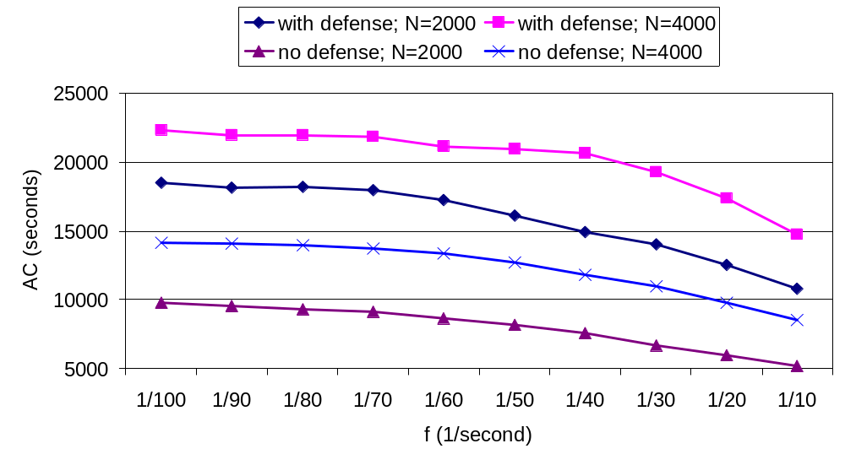
Defense Effectiveness under Different Network Parameters

Slide 23
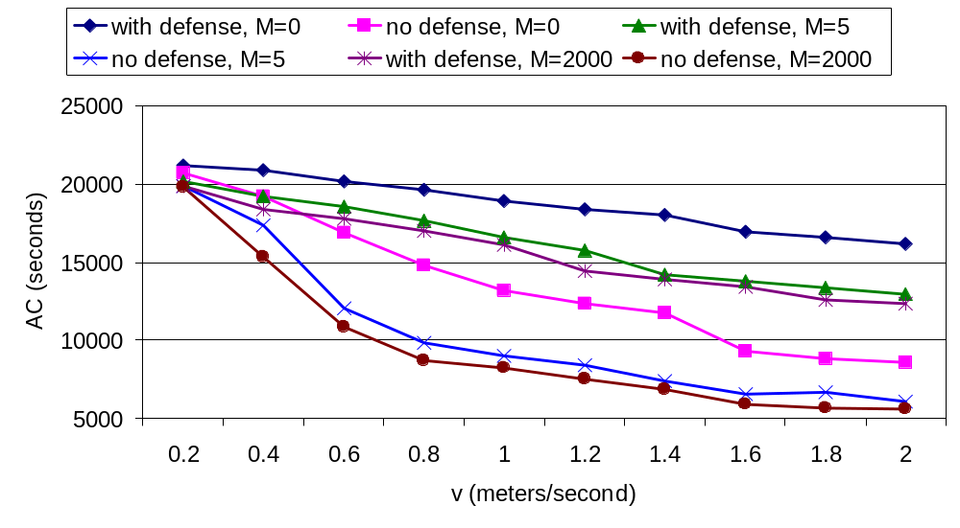
Defense Effectiveness under Different Attacker Parameters

Slide 24
Related Work
Blind physical attack:
  X. Wang et al. Lifetime Optimization of Sensor Networks under Physical Attacks, ICC, 2005
Jamming attack:
  D. Wood et al. Jam: A Jammed-Area Mapping Service for Sensor Networks, RTSS, 2003
Other electronic attacks:
  C. Karlof et al. Secure Routing in Wireless Sensor Networks: Attacks and Countermeasures, WSNA, 2003
WSN security survey:
  A. Perrig et al. Security in Wireless Sensor Networks, Communications of the ACM, 2004

Slide 25
Final Remarks
Physical attacks are patent and potent threats to sensor networks
We modeled Search-based Physical attacks
We proposed a Sacrificial Node-assisted approach to defend against physical attacks
Viability of future sensor networks is contingent on their ability to defend against physical attacks

Slide 26
Thank You !

