Slide 1

Network Decoupling for
Secure Communications in
Wireless Sensor Networks
Wenjun Gu, Xiaole Bai, Sriram Chellappan and Dong Xuan
Presented by Wenjun Gu
gu@cse.ohio-state.edu
Department of Computer Science and Engineering
The Ohio State University, U.S.A.
IWQoS06, June 20th 2006

Slide 2
Secure communications in WSNs
Wireless sensor networks (WSNs)
  Secure communications are important
  Pair-wise keys among neighboring nodes are needed
Random Key Pre-distribution (RKP) schemes
  Pre-deployment: distribute a random set of keys to each sensor
  Post-deployment: establish pair-wise keys
RKP schemes have been well accepted
  Random deployment of WSNs in many cases
  Simplicity
  Distributed
  Many follow-up works

Slide 3
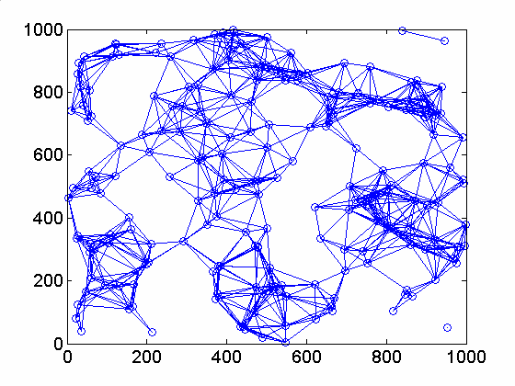
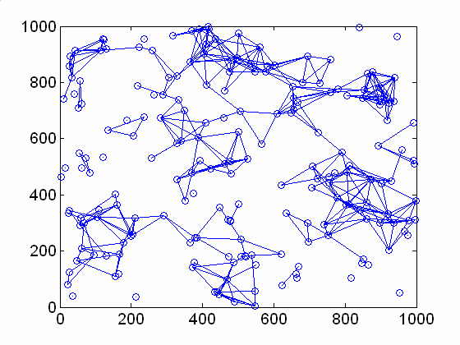
However…
RKP schemes have two inherent limitations:
  Randomness in key pre-distribution
  Strong constraint in key path construction
The current RKP schemes can only
work in highly dense networks!!
(a) physical node degree: 9.71 (b) secure node degree: 4.06

Slide 4
Our major contributions
We propose network decoupling to release the strong constraint, making RKP schemes applicable in non-highly dense networks
We further design a new RKP-based protocol, i.e. RKP-DE, in a decoupled sensor network

Slide 5
Outline
Background: Random Key Pre-distribution (RKP) schemes
Network decoupling methodology
RKP-DE: a secure neighbor establishment protocol
Performance analysis
Related work
Final remarks

Slide 6
Why new key management schemes in WSNs
Traditional schemes cannot work in WSNs
  Key distribution center (KDC) →
  poor scalability and single point of failure
  Public key based schemes →
  high communication / computation overhead
  Single master key for all sensors →
  poor security
  Distinct key for each pair of sensors →
  high storage overhead

Slide 7
Random Key Pre-distribution (RKP) schemes
Key pre-distribution
  Each sensor is pre-distributed with k keys randomly chosen from a key pool with size K
  Sensors are deployed randomly
Pair-wise key establishment
  Direct setup: share pre-distributed keys
  Indirect setup: construct a key path via a proxy sensor nearby

Slide 8
An example of RKP scheme
{k₅, k₈, k₉}
k = 3
K = 10
{k₁, k₄, k₅}
{k_{ac}}_{k1}
Req
d
b
Req
Req
Req
a
{k₁, k₂, k₃}
{k_{ac}}_{k4}
c
e
{k₄, k₆, k₇}
{k₆, k₈, k₉}

Slide 9
Inherent limitation of RKP schemes
Logical constraint
  Sharing pre-distributed key(s)
Physical constraint
  Within communication range
Both constraints
are coupled
{k₅, k₈, k₉}
{k₁, k₄, k₅}
d
b
a
{k₁, k₂, k₃}
c
e
{k₄, k₆, k₇}
{k₆, k₈, k₉}

Slide 10
Attack model and performance metrics
Attack model
  Link monitoring: monitor all links
  Node capture: capture some nodes
Performance metrics
  Connectivity: probability two neighboring sensors can establish a pair-wise key
  Resilience: probability a pair-wise key is uncompromised

Slide 11
Low secure node degree with RKP
(a) (b)
physical node degree: 9.71 secure node degree: 4.06
secure node degree = physical node degree * connectivity

Slide 12
Our solutions
Methodology: network decoupling
  Decouple the logical and physical constraints in key path construction
Protocol: RKP-DE
  A secure neighbor establishment protocol based on network decoupling
  Dependency elimination

Slide 13
Network decoupling
A network is decoupled into
  A logical key-sharing network: an edge between two sensors iff they share pre-distributed keys
  A physical neighborhood network: an edge between two sensors iff they are within communication range

Slide 14
An example of network decoupling
d
b
a
{k₅, k₈, k₉}
{k₁, k₄, k₅}
d
c
e
b
(b) Logical graph
decouple
a
d
{k₁, k₂, k₃}
b
c
e
a
{k₄, k₆, k₇}
{k₆, k₈, k₉}
c
e
(a) Local information of node a
(c) Physical graph

Slide 15
RKP-DE protocol
Keys are randomly pre-distributed to each node at the pre-deployment stage. There are four steps at post-deployment stage:
  Step1: Local graphs construction
  Step2: Key paths construction
    Logical key paths are constructed in logical network
    Each logical link is constructed in physical network
  Step 3: Link and path dependency elimination
  Step 4: Pair-wise key establishment

Slide 16
Key paths construction
a
d
b
a
b
c
e
a
c
Logical graph
d
a
d
b
e
a
c
e
d
Physical graph
Two key paths from a to d

Slide 17
Link and path dependency elimination
Not all key paths helpful for resilience
Link dependency
Path dependency
{k₁, k₂}
{k₁, k₂}
{k₁, k₂, k₃}
c
d
e
f
a
b
{k₁, k₂}
c
{k₄}
a
b
{k₂}
{k₄}
d

Slide 18
Pair-wise key establishment
{k₅, k₈, k₉}
{k₁, k₄, k₅}
{k_{ad}⁽¹⁾}_{k5}
d
{k_{ad}⁽²⁾}_{k4}
b
k_{ad}⁽¹⁾
{k_{ad}⁽¹⁾}_{k1}
{k_{ad}⁽²⁾}_{k1}
k_{ad}⁽²⁾
a
{k₁, k₂, k₃}
{k_{ad}⁽²⁾}_{k8}
{k_{ad}⁽²⁾}_{k6}
c
e
{k₄, k₆, k₇}
{k₆, k₈, k₉}
k_{ad} = k_{ad}⁽¹⁾ XOR k_{ad}⁽²⁾

Slide 19
Performance analysis
Methodologies
  Theoretical analysis
  Simulation
Metrics
  Secure node degree
  Connectivity: local and global connectivity
  Resilience

Slide 20
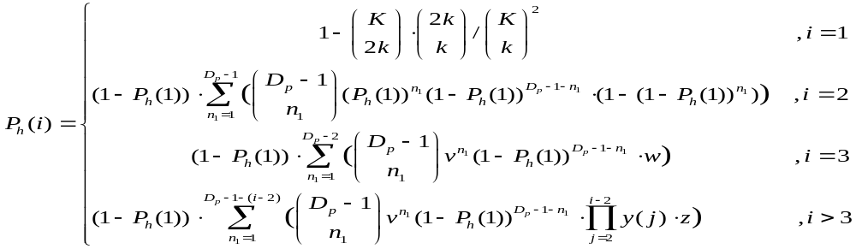
Analyzing secure node degree
probability that a sensor u can find a key path to a neighboring sensor v within both sensors’ information areas with minimum i logical hops
probability that a sensor u can find a key path to a neighboring sensor v within sensor u’s information area with minimum i logical hops
secure node degree in RKP-DE protocol
For explanation and derivation of other variables, please refer to our technical report at ftp://ftp.cse.ohio-state.edu/pub/tech-report/2006/TR27.pdf

Slide 21
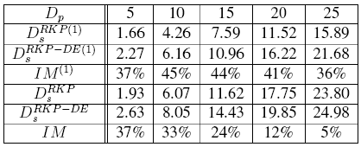
Improved secure node degree (analytical result)
Formulas in previous slide are for arbitrary number of hops, while data here and in next slide are for 2 hops only. Formulas for 2 hops are much simpler.
only one proxy is used on each logical key path
arbitrary number of proxies are used on each logical key path

Slide 22
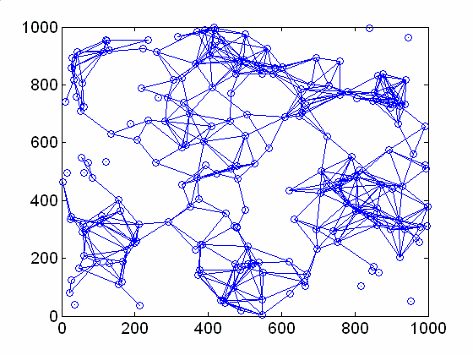
Improved secure node degree
(simulation result)
(a) (b) (c)
physical node secure node secure node
degree: 9.71 degree: 4.06 degree: 5.68

Slide 23
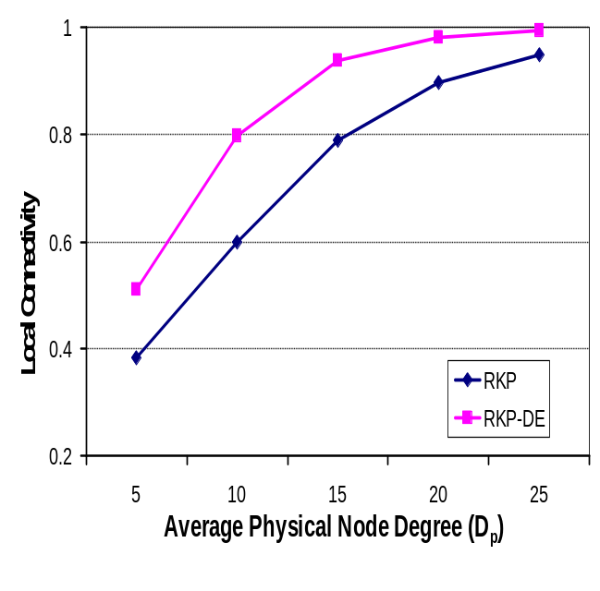
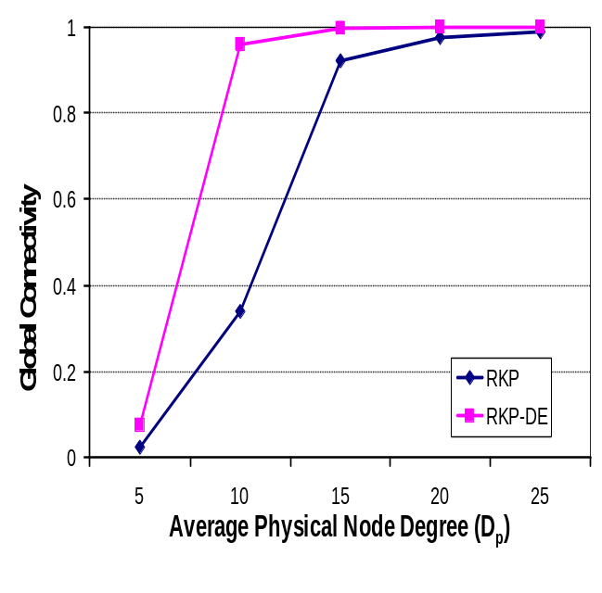
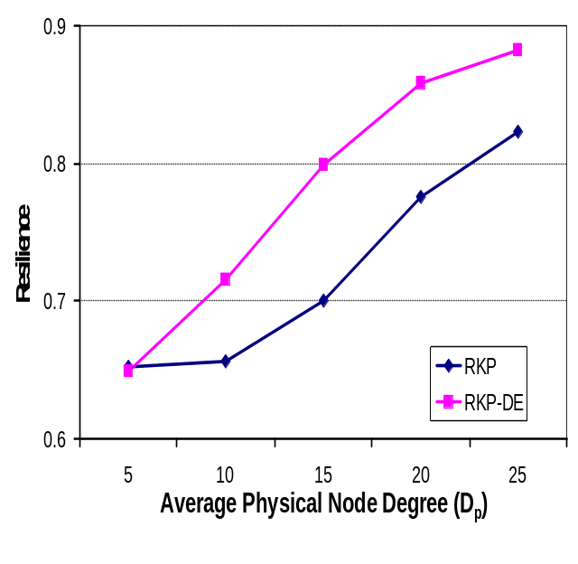
Connectivity and resilience
Sensitivity to physical node degree (D_{p})

Slide 24
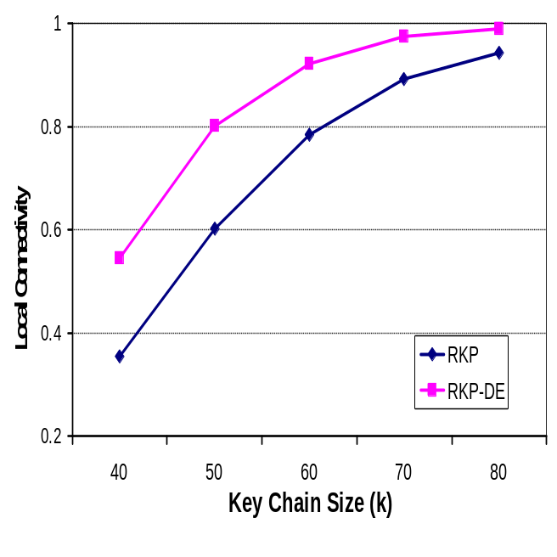
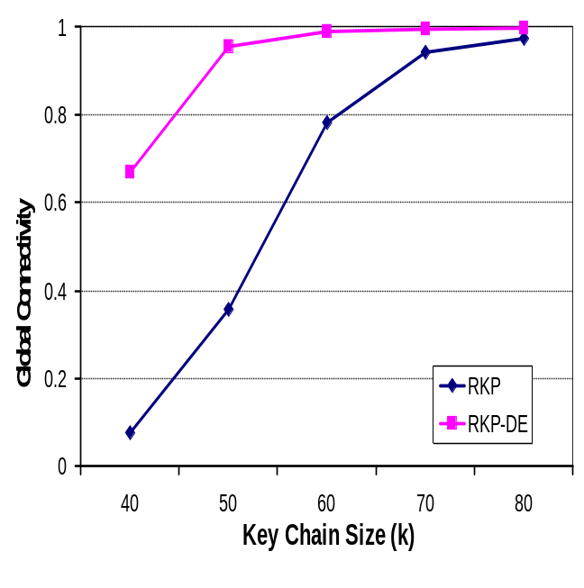
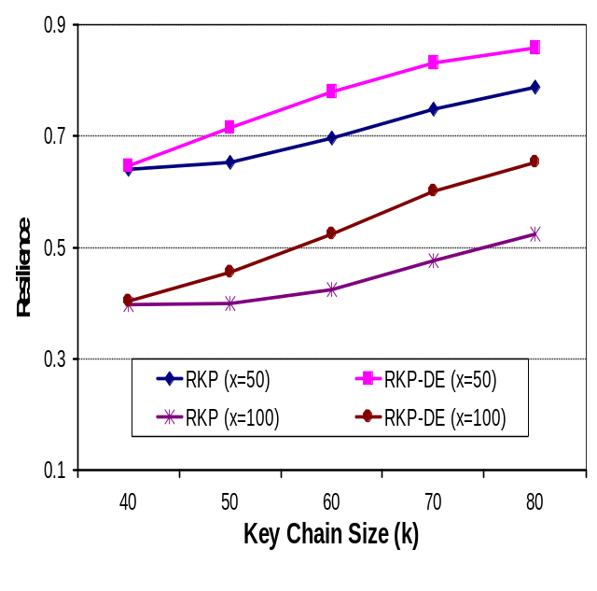
Connectivity and resilience (cont.)
Sensitivity to key chain size (k) and number of captured nodes (x)

Slide 25
Related work
Network decoupling
  Internet: QoS control plane and data forwarding plane decoupling [Kung & Wang 1999]
  Sensor Networks: path naming and selection [Niculescu & Nath 2003]
Improving RKP
  Pre-deployment: key pre-distribution based on deployment knowledge [Du et al. 2004]
  Post-deployment: Remote proxy [Chan & Perrig 2005]

Slide 26
Final remarks
Secure communications are important in WSNs
Traditional RKP schemes suffer from the strong constraint in key path construction
Our contributions:
  Network decoupling releases the strong constraint
  RKP-DE protocol for secure neighbor establishment
Future work:
  Testbed implementation

Slide 27
References
[Kung & Wang 1999]: Tcp trunking: Design, implementation and performance, ICNP 1999
[Niculescu & Nath 2003]: Trajectory based forwarding and its applications, Mobicom 2003
[Du et al. 2004]: A key management scheme for wireless sensor networks using deployment knowledge, Infocom 2004
[Chan & Perrig 2005]: PIKE: Peer Intermediaries for Key Establishment in Sensor Networks, Infocom 2005

Slide 28
Thank You !

