Slide 1

Deploying Wireless Sensors to Achieve
Both Coverage and Connectivity
Xiaole Bai* , Santosh Kumar* , Dong Xuan* ,
Ziqiu Yun⁺ , Ten H. Lai*
* Computer Science and Engineering
The Ohio State University
USA
+ Department of Mathematics,
Suzhou University
P.R.CHINA

Slide 2
The Optimal Connectivity and Coverage Problem
What is the optimal number of sensors needed to achieve p-coverage and q-connectivity in WSNs?
An important problem in WSNs:
  Connectivity is for information transmission and coverage is for information collection
  To save cost
  To help design topology control algorithms and protocols; other practical benefits
The Ohio State University

Slide 3
Outline
p-coverage and q-connectivity
Previous work
Main results
  On optimal patterns to achieve coverage and connectivity
  On regular patterns to achieve coverage and connectivity
Future work
Conclusion
The Ohio State University

Slide 4
p- Coverage and q-Connectivity
p-coverage: every point in the plane is covered by at least p different sensors
q-connectivity: there are at least q disjoint paths between any two sensors
Node C
r_{c}
r_{s}
Node D
For example, nodes A, B, C and
D are two connected
Node A
Node B
The Ohio State University

Slide 5
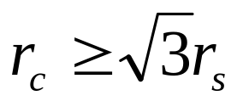
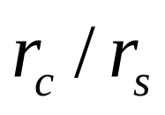
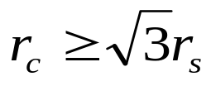
Relationship between r_{s} and r_{c}
Most existing work is focused on
In reality, there are various values of
The reliable communication range of the Extreme Scale Mote (XSM) platform is 30 m and the sensing range of the acoustics sensor for detecting an All Terrain Vehicle is 55 m
Sometimes even when it is claimed for a sensor platform to have , it may not hold in practice because the reliable communication range is often 60-80% of the claimed value
The Ohio State University

Slide 6
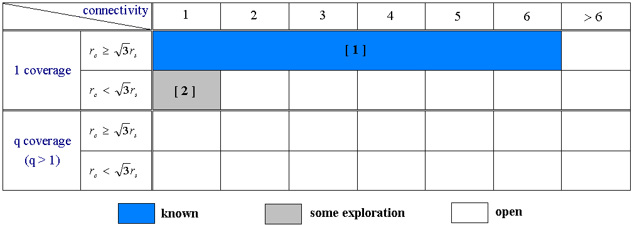
Previous Work
Research on Asymptotically Optimal Number of Nodes
[1] R. Kershner. The number of circles covering a set. American Journal of Mathematics, 61:665–671, 1939, reproved by Zhang and Hou recently.
[2] R. Iyengar, K. Kar, and S. Banerjee. Low-coordination topologies for redundancy in sensor networks. MobiHoc2005.
The Ohio State University

Slide 7
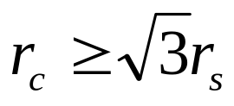
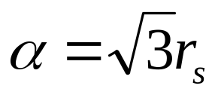
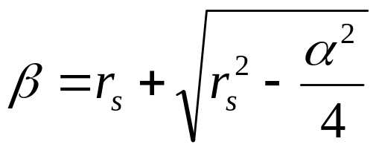
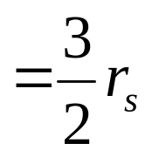
Well Known Results: Triangle Lattice Pattern [1]
β
α
We notice it actually achieves 1-coverage and 6-connectivity.
The Ohio State University

Slide 8
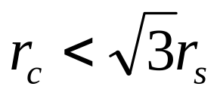
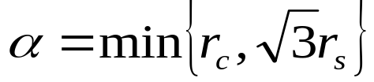

Strip-based Pattern
β
α
α/2
In [2], the strip-based pattern is showed to be close to the optimal
deployment pattern when r_{c} = r_{s} in terms of number of nodes needed.
The Ohio State University

Slide 9
Our Focuses
Research on Asymptotically Optimal Number of Nodes
OUR WORK
The Ohio State University

Slide 10
Our Main Results
1-connectvity: We prove that a strip-based deployment pattern is asymptotically optimal for achieving both 1-coverage and 1-connectivity for all values of r_{c} and r_{s}
2-connectvity: We also prove that a slight modification of this pattern is asymptotically optimal for achieving 1-coverage and 2-connectivity
Triangle lattice pattern can be considered as a special case of strip-based deployment pattern
The Ohio State University

Slide 11
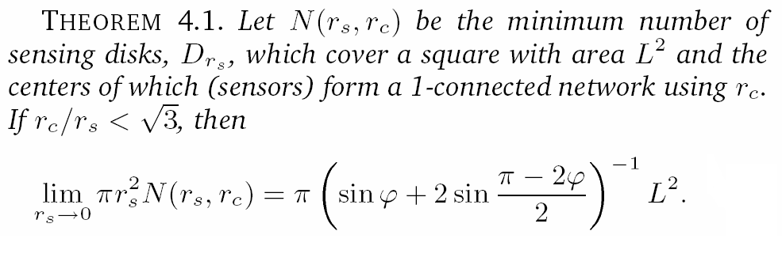
Theorem on Minimum Number of Nodes for 1-Connectivity
The Ohio State University

Slide 12


Sketch of the proof : basic ideas for both 1-connectivity and 2-connectivity
1.
We show that, when 1-connectivity is achieved, the whole area is
maximized when the Voronoi Polygon for each sensor is a hexagon.
2.
We get the lower bound:
3.
Prove the upper bound by construction
The Ohio State University

Slide 13
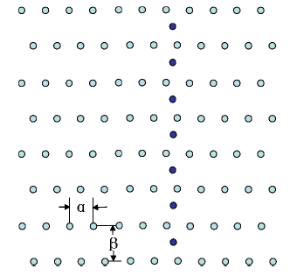
Our Optimal Pattern for 1-Connectivity
Place enough disks between the strips to connect them
  See the paper for a precise expression
  The number is disks needed is negligible asymptotically
Note : it may be not the only possible deployment pattern
The Ohio State University

Slide 14
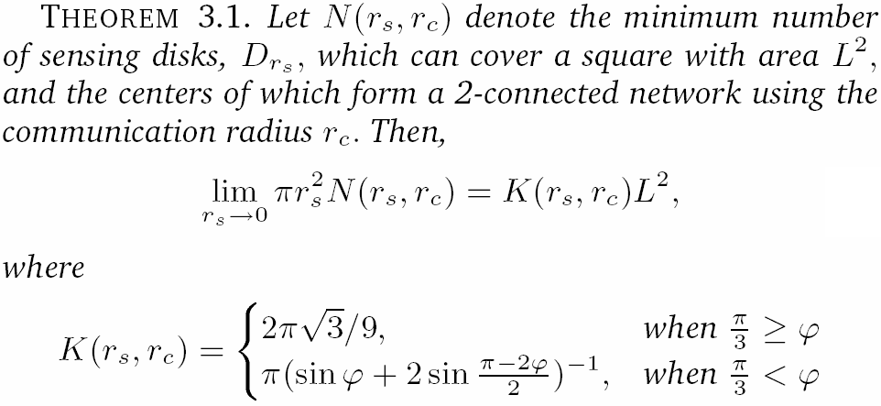
Theorem on Minimum Number of Nodes for 2-Connectivity
The Ohio State University

Slide 15
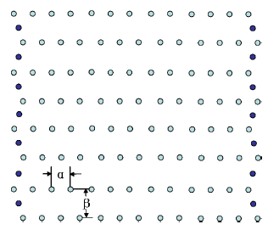
Our Optimal Pattern for 2-Connectivity
Connect the neighboring horizontal strips at its two ends
Note : it may be not the only possible deployment pattern
The Ohio State University

Slide 16
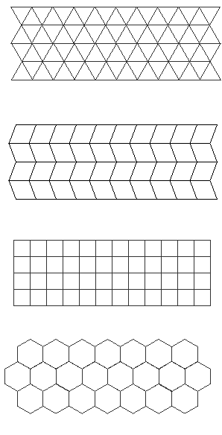
Regular Patterns
Triangular Lattice (can achieve 6 connectivity)
Rhombus Grid (can achieve 4 connectivity)
Square Grid (can achieve 4 connectivity)
Hexagonal (can achieve 3 connectivity)
The Ohio State University

Slide 17
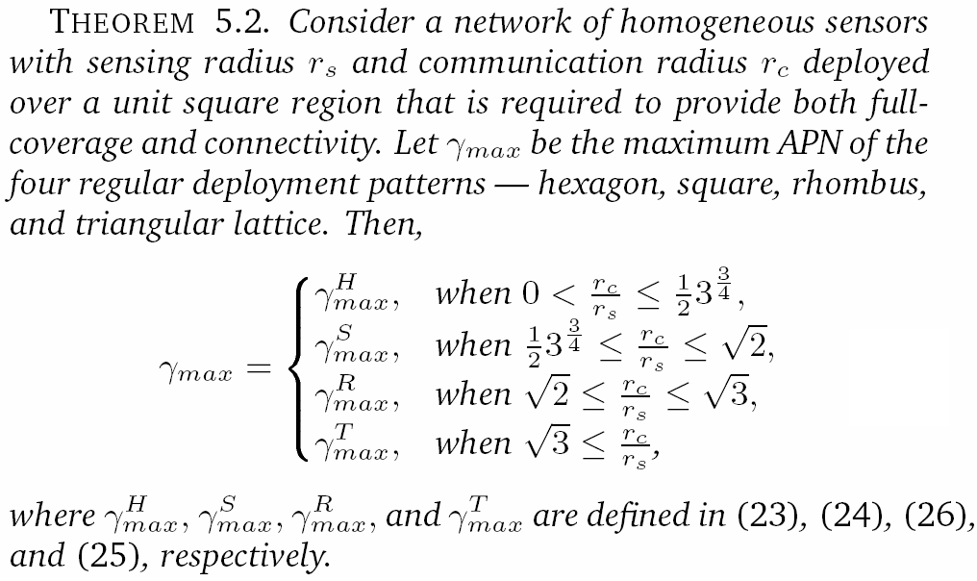
Efficiency of Regular Patterns
The Ohio State University

Slide 18
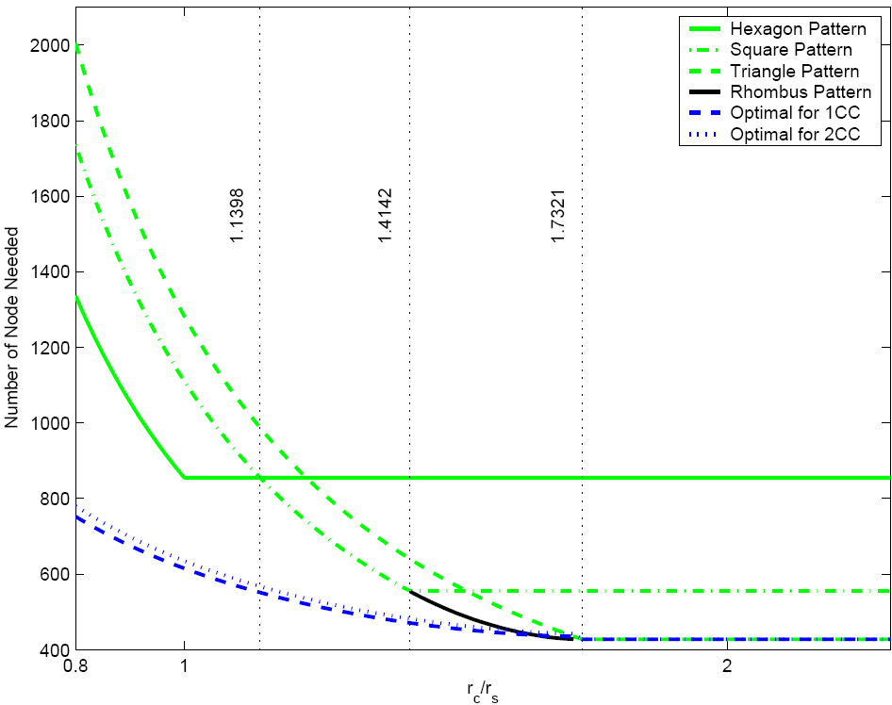
Efficiency of Regular Patterns to Achieve Coverage and Connectivity
The Ohio State University

Slide 19
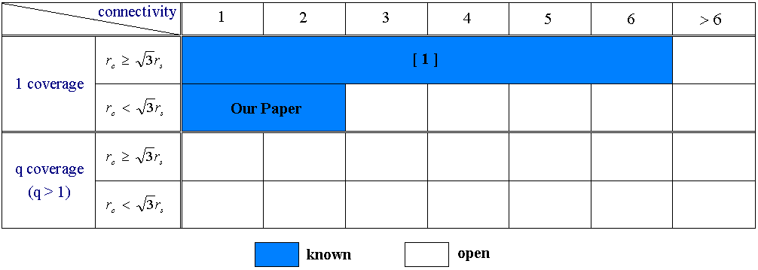
Future work
More general optimal number of sensors needed to achieve p-coverage and q-connectivity
Irregular sensing and communication range
The Ohio State University

Slide 20
Conclusions
Proved the optimality of the strip-based deployment pattern for achieving both coverage and connectivity in WSNs (For proof details, please see our paper)
Different regular patterns are the best in different communication and sensing range.
The results have applications to the design and deployment of wireless sensor networks
The problem of finding an optimal pattern that achieves p-coverage and q-connectivity is still open for general values of p and q. Optimal problems for irregular sensing and communication range are more challenging
The Ohio State University

Slide 21
Thank You!
The Ohio State University

Slide 22
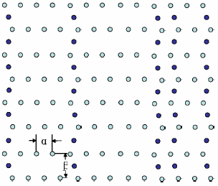
“q-connectivity (for a general q) problem is very easy?”
1 connectivity
2 connectivity
q vertical lines
➔ q-connectivity?
The Ohio State University

Slide 23
Efficiency of Regular Patterns to Achieve Coverage and Connectivity
can achieve
4 connectivity
The Ohio State University

