Slide 1

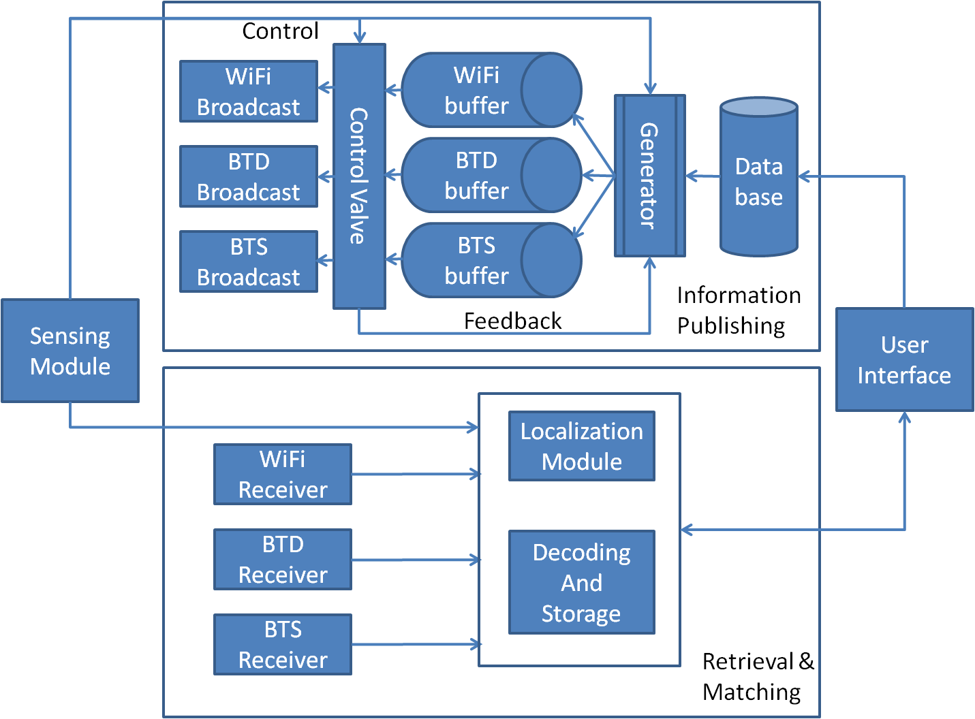

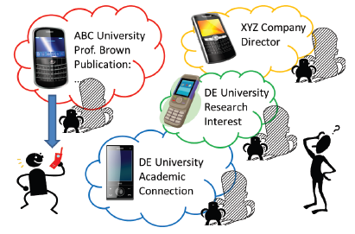
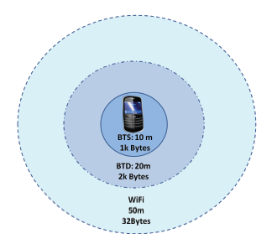
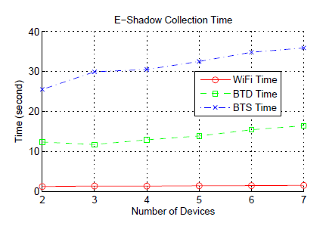
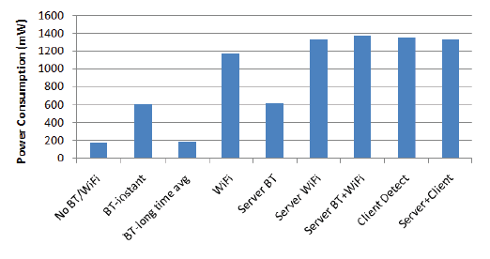
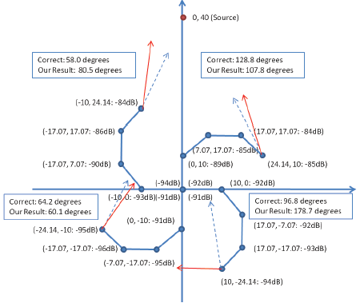
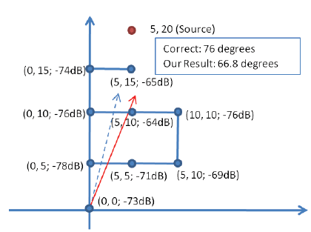
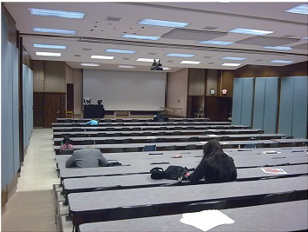
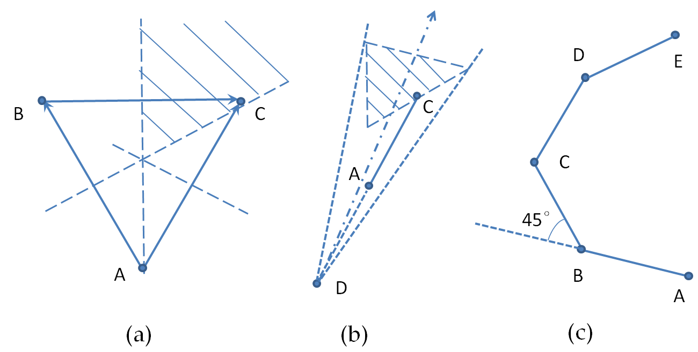
E-Shadow: Lubricating Social Interaction using Mobile Phones
Jin Teng Ph.D. Advisor: Dr. Dong Xuan
Joint Work with Boying Zhang, Xinfeng Li, Xiaole Bai
Motivation
Our Solution
Implementation
    Importance of Face-to-Face Interaction
    Prevalence of mobile phones
Layered publishing
    Attracts more people by unobtrusively publishing different content at different distances
    Saves energy using hybrid wireless communication technologies
Human direction-driven localization
    Auxiliary support for mutually interested people to approach each other
    Implemented on HTC Touch Diamond2, Windows Mobile 6.1
Concept
    E-Shadow attends its owner like a shadow
    Local profile as a personal social descriptor
    Mobile phone based local social interaction tools:
    E-Shadow publishing and E-Shadow localization
    Working Scenario
Layered Publishing
Features of mainstream wireless communication technologies
 | Unobtrusive Publishing Approach | Effective Range | Allowable Message Size | Power Consumption
Wi-Fi | SSID | 40-50 meters | 32 bytes | High
Bluetooth | Device Name | 20 meters | 2k bytes | Low
 | Service Name | 10 meters | 1k bytes | Low
Evaluation
Our methodology
    Uses three layers to publish different information for the same person
    Uses different wireless communication technologies at each layer
    E-Shadow collection time and power consumption
Related Work
    Mobile social networking applications
    Ref. N. Eagle and A. Pentland, “Social Serendipity: Mobilizing Social Software”. In IEEE Pervasive Computing, 2005.
    Localization techniques for mobile phones
    Ref. N. Banerjee, S. Agarwal, P. Bahl, et al., “Virtual compass: relative positioning to sense mobile social interactions”. In Pervasive, 2010.
Limitations
    Unable to capture the dynamics of surroundings
    No mapping between electronic IDs and human faces
    Localization techniques either not pervasive or inaccurate at long range
Human Direction-Driven Localization
    E-Shadow localization accuracy
Localization in local social networking
    Traditional localization techniques are either unavailable or imprecise
    Direction is more important than distance
A new range-free localization technique
    RSSI comparison: Less prone to errors
    Space partitioning: Tailored for direction decision
    Walking routes design
    Triangular route: A→B→C in (a)
    Semi-octagonal route: A→B→C→D→E in (c)
Outdoor: Open Campus
Indoor: Large Classroom
Future Work
Design Goals and Challenges
Enhance information publishing capability in crowded areas
Provide more accurate and feasible matching algorithm
Increase user capability to control privacy and security
Design more tools that can further increase user capabilities in
face-to-face social networking
    Publication:
Jin Teng, Boying Zhang, Xinfeng Li, Xiaole Bai and Dong Xuan. “E-Shadow: Lubricating Social Interaction using Mobile Phones”, to appear in Proc. of IEEE International Conference on Distributed Computing Systems (ICDCS) ’11.
Design Goals
    Far-reaching and unobtrusive
    Auxiliary support for further interactions
    Broad adoption
Challenges
    Lack of communication support
    Non-pervasive localization service
    Power and computation limitations

