Slide 1


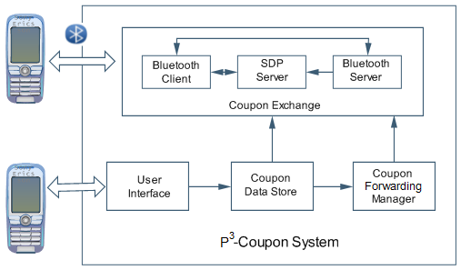
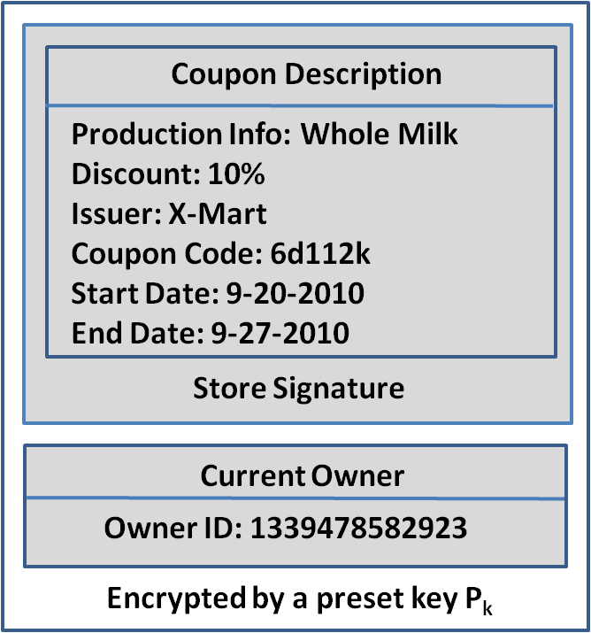
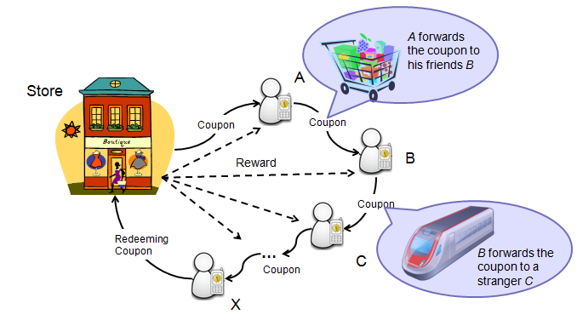
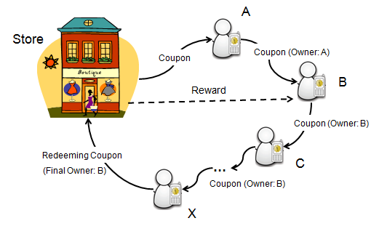
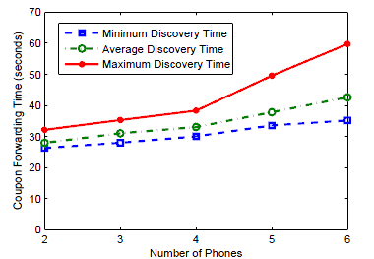
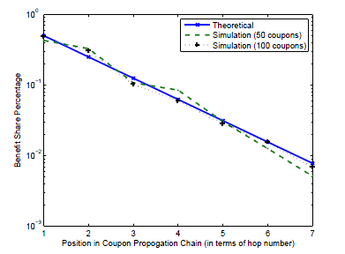
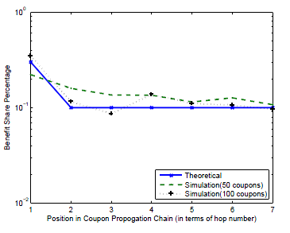
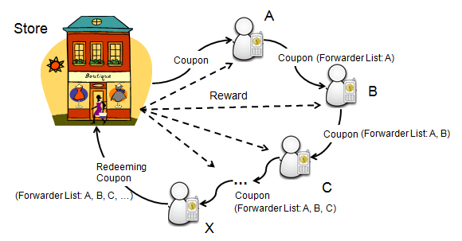


P³-Coupon: A Probabilistic System for Prompt and Privacy-Preserving Electronic Coupon Distribution
Boying Zhang Ph.D. Advisor: Dr. Dong Xuan
Joint Work with Jin Teng, Xiaole Bai, Zhimin Yang
Electronic Coupon Distribution System
Our Solution
Implementation
Preliminaries
    Electronic coupon is similar to paper coupons and stored on mobile phones.
    Electronic coupons are shared as people come into contact with each other.
    If a coupon is redeemed, all forwarders will be rewarded by the store.
Probabilistic sampling on a forwarding path
    Keeping only one forwarder for each coupon
    Probabilistically flipping coupon ownership at each hop
Reasoning
    Statistically meting out individual rewards with enough coupons
    Forwarding path information dynamically changed
    Developing tools: J2ME+Sun Java Wireless Toolkit
    Mobile phones: Samsung (SGH-i550), Nokia (N82, 6650, N71x)
Working scenario
Workflow
System Architecture
Coupon Format
Evaluations
Small-scale experiment results
    Coupon forwarding time: avg. 33.52s
    Power consumption: Nokia N82 last
    25 hours with our system running in background
Large-scale simulation results
    Major results: small deviation between theoretical and actual reward distribution (50-coupon
    in 5000-people)
Key Factors of Large Scale Distribution
Incentives
    Encouraging more forwarding behavior
Privacy-preserving
    Maintaining all forwarders’ motivation
Incentive Design
Coupon Forwarding Time
Always-Flip Model
One-Flip Model
A Straightforward Solution
Goal
    Accurately meting out each forwarder’s reward based on store policy
Always-Flip Model
    The coupon ownership always flips with certain probability P_{i} at each hop i.
    P_{i} is calculated conforming to each store’s rewarding policy, e.g. the
    parent forwarder receives k times the reward given to children forwarders.
Related Work
Recording all forwarders’ IDs in the coupon
Peer-to-peer electronic coupon distribution system [1]
    Recording the entire forwarding path for rewards distribution
Probabilistic packet marking scheme [2]
    Designed for IP traceback, aiming to recover the attack route using fixed marking probability
[1] A. Garyfalos and K. C. Almeroth, “Coupons: A multilevel incentive scheme for information dissemination in mobile networks”. In IEEE Transactions of Mobile Computing, 2008.
[2] S. Savage, D. Wetherall, A. Karlin, and T. Anderson, “Practical network support for IP traceback”. In Proceedings of ACM SIGCOMM, 2000.
One-Flip Model
    Once flipped at hop i, a coupon’s ownership is fixed in a forwarding path .
    P_{i} is calculated conforming to each store’s rewarding policy, e.g. a user at hop i gets q_{i} percent of the total reward.
Future Work
However……
    Recording the entire forwarding path Private social interactions exposed
    Not recording entire the forwarding path Incentives not guaranteed
    Incentive design
    Security and privacy protection
    Deployment and commercialization
    Publications:
Boying Zhang, Jin Teng, Xiao Bai, Zhimin Yang and Dong Xuan. “P³-Coupon: A Probabilistic System for Prompt and Privacy-preserving Electronic Coupon Distribution”, in IEEE PerCom11.
Comparison of two rewarding schemes
    Always-Flip model is good for realizing store policies whose rewards distribution is relevant to the whole path length
    One-Flip model is good for realizing store policies whose rewards distribution is irrelevant to the whole path length
A Dilemma!

