Slide 1

Connected Coverage of Wireless Networks
under
Theoretical and Practical Settings
Dong Xuan
Professor
Department of Computer Science and Engineering
The Ohio State University
http://www.cse.ohio-state.edu/~xuan.3
Supported by the National Science Foundation (NSF) and the Army Research Office (ARO)
February 2020 (Updated)

Slide 2


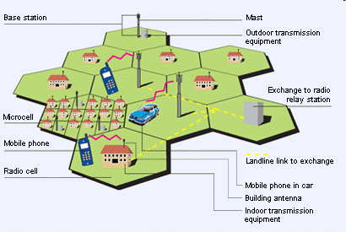
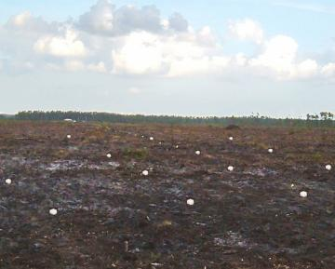
Connected Coverage in Wireless Networks
Wireless Sensor Networks
Cellular and Mesh Networks

Slide 3
Outline
Problem Space and Significance
Optimal Deployment for Connected Coverage in 2D Space
Optimal Deployment for Connected Coverage in 3D Space
Future Research
Summary

Slide 4
An Optimal Deployment Problem
How to deploy sensors in a 2D or 3D area, such that
  Each point in the area is covered (sensed) by at least m sensor
    m-coverage
  Between any two sensors there are at least k disjoint paths
    k-connectivity
  The sensor number needed is minimal
A fundamental problem in wireless sensor networks (WSNs)

Slide 5
Problem Space
Connectivity
Multiple
Dimension
One
3D
2D
Coverage
Multiple
One

Slide 6
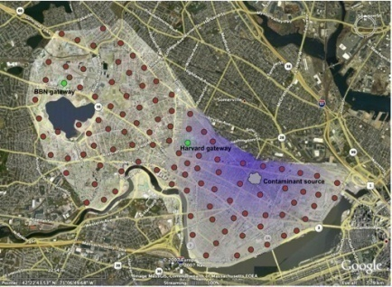
Problem Significance: Applications in 2D Space
CitySense network for urban monitoring in Harvard University
Project “Line in the Sand” at OSU

Slide 7
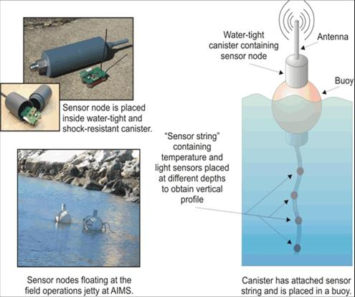
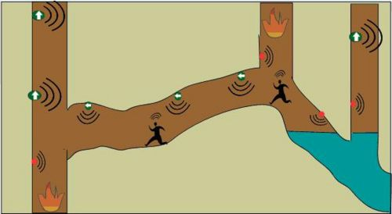
Problem Significance: Applications in 3D Space
Smart Sensor Networks
for Mine Safety and Guidance
@Washington State University
Underwater WSN monitoring at the Great Barrier Reef by the Univ. of Melbourne

Slide 8
Problem Significance: A Summary
In a practical view
  Optimal patterns have many applications
  Avoid ad hoc deployment to save cost
  Guide to design topology control algorithms and protocols
  What happens if there is no knowledge of optimal patterns?
    Square or triangle pattern in 2D?
    Cubic pattern in 3D?
    Why? How good are they?
In a theoretical view
  Connected coverage is also a discrete geometry problem.

Slide 9
Outline
Problem Space and Significance
Optimal Deployment for Connected Coverage in 2D Space
Optimal Deployment for Connected Coverage in 3D Space
Future Research
Summary

Slide 10
Optimal Deployment for Connected Coverage in 2D Space
Connectivity
Multiple
Dimension
One
3D
2D
Coverage
Multiple
One

Slide 11

Theoretical Settings in 2D Space
Node C
Disc coverage scope with range R_{s}
R_{c}
R_{s}
Node D
Disc communication scope with range R_{c}
Node A
Node B
Homogeneous coverage and communication scopes
No geographical constraints on deployment
  No boundary consideration
    Asymptotically optimal
  No constraints on deployment locations

Slide 12
The Nature of the 2D Problem under Theoretical Settings
Given a target area
Given discs each with a certain area
Deploy the discs to cover the entire target area
The centers of these discs need to be connected
With minimal number of discs

Slide 13
Historic Review on the 2D Problem
Problem | Date of the First Major Conclusion | Proof Status
Pure Coverage | 1939 [1] | Done in1939
1- Connectivity | 2005 [2] | Open
[1] R. Kershner. The number of circles covering a set. American Journal of Mathematics, 61:665–671, 1939, reproved by Zhang and Hou in 2002.
[2] R. Iyengar, K. Kar, and S. Banerjee. Low-coordination topologies for redundancy in sensor networks, ACM MobiHoc 2005.

Slide 14
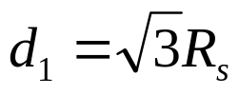
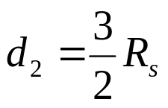
The Pure Coverage Problem in 2D
How to efficiently fill a plane with homogeneous discs
The triangular lattice pattern is optimal
  Proposed by R. Kershner in 1939
No connectivity was considered
d₂
d₁

Slide 15





A Big Misconception
The triangular lattice pattern (hexagon cell array in terms of Vronoi polygons) is optimal for k-connectivity
When
When
A
The triangle lattice pattern is optimal for k (k≤6) connectivity only when R_{c}/R_{s} ≥
d₂
d₁

Slide 16

However, Relationship between R_{c} and R_{s} Can Be Any
In the context of WSNs, there are various values of R_{c} / R_{s}
The communication range of the Extreme Scale Mote (XSM) platform is 30 m and the sensing range of the acoustics sensor is 55 m
Sometimes even when it is claimed for a sensor to have , it may not hold in practice because the reliable communication range is often 60-80% of the claimed value

Slide 17

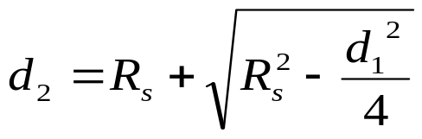
1-Connectivity Pattern
R. Iyengar, K. Kar, and S. Banerjee proposed strip based pattern to achieve 1-coverage and 1-connectivity in 2005
  Only for the condition when R_{c} equals to R_{s}
  No optimality proof is given
d₂
d₁

Slide 18
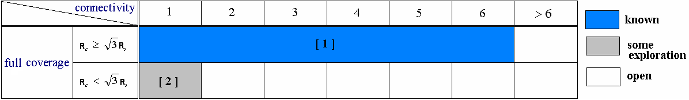
Our Main Results on 2D
MobiHoc06
MobiHoc08,ToN
Infocom08,TMC
MobiHoc08, ToN
Infocom10
Infocom10
Infocom10
[1] R. Kershner. The number of circles covering a set. American Journal of Mathematics, 61:665–671, 1939, reproved by Zhang and Hou in 2002
[2] R. Iyengar, K. Kar, and S. Banerjee. Low-coordination topologies for redundancy in sensor networks, ACM MobiHoc05.
[3] X. Bai, S. Kumar, D. Xuan, Z. Yun and T. Lai, Deploying Wireless Sensors to Achieve Both Coverage and Connectivity, ACM MobiHoc06
[4] X. Bai, Z. Yun, D. Xuan, T. Lai and W. Jia, Deploying Four-Connectivity And Full-Coverage Wireless Sensor Networks and IEEE TMC10
[5] X. Bai, D. Xuan, Z. Yun, T. Lai and W. Jia, Complete Optimal Deployment Patterns for Full-Coverage and K Connectivity (k<=6) Wireless Sensor Networks, ACM Mobihoc08 and IEEE/ACM ToN10
[6] X. Bai, Z. Yun, D. Xuan, W. Jia and W. Zhao, Pattern Mutation in Wireless Sensor Deployment, IEEE INFOCOM10 and IEEE/ACM ToN12

Slide 19

Optimal Pattern for 1, 2-Connectivity
Connect the neighboring strips at its one or two ends
A
d₂
Optimality proved for all
d₁
[3] X. Bai, S. Kumar, D. Xuan, Z. Yun and T. Lai, Deploying Wireless Sensors to Achieve Both Coverage and Connectivity, ACM MobiHoc06

Slide 20
Two “Critical” Questions
Is there any contradiction between 1-, 2-connectivity pattern and the triangular lattice pattern?
1, 2-connectivity are good enough. Why need we design other connectivity patterns?

Slide 21



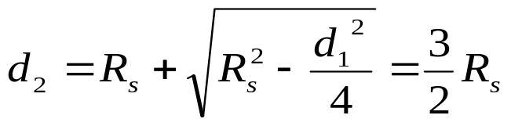

Contradiction between 1, 2-Connectivity and Triangular Patterns?
R_{c} increases
d₂
d₁
1- and 2-connectivity patterns evolve to the
triangle lattice pattern when R_{c}/R_{s}≥

Slide 22
Are1, 2-Conectiviety Patterns Enough?
A
B
A long communication path problem

Slide 23
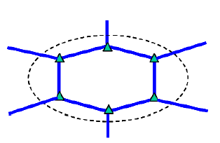
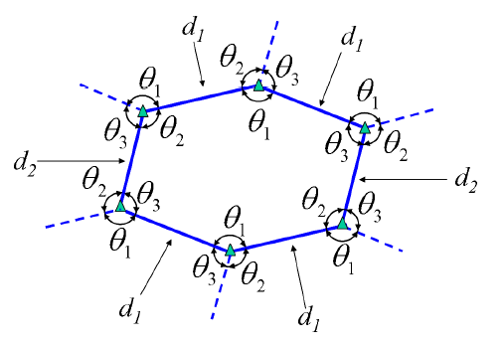

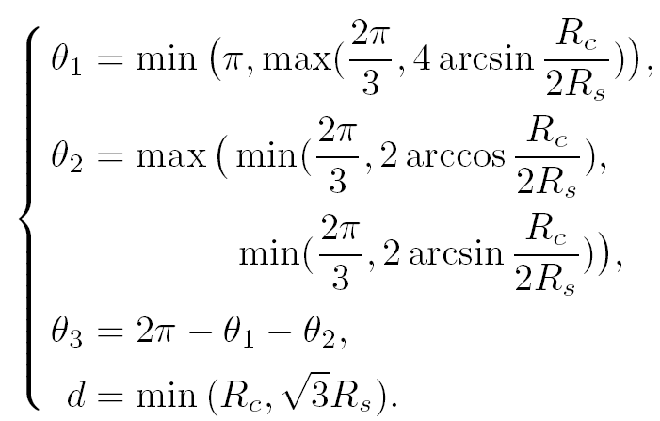

Optimal Pattern for 3-Connectivity
d₁
d₁
d₂
θ₂
θ₁
d₂
Hexagon pattern
d₁
d₁
A

Slide 24

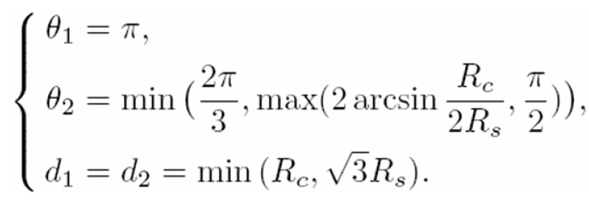
Optimal Pattern for 4-Connectivity
d₁
d₁
Diamond pattern
d₂
θ₂
θ₁
d₂
d₁
d₁
A

Slide 25
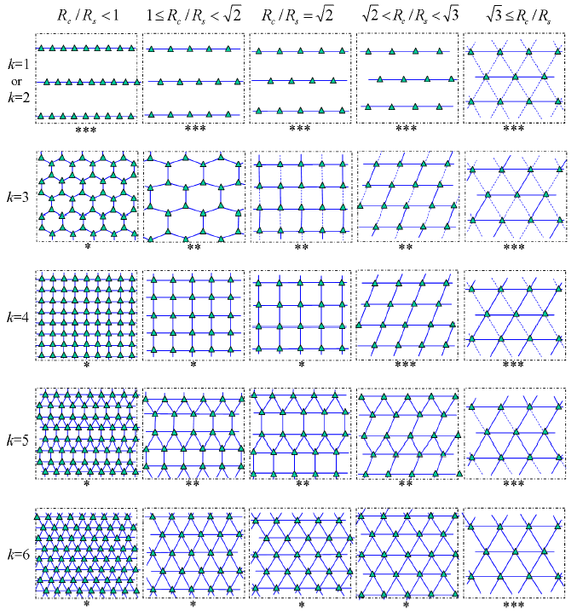
A Complete Picture of Optimal Patterns
R_{s} is invariant
R_{c} varies
All optimal patterns eventually
converge to the triangle lattice
pattern
[4] X. Bai, Z. Yun, D. Xuan, T. Lai and W. Jia, Deploying Four-Connectivity And Full-Coverage Wireless Sensor Networks, IEEE INFOCOM08 and IEEE TMC10
[5] X. Bai, D. Xuan, Z. Yun, T. Lai and W. Jia, Complete Optimal Deployment Patterns for Full-Coverage and K Connectivity (k<=6) Wireless Sensor Networks, ACM Mobihoc08 and IEEE/ACM ToN10

Slide 26
Four “Challenging” Questions
How good are the designed patterns in term of sensor node saving?
Are those conjectures correct?
How are these patterns designed?
How is the optimality of these patterns proved?

Slide 27
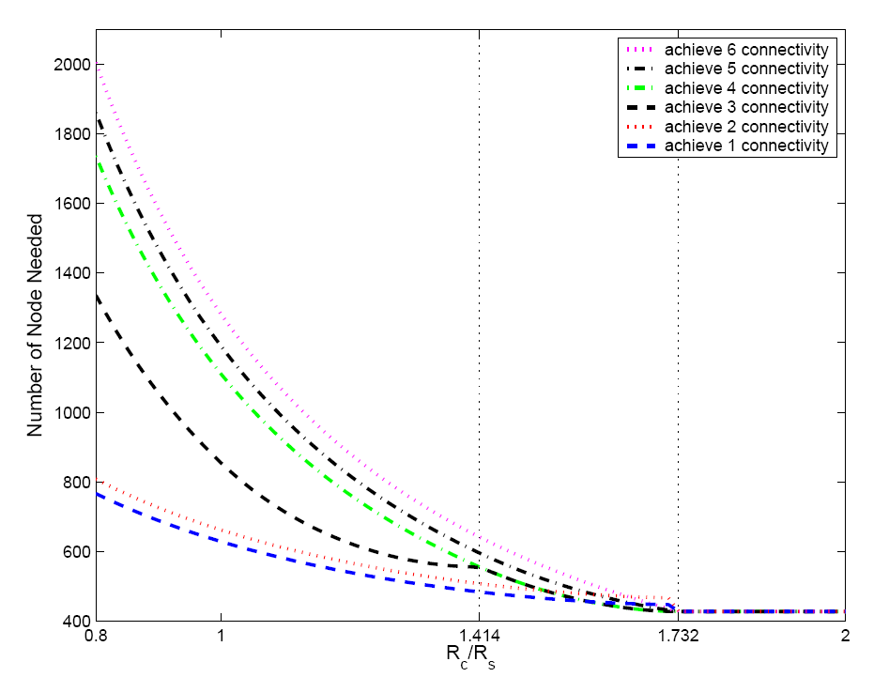
How Good Are the Optimal Patterns?
Number of nodes needed to achieve full coverage and 1-6 connectivity respectively by optimal patterns. The region size is 1000m×1000m. R_{s} is 30m. R_{c} varies from 20m to 60m

Slide 28








Are Those Conjectures Correct?
[6] X. Bai, Z. Yun, D. Xuan, W. Jia and W. Zhao, Pattern Mutation in Wireless Sensor Deployment, IEEE INFOCOM10 and IEEE/ACM ToN12

Slide 29
How Are These Patterns Designed?
Pattern design for the same connectivity under
different
  Sensor horizontal distance increases as increases
  Sensor vertical distance decreases
Pattern design for different connectivity requirements
  A hexagon-based uniform pattern
  4-connectivity and 6-connectivity patterns → 5-connectivity pattern

Slide 30
How to Prove Optimality of Designed Patterns?
Challenge
  There are no solid foundations in the areas of computational geometry and topology for this particular problem
Our methodology
  Step 1: for any collection of the Voronoi polygons forming a tessellation, the average edge number of them is not larger than 6 asymptotically
  Step 2: any collection of Voronoi polygons generated in any deployment can be transformed into the same number of Voronoi polygons generated in a regular deployment while full coverage and desired connectivity can still be achieved
  Step 3: the number of Voronoi polygons from any regular deployment has a lower bound
  Step 4: the number of Voronoi polygons used in the patterns we proposed is exactly the lower bound value

Slide 31
The Optimal Deployment Problem in 2D Space in Practical Settings
Theoretical Settings
Practical Settings
Disc sensing and communication
Homogeneous sensors
No geographical constraints on deployment
  No boundary
  No constraints on deployment locations
Non-disc sensing and communication
Heterogeneous sensors
Geographical constraints on deployment
  Boundary consideration
  Some obstacles

Slide 32
Outline
Problem Space and Significance
Optimal Deployment for Connected Coverage in 2D Space
Optimal Deployment for Connected Coverage in 3D Space
Future Research
Summary

Slide 33
Optimal Deployment for Connected Coverage in 3D Space
Connectivity
Multiple
Dimension
One
3D
2D
Coverage
Multiple
One

Slide 34
Theoretical Settings in 3D Space
Sphere sensing
Sphere communication
R_{s}
R_{c}
Homogeneous sensing and communication scopes
No geographical constraints on deployment
  No boundary consideration
    Asymptotically optimal
  No constraints on deployment locations

Slide 35
The Nature of the 3D Problem under Theoretical Settings
Given a target 3D space
Given spheres each with a certain volume
Deploy these spheres to cover the entire target space
The centers of these spheres need to be connected
With minimal number of spheres

Slide 36
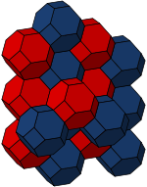
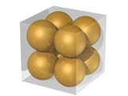
Historic Review on the 3D Problem
Problem | Date of the First Major Conclusion | Proof Status
Sphere Packing | 1611 | Done in 2005
Sphere Coverage | 1887 | Open
Sphere Connectivity Coverage | 2006 | 14-connecitvity pattern conjectured
Sphere Packing
Sphere Coverage

Slide 37

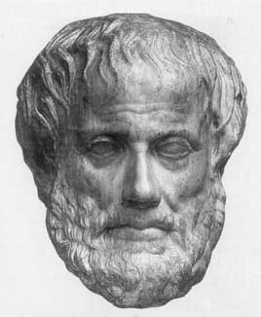

The 3D Packing Problem
How to efficiently fill a space with geometric solids?
The tetrahedron fills a space most efficiently
Face-centered cubic lattice is the best packing pattern to fill a space
Aristotle
Johannes Kepler
Ancient Greece
1661
Proven wrong in the 16th century
Proven by Hales in 1997

Slide 38
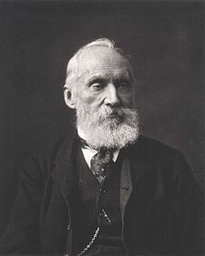
The 3D Coverage Problem
The 3D coverage problem: what is the optimal way to fill a 3D space with cells of equal volume, so that the surface area is minimized?
His Conjecture:
14-sided truncated octahedron
Lord Kelvin
1887
Proof is still open to date

Slide 39
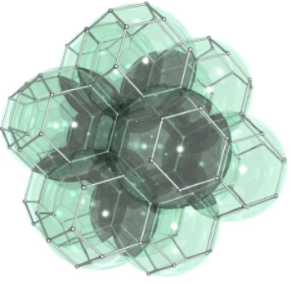
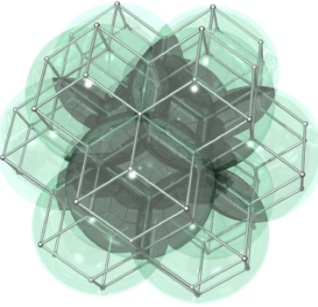


A Moderate Answer to the 3D Coverage Problem
Optimal patterns under certain regularity constraints.
  R. P. Bambah, “On lattice coverings by spheres,” Proc. Nat. Sci. India,no. 10, pp. 25–52, 1954.
  E. S. Barnes, “The covering of space by spheres,” Canad. J. Math., no. 8, pp. 293–304, 1956.
  L. Few, “Covering space by spheres,” Mathematika, no. 3, pp. 136–139, 1956.
Least covering density of identical spheres is
It occurs when the sphere centers form a body-centered lattice with edges of a cube equal to , where r is the sensing range.

Slide 40
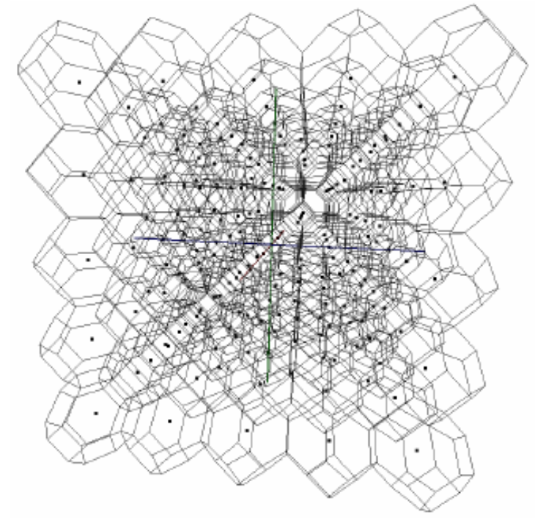
A New Angle of the 3D Coverage Problem
A special 3D Connectivity-Coverage problem: full Coverage with 14-connectivity
  S. M. N. Alam and Z. J. Haas, “Coverage and Connectivity in Three-Dimensional Networks,” MobiCom, 2006
  The sensor deployment pattern that creates the Voronoi tessellation of truncated octahedral cells in 3D space is the most efficient
  However, no theoretical
  proof is given!

Slide 41
Challenges
2D
The coverage problem is solved
Patterns are relatively easy to visualize
Relatively less cases to be considered
3D
The coverage problem is open
Patterns are hard to visualize
Much more cases to be considered

Slide 42
Our Solution
Learning some lessons from the work on 2D
  Regularity is impotent and can be exploited in pattern exploration
  There are interesting rules in optimal patterns evolution
We first limit our exploration of 3D optimal patterns among lattice patterns

Slide 43
Our Main Results on 3D
Connectivity | 1 | 2 | 3 | 4 | 5 | 6 | … | 14 | …
Solution
Mobhoc2009 &
JSAC 2010
Infocom 2009
Infocom 2009
[7] X. Bai, C. Zhang, D. Xuan and W. Jia, Full-Coverage and k-Connectivity (k=14, 6) Three Dimensional Networks, IEEE INFOCOM09
[8] X. Bai, C. Zhang, D. Xuan, J. Teng and W. Jia, Low-Connectivity and Full-Coverage Three Dimensional Networks, ACM MobiHoc09 and IEEE JSAC10

Slide 44
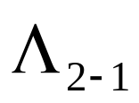



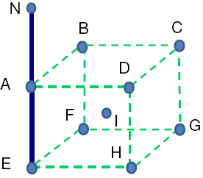
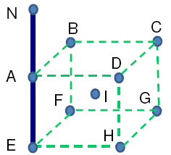







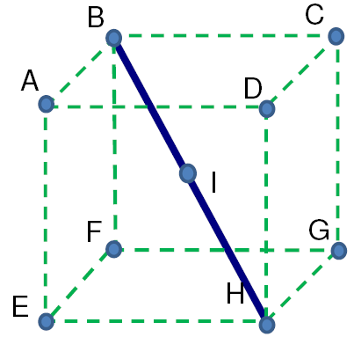
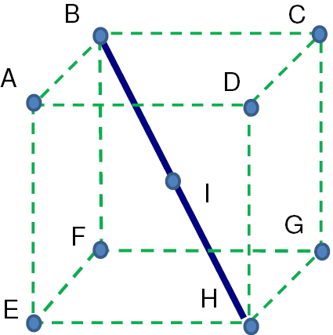

Lattice Patterns for 1- or 2-Connectivity and Full-Coverage
Actually achieves 8-connectivity
Actually achieves 14-connectivity

Slide 45


Lattice Patterns for 1- or 2-Connectivity and Full-Coverage Example

Slide 46
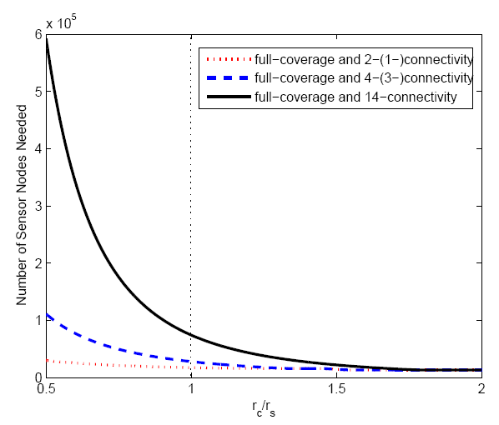
How Good Are the Optimal Patterns?
Number of nodes needed to achieve full coverage and 2- (1-) or 4- (3-) connectivity respectively by optimal patterns. The region size is 1000m×1000m. R_{s} is 30m. R_{c} varies from 15m to 60m

Slide 47
Outline
Problem Space and Significance
Optimal Deployment for Connected Coverage in 2D Space
Optimal Deployment for Connected Coverage in 3D Space
Future Research
Summary

Slide 48
Future Research
Connectivity
Multiple
Dimension
One
3D
2D
Coverage
Multiple
One

Slide 49
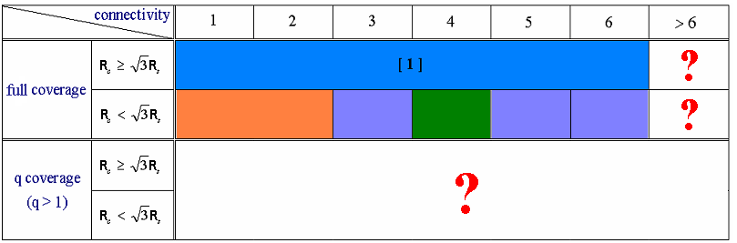
Further Exploration under Theoretical Settings
In 2D space
Globally Optimal Patterns ?
In 3D space
  Relax the assumption of lattice
  Multiple coverage and other connectivity requirements

Slide 50
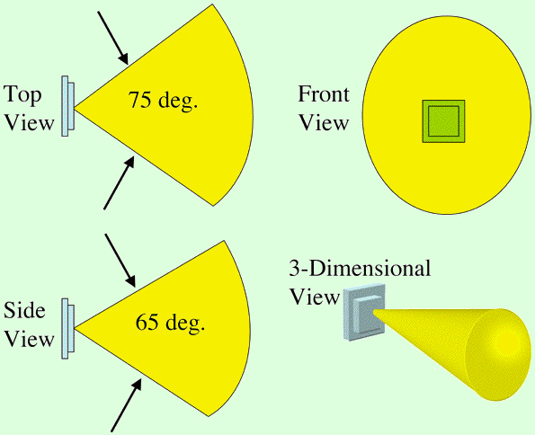



Further Exploration under Practical Settings
Directional Coverage
Directional Communication
Surveillance Camera
Directional Antenna
[9] Z. Yu, F. Yang, J. Teng, A, Champion and D. Xuan, Local Face-View Barrier Coverage in Camera Sensor Networks, IEEE INFOCOM15
[10] Z. Yu, J. Teng, X. Bai, D. Xuan and W. Jia, Connected Coverage in Wireless Networks with Directional Antennas, IEEE INFOCOM11 and ACM ToSN14

Slide 51
Further Exploration under Practical Settings
Bounded Deployment Area
[11] Z. Yu, J. Teng, X. Li and D. Xuan, On Wireless Network Coverage in Bounded Areas, IEEE INFOCOM13

Slide 52

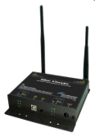
Further Exploration under Practical Settings cont’d
How to apply our results to 802.15.4 networks?
  Two types of devices
    full-function device (FFD)
    reduced-function device (RFD)
  Coverage is determined by the communication range between FFDs and RFDs
  Connectivity is required among FFDs

Slide 53
Summary
 | Key Publications | Key Contributions
2D Space | X. Bai, S. Kumar, D. Xuan, Z. Yun and T. Lai, Deploying Wireless Sensors to Achieve Both Coverage and Connectivity, ACM MobiHoc06 | Optimal deployment patterns for 1 and 2-connectivity
 | X. Bai, Z. Yun, D. Xuan, T. Lai and W. Jia, Deploying Four-Connectivity And Full-Coverage Wireless Sensor Networks, IEEE INFOCOM08 and IEEE TMC10 | Optimal deployment pattern for 4-connectivity
 | X. Bai, D. Xuan, Z. Yun, T. Lai and W. Jia, Complete Optimal Dep loyment Patterns for Full-Coverage and K Connectivity (k<=6) Wireless Sensor Networks, ACM Mobihoc08 and IEEE/ACM ToN10 | Optimal deployment patterns for 3 and 5-connectivity
 | X. Bai, Z. Yun, D. Xuan, W. Jia and W. Zhao, Pattern Mutation in Wireless Sensor Deployment, IEEE INFOCOM10 and IEEE/ACM ToN12 | Pattern mutation
 | Z. Yu, F. Yang, J. Teng, A, Champion and D. Xuan, Local Face-View Barrier Coverage in Camera Sensor Networks, IEEE INFOCOM15 | Optimal deployment pattern with sector sensors
 | Z. Yu, J. Teng, X. Bai, A, D. Xuan and W. Jia, Connected Coverage in Wireless Networks with Directional Antennas, IEEE INFOCOM11 and ACM ToSN14 | Optimal deployment pattern with directional antenna
 | Z. Yu, J. Teng, X. Li and D. Xuan, On Wireless Network Coverage in Bounded Areas, IEEE INFOCOM13 | Optimal deployment pattern in bounded areas
3D Space | X. Bai, C. Zhang, D. Xuan and W. Jia, Full-Coverage and k-Connectivity (k=14, 6) Three Dimensional Networks, IEEE INFOCOM09 | Optimal deployment patterns for 6 and 14-connectivity
 | X. Bai, C. Zhang, D. Xuan, J. Teng and W. Jia, Low-Connectivity and Full-Coverage Three Dimensional Networks, ACM MobiHoc09 and IEEE JSAC10 | Optimal deployment patterns for 1, 2, 3 and 4-connectivity

Slide 54
References
R. Kershner. The number of circles covering a set. American Journal of Mathematics, 61:665–671, 1939, reproved by Zhang and Hou in 2002.
R. Iyengar, K. Kar, and S. Banerjee. Low-coordination topologies for redundancy in sensor networks, ACM MobiHoc 2005.
X. Bai, S. Kumar, D. Xuan, Z. Yun and T. Lai, Deploying Wireless Sensors to Achieve Both Coverage and Connectivity, ACM MobiHoc06
X. Bai, Z. Yun, D. Xuan, T. Lai and W. Jia, Deploying Four-Connectivity And Full-Coverage Wireless Sensor Networks, IEEE INFOCOM08 and IEEE TMC10
X. Bai, D. Xuan, Z. Yun, T. Lai and W. Jia, Complete Optimal Dep loyment Patterns for Full-Coverage and K Connectivity (k<=6) Wireless Sensor Networks, ACM Mobihoc08 and IEEE/ACM ToN10
X. Bai, Z. Yun, D. Xuan, W. Jia and W. Zhao, Pattern Mutation in Wireless Sensor Deployment, IEEE INFOCOM10 and IEEE/ACM ToN12
X. Bai, C. Zhang, D. Xuan and W. Jia, Full-Coverage and k-Connectivity (k=14, 6) Three Dimensional Networks, IEEE INFOCOM09
X. Bai, C. Zhang, D. Xuan, J. Teng and W. Jia, Low-Connectivity and Full-Coverage Three Dimensional Networks, ACM MobiHoc09 and IEEE JSAC10
Z. Yu, F. Yang, J. Teng, A, Champion and D. Xuan, Local Face-View Barrier Coverage in Camera Sensor Networks, IEEE INFOCOM15
Z. Yu, J. Teng, X. Bai, A, D. Xuan and W. Jia, Connected Coverage in Wireless Networks with Directional Antennas, IEEE INFOCOM11 and ACM ToSN14
Z. Yu, J. Teng, X. Li and D. Xuan, On Wireless Network Coverage in Bounded Areas, IEEE INFOCOM13

Slide 55
Thank You!
Questions?

