Slide 1
Cloud Computing Exercise 4
1 - 7
Name: Dongai Liu

Slide 2
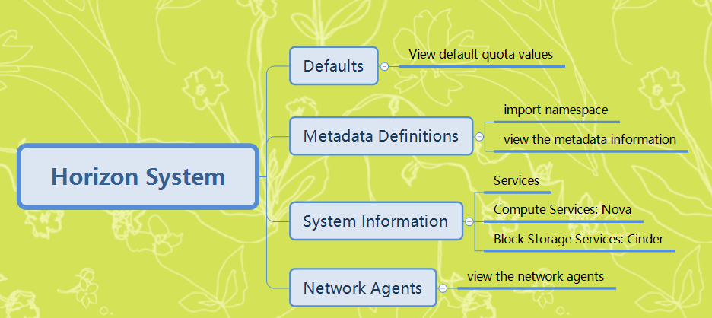
Task 1

Slide 3
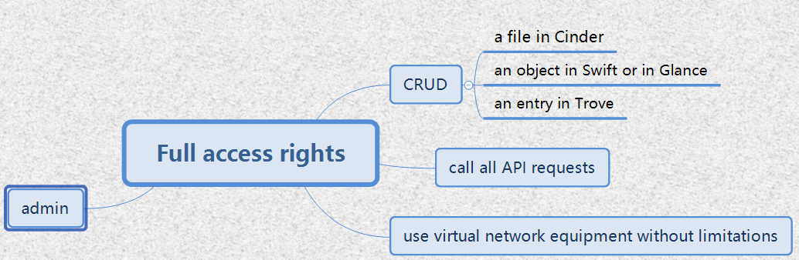
Task 2

Slide 4

Task 3

Slide 5
Task 4
A set of methods
The most important OpenStack services
Horizon
Independeant
Abstract APIs
New API releases

Slide 6
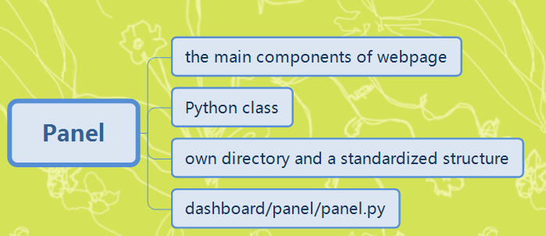
Task 5

Slide 7
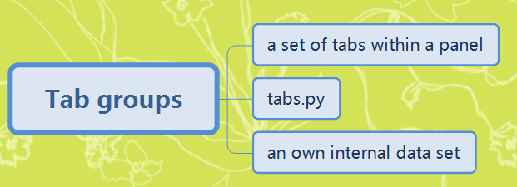
Task 5

Slide 8
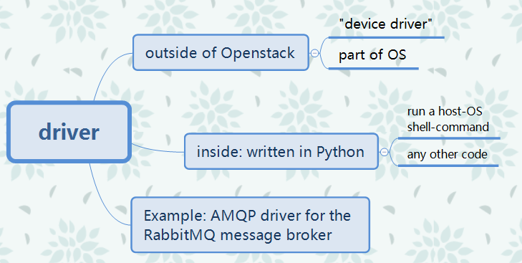
Task 6

Slide 9
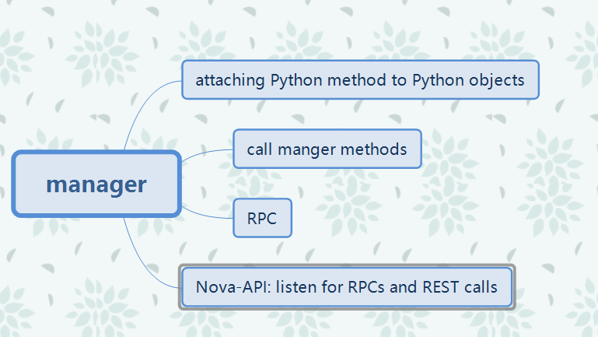
Task 7

