Slide 1

K-Scheduler: Effective Seed Scheduling for Fuzzing
with Graph Centrality Analysis
Dongdong She, Abhishek Shah, and Suman Jana
Columbia University

Slide 2
Fuzzing Workflow
Seed scheduling is crucial for fuzzing performance
Seed 1
Seed 2
Seed Scheduling
Seed Mutation
…
Seed N
Seed Corpus
Interesting Seed

Slide 3
Seed Scheduling
What is seed scheduling?
Determine the order in which seeds are selected
Compute a weight for each seed
Prioritize seeds with higher weights
Why is it important?
Fuzzer explores program code through seed mutations
Mutating a good seed => Discover more code
Mutating a bad seed => Discover less code

Slide 4
Existing Works
Tools | Scheduling Strategy
AFLFast | Hit count of path
FairFuzz | Hit count of edge
EcoFuzz | Number of discovered paths
Entropic | Entropy of discovered edges
TortoiseFuzz | Hit count of security-sensitive coverage
Limitation: all ignore the structure of the Control Flow Graph (CFG)

Slide 5
CFG in Seed Scheduling
Why CFG matters in seed scheduling?
CFG reveals potential code coverage gain from mutating each seed

Slide 6
CFG in Seed Scheduling
Seed1
Seed Corpus
Seed2
Unvisited node
Visited node
Control flow graph

Slide 7
CFG in Seed Scheduling
Seed1
Seed Corpus
Seed2
Unvisited node
Visited node
Execution path of seed1
Seed1’s path is close to 1 unvisited nodes

Slide 8
CFG in Seed Scheduling
Seed1
Seed Corpus
Seed2
Unvisited node
Visited node
Execution path of seed2
Seed2’s path is close to 3 unvisited nodes

Slide 9
CFG in Seed Scheduling
Seed1’s path is close to 1 unvisited nodes Seed2’s path is close to 3 unvisited nodes
Seed2 is the better seed
But existing seed schedulers will try seed1

Slide 10
Ideal Seed Scheduling
An ideal seed scheduling should incorporate CFG
How to use the CFG?

Slide 11
A Naïve Approach
Traverse CFG and count the number of reachable and unvisited nodes
Problem:
Each seed needs a graph traversal, which is expensive on real world program
The unvisited nodes are dynamically changing
The counting treats all unvisited nodes equally
- some nodes might be infeasible
Instead of expensive graph traversal for counting, try to approximate the count

Slide 12
An Approximate Approach
Approximate count should determine seed weight
Approximate count should have some desired features
Increase seed weight if more reachable nodes from a seed
Decrease seed weight if a node is hard to reach by fuzzer
Decrease seed weight if a node is far away from a seed
Be efficiently computable over large CFG
Graph centrality provides these features, hence is a natural fit to our need

Slide 13

Graph Centrality
A common metric in social network
Measure influence of each node
Used to identify important nodes
Graph centrality on a social network
Outgoing people => high scores
Introverted people => low scores

Slide 14
Our Approach: Graph Centrality Analysis
We use katz centrality to approximate code coverage gain for each seed
Challenge: CFG is not suitable for graph centrality analysis
Contain visited nodes => Only interested in unvisited nodes
No seed information => Need to compute centrality for each seed
Our solution: build a novel edge horizon graph composed of only unvisited nodes and seed nodes

Slide 15






Our Approach: Graph Centrality Analysis
We use katz centrality to approximate code coverage gain for each seed
$$c=1.2$$
$$c=3$$
Seed1
Seed2
Seed1
Seed2
Graph Centrality
Analysis
$$c=1$$
Node1
Node1
$$c=1.5$$
Node2
Node2
$$c=1$$
$$c=1$$
Node3
Node4
Node3
Node4
Edge horizon graph
Edge horizon graph

Slide 16
Overview of K-Scheduler

Slide 17
Edge Horizon Graph
1. Classify nodes in CFG as visited and unvisited
Seed1
Seed2
Seed Corpus
Unvisited node
Visited node
Control flow graph

Slide 18
Edge Horizon Graph
1. Classify nodes in CFG as visited and unvisited
Seed1
Seed2
Seed Corpus
Unvisited node
Visited node
Execution path of seed1

Slide 19
Edge Horizon Graph
1. Classify nodes in CFG as visited and unvisited
Seed1
Seed2
Seed Corpus
Unvisited node
Visited node
Control flow graph

Slide 20
Edge Horizon Graph
1. Classify nodes in CFG as visited and unvisited
Seed1
Seed2
Seed Corpus
Unvisited node
Visited node
Control flow graph

Slide 21
Edge Horizon Graph
2. Identify edge horizon nodes
Unvisited node whose parent node is visited
Form the boundary between visited and unvisited nodes
Seed1
Seed2
Seed Corpus
Unvisited node
Visited node
Control flow graph

Slide 22
Edge Horizon Graph
3. Remove visited nodes
Seed1
Seed2
Seed Corpus
Unvisited node
Visited node
Control flow graph

Slide 23
Edge Horizon Graph
4. Insert seed nodes
Seed1
Seed2
Each seed node corresponds to a seed
Edges are from seed node to directly-connected horizon nodes
Seed1
Seed2
Seed Corpus
Unvisited node
Visited node
Edge horizon graph

Slide 24
Edge Horizon Graph
5. Remove cycles

Slide 25
Evaluation Results
We integrate K-Scheduler on various fuzzers and a concolic execution engine
Libfuzzer evaluation
AFL havoc evaluation
QSYM evaluation
Runtime analysis

Slide 26
Evaluation on Libfuzzer
K-Scheduler increases feature coverage by 26% compared with Entropic over 24 hours

Slide 27
Evaluation on AFL havoc
K-Scheduler increases edge coverage by 4% compared with AFLFast over 24 hours

Slide 28
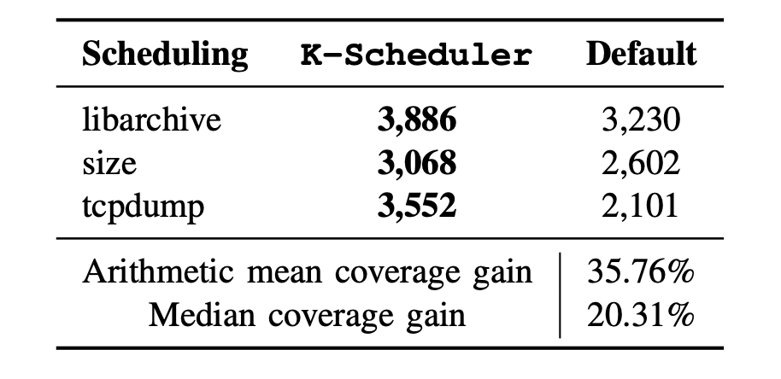
Evaluation on QSYM
K-Scheduler improves QSYM by 36% compared with the default seed scheduler over 24 hours

Slide 29
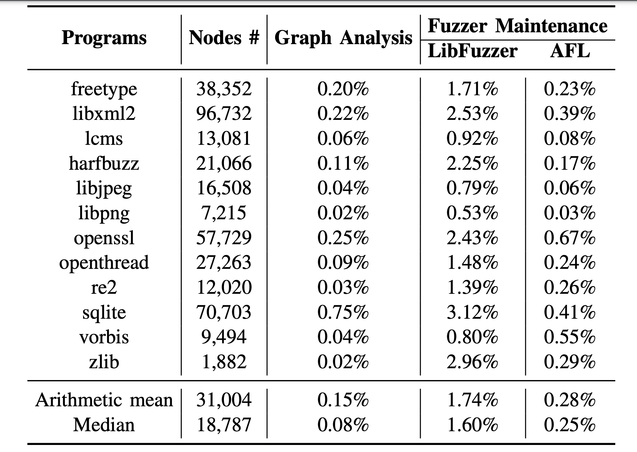
Runtime Analysis
K-Scheduler adds at most 1% overhead for graph analysis and at most 2% for maintenance

Slide 30
Conclusion
K-Scheduler is a generic seed scheduler for fuzzing (Libfuzzer and AFL) and concolic execution engine (QSYM)
K-Scheduler approximates potential code coverage gain for each seed using graph centrality scores
We open-sourced K-Scheduler and reproduction data (binaries and seed corpus) at https://github.com/Dongdongshe/K-Scheduler
We are working on integrating K-Scheduler to Libfuzzer and libAFL code repo.

