Slide 1
MDD Antidepressant
Treatment Pattern Analysis
From OMOP clinical records to interpretable treatment switching and overlap patterns
All of Us Controlled Tier CDRv8
MDD + Antidepressants
LOT1 -> LOT2 + overlap days
Project summary deck
Dongfang (Kayla) Cai
MDD antidepressant treatment pattern analysis | 1
Notes:
Opening: This project studies how patients with major depressive disorder move across antidepressant classes in real-world data. The focus is not only whether patients receive medications, but how their treatment classes change over time, and whether LOT1 and LOT2 overlap. The presentation is designed for a general audience, so I will explain the data source, cohort construction, method, outputs, key findings, and why this workflow is valuable.

Slide 2
Why this project matters
Real-world medication data can show treatment behavior that trials and prescriptions alone may miss.
MDD patients
start treatment
Drug classes
change over time
Overlap can mean
switching or add-on
Patterns inform
strategy & safety
For a pharma or health-system audience: this turns messy EHR medication records into actionable evidence on switching, augmentation, persistence, and possible drug-drug interaction context.
Business value
Identify common treatment paths, quantify real-world transition timing, and create reusable code that can scale to other drug classes or outcomes.
MDD antidepressant treatment pattern analysis | 2
Notes:
MDD treatment often involves switching from one medication class to another, or overlapping classes during a taper, cross-taper, or add-on strategy. Claims and EHR data contain these patterns, but they are not obvious unless we define index date, treatment episodes, LOT1, LOT2, and overlap days. The value is that we can move from raw data to a clinically interpretable treatment pathway.

Slide 3
Data source and analytic cohort
All of Us Controlled Tier CDRv8, structured using the OMOP Common Data Model.
393,601
participants
with EHR data
86,778
patients with
MDD diagnosis
68,301
patients with ≥1 antidepressant exposure on or after index MDD diagnosis (for entire study period 1981-2023)
62,448
mono-class
index cohort¹
The analytic cohort was predominantly older adults, female, and White: 39% were >65 years old, 60% identified as female by gender, 61% were female by sex at birth, and the largest race groups were White (55%) and Black or African American (17%). CDRv8 data cutoff used in project workflow: October 1, 2023.
1. Mono-class index cohort –patients with a single antidepressant class on the index antidepressant date. The index antidepressant date was defined as the earliest antidepressant exposure date after the first MDD diagnosis. If a patient started multiple antidepressant classes on the same index date, they were excluded from the mono-class index cohort.
MDD antidepressant treatment pattern analysis | 3
Notes:
Here I explain the data source. All of Us data are structured in OMOP tables, so diagnoses and medications are represented in standardized clinical tables. The cohort starts from EHR participants, then identifies MDD, then antidepressant exposure, then the mono-class index cohort used for line-of-therapy analysis. The distinction between all antidepressant users and mono-class index patients is important because LOT analysis needs a clear first treatment class.

Slide 4
Project objective and deliverables
The goal was to create a reproducible treatment-pattern workflow, not just one table.
Objective: characterize antidepressant treatment patterns among MDD patients, first treatment class, subsequent treatment class, and overlap timing.
Analytic question
Output created
Who enters the cohort?
Attrition + patient characteristics
Which antidepressant class starts treatment?
Index drug class distribution
How often do patients move to a different class?
LOT1 -> LOT2 transition tables
Do LOT1 and LOT2 overlap?
Overlap categories + Table 7
Can this be communicated visually?
Sankey diagrams + distribution plots
MDD antidepressant treatment pattern analysis | 4
Notes:
This slide sets up the purpose. I want the audience to see this as a full workflow: cohort construction, drug class mapping, line-of-therapy definitions, overlap statistics, and visual communication. Tables 1 to 7 are not independent pieces; they are steps in one analytic story.

Slide 5
Analysis workflow: from raw OMOP records to treatment patterns
The same logic can be reused for other medication classes or outcomes.
1
Cohort
2
Map drugs
3
Episodes ²
4
LOTs
5
Outputs
MDD index date
first diagnosis
RxNorm ingredients
into classes
Class-level start
and end dates
LOT1, LOT2,
overlap days
Tables, Sankey,
summary figures
Reusable functions created
drug cleaning -> class mapping -> episode construction -> earliest LOT2 -> overlap categories -> summary tables -> Sankey plotting -> Table 7 distribution plots
2. Episode = continuous exposure period within the same antidepressant class; for the same patient with the same antidepressant class, records with gaps <30 days were merged in this study.
MDD antidepressant treatment pattern analysis | 5
Notes:
This slide explains the pipeline. The project was not just manual Excel work. The code created reproducible pieces: drug mapping, episode construction, LOT table building, Sankey plotting, and overlap summaries. This is important because the workflow can be rerun when the data cutoff changes or adapted to another therapeutic area.

Slide 6
Index antidepressant class: SSRI dominates first observed treatment
A clear index class is required before treatment-line analysis.
Index class distribution among MDD patients with antidepressant medication (N = 68,301)
SSRI
33,619 (49.2%)
Atypical
15,044 (22.0%)
SNRI
8,023 (11.7%)
Multiple index classes
5,853 (8.6%)
TCA
5,702 (8.3%)
MAOI
60 (0.1%)
Mono-class index cohort: 62,448 patients. This removes ambiguous same-day multi-class starts before building LOT1 -> LOT2 pathways.
Drug exposure QC: missing end dates required imputation rules so class episodes and overlap days could be calculated consistently.
MDD antidepressant treatment pattern analysis | 6
Notes:
The most common index class was SSRI, almost half of the antidepressant cohort. That is why the later deep dive focuses on SSRI transitions. Another key point is the mono-class index cohort. If a patient starts multiple classes on the same index date, LOT1 is ambiguous, so the clean LOT analysis used the single-class index group.

Slide 7
Definitions that anchor the analysis
Many misunderstandings disappear once LOT1, LOT2, and overlap are defined consistently.
LOT1
first observed antidepressant treatment class after index MDD diagnosis
LOT2
first qualifying subsequent non-index antidepressant class
Overlap
intersection between LOT1 and LOT2 episodes: max(starts) to min(ends)
No qualifying LOT2
patient had no subsequent non-index class in the window
first MDD
diagnosis
index drug
date
earliest non-index
class starts
LOT1 episode (same patient use the same drug class <30 days combined as the same episode
LOT2 episode
overlap
days
MDD antidepressant treatment pattern analysis | 7
Notes:
This is one of the most important slides. LOT1 is not simply the first prescription record. It is the first observed antidepressant class episode after the index MDD diagnosis. LOT2 is the earliest subsequent non-index class. Overlap days are calculated from the intersection of LOT1 and LOT2 episodes. This allows us to distinguish no overlap, short overlap, moderate overlap, long overlap, and no qualifying LOT2.

Slide 8
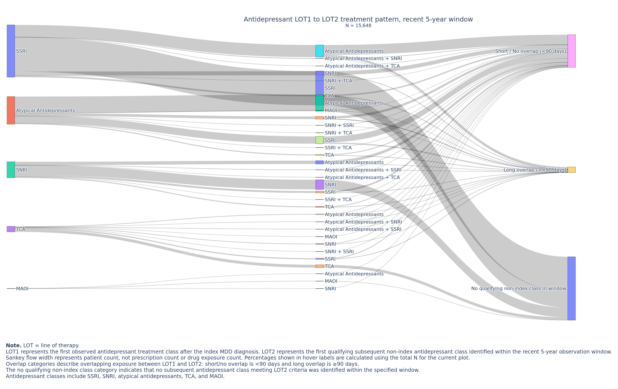
Table 6: Sankey diagrams translate tables into treatment pathways
Recent 5-year window shown as an example. Flow width represents patient count.
How to read it?
Left: LOT1 index class
Middle: earliest LOT2 class
Right: overlap outcome
Key message: many patients do not reach a qualifying non-index LOT2 within the analysis window; when LOT2 exists, most flows start from SSRI or atypical antidepressants.
MDD antidepressant treatment pattern analysis | 8
Notes:
Here I explain the Sankey. The width of each ribbon represents patient count. This chart is useful because Table 6 has many rows, including combinations of LOT2 classes and overlap categories. The Sankey makes it visually clear that SSRI is the dominant starting class and that no qualifying non-index class is a large destination category. I also added explanatory footnotes to make the exported figure understandable even outside the notebook.

Slide 9
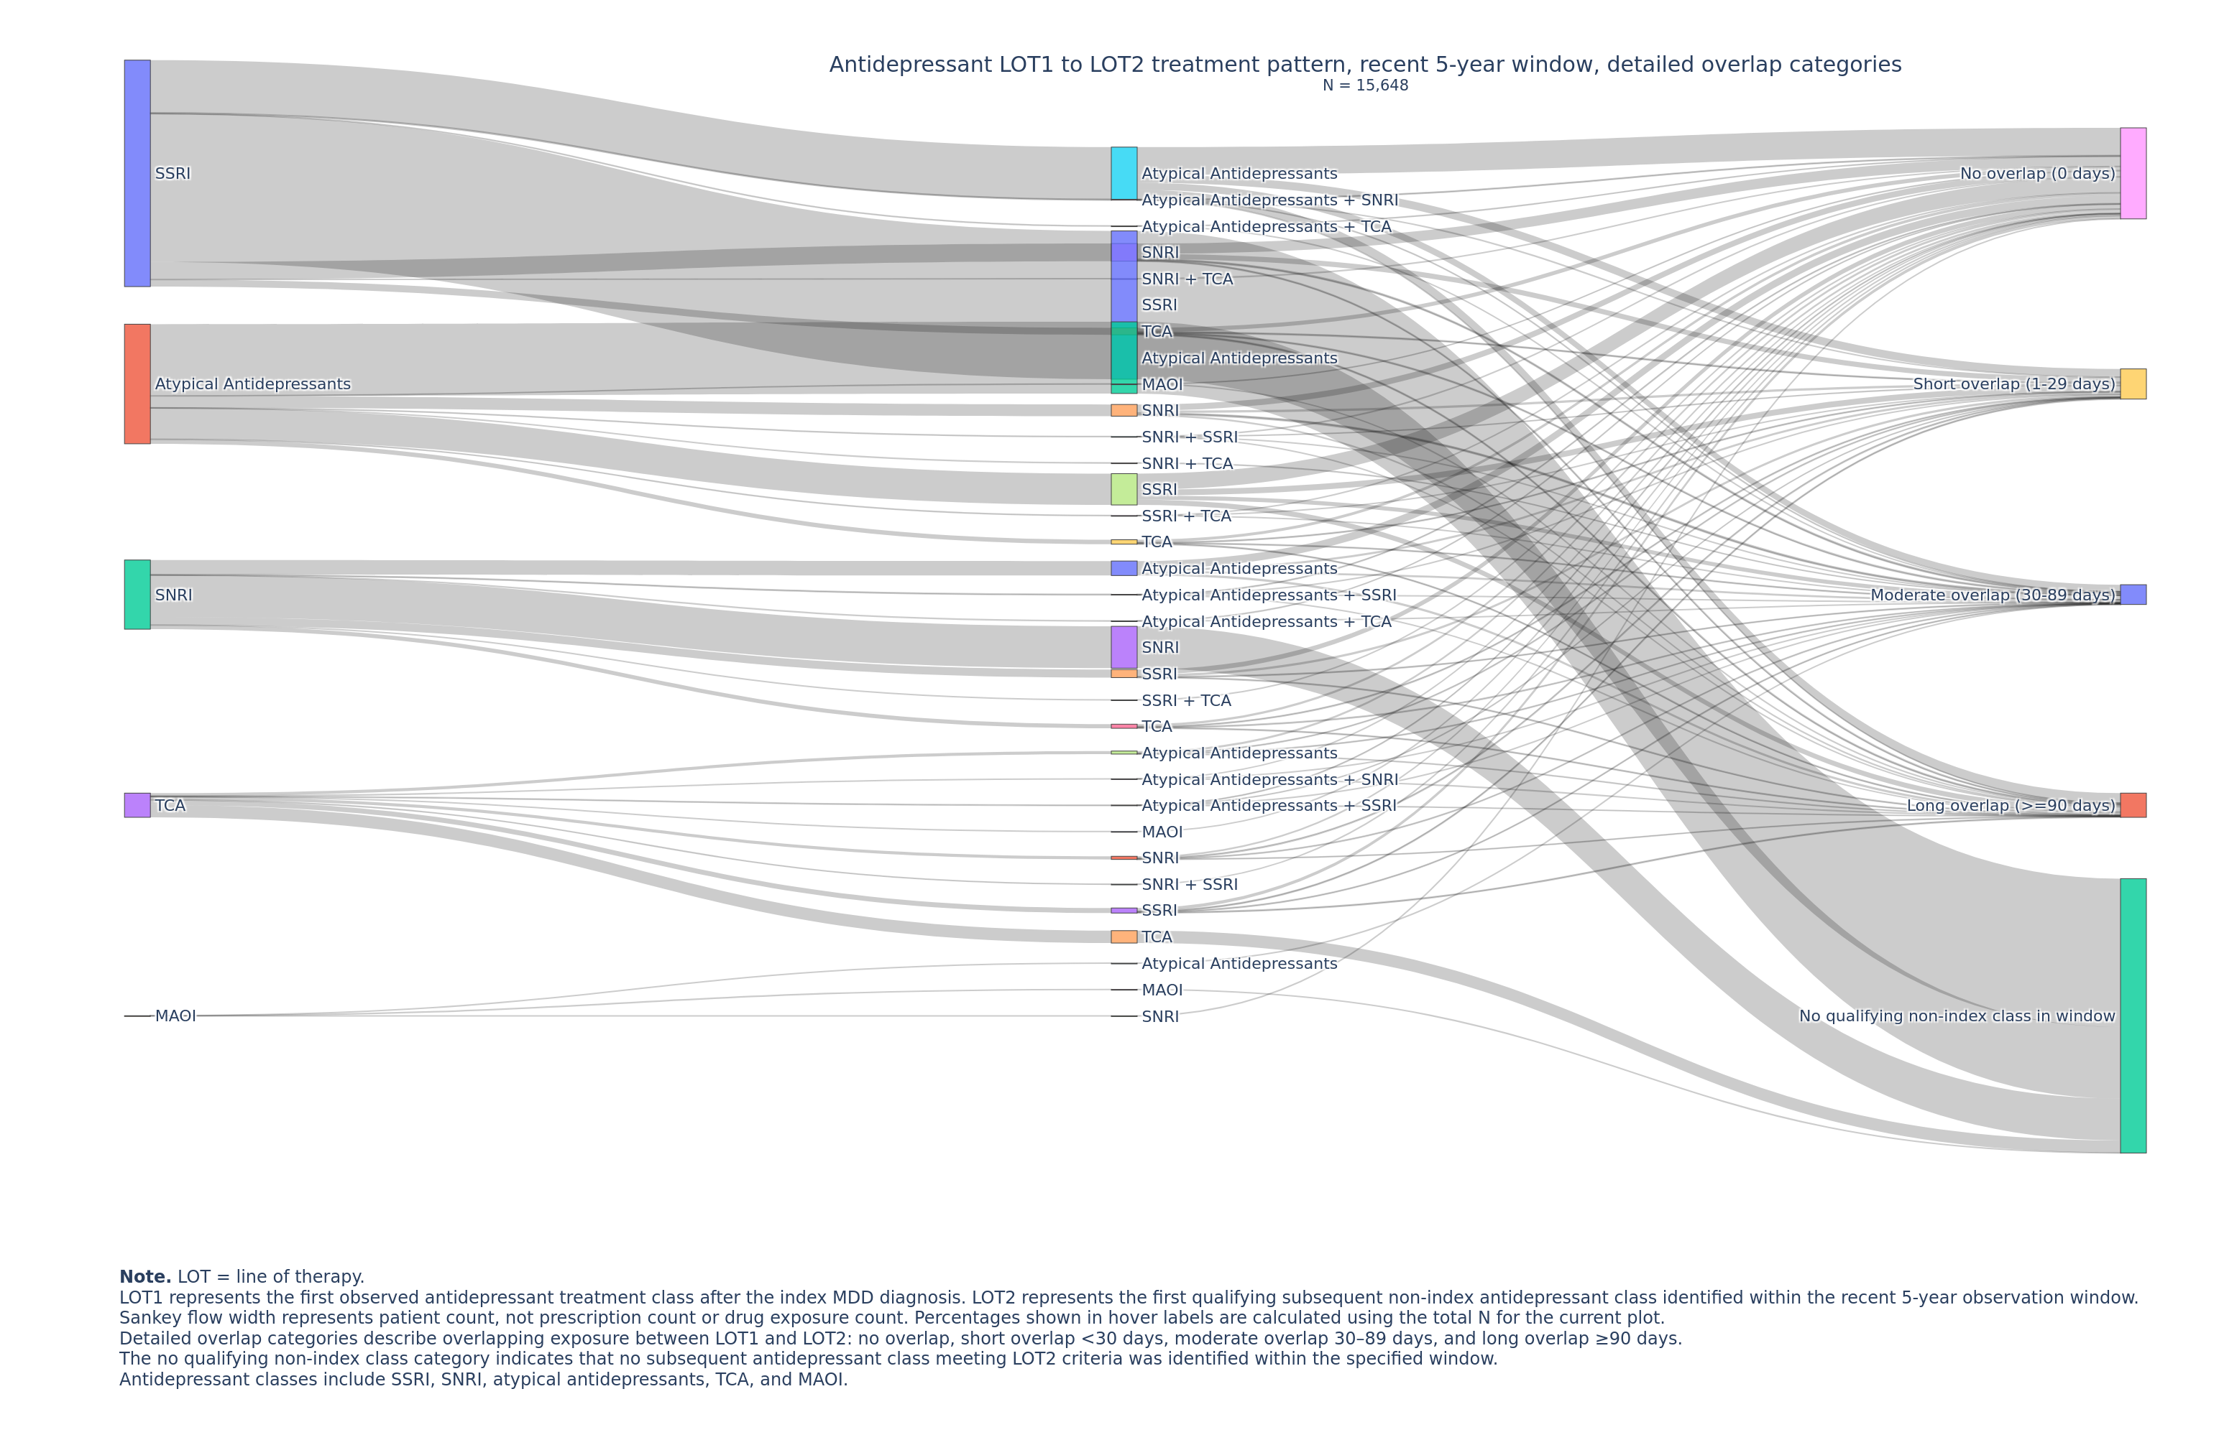
Detailed overlap categories sharpen the interpretation
The five-category version separates 0 days, short, moderate, long, and no qualifying LOT2.
0 days
No overlap between LOT1 and LOT2
1-29 days
Short overlap
30-89 days
Moderate overlap
>=90 days
Long overlap
No qualifying LOT2
No subsequent non-index class in window
Why it matters
A single “short/no overlap” group hides clinically different behaviors. The five-category view separates discontinuation-like transitions from cross-taper or add-on patterns.
MDD antidepressant treatment pattern analysis | 9
Notes:
The three-category Sankey is easy to read, but the five-category version gives a more precise clinical interpretation. No overlap is different from 1 to 29 days of overlap. Likewise, 30 to 89 days and 90 or more days may represent different levels of cross-tapering, augmentation, or prolonged combination therapy. This was an important refinement requested by the teacher.

Slide 10
Transition patterns depend strongly on follow-up window
Longer observation increases the chance of seeing a second-line monotherapy transition.
Metric
1-year
2-year
Entire FU
Recent 5-year
Eligible patients
62,448
62,448
62,448
15,648
Single-class LOT2, any overlap
13,833 (22.2%)
19,986 (32.0%)
37,736 (60.4%)
5,786 (37.0%)
No overlap
5,621 (9.0%)
10,224 (16.4%)
25,929 (41.5%)
3,180 (20.3%)
Overlap <90 days incl. no overlap
10,945 (17.5%)
16,391 (26.2%)
33,154 (53.1%)
4,932 (31.5%)
Recent 5-year values use the Oct. 1, 2023 cutoff cohort shown in Table 6 (N = 15,648).
Interpretation: entire follow-up captures many more LOT2 events, but recent 5-year analyses are more aligned with the current CDRv8 data cutoff and contemporary prescribing patterns.
MDD antidepressant treatment pattern analysis | 10
Notes:
Slide 10 speaker notes:
This table compares the same single-class LOT2 metrics across follow-up windows. The first three windows use the 62,448 mono-class index cohort. The recent 5-year column uses the Oct. 1, 2023 cutoff cohort from Table 6, N = 15,648.
The key pattern is that longer follow-up captures more LOT2 events: single-class LOT2 increases from 13,833 patients at 1 year to 37,736 across the entire available follow-up. In the recent 5-year cohort, 5,786 of 15,648 patients had a single-class LOT2 transition, or 37.0%.
For interpretation, no-overlap means LOT2 began after LOT1 ended, while overlap less than 90 days including no overlap captures short or no overlap transitions. In the recent 5-year cohort, 3,180 patients had no overlap and 4,932 had overlap under 90 days including no overlap. This supports the main message: the choice of follow-up window strongly affects how much switching or second-line monotherapy we observe.

Slide 11
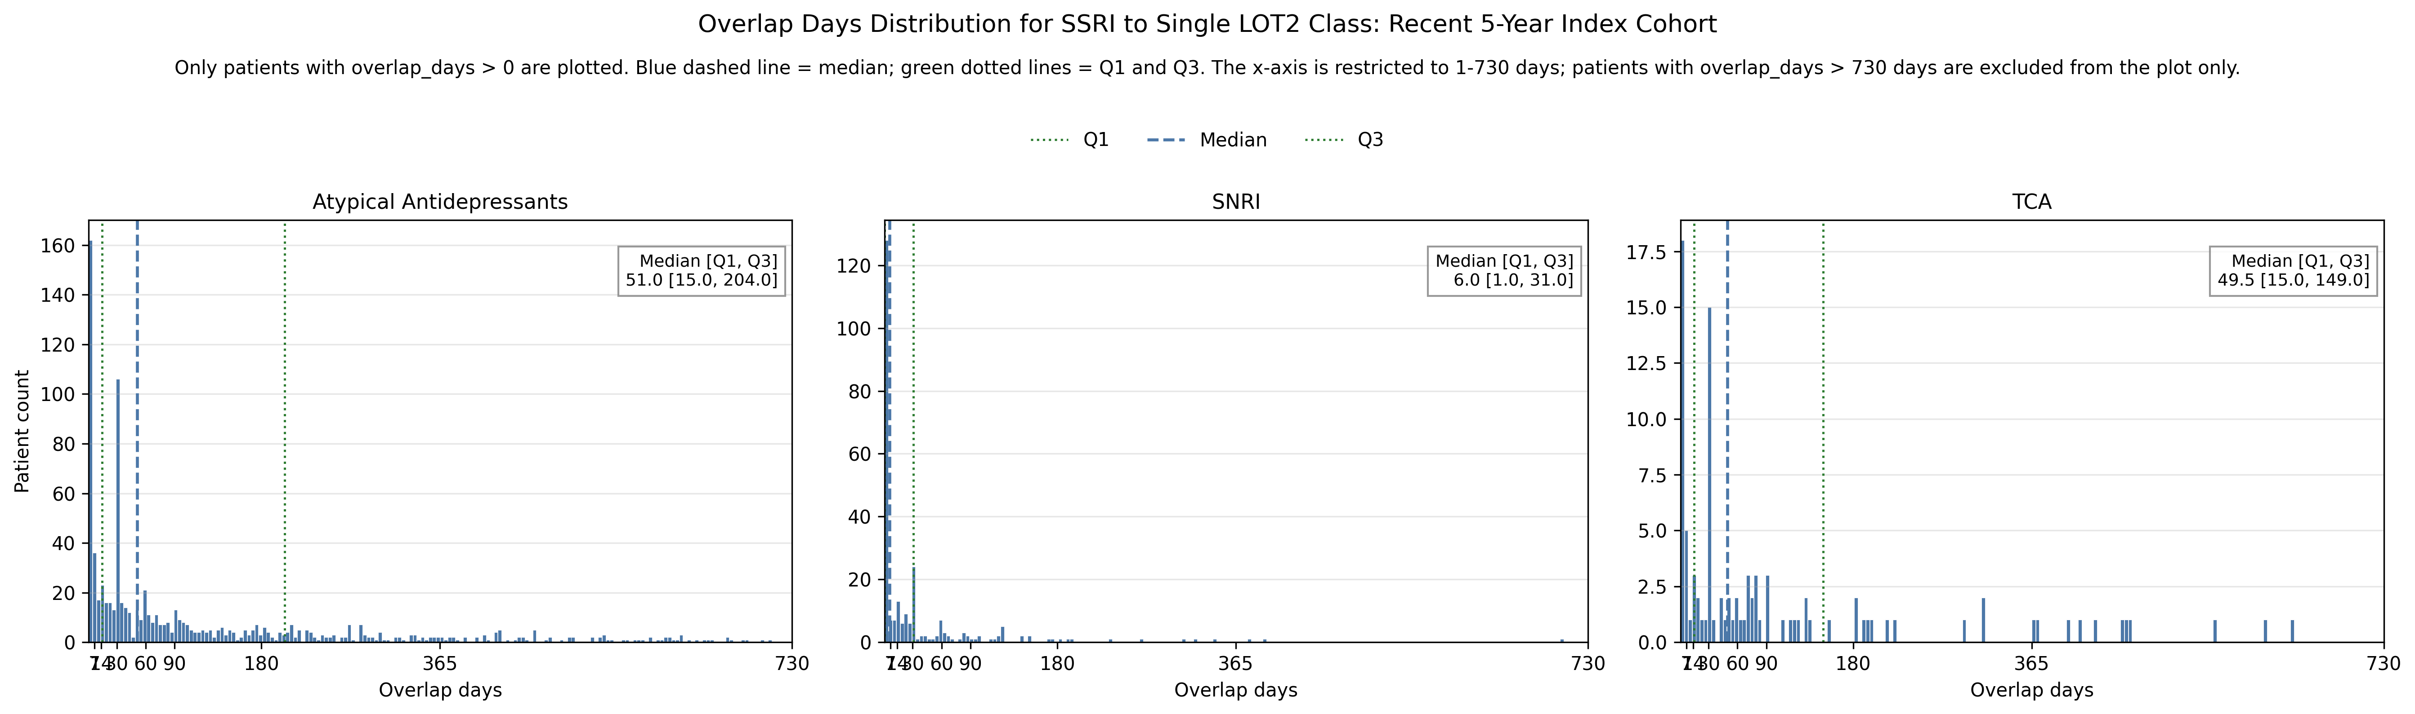
Table 7: SSRI-focused single LOT2 overlap analysis
Because SSRI was the largest index class, the final deep dive focused on SSRI -> single LOT2 transitions.
SSRI -> LOT2
Total patients
Overlap >0
Mean overlap
Median [Q1, Q3]
P95 / P99
Atypical antidepressants
1,870 (11.95%)
887 (47.43%)
160.61 d
51.0 [15.0, 204.0]
680.4 / 1,221.6
SNRI
627 (4.01%)
259 (41.31%)
40.45 d
6.0 [1.0, 31.0]
172.2 / 386.3
TCA
248 (1.58%)
102 (41.13%)
138.25 d
49.5 [15.0, 149.0]
602.4 / 867.7
Statistics shown here use overlap_days > 0 only; no-overlap patients are counted separately.
Most common transition: SSRI -> atypical antidepressants. Almost half had positive overlap, but the distribution was right-skewed: many short overlaps plus a long tail of prolonged overlap.
Important interpretation: a high first histogram bar is the mode, not the median. Median reflects cumulative 50%, so it can be much later even when the shortest bin is most frequent.
MDD antidepressant treatment pattern analysis | 11
Notes:
This slide presents one of the most important final outputs. We separated patients with no overlap from patients with positive overlap. Then the mean, median, Q1, Q3, P95, and P99 were calculated only among patients with overlap greater than zero. SSRI to atypical antidepressants was the largest transition. The median was 51 days, but P95 and P99 show a long tail, meaning a smaller group overlapped for a very long time.

Slide 12
What the results suggest
The project reveals both common patterns and long-tail behavior.
1
SSRI is the dominant starting class
Nearly half of the antidepressant cohort started with SSRI as the index class.
2
Many patients do not switch to LOT2 within short windows
Follow-up window choice changes how much switching we observe.
3
Overlap is heterogeneous
Some transitions have no overlap, while positive-overlap groups show long-tailed distributions.
4
SSRI -> atypical antidepressants deserves attention
This was the largest SSRI single LOT2 transition and showed substantial positive overlap, making it a useful subgroup for future treatment-sequencing, patient segmentation, or market-access exploration.
this workflow can identify where patients move after initial treatment, quantify transition timing, and support evidence generation for treatment sequencing, safety monitoring, or market-access narratives.
MDD antidepressant treatment pattern analysis | 12
Notes:
This slide translates the results into meaning. The key finding is not only which class was common, but how treatment moved over time. The workflow helps distinguish no switching, switching without overlap, short overlap, and prolonged overlap. These patterns are useful for clinical interpretation, safety questions, and strategic evidence generation.
One important finding is that SSRI was the dominant starting class, and among SSRI patients who moved to a single LOT2 class, the SSRI to atypical antidepressant transition was the largest subgroup.
This matters because it gives us a clinically interpretable patient segment. If a company is developing an SSRI, an atypical antidepressant, or a product positioned after SSRI treatment, this subgroup could be useful for understanding treatment sequencing and potential market opportunities.
The current analysis does not tell us why the switch happened, but it identifies where the switch happens. That creates a foundation for future work, such as comparing patient characteristics, age groups, comorbidity profiles, geographic patterns, or external prescriber-level information to understand which patients or providers are more likely to move from SSRI to atypical antidepressants.

Slide 13
Technical challenges and how they were solved
The project required several choices that affect interpretation.
Challenge
Why it mattered
Solution
Medication mapping
Generic names, combination products, RxNorm concepts
Built drug-class dictionaries and multi-ingredient handling
Ambiguous index starts
Some patients had multiple classes on index date
Created mono-class index cohort for clean LOT analysis
Episode end dates
Missing or inconsistent drug end dates
Applied end-date QC and imputation before episode construction
LOT2 combinations
Multiple non-index classes could start same day
Collapsed same-day LOT2 classes into ordered combination labels
Overlap interpretation
0 days, no qualifying LOT2, and positive overlap are different
Separated categories and added figure footnotes
Presentation clarity
Large Sankey plots were hard to read without context
Added automated notes/footnotes to exported figures
This is the “methods contribution”: the project turned raw EHR medication records into clinically interpretable treatment pathways.
MDD antidepressant treatment pattern analysis | 13
Notes:
This slide is important for showing the work behind the results. The hardest part was not plotting; it was defining the data correctly. OMOP drug data are messy, medication end dates can be missing, and treatment-line definitions need consistent rules. I solved these through mapping dictionaries, QC, episode construction, same-day collapse logic, and clearer overlap categories.

Slide 14
Final takeaways and next steps
A reusable treatment-pattern workflow was built and documented.
What was completed
What it enables
Next steps— Marketing target
Tables 1-7
Cleaned notebooks
Sankey diagrams
Table 7 overlap summaries
GitHub repository organization
Re-runnable cohort workflow
Medication class mapping
LOT1 -> LOT2 methodology
Transition timing analysis
Explore patient segments behind SSRI -> atypical transitions: Compare age, demographics, comorbidities, and follow-up patterns
Link with external data to study prescriber types and pattern
Translate findings into treatment-sequencing and market-access questions
Closing message
The project creates a bridge between real-world clinical data and treatment-strategy evidence: who starts where, who transitions, how quickly they transition, and how long classes overlap.
Appendices / repository can hold full notebooks, Excel table shell, and exported HTML/PNG figures.
MDD antidepressant treatment pattern analysis | 14
Notes:
Closing: I completed a full workflow from cohort construction to final presentation outputs. The strongest value is that the pipeline is reusable and interpretable. It allows a future analyst, advisor, or employer to understand both the analytical process and the clinical meaning of the output. The next steps would be advisor validation, data privacy review for broader sharing, and extension to outcome or drug-drug interaction questions.

